Slide 1

STUDENT SUPPORT SERVICES
FINANCIAL WELLNESS SERIES 2025
Session #5
Career Planning Issues & Strategies
April 30, 2025

Slide 2
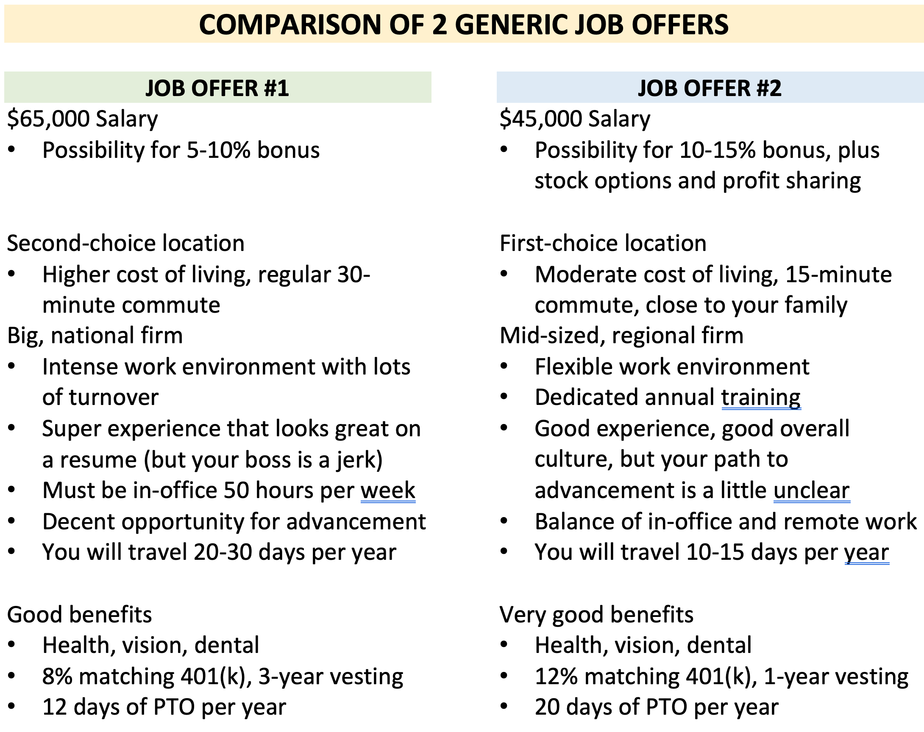

Slide 3
Brian Bolton
Professor of Finance brian.bolton@louisiana.edu http://business.louisiana.edu/financeispersonal

Slide 4
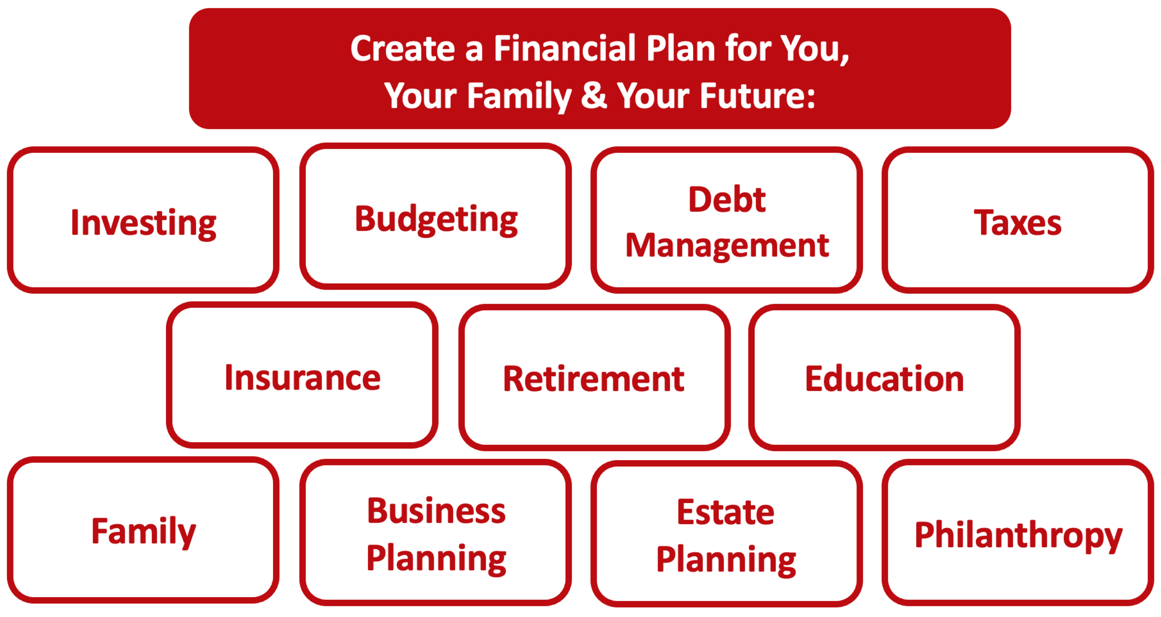

Slide 5
Owning Your Financial Future
YOUR VALUES
YOUR GOALS
Education
Career
Family
FINANCIAL STRATEGIES
Investing
Income & Expense Management
Debt Management
Taxes, Insurance & Other

Slide 6
Owning Your Financial Future
YOUR VALUES
YOUR GOALS
Education
Career
Family
FINANCIAL STRATEGIES
Investing
Income & Expense Management
Debt Management
Taxes, Insurance & Other

Slide 7
Owning Your Financial Future
YOUR VALUES
YOUR GOALS
Education
Career
Family
FINANCIAL STRATEGIES
Investing
Income & Expense Management
Debt Management
Taxes, Insurance & Other

Slide 8
TODAY THE NEXT 6 MONTHS THE NEXT 12 MONTHS 2 YEARS AFTER GRADUATION 3 YEARS AFTER GRADUATION
ONCE EVERY SEMESTER:
TRACK EVERY PENNY THAT YOU SPEND & TRACK EVERY PENNY THAT YOU EARN
IN THE NEXT 3 MONTHS:
IDENTIFY WAYS TO DECREASE YOUR DISCRETIONARY SPENDING BY 25%
IN THE NEXT 6 MONTHS:
MAKE A PLAN TO MANAGE – AND PAY OFF – YOUR DEBT
IN THE NEXT 6-12 MONTHS:
OPEN MULTIPLE SAVINGS ACCOUNTS, 1 FOR EACH GOAL
IN THE NEXT 12 MONTHS, OPEN AN IRA OR ROTH IRA
WITHIN 2 YEARS OF GRADUATION:
HAVE AN “EMERGENCY FUND” ACCOUNT, WITH 3-6 MONTHS OF NON-DISCRETIONARY EXPENSES
WITHIN 3 YEARS OF GRADUATION:
ELIMINATE ALL OF YOUR BAD DEBT.

Slide 9
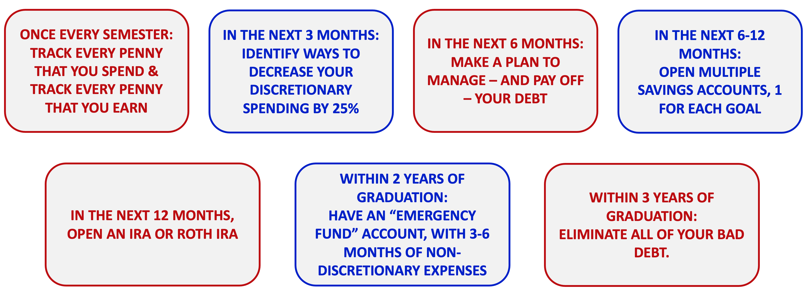
TODAY THE NEXT 6 MONTHS THE NEXT 12 MONTHS 2 YEARS AFTER GRADUATION 3 YEARS AFTER GRADUATION
One common denominator across these 7 goals is income….you need income to make them happen.
And – for most of us – our jobs are our primary sources of income.
Yes, our jobs are important sources of many other issues – happiness, self-esteem, relationships, purpose. But most of us would not do our jobs for free.

Slide 10
Let’s Take a Quick Quiz
Please define the following word:
VALUES
Now define this word:
VALUE
THESE ARE THE SAME WORDS

Slide 11
Why Are You Here?
Take a few seconds to ask yourself these 2 questions:
Why Are You in College?
What will you be doing in 5 years?
What will you be doing in 20 years?

Slide 12
Why Are You Here?
Why do we think you are here?
We think you are in college for many reasons, including…
…to transition to a better career and life and future for yourself.
We want you to be in a better career situation when you leave UL Lafayette than you would have been without your graduate degree.

Slide 13
Some General Career Planning Advice
#1 What jobs should you be applying for?
  All of them…all that interest you.
  Do NOT filter yourself out of the job search. If you are interested in a job but aren’t sure if you’re qualified, apply for that job. Let them decide.
  Many job announcements are aspirational. In reality, recruiters may be happy if they find someone who meets 75% of the qualifications.
  Always assume that you are the one making the decision. Assume that you are interviewing the company as much as they are interviewing you.

Slide 14
Some General Career Planning Advice
#2 What should you look for in a job?
  Consider all of the financial & non-financial rewards.
    What are non-financial rewards (or, non-salary rewards):
      Location, culture, family, expectations
      Will the company pay for your training or certification?
      Consider all benefits…health care, retirement, tuition forgiveness
  Consider the short-term and the long-term.
    Should you work for a high-profile, high-stress firm for 2 years to build your resume?
    What opportunities does this job prepare you for?
  Whatever you do, have a plan for how this job fits into your long-term career

Slide 15
Some General Career Planning Advice
#3 Should I negotiate my salary? If so, how?
  YES!!!
    You should all always negotiate your salary.
      There is never any harm in asking for 5-10% more salary
      Asking for 15%+ might begin to get risky…but you have to ask for what you’re worth.
        You can figure out what you’re worth by asking anyone and everyone what you should be earning.
    I have had 4 academic jobs. Each time, I was told in the interviewing process that they did not negotiate salary. Each time, I asked for more salary. 3 out of 4 times I got more salary.
    You can negotiate anything…not just salary.
      Everyone: Time-off, vacation, work-from-home, continuing education…
      Academics: Lab-funding, course load, summer pay, travel money…

Slide 16
Some General Career Planning Advice
#3 Should I negotiate my salary? If so, how?
  Remember that there will be multiple people or divisions responsible for structuring your hiring package:
    Human Resources: Responsible for following rules and policies and taking care of the process
    Your Future Boss: Responsible for hiring you to make the firm or institution better
    By identifying who is in charge in the process and who has the power, you can determine with whom you should be negotiating.

Slide 17
Some General Career Planning Advice
#4 How do I get the company to notice me?
  If you are applying for an industry job, assume the first review of your resume will be done by a computer
    Make sure your application is complete
    Make sure your application is easily searchable
      Use keywords, both for the power verbs and the accomplishments
  Write a relevant cover letter.
    My standard cover letter might have 8 paragraphs in it. 5 of these would always be the same, 3 would be (minimally) tailored to the company.
      Keep your cover letter to less than 2 pages.
  Use your contacts….use your faculty’s contacts.
    The processes generally ensure that every application is treated equally…at least first
    Once you make the first cut, a simple email from your contacts to the recruiting committee can simply serve as a “be on the lookout for this application” notice.

Slide 18
Some General Career Planning Advice
#5 I just started my new job. What decisions do I have to make?
  During your first week – or first day – of your new job, you may be required to make a number of decisions and sign a number of documents.
    W-4 form, telling your employer about your tax status
      We have to report all income we earn to the IRS, and we may owe taxes.
      Your employer is required by the IRS to keep some of your taxes and send it to them.
      The W-4 form is your way of telling your employer how much of your tax money to keep.
    If you’re fortunate, you may have the option to choose a health care plan.
    If you’re fortunate, you may have the option to choose a retirement plan

Slide 19
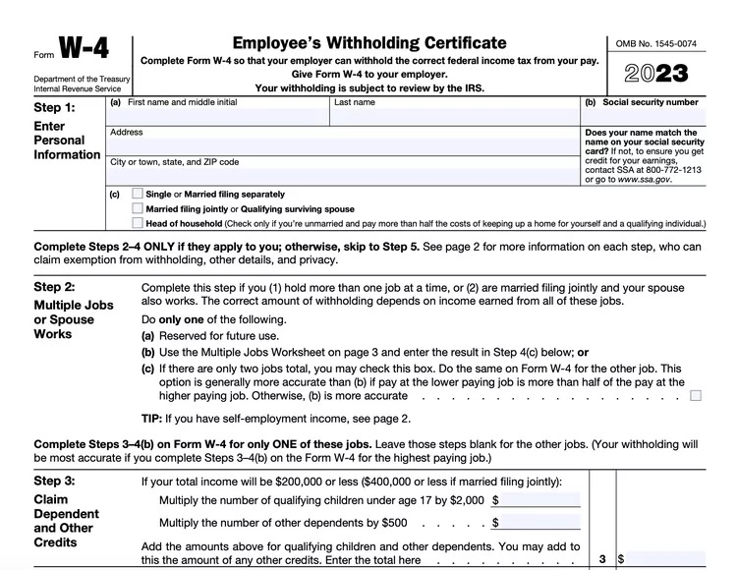
Some General Career Planning Advice
#5 I just started my new job. What decisions do I have to make?
NOTE – You get to choose what you put in the form. The IRS gives you guidance, but ultimately it is up to you.
And, if you think your total income for 2023 will be less than $13,850 for all jobs for the year, you can choose to have $0.00 withheld.

Slide 20
Some General Career Planning Advice
#5 I just started my new job. What decisions do I have to make?
    If you’re fortunate, you may have the option to choose a health care plan.
      Think about your family and your needs.
      There is a trade-off between how much you pay and the coverage you get.
      You can probably change your plan once a year, as your situation changes.

Slide 21
Some General Career Planning Advice
#5 I just started my new job. What decisions do I have to make?
    If you’re fortunate, you may have the option to choose a retirement plan
      This probably means taking some money out of your paycheck and putting it in a company-sponsored retirement plan….that will give you tax benefits when you retire.
      As difficult as it is to think about saving for retirement in your 20s, TRY TO DO IT.
      If your company offers a “match” on your contribution, TRY TO DO IT.
      If your company has a ”vesting” period, that means you do not get the match unless you stay with the company for a number of years. Be very careful in these situation.
      Your can probably changes your mind about this whenever you want. But try to participate and begin investing for your retirement as soon as you can.
      More information on both of these options are later in the slides.

Slide 22
Happiness
Long-Term Goals
Short-Term Goals
Financial Needs
Family Needs

Slide 23
Strategies & Thinking for Success
What are your career goals?
What do you expect to be your job or career in 5 years?
What career advice do you have for others?

Slide 24
What Is Your Ideal Job After Graduation?
What is your ideal job and job description?
Where will you be living?
Who are you with? What is your family situation?
What are you working towards?
What will your job be in 3-5 years?

Slide 25
What Is Your Ideal Plan B?
What If Your Plan A Doesn’t Happen?
What Becomes Important to You?
What Are Your Short-Term Possibilities?
What is Ys Your Ideal Plan B?

Slide 26
What Is Your Ideal Plan B?
What could go wrong with the above Plan A? What is the biggest threat?
What is your back-up job and job description? What is your ideal Plan B?
What can you control? What can you do today to make sure this Plan B is an option?
What can you do with your Plan B in the short-term to get to a better plan in 3-5 years?
What resources or help will you need to make this Plan B an option?

Slide 27
Past Questions From Students #1
How early should I be career planning?
How much of my time can I
expect to spend career planning?

Slide 28
Past Questions From Students #1
How early should I be career planning?
Immediately!
How much of my time can I
expect to spend career planning?
As much as is necessary…especially as you get closer to graduation.

Slide 29
Past Questions From Students #2
What would I do if I found out that my career isn't the one for me?
For example…Given the downturn in the oil and gas industry which has been a major employer of many geoscientists in the past decade, I really don't know the pathway to follow with a degree in geology as employment in the field has really been on the decline.
How and when do I know that I need to
make a career change or transition?

Slide 30
Past Questions From Students #2
What would I do if I found out that my career isn't the one for me?
For example…Given the downturn in the oil and gas industry which has been a major employer of many geoscientists in the past decade, I really don't know the pathway to follow with a degree in geology as employment in the field has really been on the decline.
How and when do I know that I need to make a career change or transition?
Only you can answer this.
Only 27% of college graduates are working in the field of their major – most people make big changes and transitions during their careers.
Doing so might mean taking one step back…with the hope of (eventually) taking many more big steps forward.
Be patient, be intentional and do what brings you the most long-term happiness.

Slide 31
Past Questions From Students #3
I have a really good job offer in Boston and an okay job offer in New Orleans. My partner will be in grad school for 2 more years in Louisiana. Eventually we want to settle in or near Louisiana.
What should I do?

Slide 32
Past Questions From Students #3
I have a really good job offer in Boston and an okay job offer in New Orleans. My partner will be in grad school for 2 more years in Louisiana. Eventually we want to settle in or near Louisiana.
What should I do?
Only you can answer this.
Focus on your goals, focus on your priorities.
You can make lists and spreadsheets and you can calculate the estimated financial value of each option.
But ultimately this is a personal decision that only you and your family can answer.
How much of the short-term are you willing to sacrifice for the long-term?

Slide 33
Past Questions From Students #4
I am graduating with my Master of Architecture. I have an opportunity to take a job in the Northeast with a really reputable firm that will take great care of me and pay for all of my continuing education and certifications over the next 3-5 years.
I also have an opportunity to take a job closer to home, but I will have to pay for all of my continuing education and certifications to advance my career.
Eventually, I would like to open my own practice in Louisiana – but that may be 5-10 years away.
What should I do?

Slide 34
Past Questions From Students #4
I am graduating with my Master of Architecture. I have an opportunity to take a job in the Northeast with a really reputable firm that will take great care of me and pay for all of my continuing education and certifications over the next 3-5 years.
I also have an opportunity to take a job closer to home, but I will have to pay for all of my continuing education and certifications to advance my career.
Eventually, I would like to open my own practice in Louisiana – but that may be 5-10 years away.
What should I do?
Again…Only you can answer this.
Focus on your goals, focus on your priorities.
You can make lists and spreadsheets and you can calculate the estimated financial value of each option.
But ultimately this is a personal decision that only you and your partner can answer.
How much of the short-term are you willing to sacrifice for the long-term?

Slide 35
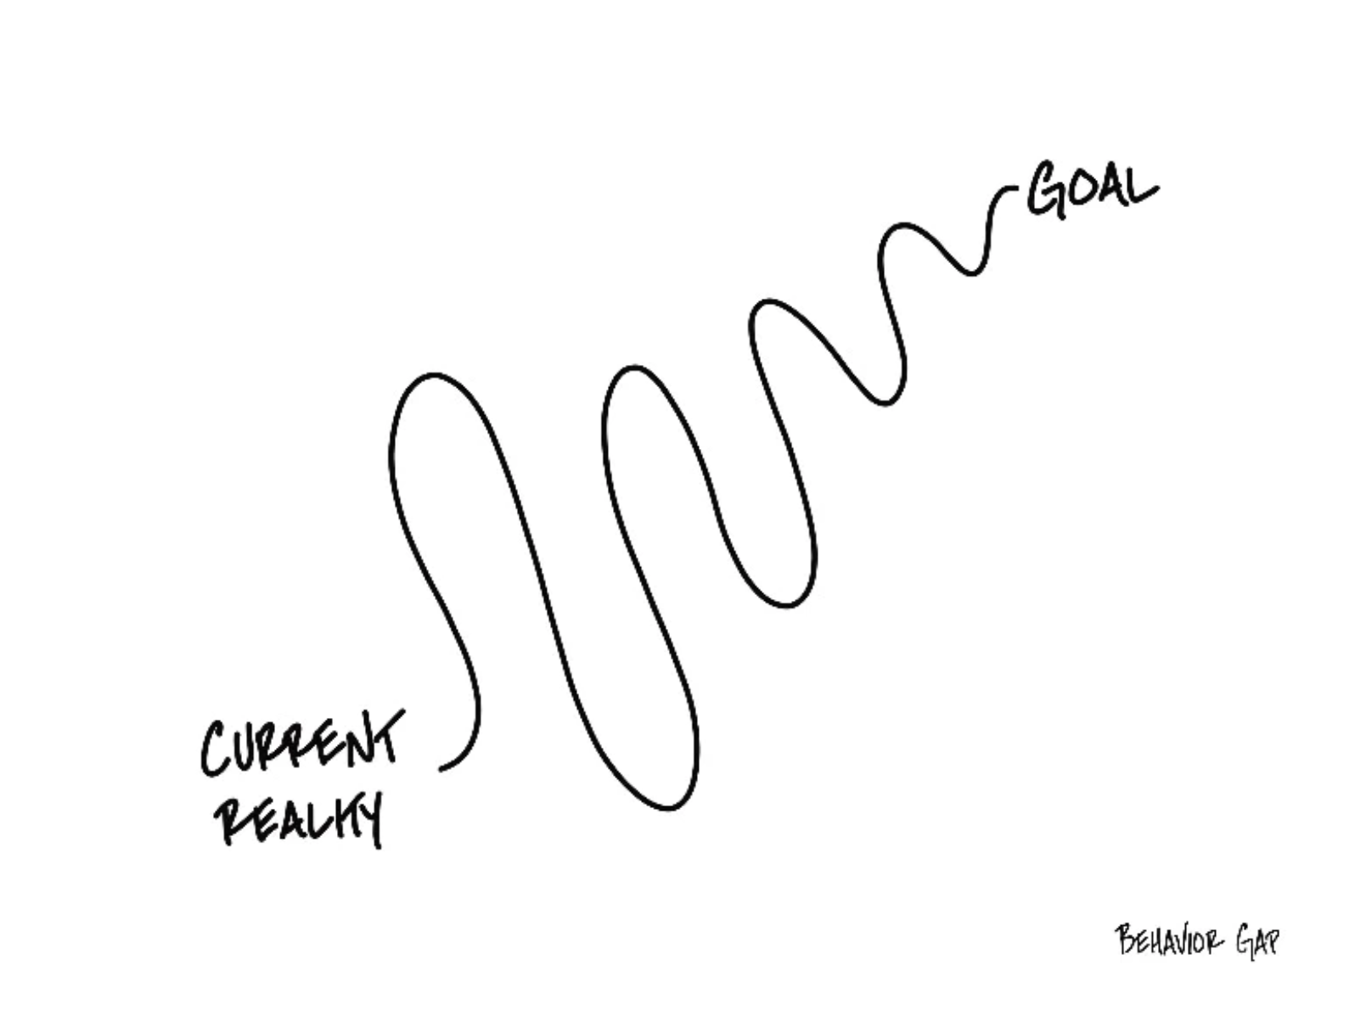

Slide 36
Questions From Students #2, #3 and #4
Decisions about jobs and careers are very personal.
They are classic trade-offs between short-term and long-term goals.
They are typically about more than just you – talk to your family.
How to decide?

Slide 37
Questions From Students #2, #3 and #4
How to decide?
Try this trick: Fully commit to one option to yourself. Tell yourself you’re doing Option #1 and try to forget about Option #2. And then pretend to live it and make plans for it…like, literally make plans. Map out the next 10 years of your life with this decision. You can use some numbers, but it will be mostly about values, goals and priorities.
Pretend that you have made this decision for 2-3 weeks.

Slide 38
Questions From Students #2, #3 and #4
Pretend that you have made this decision for 2-3 weeks.
And then assess how you feel.
Are you more or less excited?
Are you more or less anxious?
Does the 10-year plan make sense? Its it clear?
How have you been sleeping these past 2-3 weeks?
If necessary, repeat this commit-and-pretend process with the other option to try to get a better sense of how both your head and your heart respond to each option.

Slide 39
Past Questions From Students #5
I am about to start a new job and my human resources advisor has warned me that I will have to make decisions about a company-provided retirement and health plans on my first day at work.
How do I decide which plans I want?
What if I choose the wrong plan?
Can I change my decision later?

Slide 40
Past Questions From Students #5
I am about to start a new job and my human resources advisor has warned me that I will have to make decisions about a company-provided retirement and health plans on my first day at work.
How do I decide which plan I want?
What if I choose the wrong plan? Can I change my decision later?
Let’s start with the health-care plan:
You generally can select which plan option you choose once a year.
The company will deduct pre-tax salary for your premium (and the company will also contribute to the premium to share the costs)
Your family members may or may not be included.
And there are lots of financial decisions you will have to make…

Slide 41
Past Questions From Students #5
Let’s start with the health-care plan:
And there are lots of financial decisions you will have to make…
  Choose to pay a higher monthly premium to get a lower annual deductible.
  What are the annual and lifetime out-of-pocket maximums?
  What are the co-payment amounts you pay for each visit?
    Think about which medical services YOU are most likely to need.
Health Savings Accounts (HSA)
  You can contribute pre-tax dollars to an HSA to be used to pay co-pays, deductibles, other expenses
  The money in the account can roll-over from year to year
  Requires you to be part of a high-deductible health care plan
Flexible Spending Account (FSA)
  You can contribute pre-tax dollars to an FSA to be used to pay co-pays, deductibles, other expenses
  The money in the account DOES NOT roll-over from year to year
  DOES NOT require you to be part of a high-deductible health care plan

Slide 42
Past Questions From Students #5
I am about to start a new job and my human resources advisor has warned me that I will have to make decisions about a company-provided retirement and health plans on my first day at work.
How do I decide which plan I want?
What if I choose the wrong plan – can I change my decision later?
Let’s now talk about the retirement plan:
If you’re lucky, your employer will offer you the choice of a defined benefit plan (aka “pension”) or a defined contribution plan (401(k), 403(b)).
  50 years ago, most employers only offered a pension. Today, most employers only offer a defined contribution plan.
For a pension, the most important word is “vesting”
For a defined contribution plan, the 2 most important words are “vesting” and “matching”

Slide 43
Past Questions From Students #5
Let’s now talk about the retirement plan:
For a pension, the most important word is “vesting”
  The company will offer a payment upon reaching retirement age.
  This payment will be calculated based on some pre-determined formula.
    Example: 2% of your salary x The number of years you worked for the company
  The company may require you to contribute a portion of your salary into the plan
  And then the company is responsible for managing the investments to make sure it has enough money saved to make all of the required pension payments
  Why is “vesting” the most important word with pension plans?
    The plan will dictate how long you must be in the plan (and contributing) before you are eligible for retirement benefits.
    This length of time is “vesting.”
    If you leave the company before your benefits have fully vested, then you receive 0.00% of those benefits.
    If you leave the company 1 day after your benefits have fully vested,
    then you receive 100.00% of the promised benefits.

Slide 44
Past Questions From Students #5
For a 401(k) or 403(b), the most important words are “vesting” and “matching”
  Vesting is generally the same as with a pension plan – when you receive benefits, kind of.
    Any contributions you make into the plan are always 100% vested. They always belong to you.
    But if the company makes any matching contributions, they may be subject to a vesting period. If you leave the company before the matches vest, you receive 0.00% of these matched contributions.
  Matching is (kind of) free money from your employer.
    The retirement plan will specify what percentage of your salary your employer will match as a contribution into your retirement plan.
      It’s a “match” because the company only contributes if you contribute first.
    Example: At UL Lafayette, I contribute 8% of my salary to my 403(b), the University will match with a 6% contribution. So I will end up with 14% of my salary going into a retirement plan.
      If I contribute 7% of my salary to my 403(b), the University will not match anything. So I will end up with 7% of my salary going into a retirement plan.
  Once your money is in your retirement plan, then the company will have a plan sponsor (e.g investment company) manage your account.
    But YOU are responsible for directing your money into a menu of investment options that the
    plan sponsor allows.
    These options will generally be mutual funds, not individual stocks, crypto, real estate, NFTs…

Slide 45
Past Questions From Students #5
Why would you want to give up some of your hard-earned paycheck today in order to put it into a retirement fund that you may not touch for 40 years?
Two reasons: Matching & Tax-Deferral.
We saw how a company match can effectively increase your compensation
Tax-Deferral is the other big advantage of retirement plans
  Any money you contribute to a retirement plan today is before tax.
  The before tax amount will be invested.
  Your investments will grow at some rate of return over the long term until you retire.
  When you reach retirement age (generally over 60), you can begin withdrawing money from your retirement plan
    You will pay ordinary income taxes on these withdrawals
    You will never pay capital gains taxes on how much your initial investments grew

Slide 46
Past Questions From Students #6
I’m going to be a consultant and entrepreneur. Is there a way I can benefit with my own retirement plan even without an employer doing it for me?
Yes. How? With an IRA, Individual Retirement Account:
A traditional IRA allows you to invest $6,000 of pre-tax money into a qualified account, and then you direct where you invest the money and how it grows
  You cannot access the money, without fees and taxes, until retirement
  There are income limits to whom can participate; very high income folks cannot participate
  You pay ordinary income tax when you withdraw the money in retirement
A Roth IRA allows you to invest $6,000 of after-tax money into a qualified account, and then you direct where you invest the money and how it grows
  The income limits are less than with a traditional IRA
  You do not pay any tax when you withdraw the money in retirement…because you already paid income taxes.

Slide 47
8 Ways to be a More Successful Entrepreneur
Save as much as you can. Your cash flow might be unpredictable. You never know how long your cash flow is going to last.
Separate your personal and business activities. Get business bank accounts and credit cards.
Track every dollar you spend and every dollar you earn…both for your own goals and for tax planning.
Learn what tax issues are important to you. You have many obligations and responsibilities to pay taxes from your income; but there are also many opportunities to reduce your tax burden as an entrepreneur.

Slide 48
8 Ways to be a More Successful Entrepreneur
Think about the type of legal entity you run. Sole proprietorships and partnerships are the default – but creating an LLC or corporation might protect you from liability.
Set up an Individual Retirement Account as soon as possible. Invest a little when you can – and watch it grow.
Develop your team. Who can help you achieve your mission? What advisors can make your life easier?
Create your personal biography. People want to know who you are and how you can make their life better.

Slide 49
Past Questions From Students #5 and #6
A few concluding comments about retirement plans:
If possible, set up an IRA, a Roth IRA and take the maximum advantage of whatever retirement plan options your employer offers.
Why? Flexibility.
If your income grows, you may make too much to get an IRA or Roth
Having different accounts with different tax rules allows you to choose how you withdraw money in retirement
  Imagine you do some work when you’re 75 that pays you $200,000. You may choose to withdraw a lot from your Roth IRA (which will be tax-free) and less from your IRA (which will be taxed) so you can avoid claiming more income in a year when you’re in a high-tax bracket.
  Then if you take the year off when you’re 76, you’ll drop down to a lower tax bracket, and you may choose to withdraw a lot from your IRA and a little from your Roth IRA.

Slide 50
Past Questions From Students #7
How do we avoid getting a lowball job offer, given we are graduating students with little leverage and fewer resources, fewer options and less information?

Slide 51
Past Questions From Students #7
How do we avoid getting a lowball job offer, given we are graduating students with little leverage and fewer resources, fewer options and less information?
The financial planning answer:
  If you know what your budget is and what your short- and medium-term financial goals are, you can do the math to determine what the minimum compensation you need from any job.
    Include goals, family & partner situations, debt repayment, insurance and finally-living-like-an-adult expenses (such as eating less rice and ramen).

Slide 52
Past Questions From Students #7
How do we avoid getting a lowball job offer, given we are graduating students with little leverage and fewer resources, fewer options and less information?
The career planning answer:
  Know your value. Talk to other graduates. Talk to faculty. Talk to family. If possible, talk to other people who have been hired by the same company. Do your research.
  Put your emotional intelligence (EQ) to work to try to determine how much leverage you have. Try to get a sense of how much they want you.
    In general, the higher the salary, the more they want you.
    In general, the more they have invested in recruiting you, the more they want you.
    Try to get a sense of how unique the position is.
    Try to get a sense of what they would do if you asked for more money
      Would they have to start the recruiting process over? Or is their
      second choice candidate simply a phone call away?

Slide 53
Past Questions From Students #7
How do we avoid getting a lowball job offer, given we are graduating students with little leverage and fewer resources, fewer options and less information?
A very little bit of personal perspective
  I have had 6 full-time jobs as an adult.
  I have asked for more salary all 6 times.
  I have received more salary 5 out of 6 times.
  Most employers will respect that you asked, even if they cannot meet your request. It suggests that you know your value – or value yourself more. Know your value.
    Most of the people you’re interviewing with have negotiated more salary in their lives, too.

Slide 54
Past Questions From Students #7
How do we avoid getting a lowball job offer, given we are graduating students with little leverage and fewer resources, fewer options and less information?
A very little bit of personal perspective
  They (generally) understand that giving you $2,000 or $5,000 more in
  salary is a small price to pay for your happiness and productivity.
  Maybe they cannot offer you any more salary. If not, don’t be shy about trying to negotiate something else – vacation days, bonus potential, discretionary budget.
  You have to pay your bills. And, you also want to be paid what you are worth so that you are excited about this JOB becoming your CAREER.

Slide 55
Question of the Day
Why are you in college?
This is the biggest investment you’ve ever made. You are giving up several years, thousands of dollars and enormous effort & energy.
What return are you getting from this investment?

Slide 56
Financial Advice for Turbulent Times
What can YOU do today to make tomorrow less stressful.
  Finish your degree. It’s the best financial investment you can make.
  Cut your discretionary expenses.
  Save when you can. Build your emergency fund.

Slide 57
Financial Advice for Turbulent Times
What can YOU do today to make tomorrow less stressful.
  Finish your degree. It’s the best financial investment you can make.
  Cut your discretionary expenses.
  Save when you can. Build your emergency fund.
  Find extra income. Sell your old books, clothes, accessories.

Slide 58
Financial Advice for Turbulent Times
What can YOU do today to make tomorrow less stressful.
  Finish your degree. It’s the best financial investment you can make.
  Cut your discretionary expenses.
  Save when you can. Build your emergency fund.
  Find extra income. Sell your old books, clothes, accessories.
  Invest. Get comfortable taking some risks…think about the long-term. Stocks lost 15% in 2022, a truly terrible year. Stocks gained 20% in 2023 and 25% in 2024.

Slide 59
Financial Advice for Turbulent Times
What can YOU do today to make tomorrow less stressful.
  Finish your degree. It’s the best financial investment you can make.
  Cut your discretionary expenses.
  Save when you can. Build your emergency fund.
  Find extra income. Sell your old books, clothes, accessories.
  Invest. Get comfortable taking some risks…think about the long-term. Stocks lost 15% in 2022, a truly terrible year. Stocks gained 20% in 2023 and 25% in 2024.
  My savings account is paying 1.50%.
  A 1-year certificate of deposit is paying 4.00%.

Slide 60
Happiness
Long-Term Goals
Short-Term Goals
Financial Needs
Family Needs

Slide 61
Making Financial Planning a Priority
EDUCATION STRATEGIES
SCHOOL STRATEGIES
Identify Your Resources
Identify Your
Priorities & Goals
Do Your Planning
Monitor & Modify Your Progress & Plan

Slide 62
Making Financial Planning a Priority
FINANCIAL STRATEGIES
EDUCATION STRATEGIES
BUDGETING
STRATEGIES
SCHOOL STRATEGIES
Identify Your
Income & Expenses
Identify Your Resources
Identify Your
Priorities & Goals
Identify Your
Priorities & Goals
Do Your Planning
Do Your Planning
Monitor & Modify Budgeting Activities
Monitor & Modify Your Progress & Plan

Slide 63
Making Financial Planning a Priority
FINANCIAL STRATEGIES
YOU,
as students, are better wired and equipped to make long-term plans – education, career, financial & otherwise – than 99% of humanity.
Be confident.
Be intentional.
Be diligent.
Be awesome.
EDUCATION STRATEGIES
BUDGETING
STRATEGIES
SCHOOL STRATEGIES
Identify Your
Income & Expenses
Identify Your Resources
Identify Your
Priorities & Goals
Identify Your
Priorities & Goals
Do Your Planning
Do Your Planning
Monitor & Modify Budgeting Activities
Monitor & Modify Your Progress & Plan

Slide 64
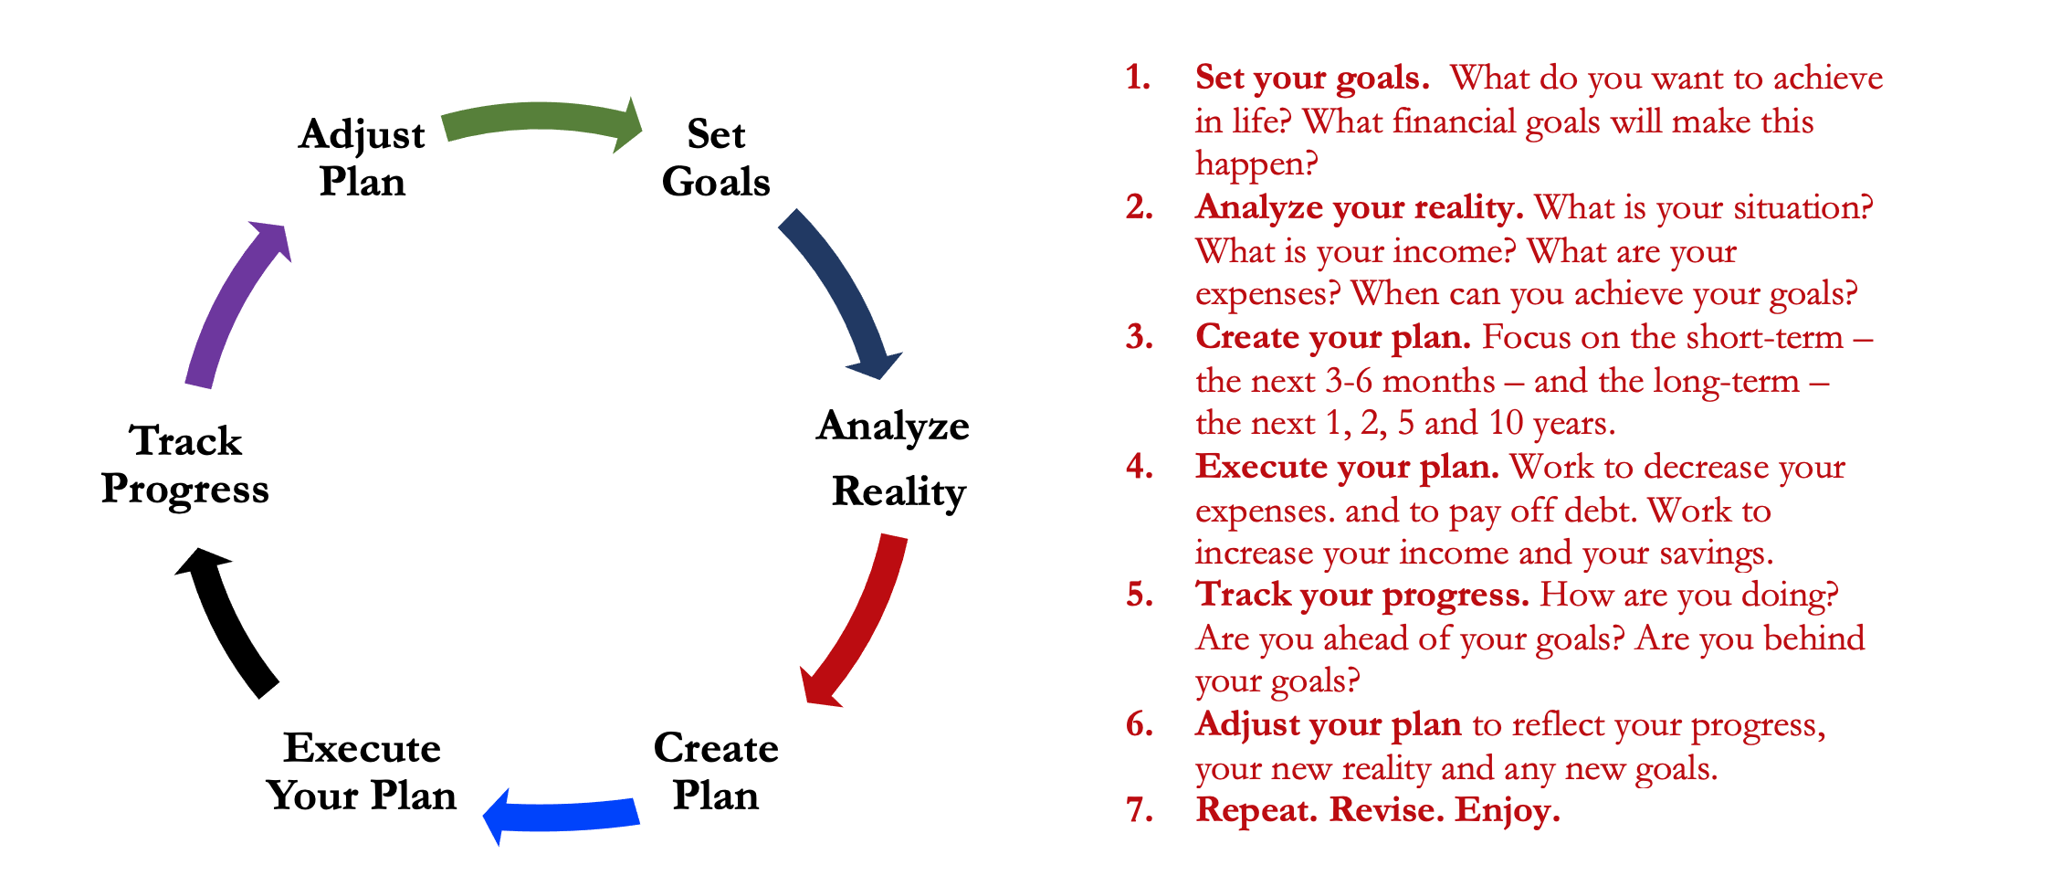
Isn’t this a lot like what you do with your education planning?

Slide 65
And as you begin to develop your full financial plan – seeing the trade-offs with Budgeting, Investing and Debt Management – you will begin to see how interconnected all of these aspects are.
Finance is just a matter of managing money across time.
And one thing we know about time is that our plans will change – so the better you have control of your initial financial plan, the more you will be able to adjust when life and time give you new goals.
Isn’t this a lot like what you do with your education planning?

Slide 66
Financial Wellness
A goal without a plan is just a dream.
Wealth is largely the result of habit.
The most difficult thing is the decision to act; the rest is mere tenacity.
It takes as much energy to plan as it does to wish.
You cannot escape the responsibility of tomorrow by avoiding it today.

Slide 67
Don’t wait around for other people to be happy for you.
Any happiness you get,
You’ve got to make yourself.
~ Alice Walker, poet & novelist
A goal without a plan is just a dream.
Wealth is largely the result of habit.
The most difficult thing is the decision to act; the rest is mere tenacity.
It takes as much energy to plan as it does to wish.
You cannot escape the responsibility of tomorrow by avoiding it today.

Slide 68
brian.bolton@louisiana.edu http//:business.louisiana.edu/financeispersonal

