Slide 1

STUDENT SUPPORT SERVICES
FINANCIAL WELLNESS SERIES 2025
Session #4
Investing for Your Future
April 7, 2025
April 9, 2025

Slide 2
Brian Bolton
Professor of Finance brian.bolton@louisiana.edu https://business.louisiana.edu/financeispersonal

Slide 3
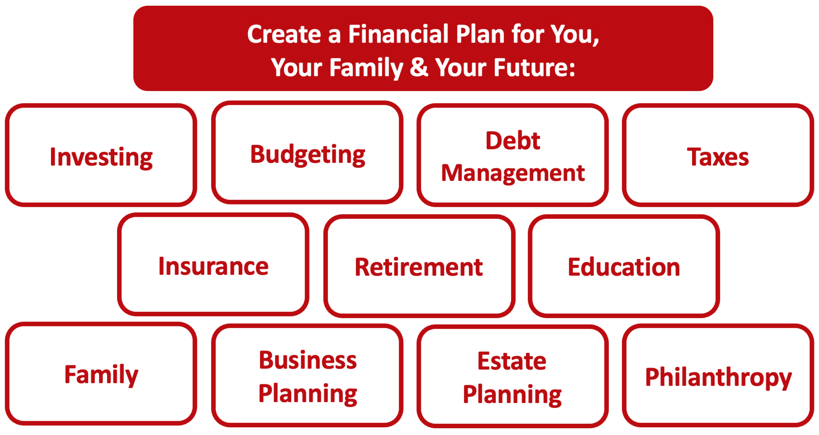

Slide 4
Owning Your Financial Future
YOUR VALUES
YOUR GOALS
Education
Career
Family
FINANCIAL STRATEGIES
Investing
Income & Expense Management
Debt Management
Taxes, Insurance & Other

Slide 5
Owning Your Financial Future
YOUR VALUES
YOUR GOALS
Education
Career
Family
FINANCIAL STRATEGIES
Investing
Income & Expense Management
Debt Management
Taxes, Insurance & Other

Slide 6
Owning Your Financial Future
YOUR VALUES
YOUR GOALS
Education
Career
Family
FINANCIAL STRATEGIES
Investing
Income & Expense Management
Debt Management
Taxes, Insurance & Other

Slide 7
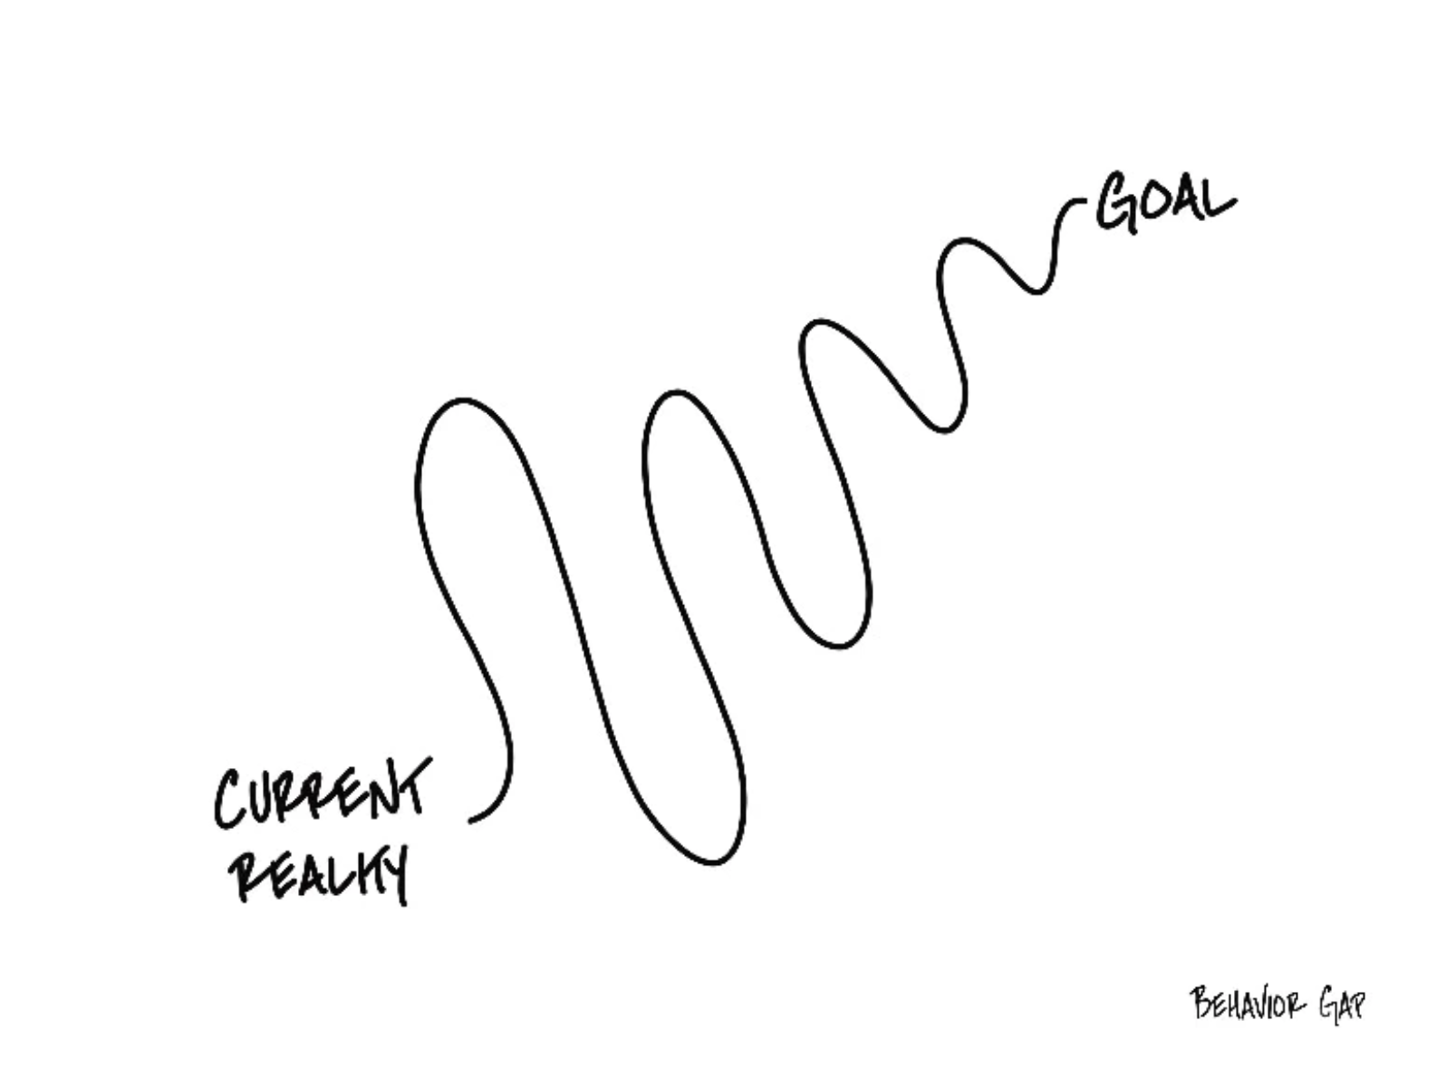
Student Support Services
Financial Wellness 2025
Session #4:
Investing for Your Future

Slide 8
A Few Opening Morals
Personal Finance is…personal.
It’s about you and not about anyone else.
You have to make it about you and your goals.

Slide 9
A Few Opening Morals
There is no judgment in personal finance.
There is no ego in personal finance.
There is no shame in personal finance.
It’s about you and not about anyone else.

Slide 10
A Few Opening Morals
Because personal finance is personal, it is virtually impossible for me to give you any specific advice.
However, there is one word of advice that applies to 99% of people working on their finances:
SAVE

Slide 11
A Few Opening Morals
SAVINGS
INVESTING
OWNERSHIP
WEALTH

Slide 12
Financial Wellness
Becoming an owner allows you to be the architect of your own future.
- Leigha Porter
Entrepreneur, Dancer, Choreographer, Founder of the Creole Nutcracker, PARC Village
and FIRE Expressions Conservatory, UL Lafayette grad, Northside High School grad

Slide 13
Let’s Do Some Fake Investing!
Which of these company stocks has performed the best over the past 5 years?
Apple
Disney
Google
JP Morgan Chase
McDonald’s
Microsoft
Nike
Pfizer
Visa
Walmart

Slide 14
Owning Your Financial Future
What Are Your Values, Dreams & Goals?
Education
Career
Family
What Is Your Current Situation?
Education
Career
Family
Financial
Create a Personal Financial Plan for You:
Investing
Budgeting
Debt Management
Taxes
Insurance
Retirement
Education
Family
Business Planning
Estate Planning
Philanthropy

Slide 15
TODAY THE NEXT 6 MONTHS THE NEXT 12 MONTHS 2 YEARS AFTER GRADUATION 3 YEARS AFTER GRADUATION
ONCE EVERY SEMESTER:
TRACK EVERY PENNY THAT YOU SPEND & TRACK EVERY PENNY THAT YOU EARN
IN THE NEXT 3 MONTHS:
IDENTIFY WAYS TO DECREASE YOUR DISCRETIONARY SPENDING BY 25%
IN THE NEXT 6 MONTHS:
MAKE A PLAN TO MANAGE – AND PAY OFF – YOUR DEBT
IN THE NEXT 6-12 MONTHS:
OPEN MULTIPLE SAVINGS ACCOUNTS, 1 FOR EACH GOAL
IN THE NEXT 12 MONTHS, OPEN AN IRA OR ROTH IRA
WITHIN 2 YEARS OF GRADUATION:
HAVE AN “EMERGENCY FUND” ACCOUNT, WITH 3-6 MONTHS OF NON-DISCRETIONARY EXPENSES
WITHIN 3 YEARS OF GRADUATION:
ELIMINATE ALL OF YOUR BAD DEBT.

Slide 16
Opening Quiz – Question #1
Imagine you put $1,000 into a Roth IRA today.
Imagine this grows to become $25,000 over the next 35 years.
When you withdraw that $25,000 at age 60, what income will be taxed?
NONE
$25,000
$24,000
$1,000

Slide 17
Opening Quiz – Question #1
Imagine you put $1,000 into a Roth IRA today.
Imagine this grows to become $25,000 over the next 35 years.
When you withdraw that $25,000 at age 60, what income will be taxed?
NONE
$25,000
$24,000
$1,000

Slide 18
Opening Quiz – Question #2
If you had invested $1,000 in the S&P 500 at the beginning of 2022
(3+ years years ago), how much would that $1,000 be worth today?
A. $775
B. $1,000
C. $1,581
D. $4,043

Slide 19
Opening Quiz – Question #2
If you had invested $1,000 in the S&P 500 at the beginning of 2022
(3+ years years ago), how much would that $1,000 be worth today?
A. $775
B. $1,000
$1,581
(that’s a 13.2% annual return)
D. $4,043

Slide 20
Opening Quiz – Question #3
If you had invested $1,000 in the S&P 500 at the beginning of 2015
(10+ years ago), how much would that $1,000 be worth today?
A. $775
B. $1,000
C. $1,581
D. $4,043

Slide 21
Opening Quiz – Question #3
If you had invested $1,000 in the S&P 500 at the beginning of 2015
(10+ years ago), how much would that $1,000 be worth today?
A. $775
B. $1,000
C. $1,581
D. $4,043
(that’s a 13.9% annual return)

Slide 22
Opening Quiz – Question #4
If I had invested $1,000 into the S&P 500, the overall U.S. stock market, on the day that I was born, how much would that be worth today?
A. $1,000
B. $22,257
C. $60,371
C. $95,035

Slide 23
Opening Quiz – Question #4
If I had invested $1,000 into the S&P 500, the overall U.S. stock market, on the day that I was born, how much would that be worth today?
A. $1,000
B. $22,257
$60,371
That’s an annual return of just over 10% per year.
C. $95,035

Slide 24
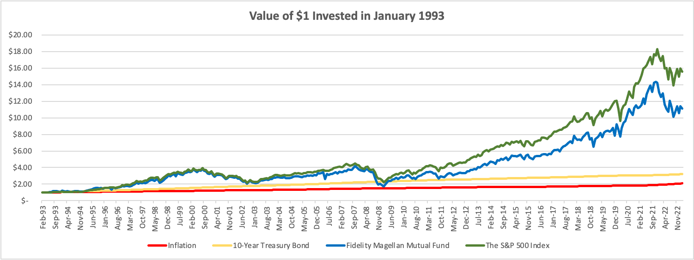
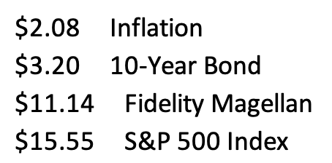

Slide 25
Let’s Do Some Fake Investing!
Which of these company stocks has performed the best over the past 2 years?
Apple
Disney
Google
JP Morgan Chase
McDonald’s
Microsoft
Nike
Pfizer
Visa
Walmart

Slide 26
Let’s Do Some Fake Investing!
Pfizer
Nike
Disney

Slide 27
Long-Term Investment Planning
YOUR VALUES
YOUR GOALS
FINANCIAL STRATEGIES
INVESTMENT STRATEGIES
Identify Your Risk Tolerance
Identify Your Time Horizons
Select Investments
Monitor & Modify Investments

Slide 28
Long-Term Investment Planning
FINANCIAL STRATEGIES
INVESTMENT STRATEGIES
Identify Your Risk Tolerance
Identify Your Time Horizons
Select Investments
Monitor & Modify Investments

Slide 29
Long-Term Investment Planning
FINANCIAL GOALS
EDUCATION GOALS
INVESTMENT STRATEGIES
EDUCATION STRATEGIES
Identify Your Risk Tolerance & Priorities
Identify Your Risk Tolerance & Priorities
Identify Your Time Horizons
Identify Your Time Horizons
Select Investments
Select Your Field, Program, Specialization, Thesis
Monitor & Modify Investments
Monitor & Modify Your Progress & Plan

Slide 30
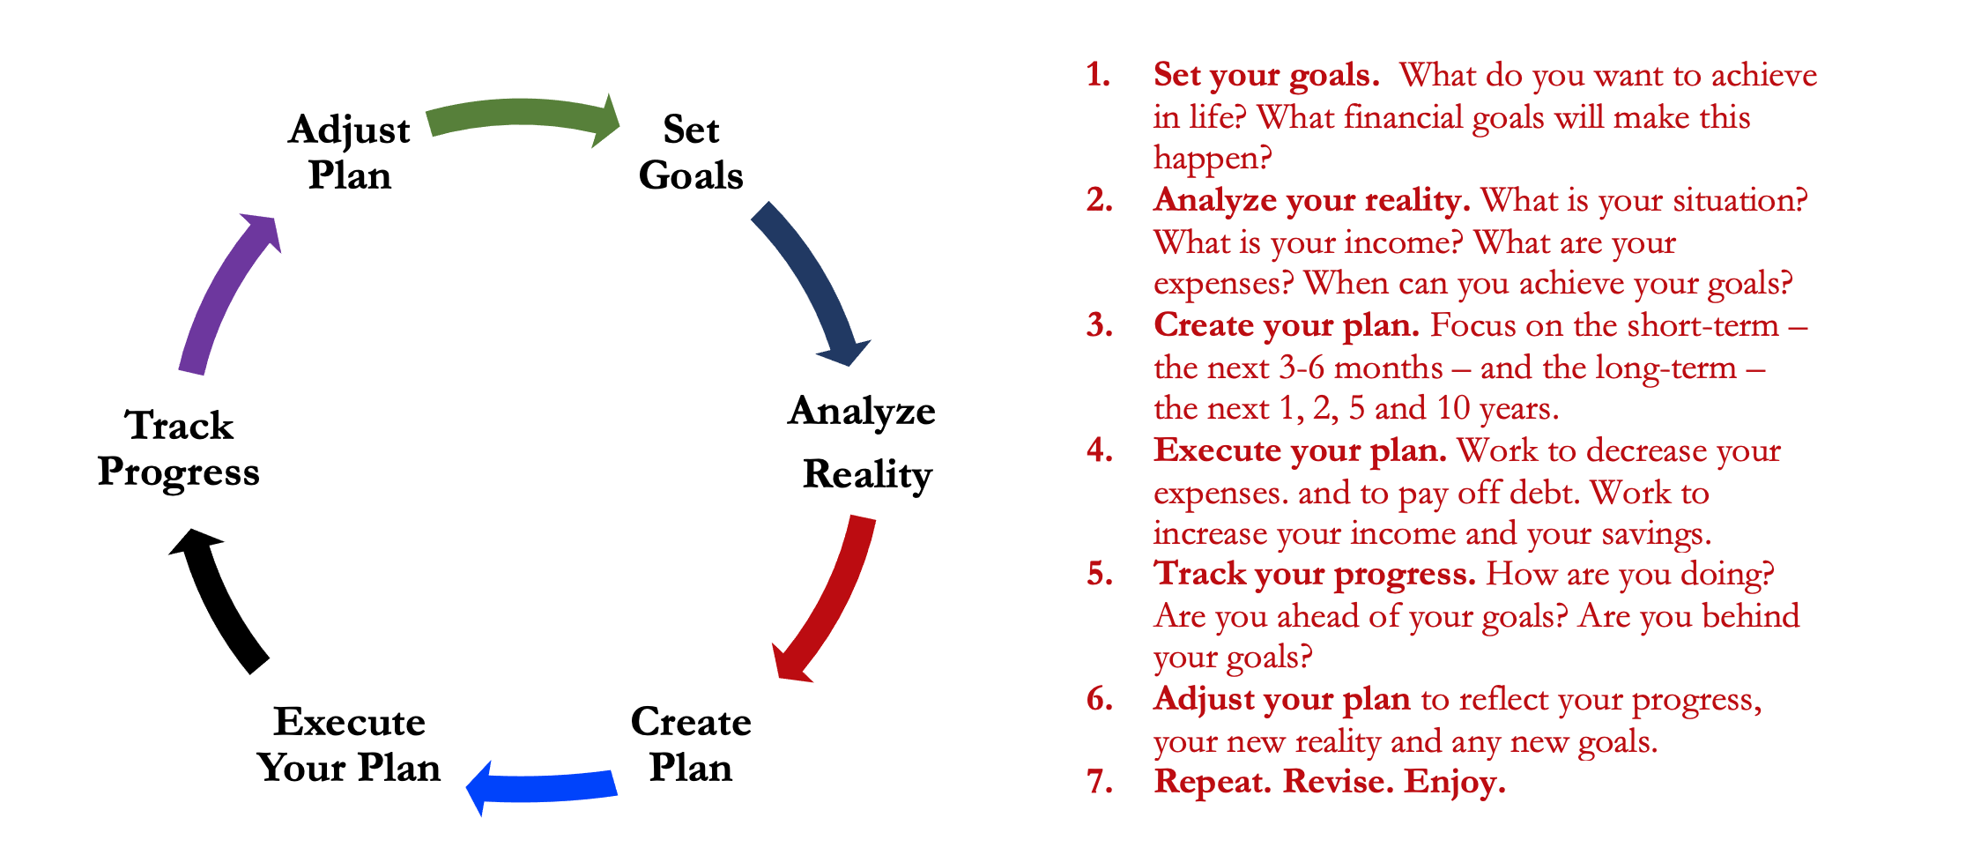
Isn’t this a lot like what you do with your education planning?

Slide 31
Long-Term Investment Planning
FINANCIAL GOALS
YOU,
as college students, are better wired and equipped to make long-term plans – education, career, financial & otherwise – than 99% of humanity.
Be confident.
Be intentional.
Be diligent.
Be awesome.
EDUCATION GOALS
INVESTMENT STRATEGIES
EDUCATION STRATEGIES
Identify Your Risk Tolerance & Priorities
Identify Your Risk Tolerance & Priorities
Identify Your Time Horizons
Identify Your Time Horizons
Select Investments
Select Your Field, Program, Specialization, Thesis
Monitor & Modify Investments
Monitor & Modify Your Progress & Plan

Slide 32
Owning Your Financial Future
YOUR VALUES
YOUR GOALS
Education
Career
Family
FINANCIAL STRATEGIES
Investing
Income & Expense Management
Debt Management
Taxes, Insurance & Other

Slide 33
What is INVESTING?
Investing is saving for the future.
We typically think of investing as long-term – anywhere from 1 or 2 years all the way through retirement.
Saving vs. Investing
  Saving can be short-term, Investing is typically long-term.
  Saving is passive, Investing is dedicated…it could be relatively passive or extremely active.
    Passive: Mutual funds. Extremely Active: Owning an apartment complex.
  Saving is typically very low risk, Investing generally has more risk.
  Saving provides low returns on investment (currently about 0.0%)
  Inflation is risky…You can lose 100% or realize huge positive returns.

Slide 34
What Is Your Investing Goal?
Take a few seconds to ask yourself:
Why Are You Investing?
What are your investing goals?
To buy a house?
To buy a car?
To pay off debt?
To retire?

Slide 35
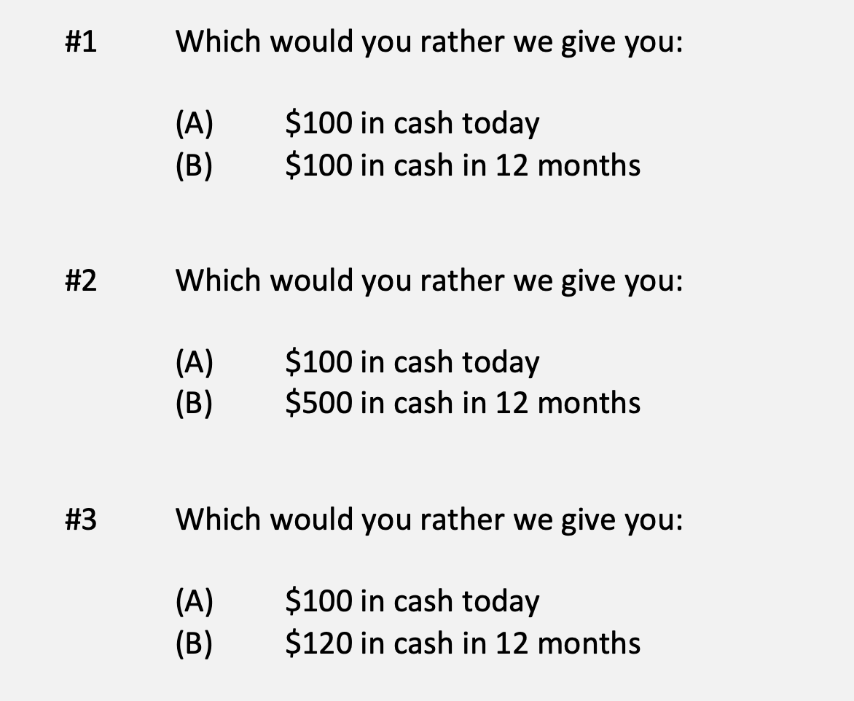
A Few Rules About INVESTING
Investing is about Trade-Offs. Using money today to get (hopefully more) money in the future:

Slide 36
A Few Rules About INVESTING
Risk matters. Know your risk tolerance.
Goals matter. Be intentional about what you are saving for.
  Maybe create 3-5 different investment accounts for different goals.
  This is what I do – I’ll show you why in a bit.
Transaction costs matter. You can pay a lot of fees for not much benefit or service. Be careful.
Experts rarely have tips or secrets. Investing is about predicting the future, and none of us can predict the future (perfectly). Be careful.
  If there really were sure-things or get-rich-quick schemes, the experts would be using them themselves, not sharing them with you.
Communicate with your family. Achieving goals is a family affair.

Slide 37
A Few Rules About INVESTING
Investing lets COMPOUND INTEREST be your friend.
  With compound interest, your interest earns interest.
  Without actively making decisions, your money can grow exponentially.
  Yes, there is risk – the exponential growth rate could be negative.
  Such risk is greatest if you ‘invest’ over very short periods of time.
  Historically, over the past 100+ years, if you invest for 5+ years, you have benefited from positive exponential growth.
  The average return of a common stock over the past 100 years is 10%.
    The word ’average’ is very important here. But, the good news, we can all achieve ‘average’ returns relatively easily (though they may not be 10% in the future)

Slide 38
A Few Rules About INVESTING
Investing lets COMPOUND INTEREST be your friend.
  Invest $100 at 10% interest or growth:
  Year 1: $100 x (1 + 10%) = $110
  Year 2: $110 x (1 + 10%) = $121
  $100 x (1 + 10%)² = $121
  Year 1: $10 of interest
  Year 2: $10 of interest on your original $100
  + $1 of interest on year 1 interest

Slide 39
Expertise Matters
Take a minute to think about the following question:
What do YOU do better than 99.9% of humanity?
Think about what you’re studying. Think about what you’ve been working on for years. Think about what you know that I do not know.
I’ve probably only spent 1-2 hours studying what you have dedicated your life to studying and becoming an expert in.
  Could I do your job as well as you do it?

Slide 40
Expertise Matters
Of course, I couldn’t do your job as well as you.
Now connect this logic to investing: there are many professionals who have dedicated their lives to making investments. They are good.
  Yes, there are many amateurs involved in trading stocks – but they (usually) account for a very minor portion of the total money invested.
Remind yourself of this old gambling maxim:
When you are sitting at the poker or gambling table, take a look around and see if you can figure out who the sucker is. If you cannot identify who the sucker is, then the sucker is probably you.

Slide 41
Isn’t this a lot like what you do with your education planning?

Slide 42
Determining Your Risk Tolerance
High Risk Attitude
I want to summer in Paris and winter in Hawaii
Medium-High Risk Attitude
I will work through normal retirement age, but I want my spouse to retire early - and we want to visit Paris & Hawaii
Medium-Low Risk Attitude
I want my children to have a college education
Low Risk Attitude
I want food on the table and a roof over my head

Slide 43
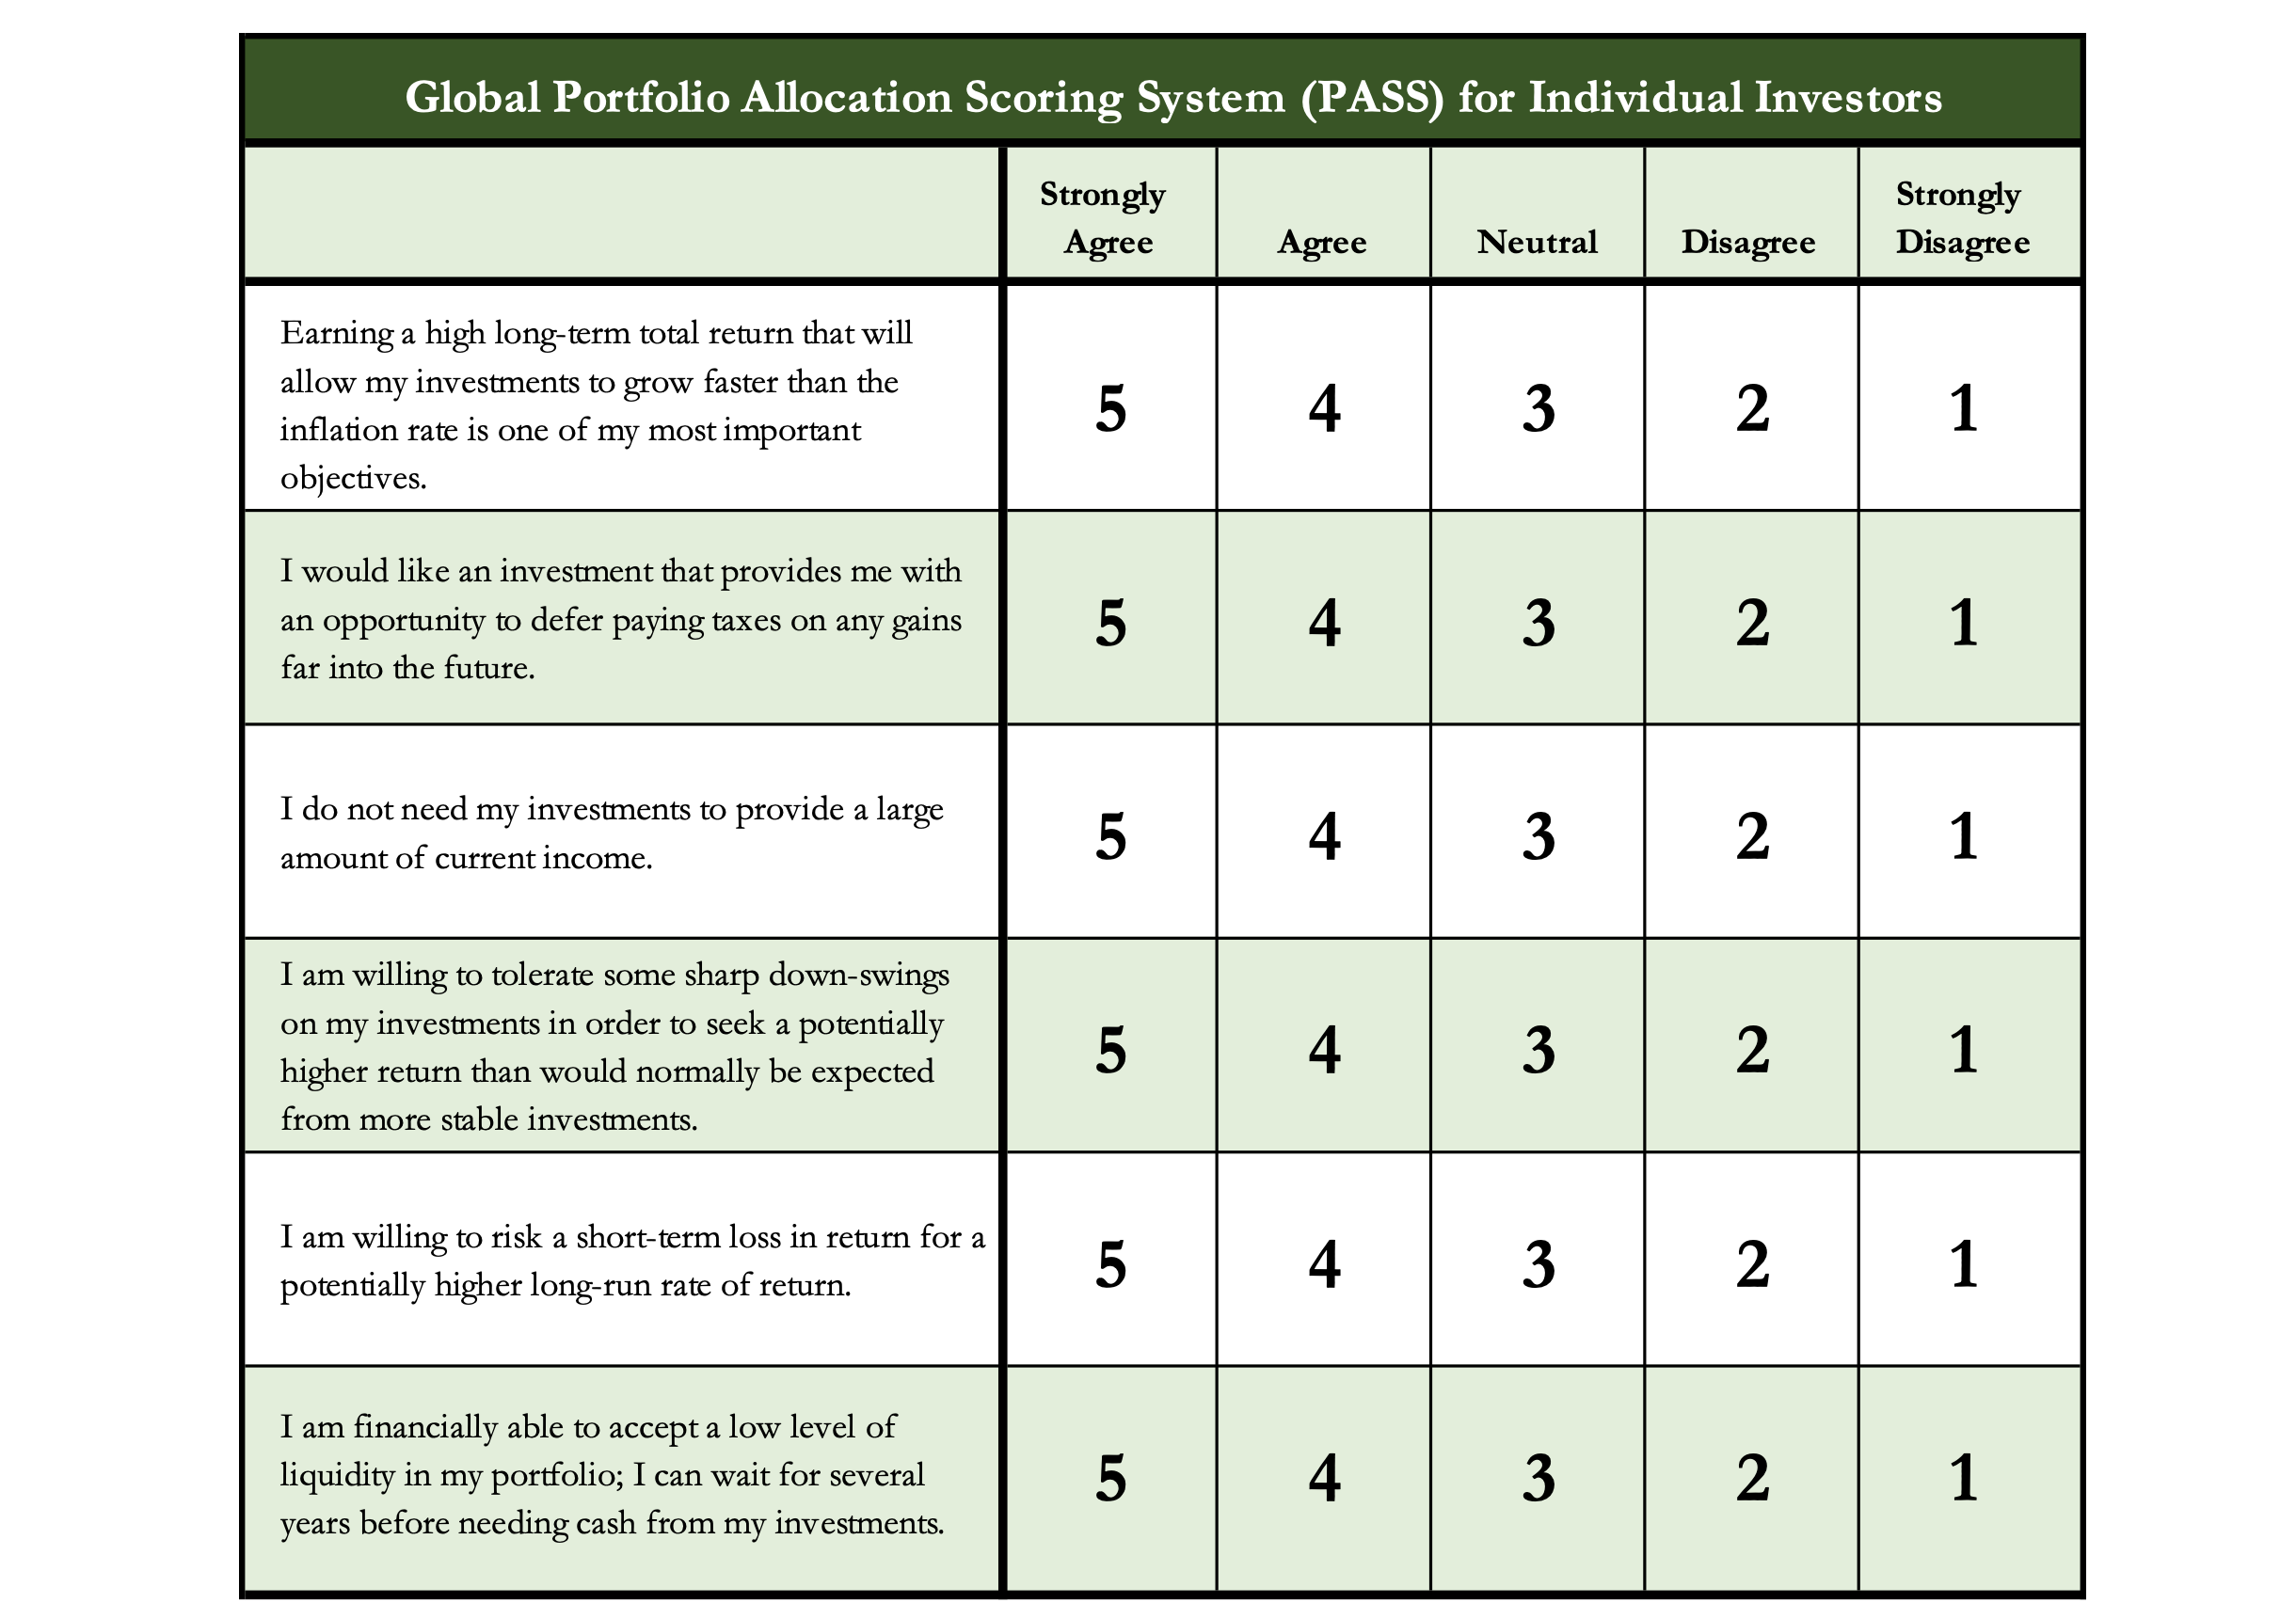
Determining Your Risk Tolerance

Slide 44
Comparing Different Investments

Slide 45
Comparing Different Investments

Slide 46
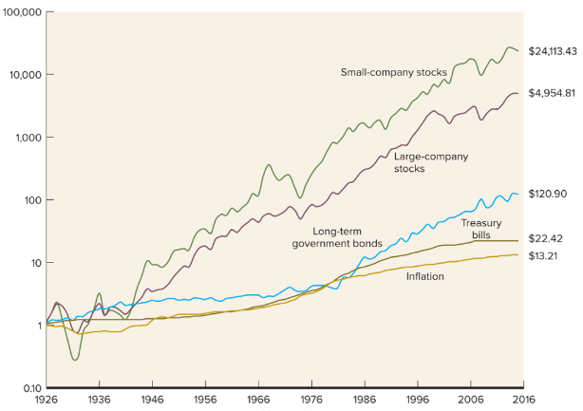
Comparing Different Investments

Slide 47
The Magic of Compound Returns

Slide 48
The Magic of Compound Returns

Slide 49
The Magic of Compound Returns
Quiz Question on Compound Returns:
Under which of the following scenarios will you have more money saved when you turn 65?
Investing $100 per month from age 25-35 (and then nothing from 35-65)
With an 8% return, you will have $185,000 accumulated at 65.
Investing $100 per month from age 35-65 (but nothing from 25-35)
With an 8% return, you will have $150,000 accumulated at 65.
Note: If the returns on your investments are less than 6%, (B) will lead to greater wealth.
There’s a similar but different problem on page 37 of your handbook.

Slide 50
The Magic of Compound Returns
Quiz Question on Compound Returns:
Under which of the following scenarios will you have more money saved when you turn 65?
Investing $100 per month from age 25-35 (and then nothing from 35-65)
With an 8% return, you will have $185,000 accumulated at 65.
Investing $100 per month from age 35-65 (but nothing from 25-35)
With an 8% return, you will have $150,000 accumulated at 65.
Note: If the returns on your investments are less than 6%, (B) will lead to greater wealth.
There’s a similar but different problem on page 37 of your handbook.

Slide 51
Review: A Few Rules About INVESTING
Investing lets COMPOUND INTEREST be your friend.
  With compound interest, your interest earns interest.
  Without actively making decisions, your money can grow exponentially.
  Yes, there is risk – the exponential growth rate could be negative.
  Such risk is greatest if you ‘invest’ over very short periods of time.
  Historically, over the past 100+ years, if you invest for 5+ years, you have benefited from positive exponential growth.
  The average return of a common stock over the past 100 years is 10%.
    The word ’average’ is very important here. But, the good news, we can all achieve ‘average’ returns relatively easily (though they may not be 10% in the future)

Slide 52
Review: A Few Rules About INVESTING
Investing lets COMPOUND INTEREST be your friend.
  With compound interest, your interest earns interest.
  Without actively making decisions, your money can grow exponentially.
  Yes, there is risk – the exponential growth rate could be negative.
  Such risk is greatest if you ‘invest’ over very short periods of time.
  Historically, over the past 100+ years, if you invest for 5+ years, you have benefited from positive exponential growth.
  The average return of a common stock over the past 100 years is 10%.
    The word ’average’ is very important here. But, the good news, we can all achieve ‘average’ returns relatively easily (though they may not be 10% in the future)
Not to be too esoteric or philosophical…
But compound interest doesn’t just apply to investing.
Compound interest applies to all aspects of college life:
Time Management
Mental Health
Health Management
Writing Skills
Relationships
And…Of course, Money Management

Slide 53
Investing – Some Perspective
I am biased because I am a finance professor. I study investing and I teach investing. My perspective on risk may be meaningless to you.
Do not take my advice on what level of risk you should take. Be thoughtful, be prudent.
Avoid doing things that you know are stupid and that you know will cause you stress.
But don’t be afraid of taking risks just because they scare you. You have already taken many, many risks in your life. Taking informed and measured risks will continue to open many doors and opportunities for you – in both your personal and financial lives.

Slide 54
A Few Opening Morals
SAVINGS
INVESTING
OWNERSHIP
WEALTH

Slide 55
Common Questions about Investing & Saving
How can I save when my income is so low as a student?
My problem isn’t budgeting but it’s having too little income.
Your short-term priorities while in grad school need to be your education, your family and your mental health.
Maybe saving cannot be a priority for you while you’re in school.
The goal is to develop habits and a mindset that will prepare you to maximize the benefits of saving when your income allows you to do so. Be patient. The benefits of good habits will grow exponentially.

Slide 56
Common Questions about Investing & Saving
How can I save when my income is so low as a student?
My problem isn’t budgeting but it’s having too little income.
And think of ways to generate more money: gigs, internships, tutor, lab assistant, freelance positions, blogger, podcasts, consulting
  Create new jobs for yourself: maybe sell your skills in social media marketing
  to a company you want to work for, regardless of your program
A lot of the advice we think of in budgeting is about “reducing expenses.”
And that’s because we generally have more control over our expenses than we do over our income, at least in the short-term. Do what you can.
  And, decreasing expenses can feel like an increase income. Same same.

Slide 57
Common Questions about Investing & Saving
How much of my income should I be saving each month?
Only you can answer this. Nobody can answer it for you.
It depends on:
  What your goals are, both short- and medium-term.
  What your immediate expenses are.
I frequently advise students to save $25 of every paycheck as soon as they receive each paycheck. Save or set aside as much as you can.
  When I was getting my Master degree, I had no income. I was living off a little savings and a lot of debt. But I intentionally saved $10 to $25 on the first day of each month…simply to develop the habit.
  In school, the habit is more important than the amount.

Slide 58
Common Questions about Investing & Saving
How much of my income should I be saving each month?
My challenge to you:
Take $10 of every paycheck and move it into a savings account.
If you can save more, do it.
But at a minimum, save $10 of every paycheck to develop the habit.
My advanced challenge to you:
Take half of what you save each month and invest it in the stock market.

Slide 59
Common Questions about Investing & Saving
How do I save for a big purchase – house, car, etc…?
Stary by asking yourself a few questions:
  How much do I need to save?
  When am I going to make this purchase?
  Is this essential or discretionary? (A refrigerator or car vs. a vacation)
These questions will help identify timing and priority.
  Knowing timing & priority will help determine how you save.
    Do you use a bank savings account or do you have time to invest in the stock market?

Slide 60
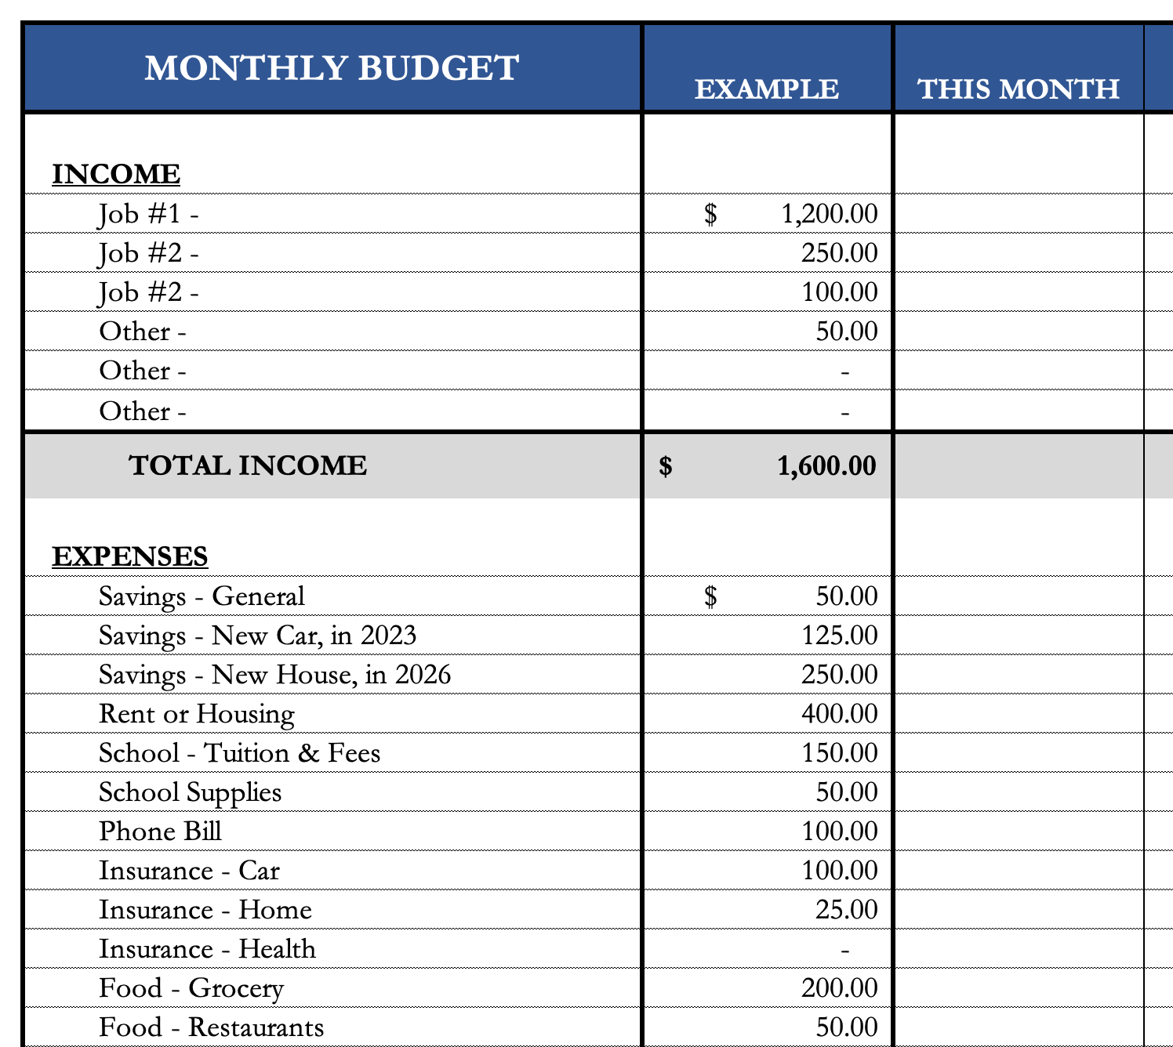
Common Questions about Investing & Saving
How do I save for a big purchase – house, car, etc…?
I would explicitly allocate some of my monthly
savings to this purchase.
  I have already penciled in my holiday gift purchases –
  even though I won’t make them for 2 months.
If it’s a really big purchase (e.g. house), you
could even set up a dedicated saving or
investing account just for that purchase.

Slide 61
Common Questions about Investing & Saving
How much of my income should I be investing each month?
Again, only you can answer this. Nobody can answer this for you.
Your goals, values and resources are unique to you…and only you.
You may read reports about how much you should have saved by a certain age or whatever.
  It’s okay to read those, but be sure to put them into your own perspective.
  Those articles do not know what your goals are, do not know that you are in graduate school and do not know what your future plans are.
  It is important to have a plan – but it is critical that that plan is unique to you and your situation.

Slide 62
Some Parting Words
Nothing in finance is free. Do not think some institution is giving you a super deal just because they like you. There will be costs.
Investment companies work really hard to get your money. They hire psychologists to figure out how to get you addicted to your products. Your money pays for their commercials, buildings, fancy cars and vacation homes.
I check my bank, savings & investment accounts daily. I do not make changes daily (or even monthly). I just don’t want any surprises.

Slide 63
Isn’t this a lot like what you do with your education planning?

Slide 64
Happiness
Long-Term Goals
Short-Term Goals
Financial Needs
Family Needs

Slide 65
Financial Wellness
A goal without a plan is just a dream.
Wealth is largely the result of habit.
The most difficult thing is the decision to act; the rest is mere tenacity.
It takes as much energy to plan as it does to wish.
You cannot escape the responsibility of tomorrow by avoiding it today.

Slide 66
Don’t wait around for other people to be happy for you.
Any happiness you get,
You’ve got to make yourself.
~ Alice Walker, poet & novelist
A goal without a plan is just a dream.
Wealth is largely the result of habit.
The most difficult thing is the decision to act; the rest is mere tenacity.
It takes as much energy to plan as it does to wish.
You cannot escape the responsibility of tomorrow by avoiding it today.

Slide 67
brian.bolton@louisiana.edu http//:business.louisiana.edu/financeispersonal

