Slide 1

STUDENT SUPPORT SERVICES
FINANCIAL WELLNESS SERIES 2025
Session #2
Debt, Taxes & Financial Resolutions
February 26, 2025
February 27, 2025

Slide 2
Brian Bolton
Professor of Finance brian.bolton@louisiana.edu https://business.louisiana.edu/financeispersonal

Slide 3
Financial Wellness
If you don’t know where you’ve come from, you can’t know where you’re going.
- Maya Angelou

Slide 4
I believe that your college degree is the best investment you can ever make.
But it is very expensive – in terms of money, time, energy and opportunity costs.
Take a minute to think about all of the costs involved in getting your degree…

Slide 5
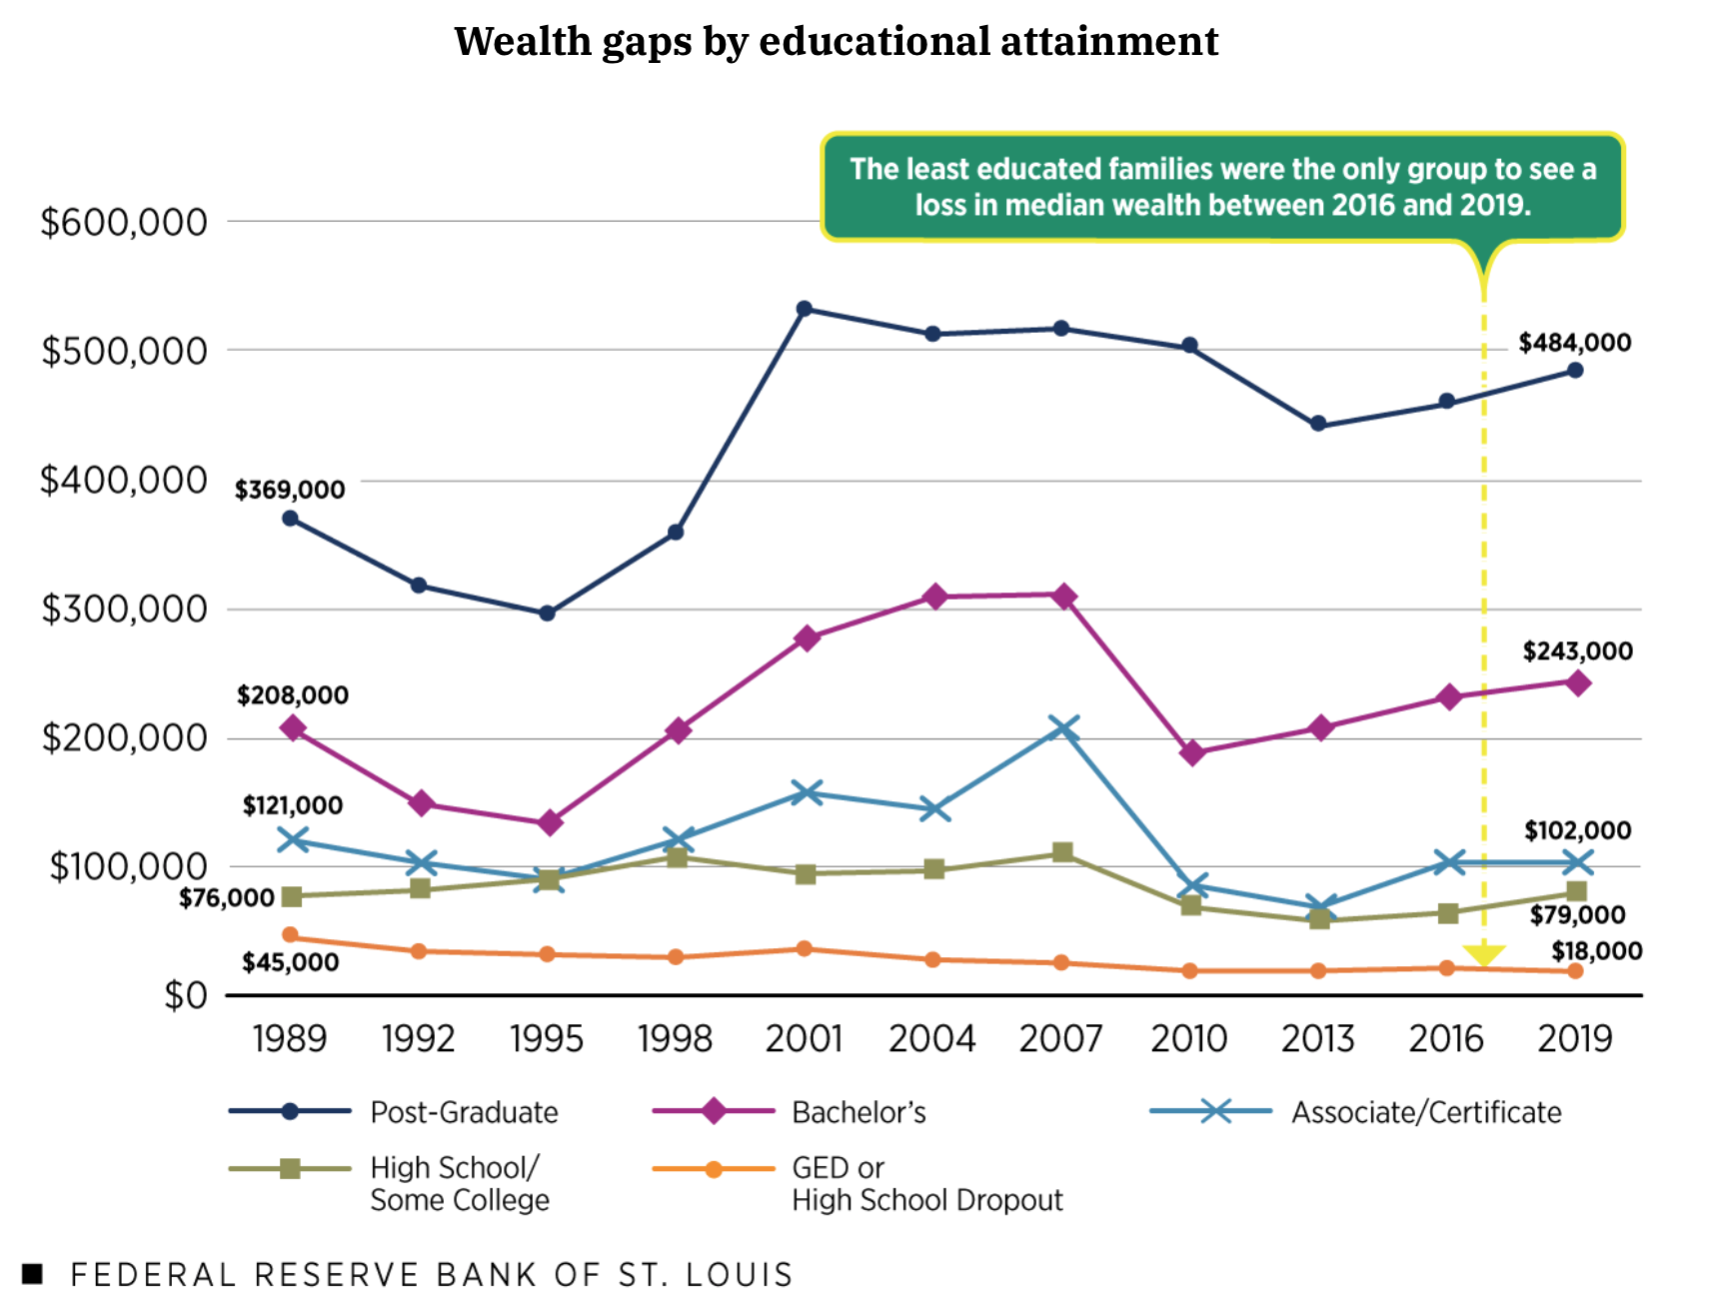
THE WEALTH GAP
IN THE
USA

Slide 6
A Few Opening Morals
Personal Finance is…personal.
It’s about you and not about anyone else.
You have to make it about you and your goals.

Slide 7
A Few Opening Morals
There is no judgment in personal finance.
There is no ego in personal finance.
There is no shame in personal finance.
It’s about you and not about anyone else.

Slide 8
A Few Opening Morals
Because personal finance is personal, it is virtually impossible for me to give you any specific advice.
However, there is one word of advice that applies to 99% of people working on their finances:
SAVE

Slide 9
A Few Opening Morals
SAVINGS
INVESTING
OWNERSHIP
WEALTH

Slide 10
Financial Wellness
Becoming an owner allows you to be the architect of your own future.
- Leigha Porter
Entrepreneur, Dancer, Choreographer, Founder of the Creole Nutcracker, PARC Village
and FIRE Expressions Conservatory, UL Lafayette grad, Northside High School grad

Slide 11
Financial Wellness
A goal without a plan
Is just a dream.
~ Antoine de Saint-Exupéry

Slide 12
Let’s Do Some Fake Investing!
Which of these company stocks has performed the best over the past 5 years?
Apple
Disney
Google
JP Morgan Chase
McDonald’s
Microsoft
Nike
Pfizer
Visa
Walmart

Slide 13
Owning Your Financial Future
What Are Your Values, Dreams & Goals?
Education
Career
Family
What Is Your Current Situation?
Education
Career
Family
Financial
Create a Personal Financial Plan for You:
Investing
Budgeting
Debt Management
Taxes
Insurance
Retirement
Education
Family
Business Planning
Estate Planning
Philanthropy

Slide 14
Opening Quiz – Question #1
If you had invested $1,000 in the S&P 500 at the beginning of 2022
(3+ years years ago), how much would that $1,000 be worth today?
A. $775
B. $1,000
C. $1,581
D. $4,043

Slide 15
Opening Quiz – Question #1
If you had invested $1,000 in the S&P 500 at the beginning of 2022
(3+ years years ago), how much would that $1,000 be worth today?
A. $775
B. $1,000
$1,581
(that’s a 13.2% annual return)
D. $4,043

Slide 16
Opening Quiz – Question #2
If you had invested $1,000 in the S&P 500 at the beginning of 2015
(10+ years ago), how much would that $1,000 be worth today?
A. $775
B. $1,000
C. $1,581
D. $4,043

Slide 17
Opening Quiz – Question #2
If you had invested $1,000 in the S&P 500 at the beginning of 2015
(10+ years ago), how much would that $1,000 be worth today?
A. $775
B. $1,000
C. $1,581
D. $4,043
(that’s a 13.9% annual return)

Slide 18
Opening Quiz – Question #3
Which of these 4 countries currently
has the lowest inflation rate?
United States
England
Germany
Mexico

Slide 19
Opening Quiz – Question #3
Which of these 4 countries currently
has the lowest inflation rate?
United States
England
Germany
Mexico

Slide 20
Opening Quiz – Question #4
Which of these 4 countries
currently has the HIGHEST inflation rate?
United States
England
Germany
Mexico

Slide 21
Opening Quiz – Question #4
Which of these 4 countries
currently has the HIGHEST inflation rate?
United States (3.0%)
England (3.0%)
Germany (2.3%)
Mexico (3.6%)

Slide 22
Opening Quiz – Question #5
If you sold cookies out of your apartment during 2024, received
made $500 from those sales, and spent $200 making those cookies,
what do you owe taxes on?
$500
$300
$200
$0

Slide 23
Opening Quiz – Question #5
If you sold cookies out of your apartment during 2024, received
made $500 from those sales, and spent $200 making those cookies,
what do you owe taxes on?
$500
$300
$200
$0

Slide 24
Opening Quiz – Question #6
If you sold cookies out of your apartment during 2024, received
made $500 from those sales, and spent $700 making those cookies,
what do you owe taxes on?
$500
$700
$0
You get a refund
for the $200 loss

Slide 25
Opening Quiz – Question #6
If you sold cookies out of your apartment during 2024, received
made $500 from those sales, and spent $700 making those cookies,
what do you owe taxes on?
$500
$700
$0
You get a refund
for the $200 loss

Slide 26
Opening Quiz – Question #7
If you earned $14,500 of income in 2024,
which of the following applies to you:
You owe taxes on the entire $14,500.
It depends on whether someone else claims you as a dependent.
You do not owe any taxes and you do not have to file a tax return.
You do not owe any taxes but you have to file a tax return.

Slide 27
Opening Quiz – Question #7
If you earned $14,500 of income in 2024,
which of the following applies to you:
You owe taxes on the entire $14,500.
It depends on whether someone else claims you as a dependent.
You do not owe any taxes and you do not have to file a tax return.
You do not owe any taxes but you have to file a tax return.

Slide 28
Opening Quiz – Question #8 – Last One
If I had invested $1,000 into the S&P 500, the overall U.S. stock market, on the day that I was born, how much would that be worth today?
A. $1,000
B. $22,257
C. $60,371
C. $95,035

Slide 29
Opening Quiz – Question #8 – Last One
If I had invested $1,000 into the S&P 500, the overall U.S. stock market, on the day that I was born, how much would that be worth today?
A. $1,000
B. $22,257
$60,371
That’s an annual return of just over 10% per year.
C. $95,035

Slide 30
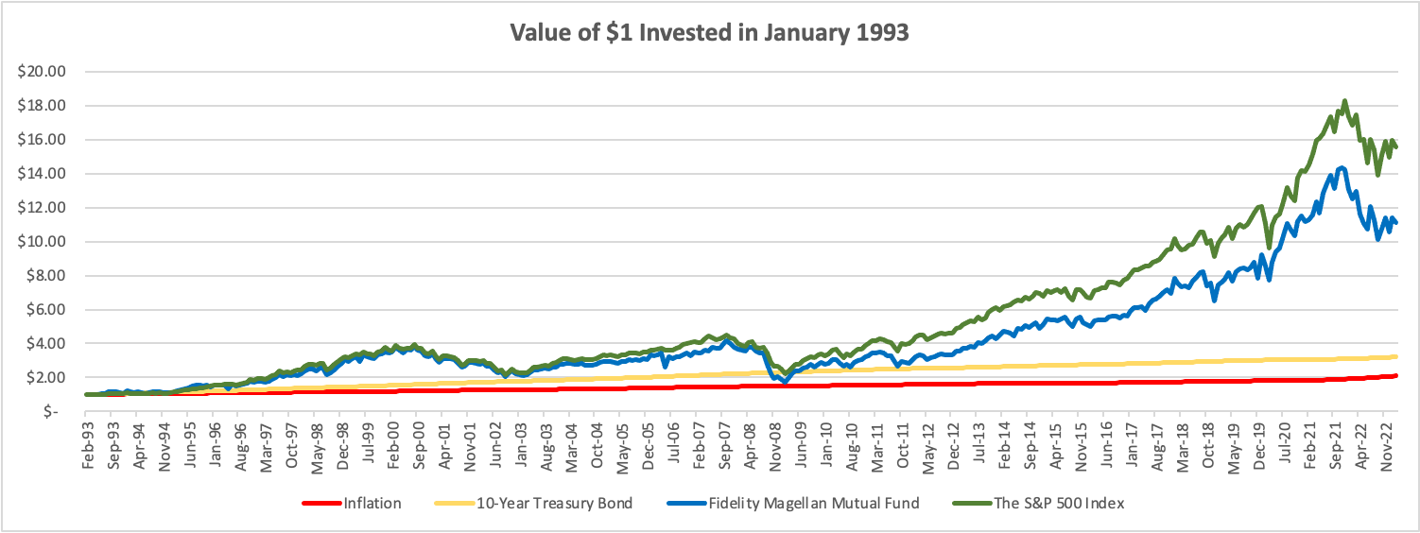
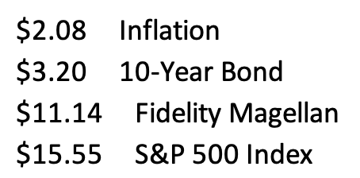

Slide 31
Let’s Do Some Fake Investing!
Which of these company stocks has performed the best over the past 2 years?
Apple
Disney
Google
JP Morgan Chase
McDonald’s
Microsoft
Nike
Pfizer
Visa
Walmart

Slide 32
Let’s Do Some Fake Investing!
Pfizer
Nike
Disney

Slide 33
Happiness
Long-Term Goals
Short-Term Goals
Financial Needs
Family Needs

Slide 34
Owning Your Financial Future
YOUR VALUES
YOUR GOALS
Education
Career
Family
FINANCIAL STRATEGIES
Investing
Income & Expense Management
Debt Management
Taxes, Insurance & Other

Slide 35
Owning Your Financial Future
YOUR VALUES
YOUR GOALS
Education
Career
Family
FINANCIAL STRATEGIES
Investing
Income & Expense Management
Debt Management
Taxes, Insurance & Other

Slide 36
Owning Your Financial Future
YOUR VALUES
YOUR GOALS
Education
Career
Family
FINANCIAL STRATEGIES
Investing
Income & Expense Management
Debt Management
Taxes, Insurance & Other
Debt, Taxes & Resolutions

Slide 37
TODAY THE NEXT 6 MONTHS THE NEXT 12 MONTHS 2 YEARS AFTER GRADUATION 3 YEARS AFTER GRADUATION
ONCE EVERY SEMESTER:
TRACK EVERY PENNY THAT YOU SPEND & TRACK EVERY PENNY THAT YOU EARN
IN THE NEXT 3 MONTHS:
IDENTIFY WAYS TO DECREASE YOUR DISCRETIONARY SPENDING BY 25%
IN THE NEXT 6 MONTHS:
MAKE A PLAN TO MANAGE – AND PAY OFF – YOUR DEBT
IN THE NEXT 6-12 MONTHS:
OPEN MULTIPLE SAVINGS ACCOUNTS, 1 FOR EACH GOAL
IN THE NEXT 12 MONTHS, OPEN AN IRA OR ROTH IRA
WITHIN 2 YEARS OF GRADUATION:
HAVE AN “EMERGENCY FUND” ACCOUNT, WITH 3-6 MONTHS OF NON-DISCRETIONARY EXPENSES
WITHIN 3 YEARS OF GRADUATION:
ELIMINATE ALL OF YOUR BAD DEBT.

Slide 38
WHAT IS DEBT
Debt is borrowing from YOUR future.
We borrow because we want something today that we cannot afford today.
We make a promise to pay for that something in the future.
The entity we borrow from wants to make money. They are not our friends.
We have to pay them helping us get what we want today.
  At a minimum, we pay them interest on our debt.
  Depending on the type of debt, we may have to pay them much more (fees, collateral, earnings, control, etc.)

Slide 39
WHAT IS DEBT
Debt is borrowing from YOUR future.
If your debt is keeping you up at night…
If your debt is preventing you from achieving your goals…
If your debt is damaging your relationships…
…Then you may have too much debt.
(we will return to this issue later)

Slide 40
One Truism About DEBT
If you borrow $10,000,
You will have to repay $10,000.
Whatever you borrow, you will have to repay – in full, with interest – 99% of the time. Lenders do not exist to give you money.
One good exception: Student loan forgiveness.
Lots of bad exceptions: Default, bankruptcy, short sale…

Slide 41
Frequently Asked Question
Is it smart to pay off student debt as soon as you are able to?
General Answer: No, not for most people.
Student loans – if they are federally subsidized loans – are some of the BEST debt you have.
They generally have low interest rates, flexible repayment plans& the possibility of forgiveness.
HOWEVER, if you have private, unsubsidized student loans, they could be BAD debt that you want to pay off as soon as you are able.

Slide 42
Frequently Asked Question
Is it smart to pay off CREDIT CARD DEBT as soon as you are able to?
General Answer: YES. ALWAYS. FOR EVERYONE.

Slide 43
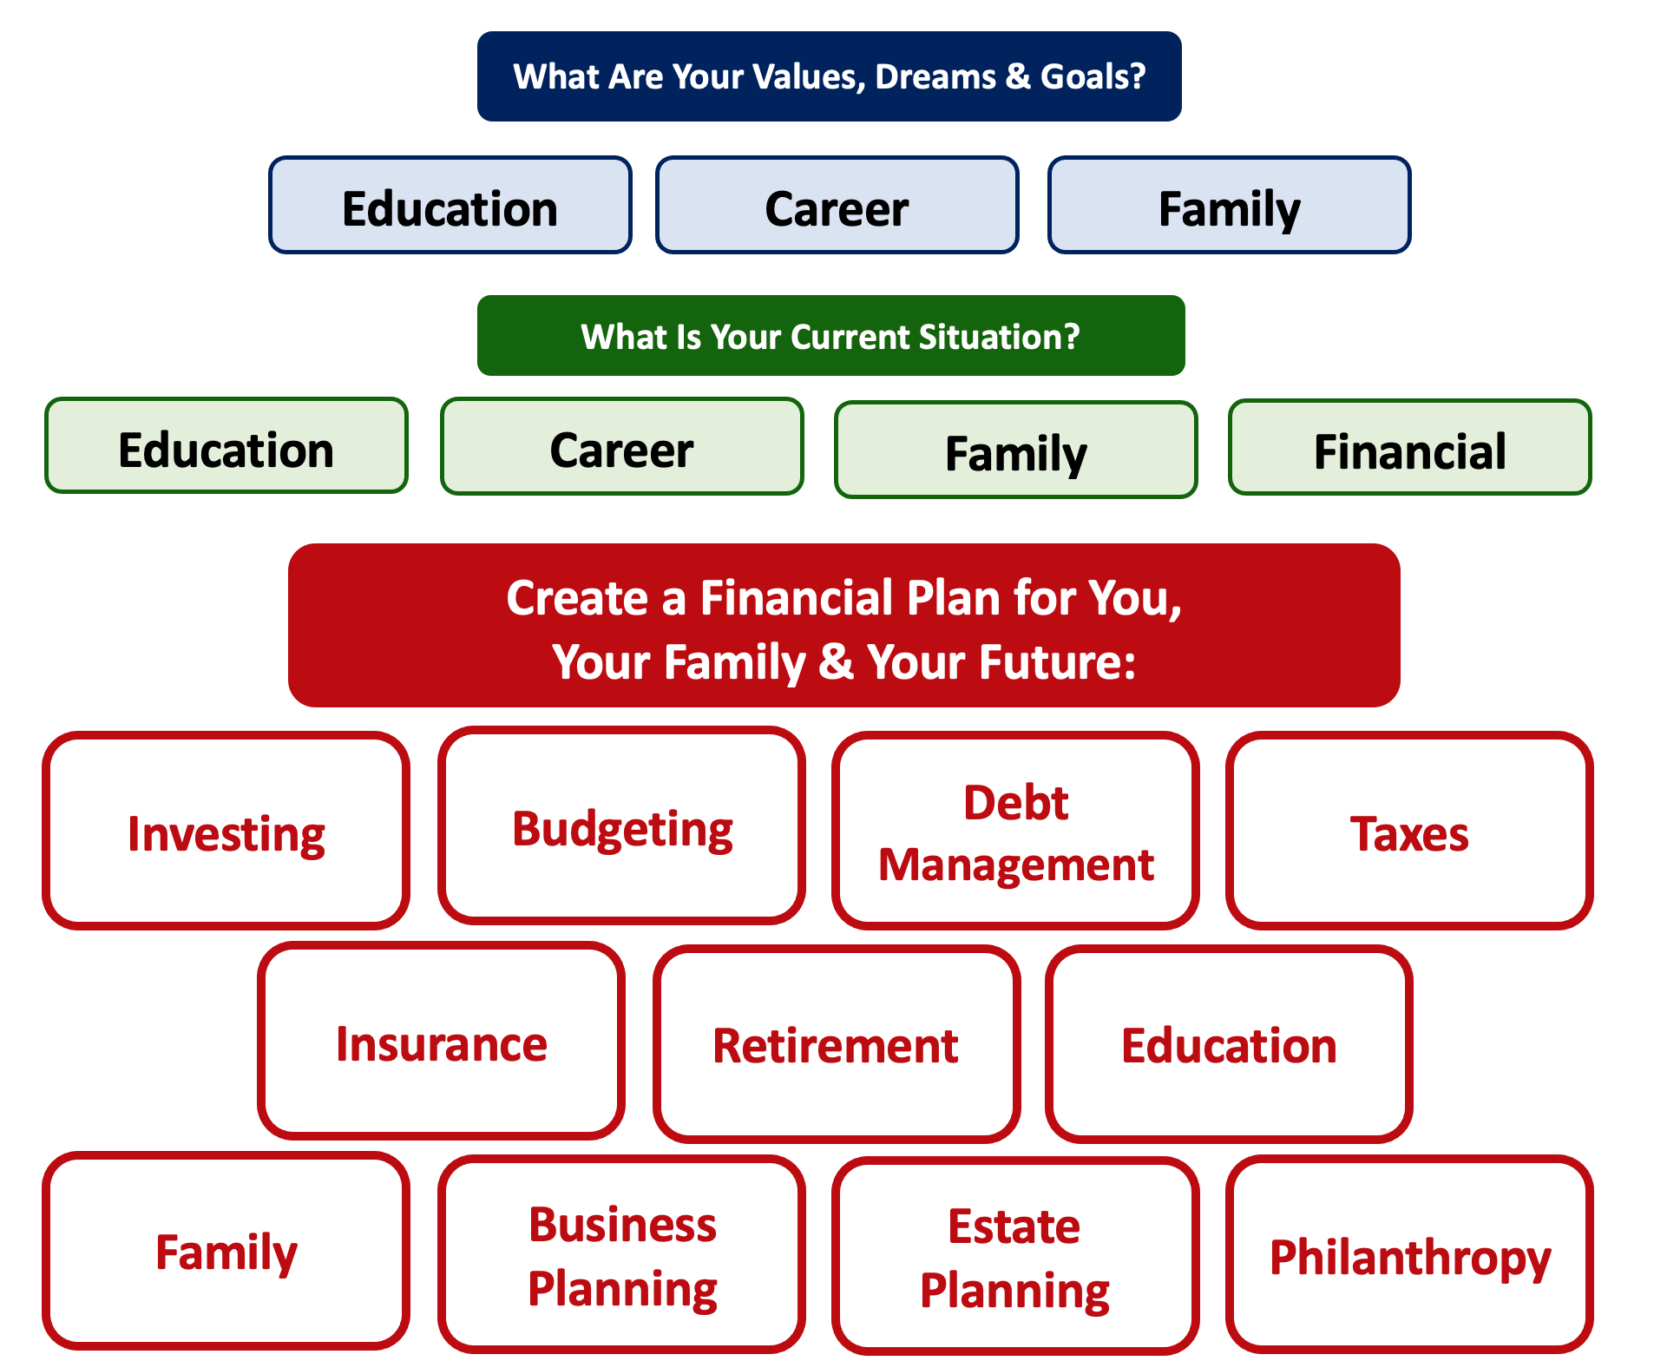
Debt is NOT a bad thing.
Debt can help us achieve our goals, depending on our current situations and what those goals are.
Debt is also called “leverage” – because it gives us the ability do things we might not be able to do otherwise.

Slide 44
Debt is NOT a bad thing.
My one primary piece of advice:
Whenever borrow money – whether it’s $20 for a Friday night pizza on your credit card or a $10,000 student loan – have a plan for paying it back.
Know why you are borrowing and where you will get the money to repay it.

Slide 45
Good Debt vs. Bad Debt
NOTE:
Using a credit card is not necessarily a bad idea.
Only racking up loads of credit card debt is a bad idea.
I regularly use 3 credit cards.
Here’s how and here’s why…

Slide 46
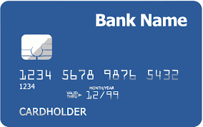
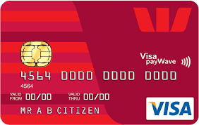
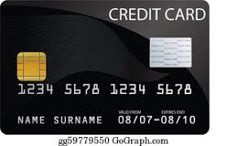
Credits Cards as Tools for Financial Planning
Card #1: Automatic bill payment of recurring monthly expenses (phone, insurance, cable, utilities)
Card #2: Living and discretionary expenses (gas, groceries, coffee, pizza, new shoes)
Card #3: Non-recurring big expenses (vacation, holidays, charity, new refrigerator)
Card #3 frequently has a $0.00 balance

Slide 47
Credits Cards as Tools for Financial Planning
WHY DO I DO THIS?
Mental Budgeting: This helps me mentally be aware of what I’m spending and why I’m spending.
  Instead of just knowing that I’m putting $1,000 on my credit cards in a month, separating the expenses across cards forces me to be aware of what I’m spending money on.
  When I review my statements and budgets at the end of each month, this gives me an easy opportunity to judge myself and to analyze my own behavior.
Card #1: Automatic bill payment of recurring monthly expenses (phone, insurance, cable, utilities)
Card #2: Living and discretionary expenses (gas, groceries, coffee, pizza, new shoes)
Card #3: Non-recurring big expenses (vacation, holidays, charity, new refrigerator)

Slide 48
Credits Cards as Tools for Financial Planning
WHY DO I DO THIS?
FREE MONEY!
  I pay off the full balance of each card each month. If I make a purchase on October 5, the cash does not leave my bank account until December 1.
    It might only be a penny or two, but earning interest during those 57 days feels kind of nice.
  Miles, cash-back and other rewards.
    Choose a card with benefits that you would be paying for anyway. And then cash in the rewards instead of paying cash in the future.
Card #1: Automatic bill payment of recurring monthly expenses (phone, insurance, cable, utilities)
Card #2: Living and discretionary expenses (gas, groceries, coffee, pizza, new shoes)
Card #3: Non-recurring big expenses (vacation, holidays, charity, new refrigerator)

Slide 49
LET’S MAKE THIS PERSONAL…
WHAT IMPACTS YOUR CREDIT RATING AS A CONSUMER?

Slide 50
LET’S MAKE THIS PERSONAL…
WHAT IMPACTS YOUR CREDIT RATING AS A CONSUMER?
35% Payment History – This is perhaps this simplest category, as it looks at how well you repay all borrowed amounts on credit cards, retail accounts, auto loans, utilities and phone bills, other installment loans and other debts. The better you are at repaying, the better your Payment History. Pay your bills on time.

Slide 51
LET’S MAKE THIS PERSONAL…
WHAT IMPACTS YOUR CREDIT RATING AS A CONSUMER?
30% Amounts Owed –The amount you owe is not simply about how much money you owe, but it’s also about how much of your available credit you use. If you have a credit card limit of $5,000 and your balance is $4,000, that’s worse than having a limit of $20,000 and a balance of $10,000. There are many trade-offs within this category and it can be confusing.
Pro-tip if you are using more than 30% of your available balance: Pay it off or down before the end of your reporting cycle and the credit agencies will never know it existed.

Slide 52
LET’S MAKE THIS PERSONAL…
WHAT IMPACTS YOUR CREDIT RATING AS A CONSUMER?
30% Amounts Owed –The amount you owe is not simply about how much money you owe, but it’s also about how much of your available credit you use. If you have a credit card limit of $5,000 and your balance is $4,000, that’s worse than having a limit of $20,000 and a balance of $10,000. There are many trade-offs within this category and it can be confusing.
Pro-tip if you are using more than 30% of your available balance: Pay it off or down before the end of your reporting cycle and the credit agencies will never know it existed.
One thing you can do tomorrow that might improve your credit score:
Ask for a credit limit increase on all of your credit cards or outstanding lines of credit.

Slide 53
LET’S MAKE THIS PERSONAL…
WHAT IMPACTS YOUR CREDIT RATING AS A CONSUMER?
15% Length of Credit History – This is also pretty simple – the longer your history of paying bills and loans, the better off you’ll be. Yes, this does bias against younger borrowers – but if your behavior in the other categories is strong, you should be okay. Be patient – you’ll build your history.

Slide 54
LET’S MAKE THIS PERSONAL…
WHAT IMPACTS YOUR CREDIT RATING AS A CONSUMER?
10% Credit Mix – Perhaps ironically, it can be better to have 5 different accounts that you repay regularly than it is to have just 2 different accounts. The greater the variety of accounts you have, the more opportunity you have to indicate that you are a low credit risk. Of course, if you have 5 accounts and you miss your payments, that will be doubly bad. Pay your bills on time and the Credit Mix will take care of itself.

Slide 55
LET’S MAKE THIS PERSONAL…
WHAT IMPACTS YOUR CREDIT RATING AS A CONSUMER?
10% New Credit – Opening a large number of new accounts in a short period of time may indicate that you are a higher risk. So, is the moral to never open new accounts? No – because then you can never indicate that you are a low risk. Be mindful of opening too many accounts in a short period of time, pay all your bills on time, and the New Credit category will not be a big issue.

Slide 56
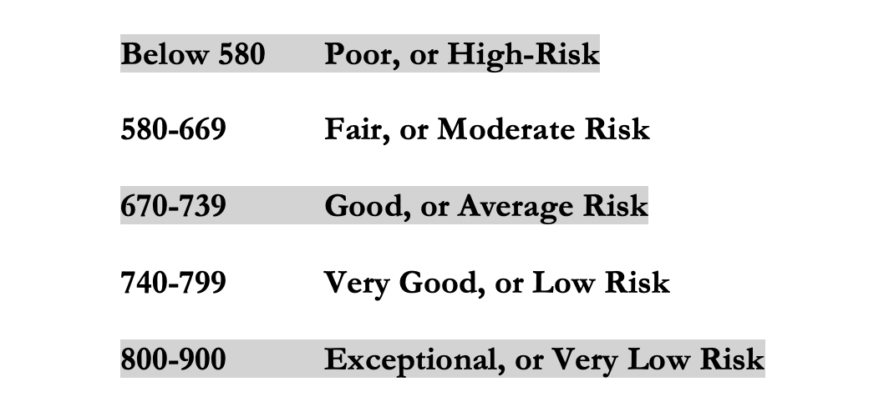
LET’S MAKE THIS PERSONAL…
WHAT IMPACTS YOUR CREDIT RATING AS A CONSUMER?
Your FICO Score will become an actual number: between 250 and 900.
The higher your Score, the lower interest rates you will pay on most loans.
The average FICO Score for Americans is just over 700.
The average in Louisiana is 677, the second lowest in the 50 U.S. states; only Mississippi has a lower average FICO Score.

Slide 57
LET’S MAKE THIS PERSONAL…
WHAT SHOULD YOU BE FOCUSED ON WITH RESPECT TO YOUR CREDIT SCORE?
If your FICO Score is below 600, there are probably 1 or 2 areas where you have significant weaknesses in your history.
Commit to correcting these weaknesses and not creating any new weaknesses.
If your FICO Score is between 600-700, there are probably 1 or 2 areas that can be improved – or where you used to have significant weaknesses.
Keep doing what you’re doing – and commit to not creating any new concerns.
If your FICO Score is over 700, keep doing what you’re doing and time will eventually get you the best score possible.

Slide 58
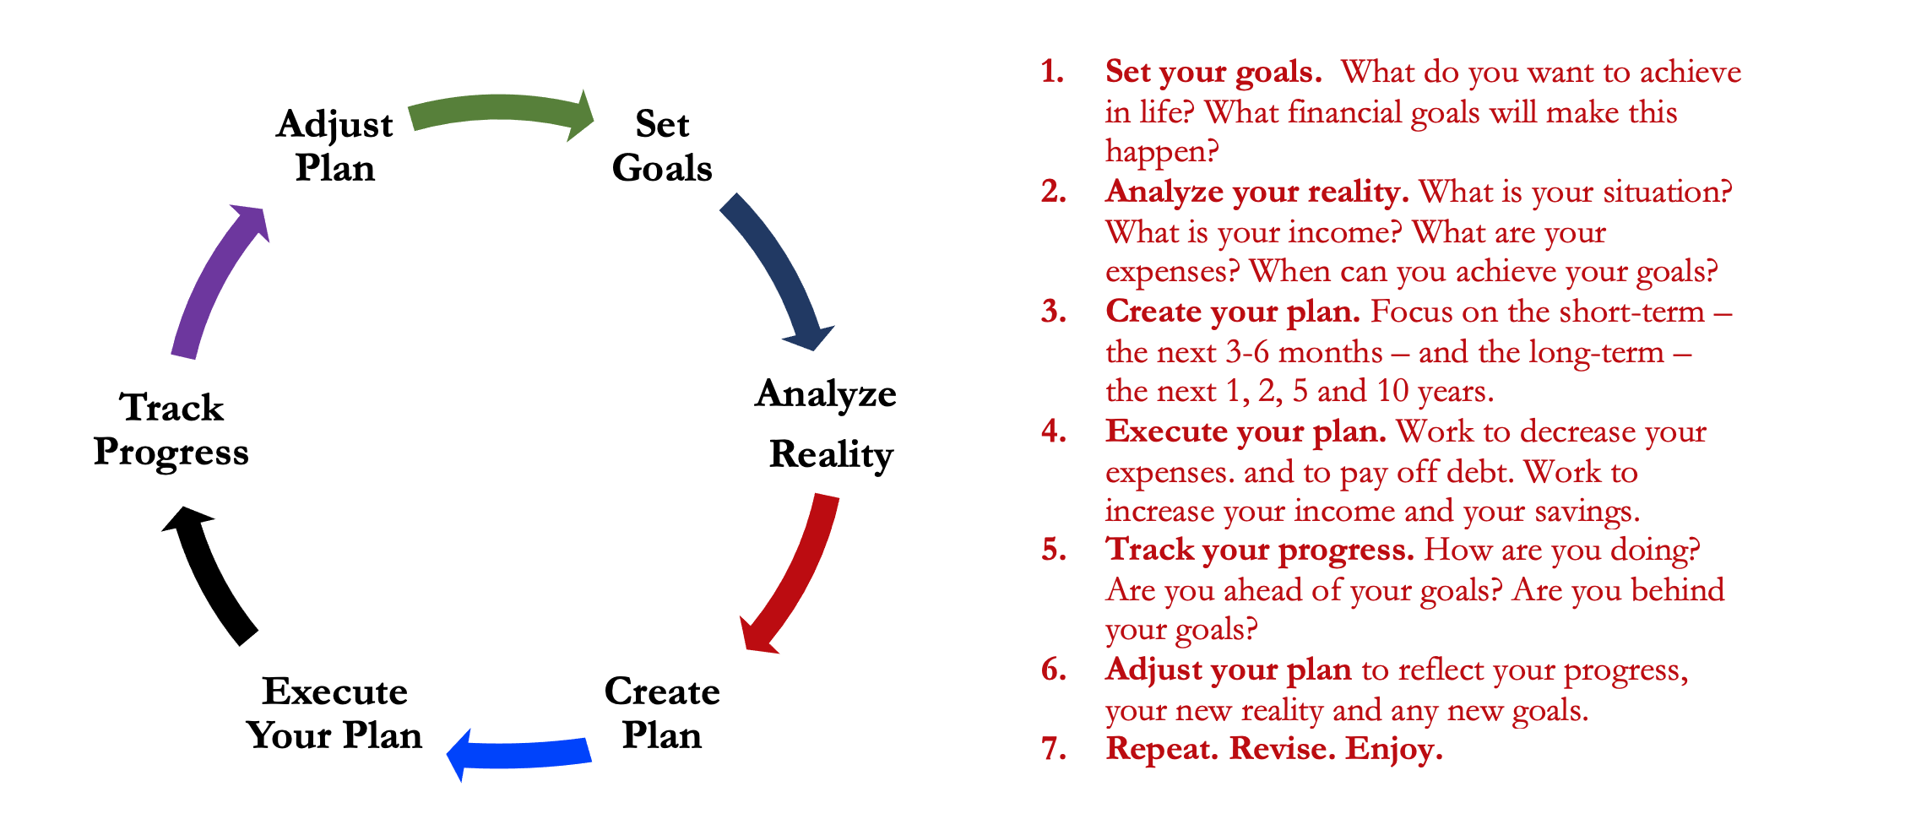
Isn’t this a lot like what you do with your education planning?

Slide 59
And as you begin to develop your full financial plan – seeing the trade-offs with Budgeting, Investing and Debt Management – you will begin to see how interconnected all of these aspects are.
Finance is just a matter of managing money across time.
And one thing we know about time is that our plans will change – so the better you have control of your initial financial plan, the more you will be able to adjust when life and time give you new goals.
Isn’t this a lot like what you do with your education planning?

Slide 60
You cannot escape the responsibility
of tomorrow by avoiding it today.

Slide 61
5 Things You Can Do To Reduce Your Taxes
Open an Individual Retirement Account or Roth IRA
  You can defer income tax and avoid capital gains tax altogether
Talk to HR and reduce your tax withholding
  If you get a refund, you are loaning your income to the government
Cluster your income so you make less than $14,600 in a year
  If possible, shift income between years to get the maximum deduction
Scan tax code and identify 3-5 deductions & credits you qualify for
  Child tax credit, education expenses (tuition, books…), student loan interest, charitable deductions, small business or hobby-related expenses
Get rid of your income

Slide 62
The 3 Legal Ways to Avoid Taxes
(Avoiding Taxes is Legal & Good; Evading Taxes is Not Legal)
RETIREMENT INVESTING
Contributing to an IRA or 401(k) can defer income tax and avoid capital gains taxes
HEALTH CARE EXPENSES
Ordinary expenses are tax deductible & contributing to an HSA o FSA avoids income and capital gain taxes
EDUCATION EXPENSES
Some ordinary expenses are tax deductible & contributing to a 529 account avoids capital gain taxes

Slide 63
4 Frequently Asked Questions – TAXES
Gross Salary & Wages
Less: Medical Expenses
Less: Student Loan Interest paid
Less: Contributions to Retirement Accounts
Adjusted Gross Income
Less: Standard Deduction or Itemized Deduction
Taxable Income
x Tax Rate .
Gross Taxes Owed
Less: Tax Credits .
Taxes Owed
“Above-the-Line” Deductions.
We like these because they reduce “Adjusted Gross Income” and you also get another deduction “below-the-line”
Standard Deduction = $14,600 for 2024
(or $29,200 for married-filing-jointly)
Everyone gets this deduction / subtraction, at least. Some will “itemize” certain deductions to get an even larger subtraction
Credits are wonderful → The reduce the taxes owed, dollar-for-dollar
But not everyone will have credits. They are for specific situations (see previous slide), but do a little homework to see if any apply to you.

Slide 64
2 More Frequently Asked Questions
Should we file taxes as Married Filing Jointly or Separately?
It depends.
It will be different for each family…and it may be different for each year.
  Both spouses are NOT allowed to take the same deductions & credits on their own returns.
  You want to be strategic and do the math to see where your combined tax liability is lowest.
  Perhaps you file separately and the higher-income spouse claims all of the deductions & credits to reduce their income the most.
  If there is a big difference in your incomes, you may be able to strategically lower your tax liability by filing individually (in theory). Look at both options and choose the better one (this year).
  A couple examples:
    The IRS allows us to have professional tax preparation if our income is less than $73,000, regardless of how you file.
    If you are working but your spouse is not, you can open an IRA for them since they cannot…but only if you file MFJ.
  “Head of Household” filing status is generally the most favorable status…but it is a legal status, it is not a description. It is generally reserved for single parents who provide >50% of dependent care.

Slide 65
2 More Frequently Asked Questions
Speaking of taxes, what are some tax benefits for families?
There are lots – each family can probably identify 3-10 benefits for them.
  The 2017 tax cuts eliminated the ability to claim a deduction for each dependent…but there are still credits and deductions available.
  The child tax credit – possibly $2,000 credit for each child.
  The dependent care credit – not exclusive to children.
  The adoption credit – can receive up to $14,000+ credit for all adoption-related expenses.
  The earned-income tax credit – available for low-income taxpayers.
  Medical expenses for having a baby may be an above-the-line deduction.
  Education credits & deductions…including the American Opportunity Tax Credit, the Lifetime Learning Credit, and deductions for student loan interest.
  As your family grows, your benefits grow…so talk to Human Resources an reduce your tax withholding.
  With all of the above, there are limitations and rules. Read the fine print.

Slide 66

How To Calculate Your Withholding
Go to the IRS calculator: https://apps.irs.gov/app/tax-withholding-estimator
This will help you determine how much Human
Resources should be taking out of your paycheck
each month.
This is ultimately up to you – but HR has a legal
obligation to the IRS to withhold estimated taxes
from your paycheck, if appropriate.
This calculator can guide you to the proper amount
of withholding – so you do not overpay taxes and
so you do not underpay and incur penalties.

Slide 67
One More Way to Possibly Avoid Taxes or to At Least Be More Efficient With Your Tax Obligations
REGISTER YOUR OWN BUSINESS IF YOU HAVE ANY CONSULTING, TUTORING, SIDE-HUSTLE OR ENTREPRENEURIAL ACTIVITIES
With your personal or family tax returns, the IRS doesn’t care about your expenses. The IRS doesn’t care how much you spend on rent, food, utilities or transportation.
You get the Standard Deduction and that’s it ($14,600 or $29,200).
With a business tax return, every business expense you incur becomes a legitimate tax deduction. You do not get a Standard Deduction, but every penny of expenses for your business will lower your taxable income.
And, there are opportunities to obtain business tax deductions when you use personal assets (like your car or home).
Note – If you do not have business income and you are recognizing business expenses for tax deduction purposes, that is fraud. Do not do that.

Slide 68
Owning Your Financial Future
Question #1
What are you going to be doing in 2030?
Will you be in graduate school? If so, what are you studying?
Are you working? If so, what is your job?
Where do you live? Who do you live with?
How do you spend your free time?

Slide 69
Owning Your Financial Future
Question #2
What are the 3 most expensive things you plan on buying in the next 10 years.
For now, exclude your undergraduate education.
But if you’re planning on graduate school, do include that.
Or maybe it’s a house, a car, a vacation, a baby, a new pair of shoes. Anything.

Slide 70
Owning Your Financial Future
Question #2
What are the 3 most expensive things you plan on buying in the next 10 years.
We do these thought exercises to begin thinking about how we might make it happen. Yes, we are just making things up in our responses – but that’s where planning begins.
For most of us, owing our financial futures begins with identifying our goals and designing a plan to achieve those goals.

Slide 71
Owning Your Financial Future
Question #3
What are your financial goals?
  What financial goals do you want to achieve in the next 3 months?
  What financial goals do you want to achieve in the next 12 months?
  What financial goals do you want to achieve in the next 3 years?

Slide 72
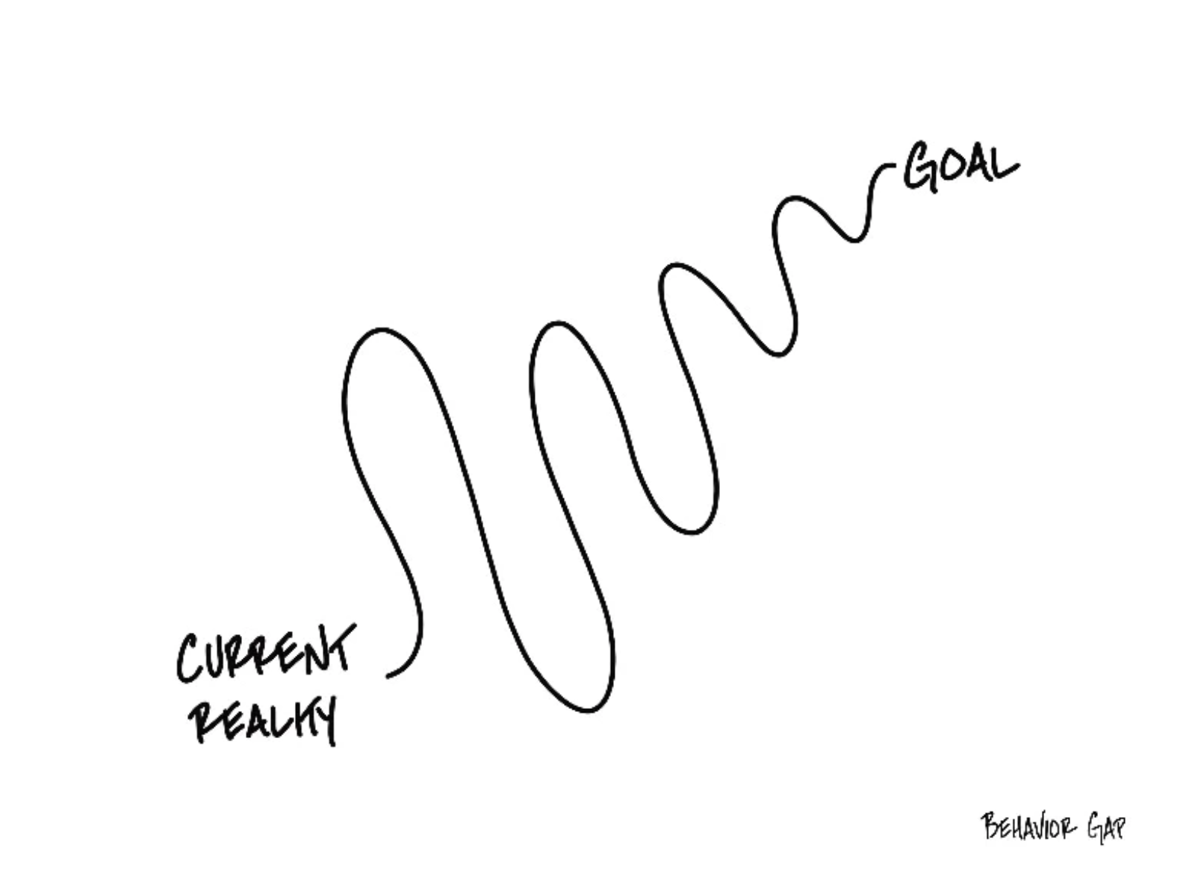

Slide 73
Financial Planning for the New School Year
5 Things Everyone Should Do:
BUDGET!
  Make shopping lists…for all types of shopping: food, gifts, fun, weekends.
  Make lists of what you ARE NOT going to buy…for all types of shopping.

Slide 74
Financial Planning for the New School Year
5 Things Everyone Should Do:
BE VERY CAREFUL ABOUT INCREASING DEBT
  Avoid increasing balances on credit card
  Maybe only use credit cards for groceries and gas and use a debt card for everything else.

Slide 75
Financial Planning for the New School Year
5 Things Everyone Should Do:
GET RID OF AT LEAST 1 SUBSCRIPTION
  Review your expenses and find any/all recurring subscriptions
  Find at least 1 to get rid of before the year end
  And make sure you do not add any that you are not going to use or get your money’s worth

Slide 76
Financial Planning for the New School Year
5 Things Everyone Should Do:
LOOK FOR DEALS…BUT ALSO BE WARY OF DEALS
  By shopping early and shopping around, you can find the best deals for what you need to buy
  But be careful – many deals will have fine print that commits you to further costs or to other constraints that are not in your best interest

Slide 77
Financial Planning for the New School Year
5 Things Everyone Should Do:
SET 5 RESOLUTIONS THAT YOU CAN STICK WITH
  Check your credit report and credit score, open multiple savings accounts, pay yourself first with $5-$25 of every paycheck going to savings, analyze every penny you spend during 3-5 months in 2024, find a budget approach that works for you, set financial goals for the next 3-5 years, finalize your back-to-school spring 2024 budget, begin investing, pay down any high-interest debt (even before savings), do not dine out or go grocery shopping in January, maximize credit card rewards

Slide 78
Some Homework for You
Think about why you are in college.
Make a list of the 5-10 most important criteria you are looking for in a job or career.
Connect these criteria to your long-term and
short-term goals. Connect these criteria to your values.
(And if you don’t know what your values are, take 30 minutes to identify them and commit to them.)

Slide 79
More Homework for You
Once a week: Make a list of the money you are
going to spend this week.
Once a month: Make a list of how college – and your
future job – serves your values over the
long-term.
Once a year: Revisit your values and identify
your short- and long-term goals.

Slide 80
Long-Term Investment Planning
YOUR VALUES
YOUR GOALS
FINANCIAL STRATEGIES
INVESTMENT STRATEGIES
Identify Your Risk Tolerance
Identify Your Time Horizons
Select Investments
Monitor & Modify Investments

Slide 81
Long-Term Investment Planning
FINANCIAL STRATEGIES
INVESTMENT STRATEGIES
Identify Your Risk Tolerance
Identify Your Time Horizons
Select Investments
Monitor & Modify Investments

Slide 82
Long-Term Investment Planning
FINANCIAL GOALS
EDUCATION GOALS
INVESTMENT STRATEGIES
EDUCATION STRATEGIES
Identify Your Risk Tolerance & Priorities
Identify Your Risk Tolerance & Priorities
Identify Your Time Horizons
Identify Your Time Horizons
Select Investments
Select Your Field, Program, Specialization, Thesis
Monitor & Modify Investments
Monitor & Modify Your Progress & Plan

Slide 83
Isn’t this a lot like what you do with your education planning?

Slide 84
Long-Term Investment Planning
FINANCIAL GOALS
YOU,
as college students, are better wired and equipped to make long-term plans – education, career, financial & otherwise – than 99% of humanity.
Be confident.
Be intentional.
Be diligent.
Be awesome.
EDUCATION GOALS
INVESTMENT STRATEGIES
EDUCATION STRATEGIES
Identify Your Risk Tolerance & Priorities
Identify Your Risk Tolerance & Priorities
Identify Your Time Horizons
Identify Your Time Horizons
Select Investments
Select Your Field, Program, Specialization, Thesis
Monitor & Modify Investments
Monitor & Modify Your Progress & Plan

Slide 85
Owning Your Financial Future
YOUR VALUES
YOUR GOALS
Education
Career
Family
FINANCIAL STRATEGIES
Investing
Income & Expense Management
Debt Management
Taxes, Insurance & Other

Slide 86
What is INVESTING?
Investing is saving for the future.
We typically think of investing as long-term – anywhere from 1 or 2 years all the way through retirement.
Saving vs. Investing
  Saving can be short-term, Investing is typically long-term.
  Saving is passive, Investing is dedicated…it could be relatively passive or extremely active.
    Passive: Mutual funds. Extremely Active: Owning an apartment complex.
  Saving is typically very low risk, Investing generally has more risk.
  Saving provides low returns on investment (currently about 0.0%)
  Inflation is risky…You can lose 100% or realize huge positive returns.

Slide 87
What Is Your Investing Goal?
Take a few seconds to ask yourself:
Why Are You Investing?
What are your investing goals?
To buy a house?
To buy a car?
To pay off debt?
To retire?

Slide 88
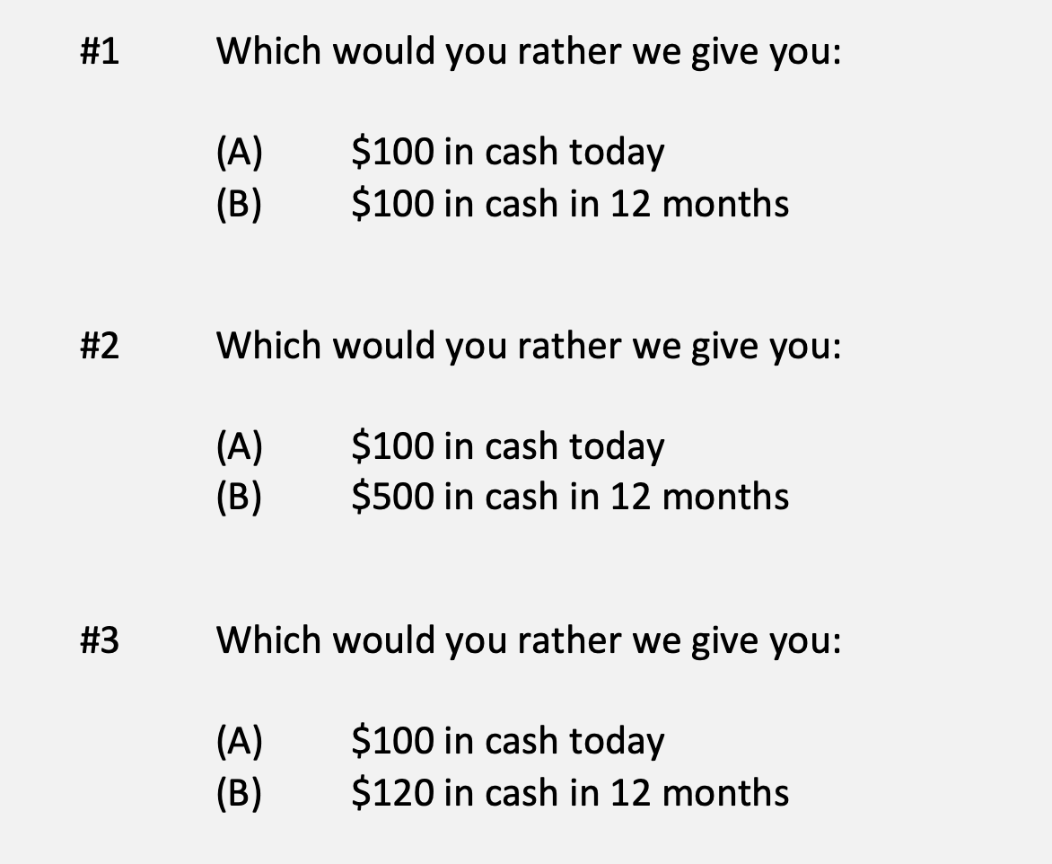
A Few Rules About INVESTING
Investing is about Trade-Offs. Using money today to get (hopefully more) money in the future:

Slide 89
A Few Rules About INVESTING
Risk matters. Know your risk tolerance.
Goals matter. Be intentional about what you are saving for.
  Maybe create 3-5 different investment accounts for different goals.
  This is what I do – I’ll show you why in a bit.
Transaction costs matter. You can pay a lot of fees for not much benefit or service. Be careful.
Experts rarely have tips or secrets. Investing is about predicting the future, and none of us can predict the future (perfectly). Be careful.
  If there really were sure-things or get-rich-quick schemes, the experts would be using them themselves, not sharing them with you.
Communicate with your family. Achieving goals is a family affair.

Slide 90
A Few Rules About INVESTING
Investing lets COMPOUND INTEREST be your friend.
  With compound interest, your interest earns interest.
  Without actively making decisions, your money can grow exponentially.
  Yes, there is risk – the exponential growth rate could be negative.
  Such risk is greatest if you ‘invest’ over very short periods of time.
  Historically, over the past 100+ years, if you invest for 5+ years, you have benefited from positive exponential growth.
  The average return of a common stock over the past 100 years is 10%.
    The word ’average’ is very important here. But, the good news, we can all achieve ‘average’ returns relatively easily (though they may not be 10% in the future)

Slide 91
A Few Rules About INVESTING
Investing lets COMPOUND INTEREST be your friend.
  Invest $100 at 10% interest or growth:
  Year 1: $100 x (1 + 10%) = $110
  Year 2: $110 x (1 + 10%) = $121
  $100 x (1 + 10%)² = $121
  Year 1: $10 of interest
  Year 2: $10 of interest on your original $100
  + $1 of interest on year 1 interest

Slide 92
Expertise Matters
Take a minute to think about the following question:
What do YOU do better than 99.9% of humanity?
Think about what you’re studying. Think about what you’ve been working on for years. Think about what you know that I do not know.
I’ve probably only spent 1-2 hours studying what you have dedicated your life to studying and becoming an expert in.
  Could I do your job as well as you do it?

Slide 93
Expertise Matters
Of course, I couldn’t do your job as well as you.
Now connect this logic to investing: there are many professionals who have dedicated their lives to making investments. They are good.
  Yes, there are many amateurs involved in trading stocks – but they (usually) account for a very minor portion of the total money invested.
Remind yourself of this old gambling maxim:
When you are sitting at the poker or gambling table, take a look around and see if you can figure out who the sucker is. If you cannot identify who the sucker is, then the sucker is probably you.

Slide 94
Isn’t this a lot like what you do with your education planning?

Slide 95
Determining Your Risk Tolerance
High Risk Attitude
I want to summer in Paris and winter in Hawaii
Medium-High Risk Attitude
I will work through normal retirement age, but I want my spouse to retire early - and we want to visit Paris & Hawaii
Medium-Low Risk Attitude
I want my children to have a college education
Low Risk Attitude
I want food on the table and a roof over my head

Slide 96
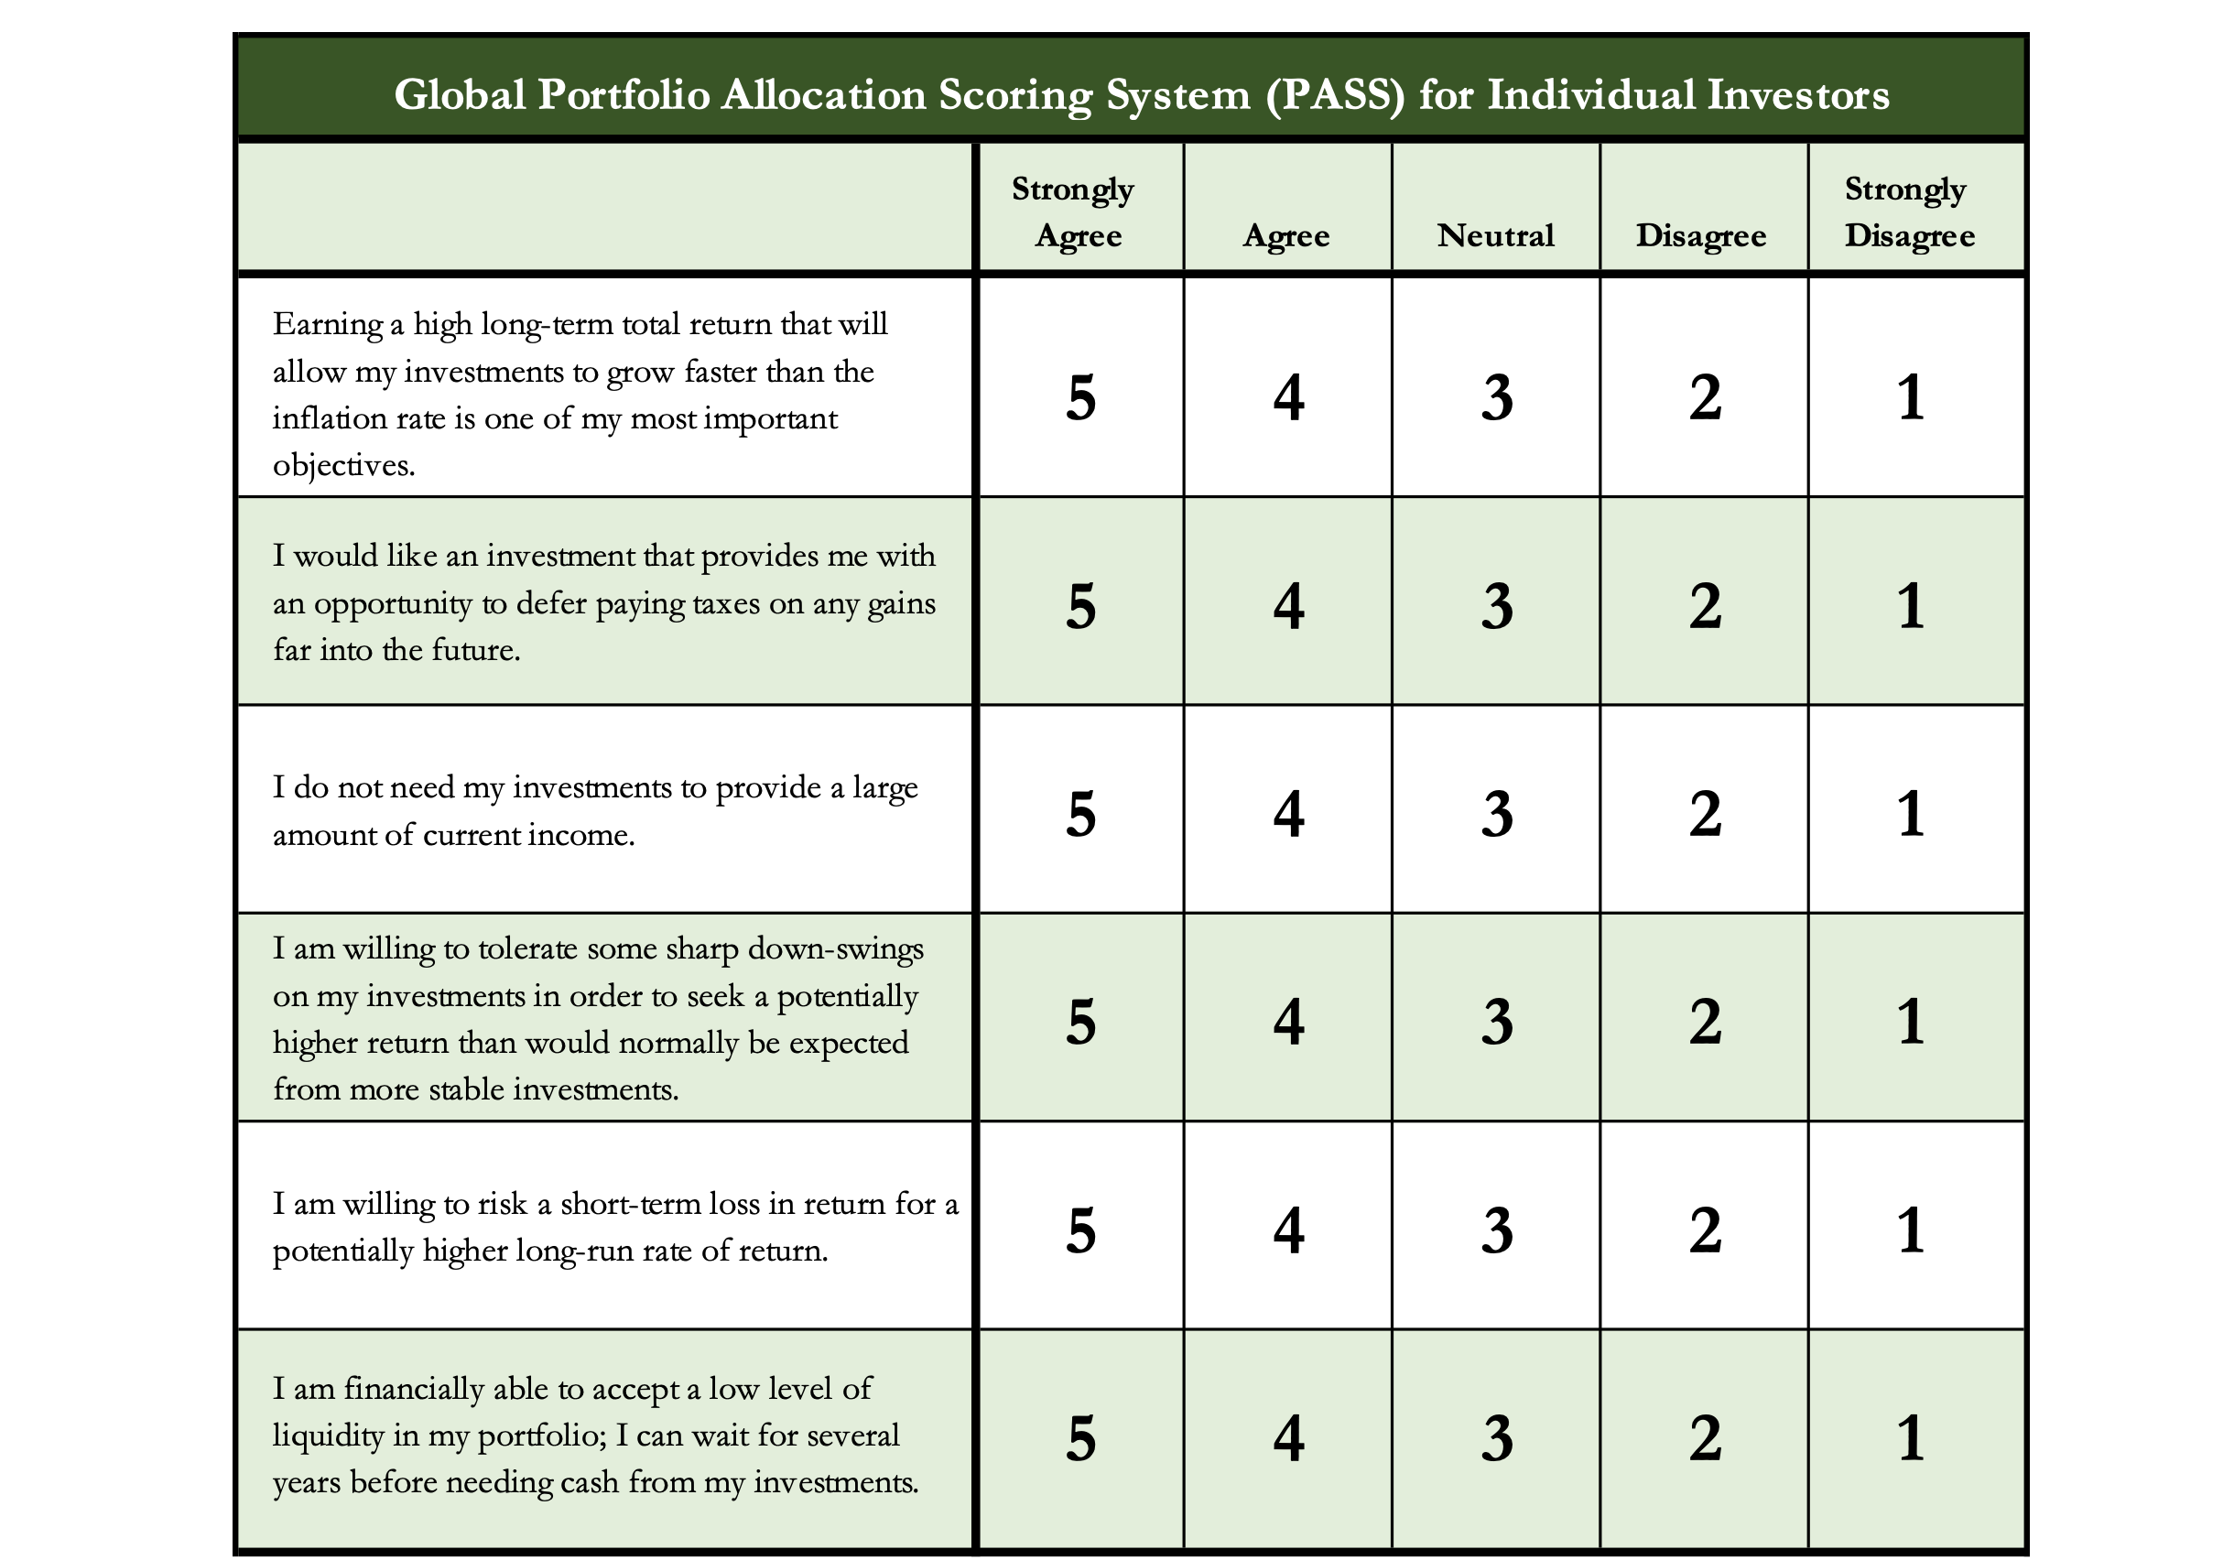
Determining Your Risk Tolerance

Slide 97
Comparing Different Investments

Slide 98
Comparing Different Investments

Slide 99
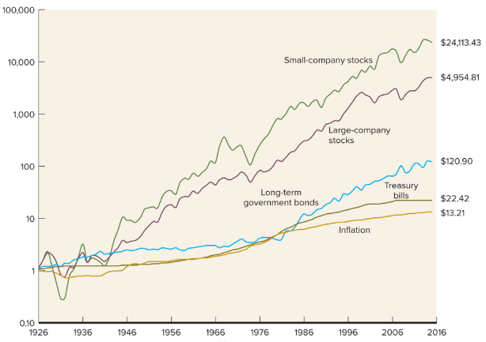
Comparing Different Investments

Slide 100
The Magic of Compound Returns

Slide 101
The Magic of Compound Returns

Slide 102
The Magic of Compound Returns
Quiz Question on Compound Returns:
Under which of the following scenarios will you have more money saved when you turn 65?
Investing $100 per month from age 25-35 (and then nothing from 35-65)
With an 8% return, you will have $185,000 accumulated at 65.
Investing $100 per month from age 35-65 (but nothing from 25-35)
With an 8% return, you will have $150,000 accumulated at 65.
Note: If the returns on your investments are less than 6%, (B) will lead to greater wealth.
There’s a similar but different problem on page 37 of your handbook.

Slide 103
The Magic of Compound Returns
Quiz Question on Compound Returns:
Under which of the following scenarios will you have more money saved when you turn 65?
Investing $100 per month from age 25-35 (and then nothing from 35-65)
With an 8% return, you will have $185,000 accumulated at 65.
Investing $100 per month from age 35-65 (but nothing from 25-35)
With an 8% return, you will have $150,000 accumulated at 65.
Note: If the returns on your investments are less than 6%, (B) will lead to greater wealth.
There’s a similar but different problem on page 37 of your handbook.

Slide 104
Review: A Few Rules About INVESTING
Investing lets COMPOUND INTEREST be your friend.
  With compound interest, your interest earns interest.
  Without actively making decisions, your money can grow exponentially.
  Yes, there is risk – the exponential growth rate could be negative.
  Such risk is greatest if you ‘invest’ over very short periods of time.
  Historically, over the past 100+ years, if you invest for 5+ years, you have benefited from positive exponential growth.
  The average return of a common stock over the past 100 years is 10%.
    The word ’average’ is very important here. But, the good news, we can all achieve ‘average’ returns relatively easily (though they may not be 10% in the future)

Slide 105
Review: A Few Rules About INVESTING
Investing lets COMPOUND INTEREST be your friend.
  With compound interest, your interest earns interest.
  Without actively making decisions, your money can grow exponentially.
  Yes, there is risk – the exponential growth rate could be negative.
  Such risk is greatest if you ‘invest’ over very short periods of time.
  Historically, over the past 100+ years, if you invest for 5+ years, you have benefited from positive exponential growth.
  The average return of a common stock over the past 100 years is 10%.
    The word ’average’ is very important here. But, the good news, we can all achieve ‘average’ returns relatively easily (though they may not be 10% in the future)
Not to be too esoteric or philosophical…
But compound interest doesn’t just apply to investing.
Compound interest applies to all aspects of college life:
Time Management
Mental Health
Health Management
Writing Skills
Relationships
And…Of course, Money Management

Slide 106
Investing – Some Perspective
I am biased because I am a finance professor. I study investing and I teach investing. My perspective on risk may be meaningless to you.
Do not take my advice on what level of risk you should take. Be thoughtful, be prudent.
Avoid doing things that you know are stupid and that you know will cause you stress.
But don’t be afraid of taking risks just because they scare you. You have already taken many, many risks in your life. Taking informed and measured risks will continue to open many doors and opportunities for you – in both your personal and financial lives.

Slide 107
A Few Opening Morals
SAVINGS
INVESTING
OWNERSHIP
WEALTH

Slide 108
Common Questions about Investing & Saving
How can I save when my income is so low as a student?
My problem isn’t budgeting but it’s having too little income.
Your short-term priorities while in grad school need to be your education, your family and your mental health.
Maybe saving cannot be a priority for you while you’re in school.
The goal is to develop habits and a mindset that will prepare you to maximize the benefits of saving when your income allows you to do so. Be patient. The benefits of good habits will grow exponentially.

Slide 109
Common Questions about Investing & Saving
How can I save when my income is so low as a student?
My problem isn’t budgeting but it’s having too little income.
And think of ways to generate more money: gigs, internships, tutor, lab assistant, freelance positions, blogger, podcasts, consulting
  Create new jobs for yourself: maybe sell your skills in social media marketing
  to a company you want to work for, regardless of your program
A lot of the advice we think of in budgeting is about “reducing expenses.”
And that’s because we generally have more control over our expenses than we do over our income, at least in the short-term. Do what you can.
  And, decreasing expenses can feel like an increase income. Same same.

Slide 110
Common Questions about Investing & Saving
How much of my income should I be saving each month?
Only you can answer this. Nobody can answer it for you.
It depends on:
  What your goals are, both short- and medium-term.
  What your immediate expenses are.
I frequently advise students to save $25 of every paycheck as soon as they receive each paycheck. Save or set aside as much as you can.
  When I was getting my Master degree, I had no income. I was living off a little savings and a lot of debt. But I intentionally saved $10 to $25 on the first day of each month…simply to develop the habit.
  In school, the habit is more important than the amount.

Slide 111
Common Questions about Investing & Saving
How much of my income should I be saving each month?
My challenge to you:
Take $10 of every paycheck and move it into a savings account.
If you can save more, do it.
But at a minimum, save $10 of every paycheck to develop the habit.
My advanced challenge to you:
Take half of what you save each month and invest it in the stock market.

Slide 112
Common Questions about Investing & Saving
How do I save for a big purchase – house, car, etc…?
Stary by asking yourself a few questions:
  How much do I need to save?
  When am I going to make this purchase?
  Is this essential or discretionary? (A refrigerator or car vs. a vacation)
These questions will help identify timing and priority.
  Knowing timing & priority will help determine how you save.
    Do you use a bank savings account or do you have time to invest in the stock market?

Slide 113
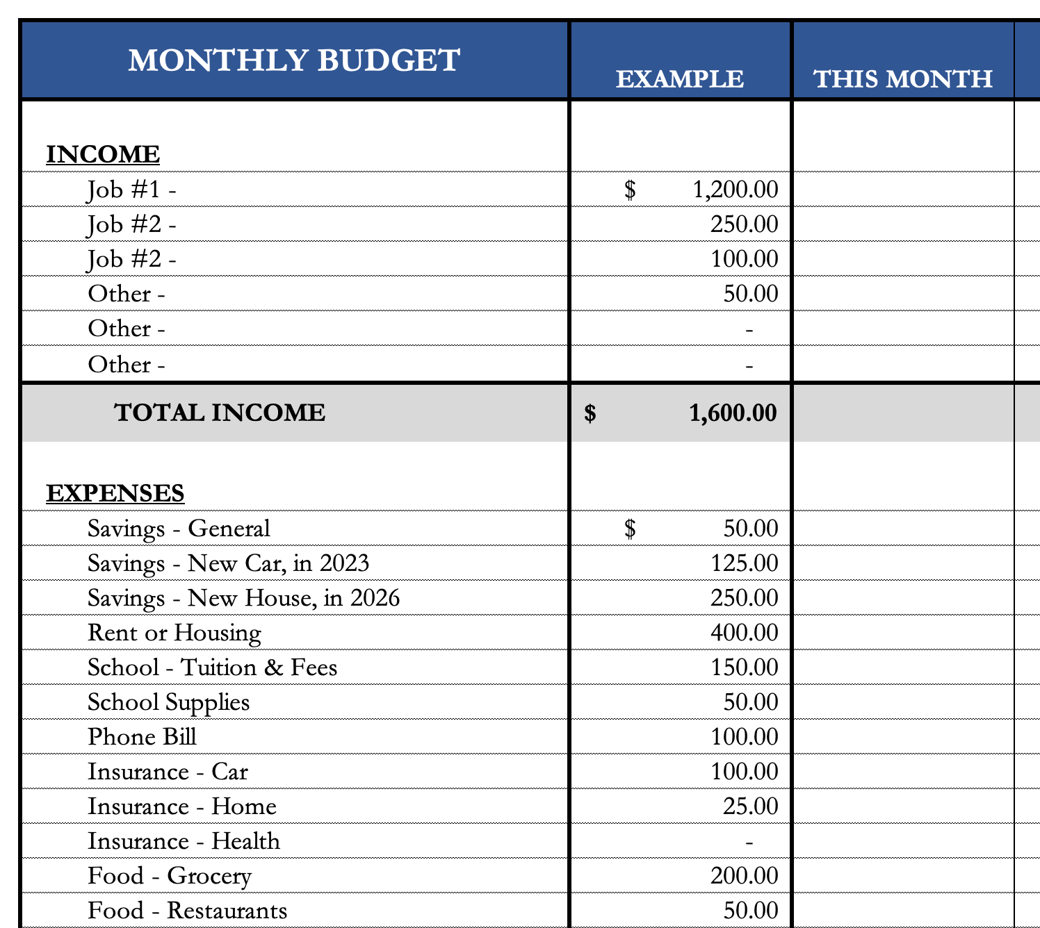
Common Questions about Investing & Saving
How do I save for a big purchase – house, car, etc…?
I would explicitly allocate some of my monthly
savings to this purchase.
  I have already penciled in my holiday gift purchases –
  even though I won’t make them for 2 months.
We will talk about my 5 buckets for saving-
investing in a few slides.
If it’s a really big purchase (e.g. house), you
could even set up a dedicated saving or
investing account just for that purchase.

Slide 114
Common Questions about Investing & Saving
How do I save for a big purchase – house, car, etc…?
I would explicitly allocate some of my monthly
savings to this purchase.
  I have already penciled in my holiday gift purchases –
  even though I won’t make them for 2 months.
We will talk about my 5 buckets for saving-
investing in a few slides.
If it’s a really big purchase (e.g. house), you
could even set up a dedicated saving or
investing account just for that purchase.
These budgeting templates are in the handbook on pages 24-25.
You can download them from the MCOBA website, search for “Personal Financial Planning.”
Or you can email me and I will send them to you.

Slide 115
Common Questions about Investing & Saving
How much of my income should I be investing each month?
Again, only you can answer this. Nobody can answer this for you.
Your goals, values and resources are unique to you…and only you.
You may read reports about how much you should have saved by a certain age or whatever.
  It’s okay to read those, but be sure to put them into your own perspective.
  Those articles do not know what your goals are, do not know that you are in graduate school and do not know what your future plans are.
  It is important to have a plan – but it is critical that that plan is unique to you and your situation.

Slide 116
Some Parting Words
Nothing in finance is free. Do not think some institution is giving you a super deal just because they like you. There will be costs.
Investment companies work really hard to get your money. They hire psychologists to figure out how to get you addicted to your products. Your money pays for their commercials, buildings, fancy cars and vacation homes.
I check my bank, savings & investment accounts daily. I do not make changes daily (or even monthly). I just don’t want any surprises.

Slide 117
Isn’t this a lot like what you do with your education planning?

Slide 118
Happiness
Long-Term Goals
Short-Term Goals
Financial Needs
Family Needs

Slide 119
Financial Wellness
A goal without a plan is just a dream.
Wealth is largely the result of habit.
The most difficult thing is the decision to act; the rest is mere tenacity.
It takes as much energy to plan as it does to wish.
You cannot escape the responsibility of tomorrow by avoiding it today.

Slide 120
Don’t wait around for other people to be happy for you.
Any happiness you get,
You’ve got to make yourself.
~ Alice Walker, poet & novelist
A goal without a plan is just a dream.
Wealth is largely the result of habit.
The most difficult thing is the decision to act; the rest is mere tenacity.
It takes as much energy to plan as it does to wish.
You cannot escape the responsibility of tomorrow by avoiding it today.

Slide 121
brian.bolton@louisiana.edu http//:business.louisiana.edu/financeispersonal

