Slide 1

STUDENT SUPPORT SERVICES
FINANCIAL WELLNESS SERIES 2025
Session #1
Financial Resolutions for the New Year
February 19, 2025

Slide 2
Brian Bolton
Professor of Finance brian.bolton@louisiana.edu https://business.louisiana.edu/financeispersonal

Slide 3
Financial Wellness
If you don’t know where you’ve come from, you can’t know where you’re going.
- Maya Angelou

Slide 4
I believe that your college degree is the best investment you can ever make.
But it is very expensive – in terms of money, time, energy and opportunity costs.
Take a minute to think about all of the costs involved in getting your degree…

Slide 5
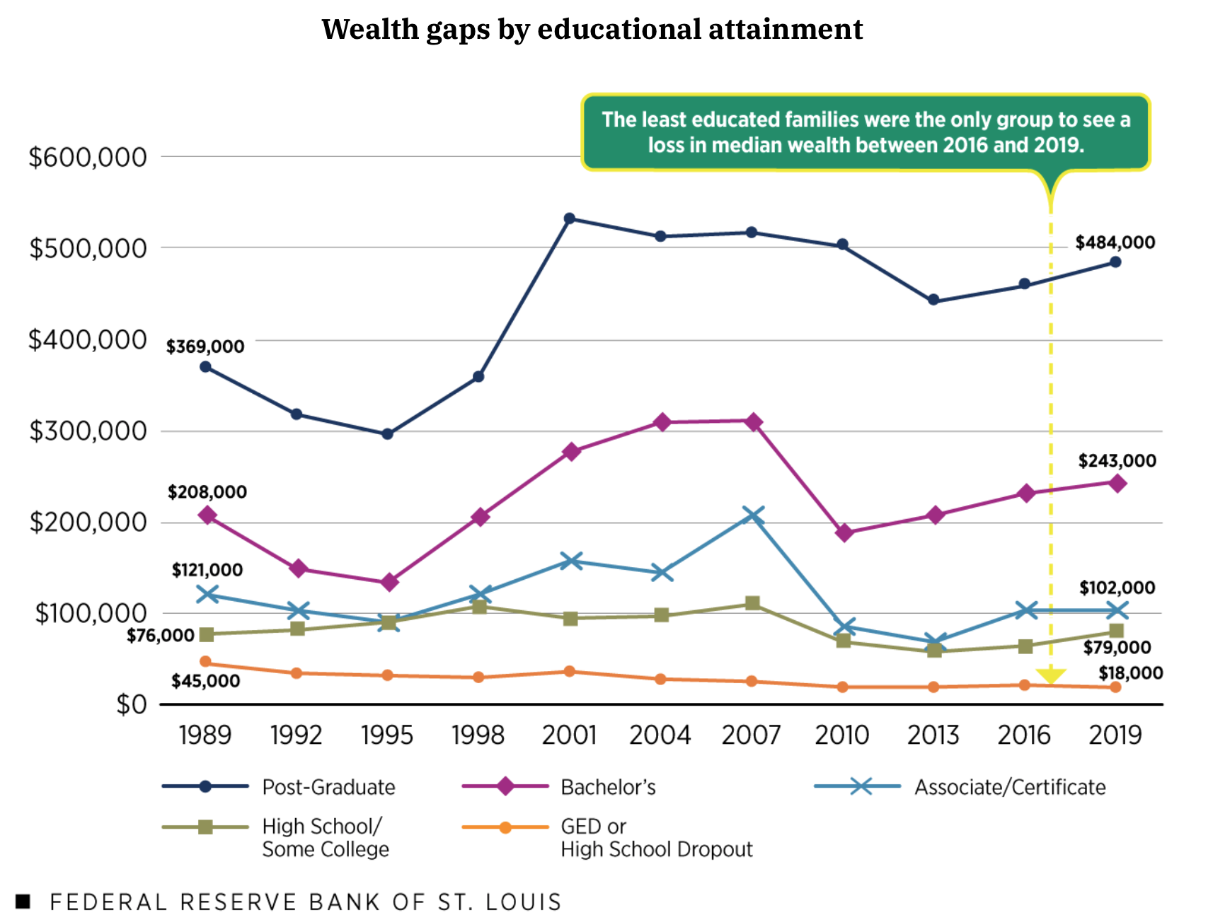
THE WEALTH GAP
IN THE
USA

Slide 6
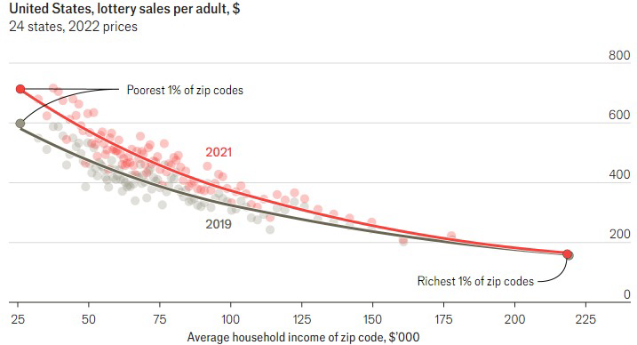

Slide 8
A Few Opening Morals
Personal Finance is…personal.
It’s about you and not about anyone else.
You have to make it about you and your goals.

Slide 9
A Few Opening Morals
There is no judgment in personal finance.
There is no ego in personal finance.
There is no shame in personal finance.
It’s about you and not about anyone else.

Slide 10
A Few Opening Morals
Because personal finance is personal, it is virtually impossible for me to give you any specific advice.
However, there is one word of advice that applies to 99% of people working on their finances:
SAVE

Slide 11
A Few Opening Morals
SAVINGS
INVESTING
OWNERSHIP
WEALTH

Slide 12
Financial Wellness
Becoming an owner allows you to be the architect of your own future.
- Leigha Porter
Entrepreneur, Dancer, Choreographer, Founder of the Creole Nutcracker, PARC Village
and FIRE Expressions Conservatory, UL Lafayette grad, Northside High School grad

Slide 13
Financial Wellness
A goal without a plan
Is just a dream.
~ Antoine de Saint-Exupéry

Slide 14
Let’s Do Some Fake Investing!
Which of these company stocks has performed the best over the past 5 years?
Apple
Disney
Google
JP Morgan Chase
McDonald’s
Microsoft
Nike
Pfizer
Visa
Walmart

Slide 15
Owning Your Financial Future
What Are Your Values, Dreams & Goals?
Education
Career
Family
What Is Your Current Situation?
Education
Career
Family
Financial
Create a Personal Financial Plan for You:
Investing
Budgeting
Debt Management
Taxes
Insurance
Retirement
Education
Family
Business Planning
Estate Planning
Philanthropy

Slide 16
Opening Quiz – Question #1
If you had invested $1,000 in the S&P 500 at the beginning of 2022
(3+ years years ago), how much would that $1,000 be worth today?
A. $775
B. $1,000
C. $1,581
D. $4,043

Slide 17
Opening Quiz – Question #1
If you had invested $1,000 in the S&P 500 at the beginning of 2022
(3+ years years ago), how much would that $1,000 be worth today?
A. $775
B. $1,000
$1,581
(that’s a 13.2% annual return)
D. $4,043

Slide 18
Opening Quiz – Question #2
If you had invested $1,000 in the S&P 500 at the beginning of 2015
(10+ years ago), how much would that $1,000 be worth today?
A. $775
B. $1,000
C. $1,581
D. $4,043

Slide 19
Opening Quiz – Question #2
If you had invested $1,000 in the S&P 500 at the beginning of 2015
(10+ years ago), how much would that $1,000 be worth today?
A. $775
B. $1,000
C. $1,581
D. $4,043
(that’s a 13.9% annual return)

Slide 20
Opening Quiz – Question #3
Which of these 4 countries currently
has the lowest inflation rate?
United States
England
Germany
Mexico

Slide 21
Opening Quiz – Question #3
Which of these 4 countries currently
has the lowest inflation rate?
United States
England
Germany
Mexico

Slide 22
Opening Quiz – Question #4
Which of these 4 countries
currently has the HIGHEST inflation rate?
United States
England
Germany
Mexico

Slide 23
Opening Quiz – Question #4
Which of these 4 countries
currently has the HIGHEST inflation rate?
United States (3.0%)
England (3.0%)
Germany (2.3%)
Mexico (3.6%)

Slide 24
Opening Quiz – Question #5
If you sold cookies out of your apartment during 2024, received
made $500 from those sales, and spent $200 making those cookies,
what do you owe taxes on?
$500
$300
$200
$0

Slide 25
Opening Quiz – Question #5
If you sold cookies out of your apartment during 2024, received
made $500 from those sales, and spent $200 making those cookies,
what do you owe taxes on?
$500
$300
$200
$0

Slide 26
Opening Quiz – Question #6
If you sold cookies out of your apartment during 2024, received
made $500 from those sales, and spent $700 making those cookies,
what do you owe taxes on?
$500
$700
$0
You get a refund
for the $200 loss

Slide 27
Opening Quiz – Question #6
If you sold cookies out of your apartment during 2024, received
made $500 from those sales, and spent $700 making those cookies,
what do you owe taxes on?
$500
$700
$0
You get a refund
for the $200 loss

Slide 28
Opening Quiz – Question #7
If you earned $14,500 of income in 2024,
which of the following applies to you:
You owe taxes on the entire $14,500.
It depends on whether someone else claims you as a dependent.
You do not owe any taxes and you do not have to file a tax return.
You do not owe any taxes but you have to file a tax return.

Slide 29
Opening Quiz – Question #7
If you earned $14,500 of income in 2024,
which of the following applies to you:
You owe taxes on the entire $14,500.
It depends on whether someone else claims you as a dependent.
You do not owe any taxes and you do not have to file a tax return.
You do not owe any taxes but you have to file a tax return.

Slide 30
Opening Quiz – Question #8 – Last One
If I had invested $1,000 into the S&P 500, the overall U.S. stock market, on the day that I was born, how much would that be worth today?
A. $1,000
B. $22,257
C. $60,371
C. $95,035

Slide 31
Opening Quiz – Question #8 – Last One
If I had invested $1,000 into the S&P 500, the overall U.S. stock market, on the day that I was born, how much would that be worth today?
A. $1,000
B. $22,257
$60,371
That’s an annual return of just over 10% per year.
C. $95,035

Slide 32
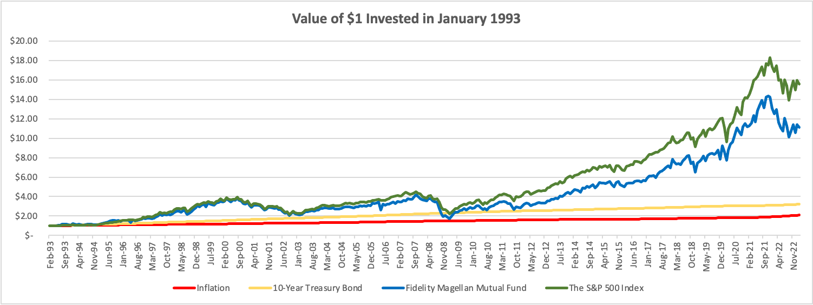
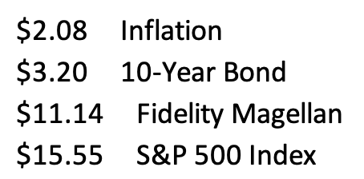

Slide 33
Let’s Do Some Fake Investing!
Which of these company stocks has performed the best over the past 2 years?
Apple
Disney
Google
JP Morgan Chase
McDonald’s
Microsoft
Nike
Pfizer
Visa
Walmart

Slide 34
Let’s Do Some Fake Investing!
Pfizer
Nike
Disney

Slide 35
Owning Your Financial Future
Question #1
What are you going to be doing in 2030?
Will you be in graduate school? If so, what are you studying?
Are you working? If so, what is your job?
Where do you live? Who do you live with?
How do you spend your free time?

Slide 36
Owning Your Financial Future
Question #2
What are the 3 most expensive things you plan on buying in the next 10 years.
For now, exclude your undergraduate education.
But if you’re planning on graduate school, do include that.
Or maybe it’s a house, a car, a vacation, a baby, a new pair of shoes. Anything.

Slide 37
Owning Your Financial Future
Question #2
What are the 3 most expensive things you plan on buying in the next 10 years.
We do these thought exercises to begin thinking about how we might make it happen. Yes, we are just making things up in our responses – but that’s where planning begins.
For most of us, owing our financial futures begins with identifying our goals and designing a plan to achieve those goals.

Slide 38
Owning Your Financial Future
Question #3
What are your financial goals?
  What financial goals do you want to achieve in the next 3 months?
  What financial goals do you want to achieve in the next 12 months?
  What financial goals do you want to achieve in the next 3 years?

Slide 39
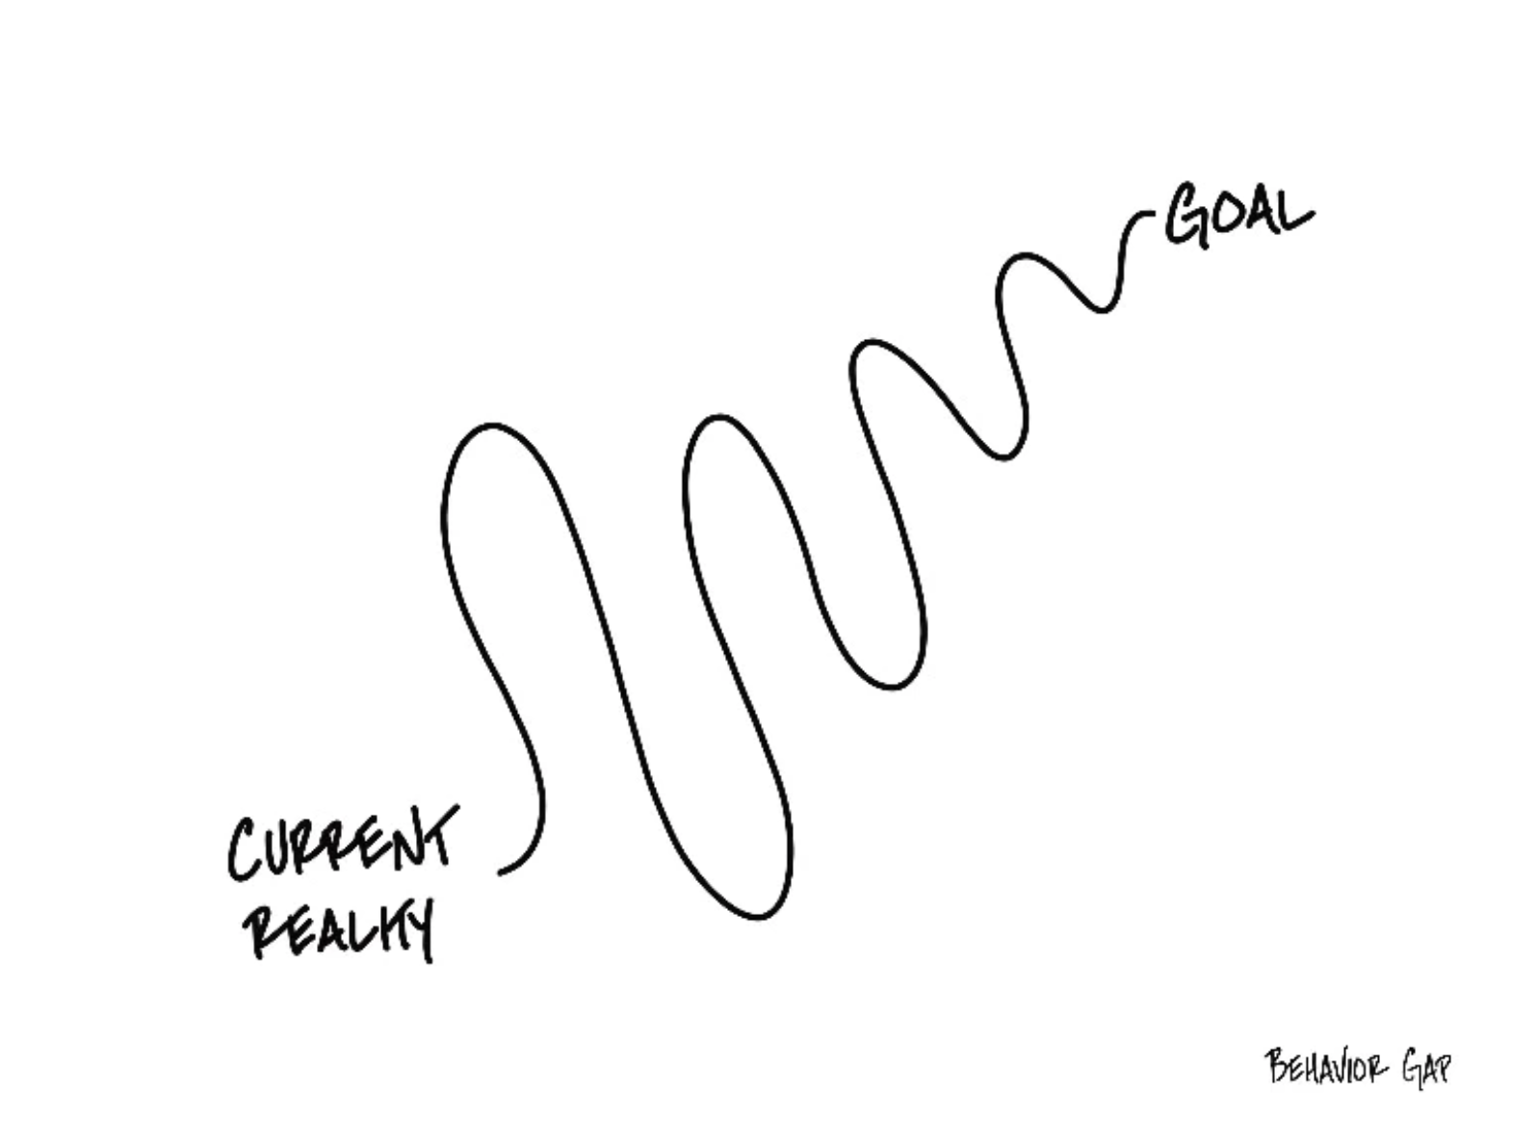

Slide 40
Financial Planning for the New School Year
5 Things Everyone Should Do:
BUDGET!
  Make shopping lists…for all types of shopping: food, gifts, fun, weekends.
  Make lists of what you ARE NOT going to buy…for all types of shopping.

Slide 41
Financial Planning for the New School Year
5 Things Everyone Should Do:
BE VERY CAREFUL ABOUT INCREASING DEBT
  Avoid increasing balances on credit card
  Maybe only use credit cards for groceries and gas and use a debt card for everything else.

Slide 42
Financial Planning for the New School Year
5 Things Everyone Should Do:
GET RID OF AT LEAST 1 SUBSCRIPTION
  Review your expenses and find any/all recurring subscriptions
  Find at least 1 to get rid of before the year end
  And make sure you do not add any that you are not going to use or get your money’s worth

Slide 43
Financial Planning for the New School Year
5 Things Everyone Should Do:
LOOK FOR DEALS…BUT ALSO BE WARY OF DEALS
  By shopping early and shopping around, you can find the best deals for what you need to buy
  But be careful – many deals will have fine print that commits you to further costs or to other constraints that are not in your best interest

Slide 44
Financial Planning for the New School Year
5 Things Everyone Should Do:
SET 5 RESOLUTIONS THAT YOU CAN STICK WITH
  Check your credit report and credit score, open multiple savings accounts, pay yourself first with $5-$25 of every paycheck going to savings, analyze every penny you spend during 3-5 months in 2024, find a budget approach that works for you, set financial goals for the next 3-5 years, finalize your back-to-school spring 2024 budget, begin investing, pay down any high-interest debt (even before savings), do not dine out or go grocery shopping in January, maximize credit card rewards

Slide 45
Some Homework for You
Think about why you are in college.
Make a list of the 5-10 most important criteria you are looking for in a job or career.
Connect these criteria to your long-term and
short-term goals. Connect these criteria to your values.
(And if you don’t know what your values are, take 30 minutes to identify them and commit to them.)

Slide 46
More Homework for You
Once a week: Make a list of the money you are
going to spend this week.
Once a month: Make a list of how college – and your
future job – serves your values over the
long-term.
Once a year: Revisit your values and identify
your short- and long-term goals.

Slide 47
Long-Term Investment Planning
YOUR VALUES
YOUR GOALS
FINANCIAL STRATEGIES
INVESTMENT STRATEGIES
Identify Your Risk Tolerance
Identify Your Time Horizons
Select Investments
Monitor & Modify Investments

Slide 48
Long-Term Investment Planning
FINANCIAL STRATEGIES
INVESTMENT STRATEGIES
Identify Your Risk Tolerance
Identify Your Time Horizons
Select Investments
Monitor & Modify Investments

Slide 49
Long-Term Investment Planning
FINANCIAL GOALS
EDUCATION GOALS
INVESTMENT STRATEGIES
EDUCATION STRATEGIES
Identify Your Risk Tolerance & Priorities
Identify Your Risk Tolerance & Priorities
Identify Your Time Horizons
Identify Your Time Horizons
Select Investments
Select Your Field, Program, Specialization, Thesis
Monitor & Modify Investments
Monitor & Modify Your Progress & Plan

Slide 50
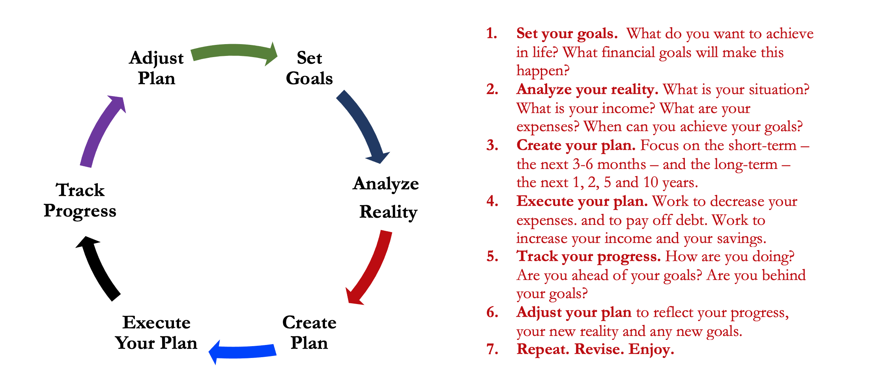
Isn’t this a lot like what you do with your education planning?

Slide 51
Long-Term Investment Planning
FINANCIAL GOALS
YOU,
as college students, are better wired and equipped to make long-term plans – education, career, financial & otherwise – than 99% of humanity.
Be confident.
Be intentional.
Be diligent.
Be awesome.
EDUCATION GOALS
INVESTMENT STRATEGIES
EDUCATION STRATEGIES
Identify Your Risk Tolerance & Priorities
Identify Your Risk Tolerance & Priorities
Identify Your Time Horizons
Identify Your Time Horizons
Select Investments
Select Your Field, Program, Specialization, Thesis
Monitor & Modify Investments
Monitor & Modify Your Progress & Plan

Slide 52
Owning Your Financial Future
YOUR VALUES
YOUR GOALS
Education
Career
Family
FINANCIAL STRATEGIES
Investing
Income & Expense Management
Debt Management
Taxes, Insurance & Other

Slide 53
What is INVESTING?
Investing is saving for the future.
We typically think of investing as long-term – anywhere from 1 or 2 years all the way through retirement.
Saving vs. Investing
  Saving can be short-term, Investing is typically long-term.
  Saving is passive, Investing is dedicated…it could be relatively passive or extremely active.
    Passive: Mutual funds. Extremely Active: Owning an apartment complex.
  Saving is typically very low risk, Investing generally has more risk.
  Saving provides low returns on investment (currently about 0.0%)
  Inflation is risky…You can lose 100% or realize huge positive returns.

Slide 54
What Is Your Investing Goal?
Take a few seconds to ask yourself:
Why Are You Investing?
What are your investing goals?
To buy a house?
To buy a car?
To pay off debt?
To retire?

Slide 55
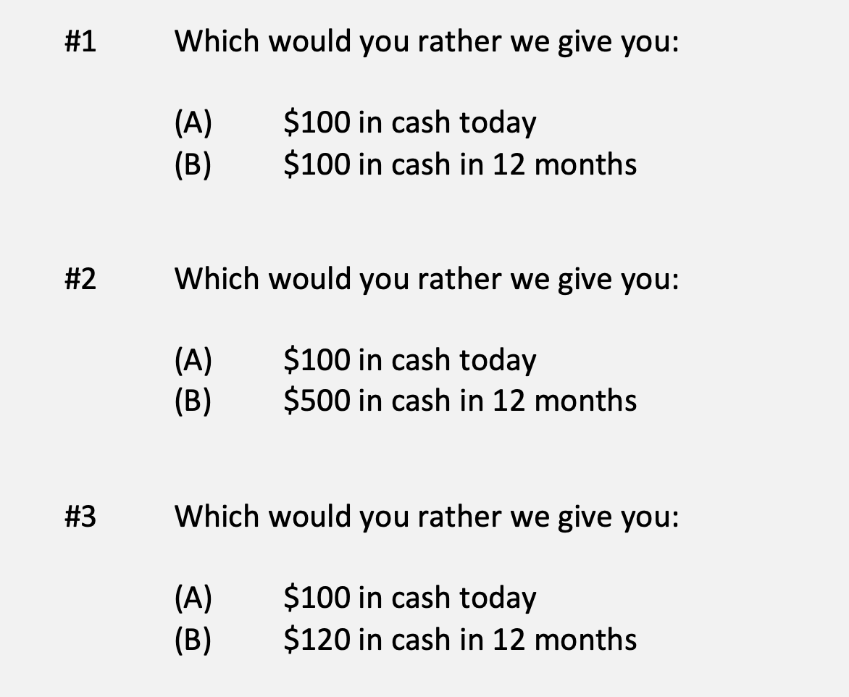
A Few Rules About INVESTING
Investing is about Trade-Offs. Using money today to get (hopefully more) money in the future:

Slide 56
A Few Rules About INVESTING
Risk matters. Know your risk tolerance.
Goals matter. Be intentional about what you are saving for.
  Maybe create 3-5 different investment accounts for different goals.
  This is what I do – I’ll show you why in a bit.
Transaction costs matter. You can pay a lot of fees for not much benefit or service. Be careful.
Experts rarely have tips or secrets. Investing is about predicting the future, and none of us can predict the future (perfectly). Be careful.
  If there really were sure-things or get-rich-quick schemes, the experts would be using them themselves, not sharing them with you.
Communicate with your family. Achieving goals is a family affair.

Slide 57
A Few Rules About INVESTING
Investing lets COMPOUND INTEREST be your friend.
  With compound interest, your interest earns interest.
  Without actively making decisions, your money can grow exponentially.
  Yes, there is risk – the exponential growth rate could be negative.
  Such risk is greatest if you ‘invest’ over very short periods of time.
  Historically, over the past 100+ years, if you invest for 5+ years, you have benefited from positive exponential growth.
  The average return of a common stock over the past 100 years is 10%.
    The word ’average’ is very important here. But, the good news, we can all achieve ‘average’ returns relatively easily (though they may not be 10% in the future)

Slide 58
A Few Rules About INVESTING
Investing lets COMPOUND INTEREST be your friend.
  Invest $100 at 10% interest or growth:
  Year 1: $100 x (1 + 10%) = $110
  Year 2: $110 x (1 + 10%) = $121
  $100 x (1 + 10%)² = $121
  Year 1: $10 of interest
  Year 2: $10 of interest on your original $100
  + $1 of interest on year 1 interest

Slide 59
Expertise Matters
Take a minute to think about the following question:
What do YOU do better than 99.9% of humanity?
Think about what you’re studying. Think about what you’ve been working on for years. Think about what you know that I do not know.
I’ve probably only spent 1-2 hours studying what you have dedicated your life to studying and becoming an expert in.
  Could I do your job as well as you do it?

Slide 60
Expertise Matters
Of course, I couldn’t do your job as well as you.
Now connect this logic to investing: there are many professionals who have dedicated their lives to making investments. They are good.
  Yes, there are many amateurs involved in trading stocks – but they (usually) account for a very minor portion of the total money invested.
Remind yourself of this old gambling maxim:
When you are sitting at the poker or gambling table, take a look around and see if you can figure out who the sucker is. If you cannot identify who the sucker is, then the sucker is probably you.

Slide 61
Isn’t this a lot like what you do with your education planning?

Slide 62
Determining Your Risk Tolerance
High Risk Attitude
I want to summer in Paris and winter in Hawaii
Medium-High Risk Attitude
I will work through normal retirement age, but I want my spouse to retire early - and we want to visit Paris & Hawaii
Medium-Low Risk Attitude
I want my children to have a college education
Low Risk Attitude
I want food on the table and a roof over my head

Slide 63
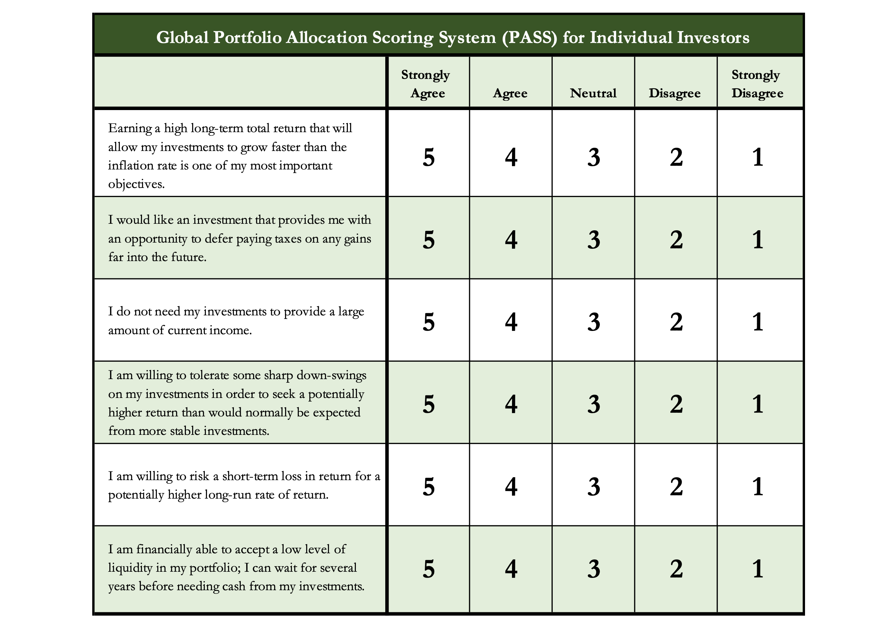
Determining Your Risk Tolerance

Slide 64
Comparing Different Investments

Slide 65
Comparing Different Investments

Slide 66
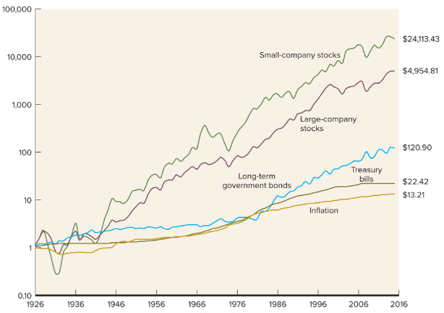
Comparing Different Investments

Slide 67
The Magic of Compound Returns

Slide 68
The Magic of Compound Returns

Slide 69
The Magic of Compound Returns
Quiz Question on Compound Returns:
Under which of the following scenarios will you have more money saved when you turn 65?
Investing $100 per month from age 25-35 (and then nothing from 35-65)
With an 8% return, you will have $185,000 accumulated at 65.
Investing $100 per month from age 35-65 (but nothing from 25-35)
With an 8% return, you will have $150,000 accumulated at 65.
Note: If the returns on your investments are less than 6%, (B) will lead to greater wealth.
There’s a similar but different problem on page 37 of your handbook.

Slide 70
The Magic of Compound Returns
Quiz Question on Compound Returns:
Under which of the following scenarios will you have more money saved when you turn 65?
Investing $100 per month from age 25-35 (and then nothing from 35-65)
With an 8% return, you will have $185,000 accumulated at 65.
Investing $100 per month from age 35-65 (but nothing from 25-35)
With an 8% return, you will have $150,000 accumulated at 65.
Note: If the returns on your investments are less than 6%, (B) will lead to greater wealth.
There’s a similar but different problem on page 37 of your handbook.

Slide 71
Review: A Few Rules About INVESTING
Investing lets COMPOUND INTEREST be your friend.
  With compound interest, your interest earns interest.
  Without actively making decisions, your money can grow exponentially.
  Yes, there is risk – the exponential growth rate could be negative.
  Such risk is greatest if you ‘invest’ over very short periods of time.
  Historically, over the past 100+ years, if you invest for 5+ years, you have benefited from positive exponential growth.
  The average return of a common stock over the past 100 years is 10%.
    The word ’average’ is very important here. But, the good news, we can all achieve ‘average’ returns relatively easily (though they may not be 10% in the future)

Slide 72
Review: A Few Rules About INVESTING
Investing lets COMPOUND INTEREST be your friend.
  With compound interest, your interest earns interest.
  Without actively making decisions, your money can grow exponentially.
  Yes, there is risk – the exponential growth rate could be negative.
  Such risk is greatest if you ‘invest’ over very short periods of time.
  Historically, over the past 100+ years, if you invest for 5+ years, you have benefited from positive exponential growth.
  The average return of a common stock over the past 100 years is 10%.
    The word ’average’ is very important here. But, the good news, we can all achieve ‘average’ returns relatively easily (though they may not be 10% in the future)
Not to be too esoteric or philosophical…
But compound interest doesn’t just apply to investing.
Compound interest applies to all aspects of college life:
Time Management
Mental Health
Health Management
Writing Skills
Relationships
And…Of course, Money Management

Slide 73
Investing – Some Perspective
I am biased because I am a finance professor. I study investing and I teach investing. My perspective on risk may be meaningless to you.
Do not take my advice on what level of risk you should take. Be thoughtful, be prudent.
Avoid doing things that you know are stupid and that you know will cause you stress.
But don’t be afraid of taking risks just because they scare you. You have already taken many, many risks in your life. Taking informed and measured risks will continue to open many doors and opportunities for you – in both your personal and financial lives.

Slide 74
A Few Opening Morals
SAVINGS
INVESTING
OWNERSHIP
WEALTH

Slide 75
Common Questions about Investing & Saving
How can I save when my income is so low as a student?
My problem isn’t budgeting but it’s having too little income.
Your short-term priorities while in grad school need to be your education, your family and your mental health.
Maybe saving cannot be a priority for you while you’re in school.
The goal is to develop habits and a mindset that will prepare you to maximize the benefits of saving when your income allows you to do so. Be patient. The benefits of good habits will grow exponentially.

Slide 76
Common Questions about Investing & Saving
How can I save when my income is so low as a student?
My problem isn’t budgeting but it’s having too little income.
And think of ways to generate more money: gigs, internships, tutor, lab assistant, freelance positions, blogger, podcasts, consulting
  Create new jobs for yourself: maybe sell your skills in social media marketing
  to a company you want to work for, regardless of your program
A lot of the advice we think of in budgeting is about “reducing expenses.”
And that’s because we generally have more control over our expenses than we do over our income, at least in the short-term. Do what you can.
  And, decreasing expenses can feel like an increase income. Same same.

Slide 77
Common Questions about Investing & Saving
How much of my income should I be saving each month?
Only you can answer this. Nobody can answer it for you.
It depends on:
  What your goals are, both short- and medium-term.
  What your immediate expenses are.
I frequently advise students to save $25 of every paycheck as soon as they receive each paycheck. Save or set aside as much as you can.
  When I was getting my Master degree, I had no income. I was living off a little savings and a lot of debt. But I intentionally saved $10 to $25 on the first day of each month…simply to develop the habit.
  In school, the habit is more important than the amount.

Slide 78
Common Questions about Investing & Saving
How much of my income should I be saving each month?
My challenge to you:
Take $10 of every paycheck and move it into a savings account.
If you can save more, do it.
But at a minimum, save $10 of every paycheck to develop the habit.
My advanced challenge to you:
Take half of what you save each month and invest it in the stock market.

Slide 79
Common Questions about Investing & Saving
How do I save for a big purchase – house, car, etc…?
Stary by asking yourself a few questions:
  How much do I need to save?
  When am I going to make this purchase?
  Is this essential or discretionary? (A refrigerator or car vs. a vacation)
These questions will help identify timing and priority.
  Knowing timing & priority will help determine how you save.
    Do you use a bank savings account or do you have time to invest in the stock market?

Slide 80
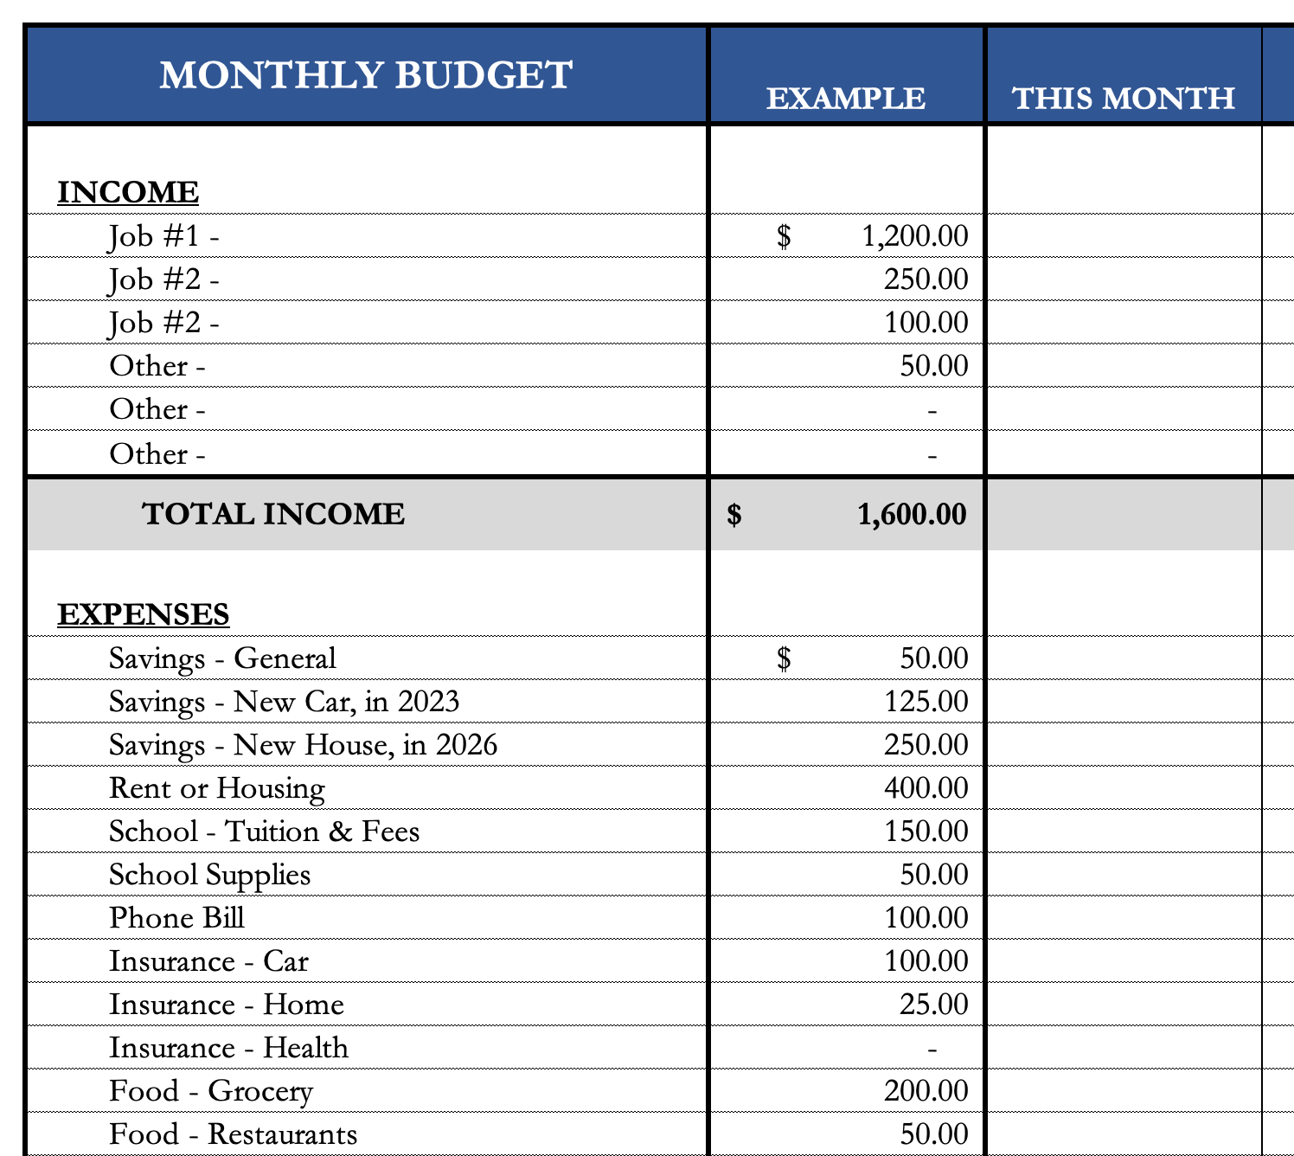
Common Questions about Investing & Saving
How do I save for a big purchase – house, car, etc…?
I would explicitly allocate some of my monthly
savings to this purchase.
  I have already penciled in my holiday gift purchases –
  even though I won’t make them for 2 months.
We will talk about my 5 buckets for saving-
investing in a few slides.
If it’s a really big purchase (e.g. house), you
could even set up a dedicated saving or
investing account just for that purchase.

Slide 81
Common Questions about Investing & Saving
How do I save for a big purchase – house, car, etc…?
I would explicitly allocate some of my monthly
savings to this purchase.
  I have already penciled in my holiday gift purchases –
  even though I won’t make them for 2 months.
We will talk about my 5 buckets for saving-
investing in a few slides.
If it’s a really big purchase (e.g. house), you
could even set up a dedicated saving or
investing account just for that purchase.
These budgeting templates are in the handbook on pages 24-25.
You can download them from the MCOBA website, search for “Personal Financial Planning.”
Or you can email me and I will send them to you.

Slide 82
Common Questions about Investing & Saving
How much of my income should I be investing each month?
Again, only you can answer this. Nobody can answer this for you.
Your goals, values and resources are unique to you…and only you.
You may read reports about how much you should have saved by a certain age or whatever.
  It’s okay to read those, but be sure to put them into your own perspective.
  Those articles do not know what your goals are, do not know that you are in graduate school and do not know what your future plans are.
  It is important to have a plan – but it is critical that that plan is unique to you and your situation.

Slide 83
Some Parting Words
Nothing in finance is free. Do not think some institution is giving you a super deal just because they like you. There will be costs.
Investment companies work really hard to get your money. They hire psychologists to figure out how to get you addicted to your products. Your money pays for their commercials, buildings, fancy cars and vacation homes.
I check my bank, savings & investment accounts daily. I do not make changes daily (or even monthly). I just don’t want any surprises.

Slide 84
Isn’t this a lot like what you do with your education planning?

Slide 85
Happiness
Long-Term Goals
Short-Term Goals
Financial Needs
Family Needs

Slide 86
Financial Wellness
A goal without a plan is just a dream.
Wealth is largely the result of habit.
The most difficult thing is the decision to act; the rest is mere tenacity.
It takes as much energy to plan as it does to wish.
You cannot escape the responsibility of tomorrow by avoiding it today.

Slide 87
Don’t wait around for other people to be happy for you.
Any happiness you get,
You’ve got to make yourself.
~ Alice Walker, poet & novelist
A goal without a plan is just a dream.
Wealth is largely the result of habit.
The most difficult thing is the decision to act; the rest is mere tenacity.
It takes as much energy to plan as it does to wish.
You cannot escape the responsibility of tomorrow by avoiding it today.

Slide 88
brian.bolton@louisiana.edu http//:business.louisiana.edu/financeispersonal

