Slide 1


MONEY MATTERS
2025 Spring – Session #2
Fin
February 17, 2025
Financial Planning for
International Students
Manage Your Money Today
Maximize Your Money in the Future

Slide 2
MONEY MATTERS SERIES: SPRING 2025
JANUARY 28
Financial Resolutions for the New Year
FEBRUARY 17
Financial Planning for International Students
MARCH 25
Tax
Planning Strategies
APRIL 8
Career Planning
& Financial Planning

Slide 3

ACCELERATE TO INDUSTRYTM SERIES: SPRING 2025
SOME TIME THIS SPRING - TBD
Industry Insights & Job Search Strategies with First Solar
APRIL 9
Translating your Academic Training & Research Skills into Industry & Entrepreneurial Futures with Opportunity Machine

Slide 4

We are exciting to announce that we are now an academic partner with Accelerate to IndustryTM, a program with a bold, new approach to enhance graduate student and postdoctoral industry workforce readiness.
The A2i approach includes a range of modules that allow graduate students, postdocs, and alumni to benefit from the entire range of activities, or individual components.

Slide 5
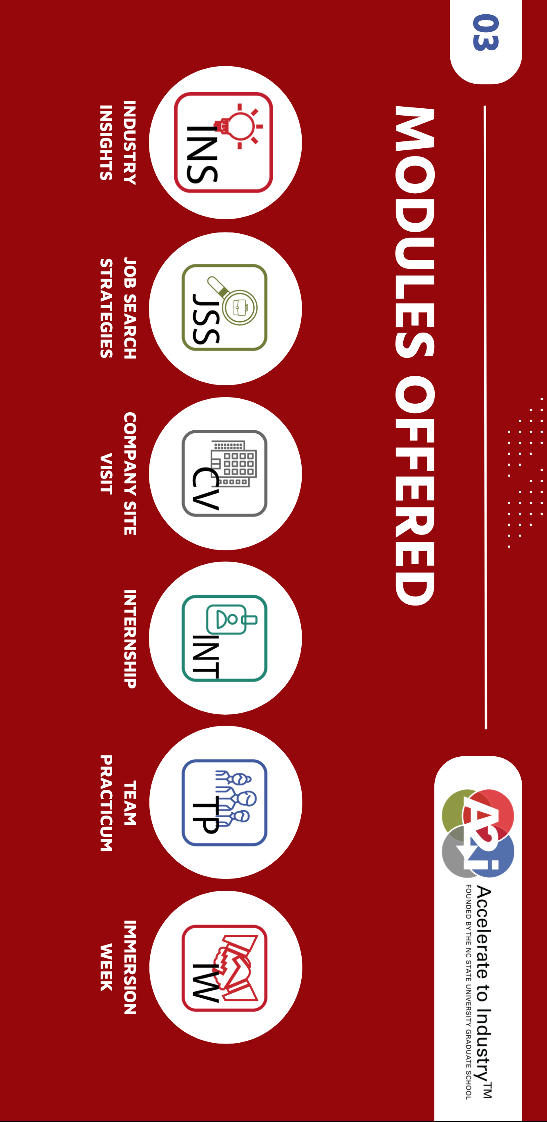

Slide 6



Slide 7
Happiness
Long-Term Goals
Short-Term Goals
Financial Needs
Family Needs

Slide 8
Owning Your Financial Future
YOUR VALUES
YOUR GOALS
Education
Career
Family
FINANCIAL STRATEGIES
Investing
Income & Expense Management
Debt Management
Taxes, Insurance & Other

Slide 9
Owning Your Financial Future
YOUR VALUES
YOUR GOALS
Education
Career
Family
FINANCIAL STRATEGIES
Investing
Income & Expense Management
Debt Management
Taxes, Insurance & Other

Slide 10
FINANCIAL PLANNING FOR INTERNATIONAL STUDENTS
YOUR VALUES
YOUR GOALS
Education
Career
Family
FINANCIAL STRATEGIES
Investing
Budgeting
Debt
Insurance
Taxes
Visa
Career Planning

Slide 11
FINANCIAL PLANNING FOR INTERNATIONAL STUDENTS
YOUR VALUES
YOUR GOALS
Education
Career
Family
FINANCIAL STRATEGIES
Investing
Budgeting
Debt
Insurance
Taxes
Visa
Career Planning

Slide 12
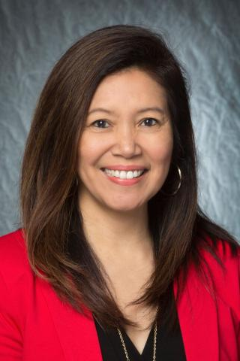
YOUR BEST FRIEND ON CAMPUS
Dr. Rose Honegger
Associate Director
UL Lafayette Division of
Global Engagement
roseh@louisiana.edu

Slide 13
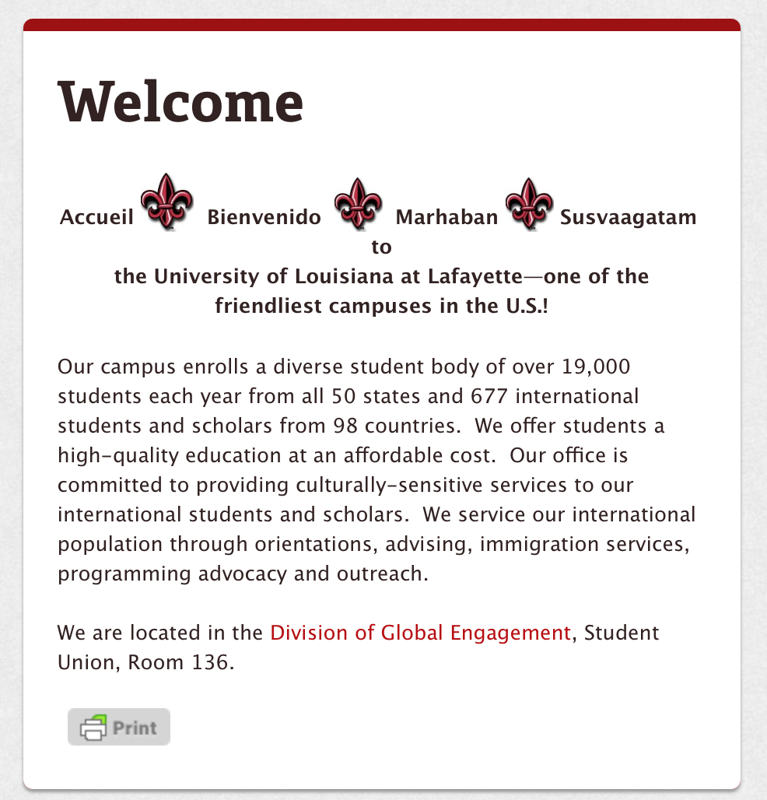
YOUR BEST FRIEND ON CAMPUS
Dr. Rose Honegger
Associate Director
UL Lafayette Division of
Global Engagement
roseh@louisiana.edu
https://louisiana.edu/globalengagement

Slide 14
5 KEY ISSUES FOR INTERNATIONAL STUDENTS
You must file a tax return, each year, whether you earn income or not.
You may be limited in what income you can earn in the U.S. This makes it all the more important that you (a) control your expenses, and (b) finish your degree.
OPT (Optional Practical Training) is a bridge from being a student in the U.S. to being a professional. If you want to stay in the U.S. long-term, begin looking for OPT opportunities early (and budget for the $410 fee).
CPT (Curricular Practical Training) is an opportunity to have a paying job or internship while you are still in school.
Yes, you are (probably) allowed to engage in all the financial activities that any permanent resident can – investing in stocks, bonds, crypto, real estate, anything.

Slide 15
Income Taxes in the U.S.
Filing for income tax:
It’s important to be aware that, as a nonresident student in the US, you’re legally required to file a tax return if you received US income during each year.
And even if you didn’t work or receive income in the US, you’re still obliged to file a Form 8843 with the IRS.
University of Louisiana at Lafayette has arranged discounted access to Sprintax Tax Preparation for you. Check to see if your institution has similar programs. Sprintax will guide you through the tax preparation process, arrange the necessary documents and check if you’re due a tax refund.
Sprintax was used by over 225,000 international students and scholars last year, and the average Federal refund received by eligible students was over $1,185.

Slide 16
Income Taxes in the U.S. (Cont.)
All you need to do is:
Register and follow the simple instructions
Sprintax will help you prepare your tax return here:
https://taxprep.sprintax.com/?utm_ref=louisiana-edu&utm_content=prmc
Complete the online questionnaire and filing review
  For a $5 discount on the Fed cost of tax-filing, enter 5ULL40F24 when you begin filing and/or on the ‘Review Your Order’ page

Slide 17
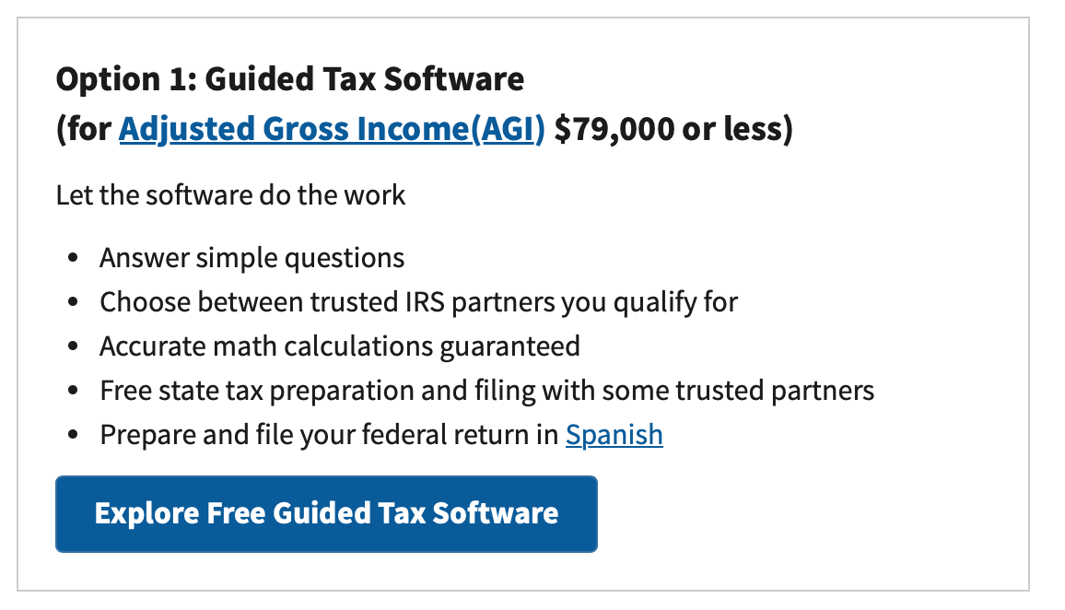
Filing Your Income Taxes for Free – Another Option
This limit of $79,000 is the same regardless of whether you are filing individually or married-jointly. Sorry.
The IRS does not prepare your taxes.
Your return will be prepared by a partner firm of the IRS (HR Block, Jackson-Hewitt, Intuit…).
If you make more than $79,000, most online tax software will cost you anywhere from $30 to $250 to do both federal and state filings.
https://www.irs.gov/filing/free-file-do-your-federal-taxes-for-free

Slide 18
Frequently Asked Question #1
How do I manage my time and finances to become financially comfortable upon graduation?
  There’s no easy way. It’s all about budgeting and planning.
  Sit down and analyze your situation: amount of debt, income, expenses, impulse spending.
  Analyze your bad habits and make plans to change them.
  You may not really become financial comfortable until you get the job you want and your income increases. But having a plan and knowing your numbers is the best place to start.

Slide 19
Frequently Asked Question #2
Are international students allowed to invest in stocks, bonds and financial products with our social security number?
  Yes.
  With a social security number, international students have all the investing and financial privileges as anyone else.

Slide 20
Frequently Asked Question #3
What are our responsibilities with taxes in bank accounts?
  You owe ordinary income taxes on interest earned in a bank account. You do not pay taxes on just the balance.
    If you have $250 in a savings account and you get $15 in interest during the year, you will owe ordinary income taxes on that $15 only.
  If you move beyond a bank account and do some investing, you will owe taxes on any investment gains or income you earn, as with the bank account.
    You may owe ordinary income taxes if your gains are short-term, you may owe capital gains taxes (which are lower) if your gains are long-term.

Slide 21
Frequently Asked Question #4
What about Individual Retirement Accounts (IRA) and Roth IRA - which one is better for international students please?
  I suspect for 95% of international students, a Roth IRA is better for you (now).
  Roth IRAs are best when your income is low and your tax rate is low. Traditional IRAs are best when your income is higher and your tax rate is lower.
  The catch: with a Roth IRA, you pay taxes on income today, so you may have less after-tax cash flow from your salary…which may not be ideal for many cash-strapped graduate students.

Slide 22
Frequently Asked Question #5
How does an international graduate student that does not earn during summer pay for his/her rent?
  CPT – Curricular Practical Training – allows you to have a paying internship while in school.
    The job must be related to your degree.
    The job must be coordinated by your school.
    If you have the job for more than 12 months, you cannot get OPT.
  Beyond that, there’s no easy way. It’s all about budgeting and planning.
  Sit down and analyze your situation: amount of debt, income, expenses, impulse spending.
  Analyze your bad habits and make plans to change them.

Slide 23
Frequently Asked Question #6
What about earning extra money by starting my own business, or investing, or trading Bitcoin?
  This can get a little tricky or delicate.
  YES, you are legally allowed to start your own business, to invest in U.S. stocks and other securities, to trade Bitcoin or engage in other side-hustles.
  BUT…you are (probably) here on a student visa, to be a student, to study, to pursue a degree and to complete a degree program.
    You are legally required to report all income, including all side-hustle income.
    And you may owe taxes if your total income (side-hustle + salary) is high enough.
    If your side-hustle becomes your dominant source of income, the IRS and the government might think that your side-hustle is more important to you than your degree. And that’s a problem.
  With your own business…you are not supposed to work more than 20 hours a week while in school, and this business can count as OPT after graduation…and you are not supposed to engage in running the business without work authorization.
  As we said, it can be tricky and delicate.

Slide 24
Budgeting
Create a budget on how you will spend your money each month
  Fixed expenses (rent, tuition, books, utilities, food, insurance, car payments, phone bill)
  Discretionary expenses (clothing, entertainment, travel, emergencies)
  Unexpected expenses (medical bills, taxes)
Learn to live within your means (avoid going into debt to maintain your lifestyle). Unpaid debt will follow you everywhere you go.
You have limited opportunities to increase your income, which makes controlling your expenses even more important.

Slide 25
Preparing & Investing for YOUR Future
Prepare and invest in your future.
If you’re about to graduate, plan to save $470 USD for your OPT (Optional Practical Training) application fees ($520 for paper applications):
(see next slide for a new, premium processing option)
  OPT is an off-campus employment benefit for F-1 students that have completed their education at an American university.
  Employment has to be related to field of study: https://internationalaffairs.louisiana.edu/current-students/working-usa/optional-practical-training-opt

Slide 26
Preparing & Investing for YOUR Future
USCIS introduced the Premium processing fee for OPT and STEM OPT Extension.
For OPT and STEM OPT Extension premium processing, USCIS guarantees they will process the application within (up to) 30 calendar days of receipt of the premium processing request. (Normal processing time might be 3-6 months.)
How much does premium processing cost?
  $1,685 if you are filing the premium processing Form I-907 for a Form I-765 with eligibility category (C)(3)(B) (for post-completion OPT), or
  $1,685 if you are filing the premium processing Form I-907 for a Form I-765 with eligibility category(C)(3)(C) (for the 24-month STEM OPT Extension).
This $1,685 premium processing fee is in addition to the $470 OPT filing fee. Currently, USCIS charges a fee of $470 for the I-765 form, which students use to apply for their OPT and STEM OPT Extension.

Slide 27
Other Common Financial
Challenges for International Students
Health insurance while in school
Costs of Living & Standards of Living
Establishing a Financial Presence in the U.S.
Career Planning
Uncertainty…The enemy of all planning

Slide 28
Other Common Financial
Challenges for International Students
Health insurance while in school
Costs of Living & Standards of Living
Establishing a Financial Presence in the U.S.
Career Planning
Uncertainty…The enemy of all planning
You are required to have health insurance while in school. The University provides this for students on F1 and J1 visas, but does not provide insurance for family members. Shop around, plan ahead.
The U.S. hospital bills and insurance practices may be different from what you’re used to. Ask lots of questions. Never pay before you absolutely have to or before you are absolutely sure of what you owe.

Slide 29
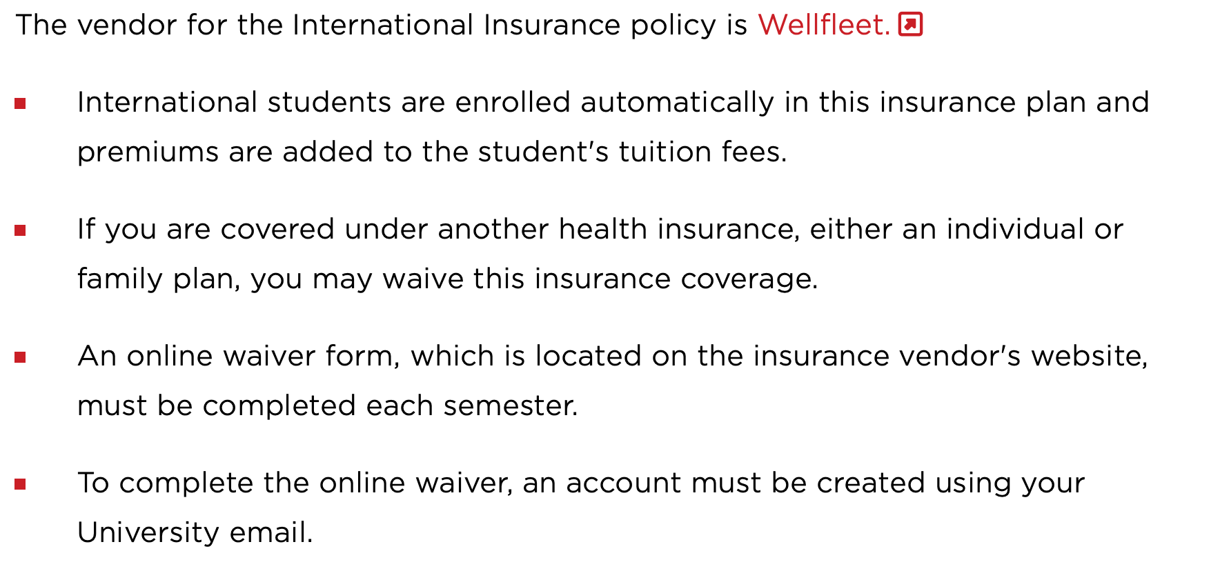
Other Common Financial
Challenges for International Students
Health insurance while in school
Costs of Living & Standards of Living
Establishing a Financial Presence in the U.S.
Career Planning
Uncertainty…The enemy of all planning

Slide 30
Other Common Financial
Challenges for International Students
Health insurance while in school
Costs of Living & Standards of Living
Establishing a Financial Presence in the U.S.
Career Planning
Uncertainty…The enemy of all planning
Some terms or issues that are part of U.S. health insurance that may be new to you:
Affordable Care Act
Deductibles
Co-Pay
Dental insurance
Vision insurance
Insurance during the summer

Slide 31
Other Common Financial
Challenges for International Students
Health insurance while in school
Costs of Living & Standards of Living
Establishing a Financial Presence in the U.S.
Career Planning
Uncertainty…The enemy of all planning
Rent, food, insurance and other costs of living may be very different in the U.S.
When you prepare your short- and long-term budgets, make sure you are using U.S. costs and not home costs. Ask for help when in doubt.
Always avoid pressure to live a U.S. standard of living. You are here to get a degree – you can worry about your standard of living once you graduate.

Slide 32
Other Common Financial
Challenges for International Students
Health insurance while in school
Costs of Living & Standards of Living
Establishing a Financial Presence in the U.S.
Career Planning
Uncertainty…The enemy of all planning
Get a bank account – with checking and savings accounts.
Get a credit card – it will help you build your U.S. credit history.
If you plan to borrow in the U.S., you may have to have someone co-sign on your loans.
Set aside $470 for your OPT as you get closer to graduating.

Slide 33
Other Common Financial
Challenges for International Students
Health insurance while in school
Costs of Living & Standards of Living
Establishing a Financial Presence in the U.S.
Career Planning
Uncertainty…The enemy of all planning
Filing for your OPT should be Step #1, if you plan to stay in the U.S. beyond graduation.
Think ahead and plan ahead for lots of future decisions:
Should you get another degree?
Where will you live?
Should you take a good job with uncertain visa options or a mediocre job with the promise of a visa?
Should you go back home?

Slide 34
Other Common Financial
Challenges for International Students
Health insurance while in school
Costs of Living & Standards of Living
Establishing a Financial Presence in the U.S.
Career Planning
Uncertainty…The enemy of all planning
We can never control uncertainty.
But we can create plans with different scenarios that will make uncertainty less of a surprise when it happens.
What if there’s another pandemic?
What if your advisor retires?
What if the U.S. dollar strengthens (and your home currency weakens)?
What if you start a family?
What if you win the lottery?

Slide 35
Some Concluding Tips
Ask for help!
  In many cases, your best source of information will be international faculty, either in your department or elsewhere
Plan ahead.
  Uncertainty will be a fact of life. Try to avoid major surprises.
Communicate with family, both in the U.S. and at home.
  In many cases, they are (directly or emotionally) going through this experience with you. Let them help. Share your issues with them.
Finish your degree.
  Given the constraints many of you will have, such as with limits on having a job, completing what you came here for should be your #1 priority.

Slide 36
Happiness
Long-Term Goals
Short-Term Goals
Financial Needs
Family Needs

Slide 37
Making Financial Planning a Priority
FINANCIAL STRATEGIES
EDUCATION STRATEGIES
BUDGETING
STRATEGIES
GRAD SCHOOL STRATEGIES
Identify Your
Income & Expenses
Identify Your Resources
Identify Your
Priorities & Goals
Identify Your
Priorities & Goals
Do Your Planning
Do Your Planning
Monitor & Modify Budgeting Activities
Monitor & Modify Your Progress & Plan

Slide 38
Making Financial Planning a Priority
FINANCIAL STRATEGIES
YOU,
are better wired and equipped to make long-term plans – education, career, financial & otherwise – than 99% of humanity.
Be confident.
Be intentional.
Be diligent.
Be awesome.
EDUCATION STRATEGIES
BUDGETING
STRATEGIES
GRAD SCHOOL STRATEGIES
Identify Your
Income & Expenses
Identify Your Resources
Identify Your
Priorities & Goals
Identify Your
Priorities & Goals
Do Your Planning
Do Your Planning
Monitor & Modify Budgeting Activities
Monitor & Modify Your Progress & Plan

Slide 39
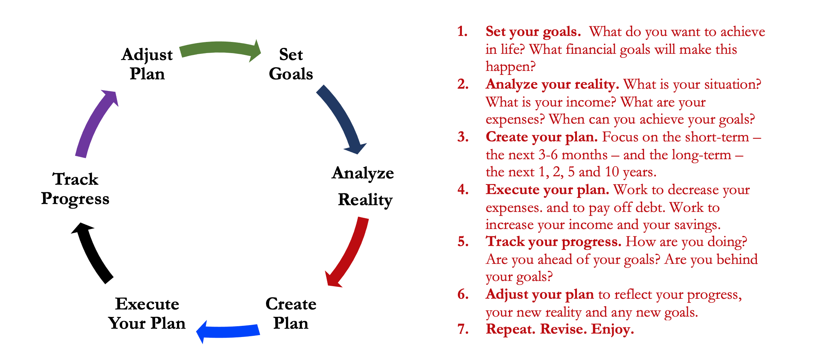
Isn’t this a lot like what you do with your education planning?

Slide 40
You’ve been doing this with your education for years.
You’re about to begin doing this with your career…and you will continue working through this process for the next 30 or 40 years.
Whether it’s education planning or career planning, by now we know that all of our personal decisions with have financial implications.
The more we plan ahead and integrate our decision-making process, the more control we will have over our futures…and the less money will be a source of stress and the more money will be a source of empowerment.
Isn’t this a lot like what you do with your education planning?

Slide 41
Don’t wait around for other people to be happy for you.
Any happiness you get,
You’ve got to make yourself.
A goal without a plan is just a dream.
Wealth is largely the result of habit.
The most difficult thing is the decision to act; the rest is mere tenacity.
It takes as much energy to plan as it does to wish.
You cannot escape the responsibility of tomorrow by avoiding it today.

Slide 42
MONEY MATTERS SERIES: SPRING 2025
JANUARY 28
Financial Resolutions for the New Year
FEBRUARY 17
Financial Planning for International Students
MARCH 25
Tax
Planning Strategies
APRIL 8
Career Planning
& Financial Planning

Slide 43

brian.bolton@louisiana.edu http//:business.louisiana.edu/financeispersonal

Slide 44

gradschool@louisiana.edu

Slide 45
YOUR BEST FRIEND ON CAMPUS
Dr. Rose Honegger
Associate Director
UL Lafayette Division of
Global Engagement
roseh@louisiana.edu

