Slide 1


MONEY MATTERS
2025 Spring – Session #1
January 28, 2025
Financial Resolutions for the New Year
Manage Your Money Today
Maximize Your Money in the Future

Slide 2
MONEY MATTERS SERIES: SPRING 2025
JANUARY 28
Financial Resolutions for the New Year
FEBRUARY 17
Financial Planning for International Students
MARCH 25
Tax
Planning Strategies
APRIL 8
Career Planning
& Financial Planning

Slide 3

ACCELERATE TO INDUSTRYTM SERIES: SPRING 2025
SOME TIME IN FEBRUARY - TBD
Industry Insights & Job Search Strategies with First Solar
APRIL 9
(PROBABLY)
Translating your Academic Training & Research Skills into Industry & Entrepreneurial Futures with Opportunity Machine

Slide 4

We are exciting to announce that we are now an academic partner with Accelerate to IndustryTM, a program with a bold, new approach to enhance graduate student and postdoctoral industry workforce readiness.
The A2i approach includes a range of modules that allow graduate students, postdocs, and alumni to benefit from the entire range of activities, or individual components.

Slide 5
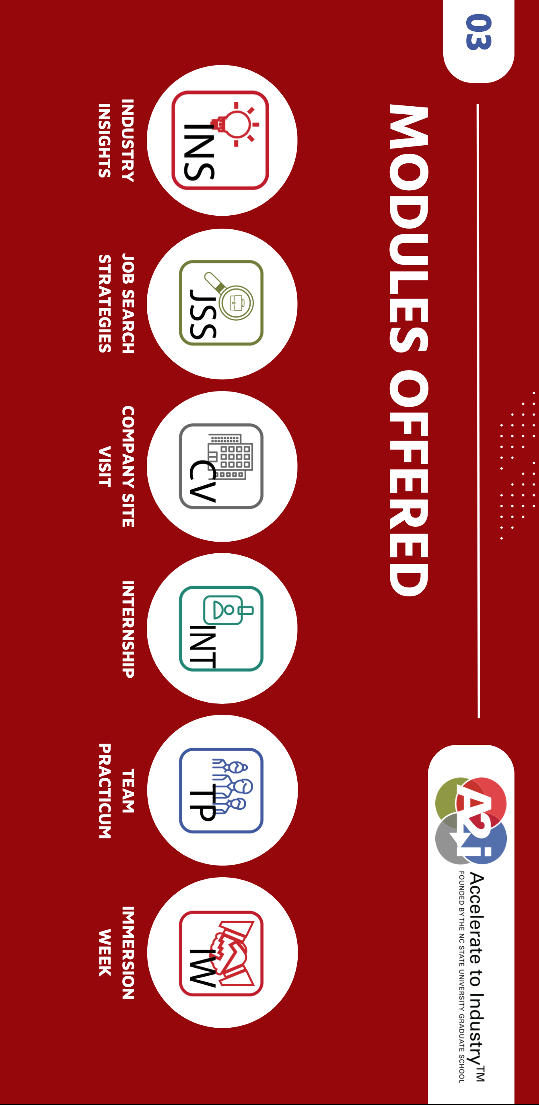

Slide 6



Slide 7
Happiness
Long-Term Goals
Short-Term Goals
Financial Needs
Family Needs

Slide 8
Owning Your Financial Future
YOUR VALUES
YOUR GOALS
Education
Career
Family
FINANCIAL STRATEGIES
Investing
Income & Expense Management
Debt Management
Taxes, Insurance & Other

Slide 9
Owning Your Financial Future
YOUR VALUES
YOUR GOALS
Education
Career
Family
FINANCIAL STRATEGIES
Investing
Income & Expense Management
Debt Management
Taxes, Insurance & Other

Slide 10

UPDATE ON THE CURRENT STATE OF THE ECONOMY

Slide 11
UPDATE ON THE CURRENT STATE OF THE ECONOMY
White House plans to freeze all federal funding for grants, loans and other program assistance at 4pm this evening.
  LOANS…
  If you have already received a federal loan, you should be able to keep the money…but you might not be able to plan on getting any more money this semester, this summer or in future terms.
  And you will be expected to repay anything you have already borrowed, presumably based on prior terms (although that might change).

Slide 12
UPDATE ON THE CURRENT STATE OF THE ECONOMY
White House plans to freeze all federal funding for grants, loans and other program assistance at 4pm this evening.
  GRANTS…
  New grant programs and proposals will be frozen temporarily, and possibly eliminated permanently.
  Outstanding grants…most grant money is phased in over the life of the grant (e.g. $1,000,000 over 5 years = $200,000 disbursed each year).
    Money that has been received is probably safe.
    Money that has been awarded but not disbursed might be frozen.
      “…agencies may also take certain administrative actions, like closing out grants”

Slide 13
UPDATE ON THE CURRENT STATE OF THE ECONOMY
Economic Effect on You & Me over the Short-Term (6 months? 6 years?)
White House plans to freeze all federal funding for grants, loans and other program assistance at 4pm this evening.
Use of tariffs for political purposes.
Immigration reform and accelerated deportation initiatives.
Unequivocally Negative
(Fewer jobs, higher inflation, higher interest rates)
Unequivocally Negative
(Fewer jobs, higher inflation, higher interest rates)
Uncertain, for the entire economy, generally

Slide 14
Owning Your Financial Future
YOUR VALUES
YOUR GOALS
Education
Career
Family
FINANCIAL STRATEGIES
Investing
Income & Expense Management
Debt Management
Taxes, Insurance & Other

Slide 15
Brian’s Top 3 Tips for
Navigating an Uncertain Economy
Cut your expenses & Build your emergency fund.
Analyze your budget and cut your discretionary expenses by 25%. Stop dining our, shop in bulk, do potluck dinners, clean out your pantry.
Have a dedicated savings account with the equivalent of 3-6 months of your non-discretionary expenses in it.
Your budget is one of the few things you can (kind of) control in a turbulent economy. This is the perfect time to focus on essentials, behaviors & habits.

Slide 16
Brian’s Top 3 Tips for
Navigating an Uncertain Economy
Cut your expenses & Build your emergency fund.
Take advantage of whatever interest rates are doing.
When they are low, refinance your mortgage, consolidate outstanding loans or credit cards (or stop using credit cards altogether). If you are close to graduating, and close to repaying student loans, learn about Income Driven Repayment or Public Service Loan Forgiveness programs (pending the White House’s impending freeze on funding).
When interest rates are high, move savings into CDs and possibly the stock market. Be proactive with your money.
    Most savings accounts are currently paying less than 1.0%. If you have a little bit of savings, you can find a Certificate of Deposit that is earning 4.0% or more. That’s a huge difference.
    The stock market gained over 20% in both 2023 and 2024. That’s great. And that’s higher than inflation.
      (It lost 19% in 2022, so there will always be risk…but it may be an option if you can invest for the long run.)

Slide 17
Brian’s Top 3 Tips for
Navigating an Uncertain Economy
Cut your expenses & Build your emergency fund.
Take advantage of whatever interest rates are doing.
Finish your degree & focus on your career opportunities.
Be proactive with your career planning. Look out for #1. Inflation is a much bigger problem when you’re earning a grad student stipend than when you’re earning a full-time professional salary.
If you are not close to graduation, explore internship and part-time opportunities. If you are an international student, begin exploring CPT and OPT opportunities (Curricular Practical Training, for before graduation, and Optional Practical Training, for after graduation).

Slide 18
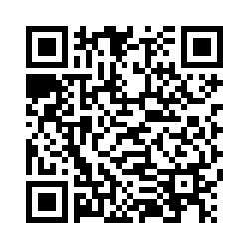

TELL US WHAT YOU THINK, PLEASE

Slide 19
You cannot escape the responsibility
of tomorrow by avoiding it today.

Slide 20
Strategies & Thinking for Success
What are your career goals?
What do you expect to be your job or career in 5 years?
What career advice do you have for others?

Slide 21
What Is Your Ideal Job After Graduation?
What is your ideal job and job description?
Where will you be living?
Who are you with? What is your family situation?
What are you working towards?
What will your job be in 3-5 years?

Slide 22
What Is Your Ideal Plan B?
What If Your Plan A Doesn’t Happen?
What Becomes Important to You?
What Are Your Short-Term Possibilities?
What is Ys Your Ideal Plan B?

Slide 23
What Is Your Ideal Plan B?
What could go wrong with the above Plan A? What is the biggest threat?
What is your back-up job and job description? What is your ideal Plan B?
What can you control? What can you do today to make sure this Plan B is an option?
What can you do with your Plan B in the short-term to get to a better plan in 3-5 years?
What resources or help will you need to make this Plan B an option?

Slide 24
Brian’s Top 3 Tips for
Navigating an Uncertain Economy
Plan ahead.
Control what you can control.

Slide 25
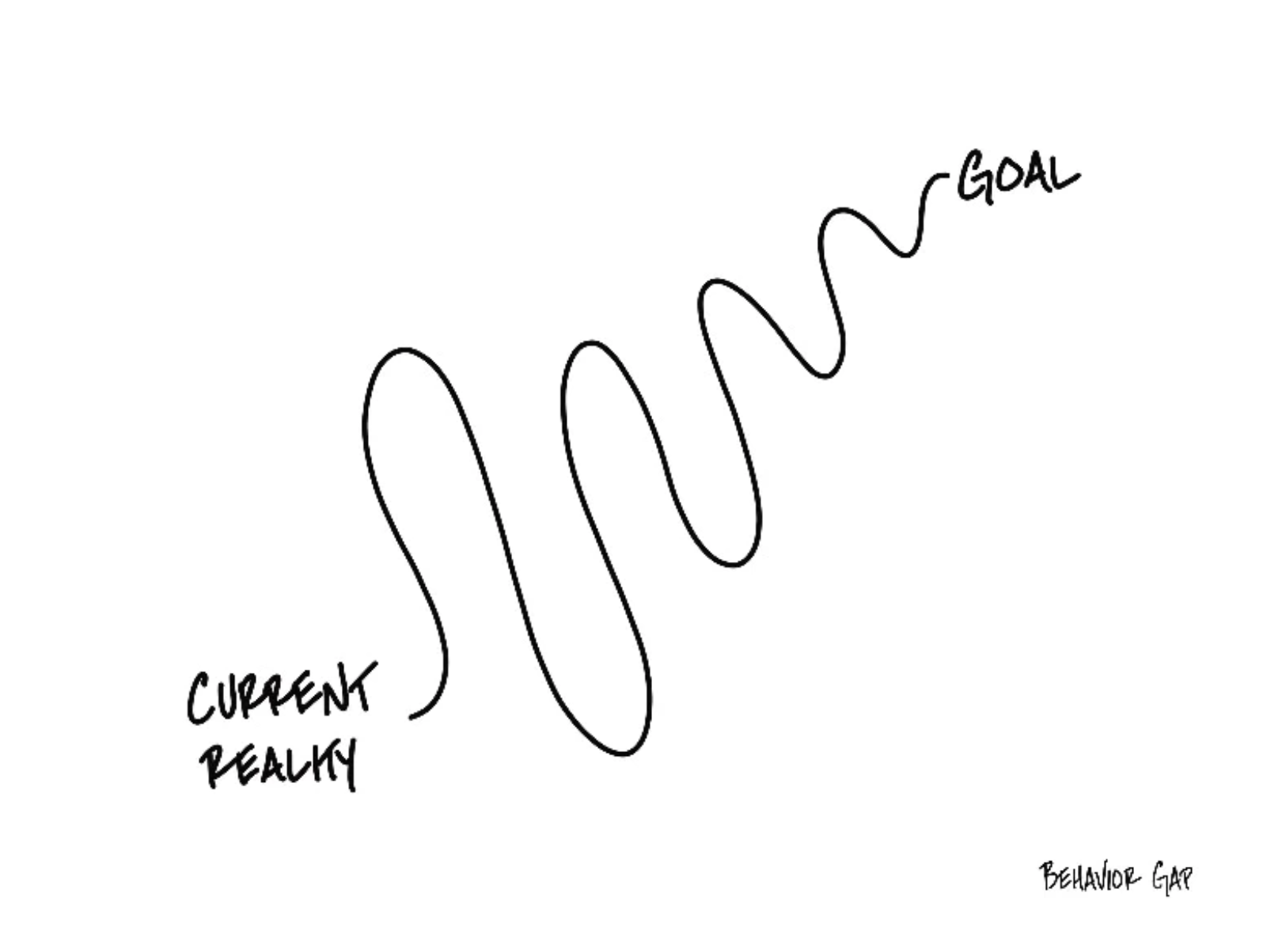

Slide 26
TODAY THE NEXT 6 MONTHS THE NEXT 12 MONTHS 2 YEARS AFTER GRADUATION 3 YEARS AFTER GRADUATION
ONCE EVERY SEMESTER:
TRACK EVERY PENNY THAT YOU SPEND & TRACK EVERY PENNY THAT YOU EARN
IN THE NEXT 3 MONTHS:
IDENTIFY WAYS TO DECREASE YOUR DISCRETIONARY SPENDING BY 25%
IN THE NEXT 6 MONTHS:
MAKE A PLAN TO MANAGE – AND PAY OFF – YOUR DEBT
IN THE NEXT 6-12 MONTHS:
OPEN MULTIPLE SAVINGS ACCOUNTS, 1 FOR EACH GOAL
IN THE NEXT 12 MONTHS, OPEN AN IRA OR ROTH IRA
WITHIN 2 YEARS OF GRADUATION:
HAVE AN “EMERGENCY FUND” ACCOUNT, WITH 3-6 MONTHS OF NON-DISCRETIONARY EXPENSES
WITHIN 3 YEARS OF GRADUATION:
ELIMINATE ALL OF YOUR BAD DEBT.

Slide 27
Challenge #1
For 3 months a year – once in the fall, once in the spring, once in the summer – track every penny you spend. Prepare a complete budget of your expenses to look in the mirror to determine what your spending habits and behaviors are.
• Identify discretionary vs. non-discretionary cash flows.
• Identify investments vs. expenses.
• Identify personal vs. business expenses.

Slide 28
Challenge #2
Open a Roth IRA (Individual Retirement Account) or a taxable brokerage account to begin investing for your future.
A Roth IRA – or any retirement plan – has some restrictions and is designed for the long-term, but comes with tax deferral and possibly tax avoidance options.
A taxable brokerage account has more flexibility, but does not have tax benefits.
When it comes to investing, TIME is your best friend. The earlier you begin investing, the sooner your investments begin working for your and your future.
There are dozens of investment platforms available, and the investing options are virtually identical across platforms, so which one you use is a personal decision. Robinhood and Fidelity are two of the most popular, but any will serve your purposes.

Slide 29
Challenge #3
Begin building your personal – and possibly business – debt profile.
Check your credit score regularly and check your credit report annually. Make sure that the information in your account and affecting your debt profile is accurate.
Get at least 1 credit card as soon as possible. Think about having 2 or 3 credit cards. Only use them as you would use a debit card or cash…but the credit features (a) can give you rewards or benefits or cash, and (b) help your credit score.
Getting a credit card is easier while you are young…so begin as quickly as possible.
When looking at credit cards, they are all very similar. Which is best depends on you. But I would look at 3 things: (1) do not pay an annual fee, (2) lower interest rate (not just any introductory rates, but the regular rates), and (3) what reward benefits are being offered.

Slide 30
Challenge #4
Many of you will have a formal or informal business at some point in your life. Getting that business legal and professional as soon as possible will make your life much easier and better.
You owe income tax on all income you earn, whether as an individual or as a business. But you only owe tax on NET business income, after expenses are deducted, which is nice.
Keep track of all personal and business expenses – and know which expenses you can claim as business expenses to reduce your overall taxable income. Yes, this is legal.
Go to https://geauxbiz.sos.la.gov to begin your business ownership journey. You can spend $25 to reserve your company name or you can spend $100 to $200 to legally establish your business in the state. When asked which legal structure you want, if in doubt, choose LLC – or Limited Liability Company – as it has the best legal liability protection and flexibility.
Even if your ‘business’ is just a small side hustle, the sooner you make it legal and professional, the more flexibility and less legal liability you might have in the future. Do it.

Slide 31
Challenge #5
Strategic planning…
Complete the thought exercises in this deck and in your book once a year, to think about your current and desired future financial goals and plans.
This plan is the first – and most important step – towards turning your goals into a plan and into reality.

Slide 32
A Few Thought Exercises
What are your short-term goals?
What are your medium-term goals?
What is your ideal career?
What is your best Plan B?
What is your dream life when you are 30?
What is your dream life when you are 50?

Slide 33
Owning Your Financial Future
What Are Your Values, Dreams & Goals?
Education
Career
Family
What Is Your Current Situation?
Education
Career
Family
Financial
Create a Personal Financial Plan for You:
Investing
Budgeting
Debt Management
Taxes
Insurance
Retirement
Education
Family
Business Planning
Estate Planning
Philanthropy

Slide 34
A Few Opening Morals
Personal Finance is…personal.
It’s about you and not about anyone else.
You have to make it about you and your goals.

Slide 35
A Few Opening Morals
There is no judgment in personal finance.
There is no ego in personal finance.
There is no shame in personal finance.
It’s about you and not about anyone else.

Slide 36
A Few Opening Morals
Because personal finance is personal, it is virtually impossible for me to give you any specific advice.
However, there is one word of advice that applies to 99% of people working on their finances:
SAVE

Slide 37
A Few Opening Morals
SAVINGS
INVESTING
OWNERSHIP
WEALTH

Slide 38
If you save or invest $5,000 per year….
With a 1% investment return, you will have a total of $325,539 after 50 years.
This includes $75,539 of passive income.

Slide 39
If you save or invest $5,000 per year….
With a 4% investment return, you will have a total of $793,869 after 50 years.
This includes $543,869 of passive income.

Slide 40
If you save or invest $5,000 per year….
With a 7% investment return, you will have a total of $2,174,930 after 50 years.
This includes $1,924,930 of passive income.

Slide 41
If you save or invest $5,000 per year….
With an 11% investment return, you will have a total of $9,261,680 after 50 years.
This includes $9,011,680 of passive income.
If you save or invest $5,000 per year….
With a 11% investment return, you will have a total of $9,261,680 after 50 years.
This includes $9,011,680 of passive income.

Slide 42
If we invest for 20 years instead of 50 years:
At 1%: $100,000 ➔ $111,196
At 4%: $100,000 ➔ $154,846
At 7%: $100,000 ➔ $219,326
At 11%: $100,000 ➔ $356,326

Slide 43
A Few Opening Morals
Begin investing as early as you can.
Get comfortable taking some risks with your investing so you can earn bigger returns.
Get comfortable playing the long game.

Slide 44
A Few Opening Morals
SAVINGS
INVESTING
OWNERSHIP
WEALTH

Slide 45
Some Homework for You
Make a list of the 5-10 most important criteria you are looking for in a job or career.
Rank these criteria.
Connect these criteria to your long-term and
short-term goals. Connect these criteria to your values.

Slide 46
More Homework for You
Once a week: Make a list of the money you are
going to spend this week.
Once a month: Make a list of how your job serves
your values – or how school serves
your values over the long-term.
Once a year: Revisit your values and identify
your short- and long-term goals.

Slide 47
Values, Financial Wellness & Resilience
Budgeting & Debt Management
Resetting your financial plan
Tax planning
Summer Work, Holiday spending & New Year’s Resolutions
Revisiting your family, personal & career goals

Slide 48
Budgeting & Debt Management
Budgeting – The one truth is that you can only spend money that you have or earn…unless you borrow.
  Find a budget approach that works for you.
  Don’t outsource all of your budgeting to apps, websites or your bank. Do it yourself. Internalize the numbers.
  Set boundaries and rules – make willpower natural.
  Set goals and challenges – make saving a game.
  Align your spending with your values and what you care about most.

Slide 49
Budgeting & Debt Management
Debt Management – When you borrow, you are saying that your present needs are so great that you are willing to endure some pain or sacrifice in the future to satisfy those needs (and almost all students do this).
  Whenever you borrow – whether it’s student loans or credit card debt – make a plan for how you’re going to repay that debt.
  Interest: the premium you pay to use someone else’s money.
    Find loans with low rates, no fees or penalties & a short repayment term.
  Once a year, talk to a bank or lender about consolidating your debt.
  Live a life that is not controlled by debt. This starts with your values, your behavior & your budgeting. Always have a plan to get rid of your debt.

Slide 50
Financial Wellness & Resilience
Resetting your financial plan
  Revisit your values and identify your short- and long-term goals
  Analyze your insurance, phone, subscription and other expenses
  Should you look for a new job?
  Start a money journal – note your behaviors, feelings and emotions related to how you spend money
  Share your financial goals with your family

Slide 51
TODAY THE NEXT 6 MONTHS THE NEXT 12 MONTHS 2 YEARS AFTER GRADUATION 3 YEARS AFTER GRADUATION
ONCE EVERY SEMESTER:
TRACK EVERY PENNY THAT YOU SPEND & TRACK EVERY PENNY THAT YOU EARN
IN THE NEXT 3 MONTHS:
IDENTIFY WAYS TO DECREASE YOUR DISCRETIONARY SPENDING BY 25%
IN THE NEXT 6 MONTHS:
MAKE A PLAN TO MANAGE – AND PAY OFF – YOUR DEBT
IN THE NEXT 6-12 MONTHS:
OPEN MULTIPLE SAVINGS ACCOUNTS, 1 FOR EACH GOAL
IN THE NEXT 12 MONTHS, OPEN AN IRA OR ROTH IRA
WITHIN 2 YEARS OF GRADUATION:
HAVE AN “EMERGENCY FUND” ACCOUNT, WITH 3-6 MONTHS OF NON-DISCRETIONARY EXPENSES
WITHIN 3 YEARS OF GRADUATION:
ELIMINATE ALL OF YOUR BAD DEBT.

Slide 52
Financial Wellness & Resilience
Tax planning
  Do you want to make any charitable donations before year-end (or wait until January)?
  Should you recognize any investment gains or losses before year-end?
  Do you know all of the deductions and credits that you are eligible for?
  Did you receive a tax refund this year? Do you really want a tax refund each year?

Slide 53
Financial Wellness & Resilience
Summer Work
  If you’re earning money this summer, make a plan for how that money is going to help you achieve your future goals.
    Yes, it’s okay to enjoy some of that money during this summer…but maybe don’t enjoy ALL of it.
  If you’re not earning money this summer, this is a great time to develop budgeting habits that will serve you in the long-term.
  When do you transition from a job that pays well (but doesn’t align with your career goals) (like bartending) to an internship or lower-paying job (that does align with your career goals)?
    Only you can decide that…but you probably will have to decide at some point.

Slide 54
Financial Wellness & Resilience
New Year’s Resolutions
  Create specific financial goals (For example…Eliminate 3 subscriptions this year)
  Create generic financial goals (For example…Improve my credit score)
  Think about how financial resolutions relate to other resolutions
    If you want to exercise, travel or read more, what will it cost?

Slide 55
Financial Wellness & Resilience
Revisiting your family, personal & career goals
  What do you want to achieve over the next 1-2 years?
  What do you want to achieve over the next 3-5 years?
  What do you want to achieve over the next 10 years?
  As you revisit your goals, be sure to communicate with your family and anyone else affected by your goals.

Slide 56
Owning Your Financial Future
What Are Your Values, Dreams & Goals?
Education
Career
Family
What Is Your Current Situation?
Education
Career
Family
Financial
Create a Personal Financial Plan for You:
Investing
Budgeting
Debt Management
Taxes
Insurance
Retirement
Education
Family
Business Planning
Estate Planning
Philanthropy

Slide 57
January Activities
TRACK EVERY PENNY THAT YOU SPEND & TRACK EVERY PENNY THAT YOU EARN.
CATEGORIZE EVERY EXPENSE AS EITHER ‘NON-DISCRETIONARY’ (needs) or ‘DISCRETIONARY’ (wants).
IDENTIFY WAYS TO DECREASE YOUR DISCRETIONARY SPENDING BY 25%.
REVISIT YOUR COMPANY-SPONSORED RETIREMENT PLAN CONTRIBUTIONS
Are you maximizing the company match?
MAKE A LIST OF YOUR FINANCIAL GOALS FOR THE YEAR….AND IDENTIFY HOW YOU ARE GOING TO ACHIEVE EACH GOAL?
BEGIN THINKING ABOUT AND AGGREGATING INFORMATION TO COMPLETE LAST YEAR’S TAX RETURN

Slide 58
February Activities
UNDERSTAND ALL OF YOUR DEBT.
IDENTIFY YOUR GOOD DEBT AND YOUR BAD DEBT.
MAKE A PLAN TO PAY DOWN YOUR BAD DEBT.
BEGIN PAYING $10 or $100 MORE THAN YOU NEED TO FOR EACH BAD DEBT.
IDENTIFY WAYS TO DECREASE YOUR NON-DISCRETIONARY SPENDING BY 10%
CANCEL AT LEAST 1 SUBSCRIPTION.
PREPARE LAST YEAR’S TAX RETURN.
FILE IF YOU ARE GETTING A REFUND.
WAIT UNTIL APRIL IF YOU OWE.
IF YOU ARE GETTING A TAX REFUND, CONSIDER TALKING TO HUMAN RESOURCES AND DECREASING YOUR WITHHOLDING.

Slide 59
March Activities
DO NOT GO TO THE GROCERY STORE – Except for beverages and perishables.
See if you can empty your pantry and freezer.
CHECK YOUR CREDIT SCORE.
CHECK YOUR CREDIT REPORT.
Verify that what is in the Report belongs to you. Make a plan to improve your Score.
SET A BUDGET FOR
SPRING & SUMMER.
MAKE SURE YOU KNOW WHAT INCOME & EXPENSES YOU WILL HAVE DURING THE NEXT 6 MONTHS.
REVISIT SOME OF YOUR NON-DISCRETIONARY EXPENSES TO SEE IF YOU CAN DECREASE THEM – Insurance, Cable, Phone, Subscriptions.
IF YOU HAVE RECEIVED YOUR TAX REFUND, DO SOMETHING POSITIVE WITH IT – Pay down debt, invest it, put it in an IRA, donate it.
It’s not free money – it’s yours!

Slide 60
April Activities
TRY A DRY APRIL.
NO ALCOHOL ALL MONTH
Alternatively, only drink at home. Or do the same with coffee.
PAY AN EXTRA $100 ON AT LEAST 1 DEBT BALANCE.
REVIEW YOUR INVESTMENT PORTFOLIOS.
DO YOU WANT MORE RISK?
NEW SECURITIES?
NEW ADVISORS?
MAKE SURE YOU HAVE A BASIC ESTATE PLAN.
MAKE SURE YOU HAVE A WILL. THINK ABOUT WHETHER YOU NEED TRUSTS FOR THE MOST EFFICIENT TRANSFER OR ASSETS.
IF YOU OWE TAXES, PUT YOUR RETURN AND CHECK IN SNAIL MAIL ON APRIL 15.
WAIT AS LONG AS POSSIBLE.

Slide 61
May Activities
TRACK EVERY PENNY THAT YOU SPEND & TRACK EVERY PENNY THAT YOU EARN.
SET UP A NEW SAVINGS ACCOUNT FOR DIFFERENT GOALS – Vacation, Car, House, Retirement.
Having different accounts utilizes ‘mental budgeting.’
SET UP AUTOMATIC TRANSFERS SO YOU PAY YOURSELF FIRST WITH EACH PAYCHECK. AUTOMATICALLY MOVE $XXX FROM DEBIT TO SAVINGS ACCOUNTS.
GET SAVINGS, INVESTING & POSSIBLY EDUCATION & RETIREMENT ACCOUNTS FOR YOUR CHILDREN.
Help them begin learning how to own their financial futures.
INVENTORY ALL OF YOUR PERSONAL ASSETS
(maybe do this twice a year).
TAKE PHOTOS & VIDEOS. REVIEW YOUR INSURANCE POLICIES.

Slide 62
June Activities
REVISIT YOUR FINANCIAL GOALS FOR THE YEAR.
MAKE ADJUSTMENTS TO MOVE FORWARD THE REST OF THE YEAR.
PERFORM A MID-YEAR CHECK ON ALL OF YOUR ACCOUNTS & ACTIVITIES.
IS EVERYTHING ON TRACK.
OPEN AN INDIVIDUAL RETIREMENT ACCOUNT OR ROTH IRA.
NO DINING OUT.
(Or, no fast food, or coffee, or only on weekends, or only for dinner …anything to improve habits & spending)
HAVE FUN.
ENJOY YOUR SUMMER.
THE PURPOSE OF PLANNING IS TO BE HAPPY & INDULGE
(AND TO AVOID IMPULSES)

Slide 63
July Activities
FIND A PERSONAL FINANCE PODCAST, VIDEO OR BOOK TO ENGAGE WITH.
Finance is personal. Find the tools that help you most.
HAVE A FINANCIAL HEART-TO-HEART WITH YOUR SPOUSE.
OR PARENTS.
OR CHILDREN.
ASK FOR A CREDIT LIMIT INCREASE ON ALL OF YOUR CREDIT CARDS TO IMPROVE YOUR CREDIT SCORE.**
** DO NOT do this if it will lead to more spending.
DO YOU HAVE AN EMERGENCY FUND? DO YOU HAVE A FUND WITH 3-6 MONTHS OF NON-DISCRETIONARY EXPENSES SAVED? CAN YOU?
HAVE FUN.
ENJOY YOUR SUMMER.
THE PURPOSE OF PLANNING IS TO BE HAPPY & INDULGE
(AND TO AVOID IMPULSES)

Slide 64
August Activities
ASK FOR A RAISE.
PREPARE A BACK-TO-SCHOOL BUDGET.
REVIEW YOUR SUMMER BUDGETS AND SPENDING.
WHAT CAN YOU LEARN FROM THIS FOR THE REST OF THE YEAR OR FOR NEXT YEAR?
REVISIT ANY INSURANCE and/or LIFE INSURANCE POLICIES.
DO YOU HAVE THE COVERAGE YOU NEED FOR THE TIME PERIODS YOU NEED?
START YOUR OWN BUSINESS.
IT CAN BE VERY EASY – WHETHER YOU ARE SELLING SOMETHING OR CONSULTING – TO CREATE ANOTHER INCOME STREAM

Slide 65
September Activities
TRACK EVERY PENNY THAT YOU SPEND & TRACK EVERY PENNY THAT YOU EARN.
CREATE SAVINGS GAMES FOR YOU AND YOUR CHILDREN.
If we save $XXX this month, we will reward ourselves with…
REVIEW YOUR INVESTMENT & RETIREMENT PORTFOLIOS. REBALANCE FOR THE REST OF THE YEAR.
BUDGET FOR YOUR ANNUAL CHARITABLE DONATIONS.
ALIGN YOUR GOALS WITH YOUR PLANS. MAKE SURE THE MONEY IS AVAILABLE.
PAY AN EXTRA $100 ON AT LEAST 1 DEBT BALANCE.

Slide 66
October Activities
OCTOBER IS USUALLY HEALTH INSURANCE OPEN ENROLLMENT MONTH, WHEN YOU CAN CHANGE PLANS – MAKE SURE YOU HAVE THE RIGHT PLAN FOR YOU & YOUR FAMILY.
EVALUATE ANY CONTRIBUTIONS TO AN HSA (Health Savings Account) or FSA (Flexible Spending Account).
Make sure you are optimizing these benefits.
COMPLETE THE FAFSA – FREE APPLICATION FOR FEDERAL STUDENT AID – FOR YOU and/or YOUR CHILDREN IN SCHOOL.
BUDGET FOR YOUR HOLIDAY SPENDING. MAKE SURE THE MONEY IS AVAILABLE.
MAKE A LIST OF WHAT YOU ARE NOT GOING TO SPEND, TOO.
IF YOU REQURESTED A 6-MONTH INCOME TAX FILING EXTENSION…FILE YOUR TAXES.

Slide 67
November Activities
FOR YOUR HOLIDAY SPENDING, BEGIN LOOKING FOR THE BEST DEALS.
(THE FIRST DEALS ARE NOT ALWAYS THE BEST.)
PAY AN EXTRA $100 ON AT LEAST 1 DEBT ACCOUNT.
(BEFORE YOU BECOME FOCUSED ON HOLIDAY SPENDING.)
IDENTIFY YOUR TOP 5-10 VALUES IN LIFE.
How do these values connect to your family? How do these values connect to your finances?
DO YOU NEED A NEW JOB?
DID YOUR CURRENT JOB HELP YOU ACHIEVE YOUR PERSONAL, PROFESSIONAL & FINANCIAL GOALS?
CAN YOU MAKE YOUR SIDE-HUSTLE OR BUSINESS MORE PROFESSIONAL?
FILE FOR AN LLC WITH THE STATE? HIRE EMPLOYEES? NEW BUSINESS PLAN?
REVIEW YOUR LIST OF FINANCIAL GOALS FOR THE YEAR.
HOW DID YOU DO?
CAN YOU DO BETTER?

Slide 68
December Activities
PRIORITIZE YOUR MENTAL AND PERSONAL HEALTH.
Without mental wellness, nothing else in this conversation matters.
MAKE 2-3 FINANCIAL NEW YEAR RESOLUTIONS.
Make sure your goals are aligned with your values.
DON’T JUST BUY GIFTS FOR OTHERS.
TREAT YOURSELF, TOO.
HAVE ANY OF YOUR INVESTMENTS LOST MONEY THIS YEAR? DO YOU WANT TO SELL THEM TO RECOGNIZE THE LOSSES (AND THE TAX BENEFITS)?
IF IT’S IMPORTANT TO YOU, DONATE TIME AND/OR MONEY.
For many recipients, your time is just as valuable as your money.
CELEBRATE ALL OF YOUR SUCCESS FOR THE YEAR.

Slide 69
Making Financial Planning a Priority
EDUCATION STRATEGIES
SCHOOL STRATEGIES
Identify Your Resources
Identify Your
Priorities & Goals
Do Your Planning
Monitor & Modify Your Progress & Plan

Slide 70
Making Financial Planning a Priority
FINANCIAL STRATEGIES
EDUCATION STRATEGIES
BUDGETING
STRATEGIES
SCHOOL STRATEGIES
Identify Your
Income & Expenses
Identify Your Resources
Identify Your
Priorities & Goals
Identify Your
Priorities & Goals
Do Your Planning
Do Your Planning
Monitor & Modify Budgeting Activities
Monitor & Modify Your Progress & Plan

Slide 71
Making Financial Planning a Priority
FINANCIAL STRATEGIES
YOU,
as grad students, are better wired and equipped to make long-term plans – education, career, financial & otherwise – than 99% of humanity.
Be confident.
Be intentional.
Be diligent.
Be awesome.
EDUCATION STRATEGIES
BUDGETING
STRATEGIES
SCHOOL STRATEGIES
Identify Your
Income & Expenses
Identify Your Resources
Identify Your
Priorities & Goals
Identify Your
Priorities & Goals
Do Your Planning
Do Your Planning
Monitor & Modify Budgeting Activities
Monitor & Modify Your Progress & Plan

Slide 72
Financial Planning for the Year
5 Things Everyone Should Do:
BUDGET!
  Make shopping lists…for all types of shopping: food, gifts, fun, weekends.
  Make lists of what you ARE NOT going to buy…for all types of shopping.

Slide 73
Financial Planning for the Year
5 Things Everyone Should Do:
BE VERY CAREFUL ABOUT INCREASING DEBT
  Avoid increasing balances on credit card
  Maybe only use credit cards for groceries and gas and use a debt card for everything else.

Slide 74
Financial Planning for the Year
5 Things Everyone Should Do:
GET RID OF AT LEAST 1 SUBSCRIPTION
  Review your expenses and find any/all recurring subscriptions
  Find at least 1 to get rid of before the year end
  And make sure you do not add any that you are not going to use or get your money’s worth

Slide 75
Financial Planning for the Year
5 Things Everyone Should Do:
LOOK FOR DEALS…BUT ALSO BE WARY OF DEALS
  By shopping early and shopping around, you can find the best deals for what you need to buy
  But be careful – many deals will have fine print that commits you to further costs or to other constraints that are not in your best interest

Slide 76
Financial Planning for the Year
5 Things Everyone Should Do:
SET 5 FINANCIAL RESOLUTIONS THAT YOU CAN STICK WITH
  Check your credit report and credit score, open multiple savings accounts, pay yourself first with $5-$25 of every paycheck going to savings, analyze every penny you spend during 3-5 months in 2024, find a budget approach that works for you, set financial goals for the next 3-5 years, finalize your back-to-school spring 2024 budget, begin investing, pay down any high-interest debt (even before savings), do not dine out or go grocery shopping in January, maximize credit card rewards

Slide 77
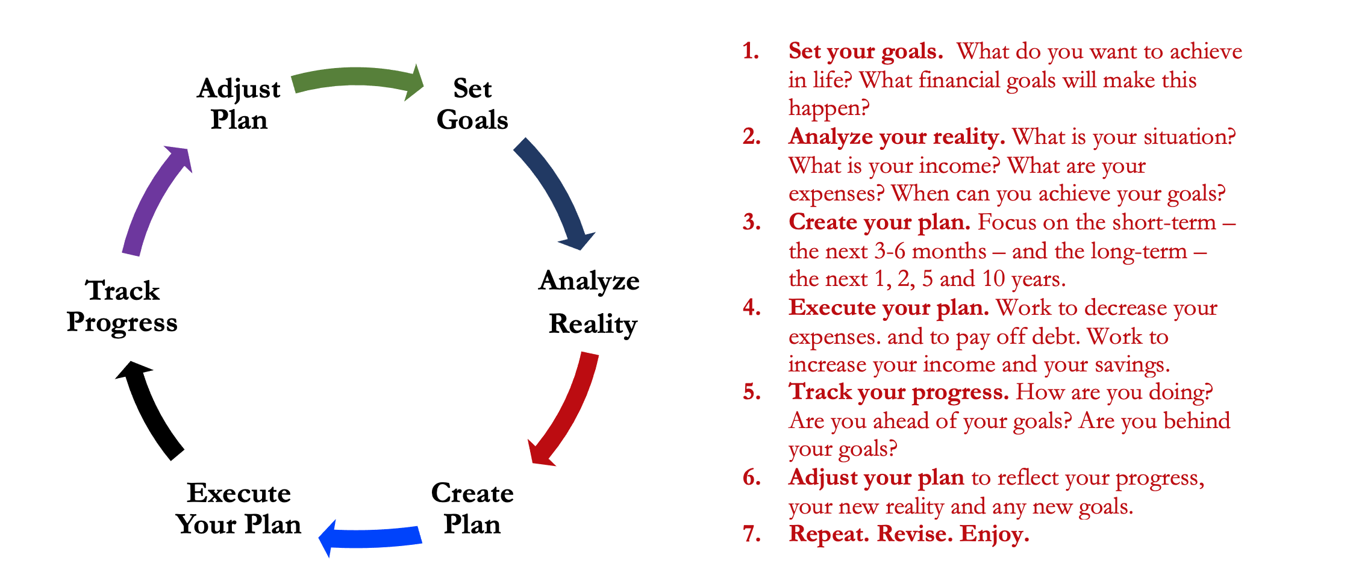
Isn’t this a lot like what you do with your education planning?

Slide 78
Financial Wellness
A goal without a plan is just a dream.
Wealth is largely the result of habit.
The most difficult thing is the decision to act; the rest is mere tenacity.
It takes as much energy to plan as it does to wish.
You cannot escape the responsibility of tomorrow by avoiding it today.

Slide 79
Don’t wait around for other people to be happy for you.
Any happiness you get,
You’ve got to make yourself.
A goal without a plan is just a dream.
Wealth is largely the result of habit.
The most difficult thing is the decision to act; the rest is mere tenacity.
It takes as much energy to plan as it does to wish.
You cannot escape the responsibility of tomorrow by avoiding it today.

Slide 80
MONEY MATTERS SERIES: SPRING 2025
JANUARY 28
Financial Resolutions for the New Year
FEBRUARY 17
Financial Planning for International Students
MARCH 25
Tax
Planning Strategies
APRIL 8
Career Planning
& Financial Planning

Slide 81

brian.bolton@louisiana.edu http//:business.louisiana.edu/financeispersonal

Slide 82

gradschool@louisiana.edu

