Slide 1
Let’s Do Some Fake Investing!
Which of these company stocks has performed the best over the past 2 years?
Apple
Disney
Google
JP Morgan Chase
McDonald’s
Microsoft
Nike
Tesla
Visa
Walmart

Slide 2


MONEY MATTERS
Fall 2024 SESSION #1
September 18, 2024
Managing Money, Grad School & Life: Balancing All of Your Priorities
Manage Your Money Today, Maximize Your Money in the Future

Slide 3
MONEY MATTERS SERIES: FALL 2024
SEPTEMBER 18
Managing Money, Grad School & Life: Balancing All of Your Priorities
OCTOBER 10
Investing for Your Future: Compounding Your Success
OCTOBER 29
Debt, Taxes & Inflation: Navigating Life's Financial Challenges

Slide 4


We are exciting to announce that we are now an academic partner with Accelerate to IndustryTM, a program with a bold, new approach to enhance graduate student and postdoctoral industry workforce readiness.
The A2i approach includes a range of modules that allow graduate students, postdocs, and alumni to benefit from the entire range of activities, or individual components.

Slide 5
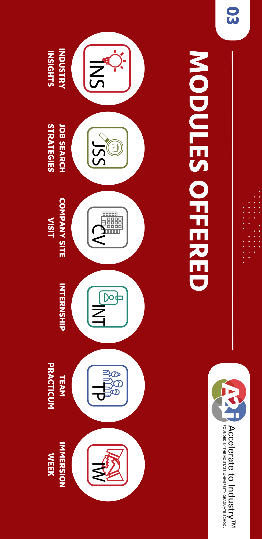

Slide 6



Slide 7
What does this mean for you?
You will have access to webinars, workshops, events and activities presented by other Academic Partners and by A2i at North Carolina State.
  We might create Money Matters programming for others to join.
We will sponsor / host / create different A2i modules here for you to better prepare for a variety of careers – including industry and academia – and to better connect with local professionals and industry partners.

Slide 8
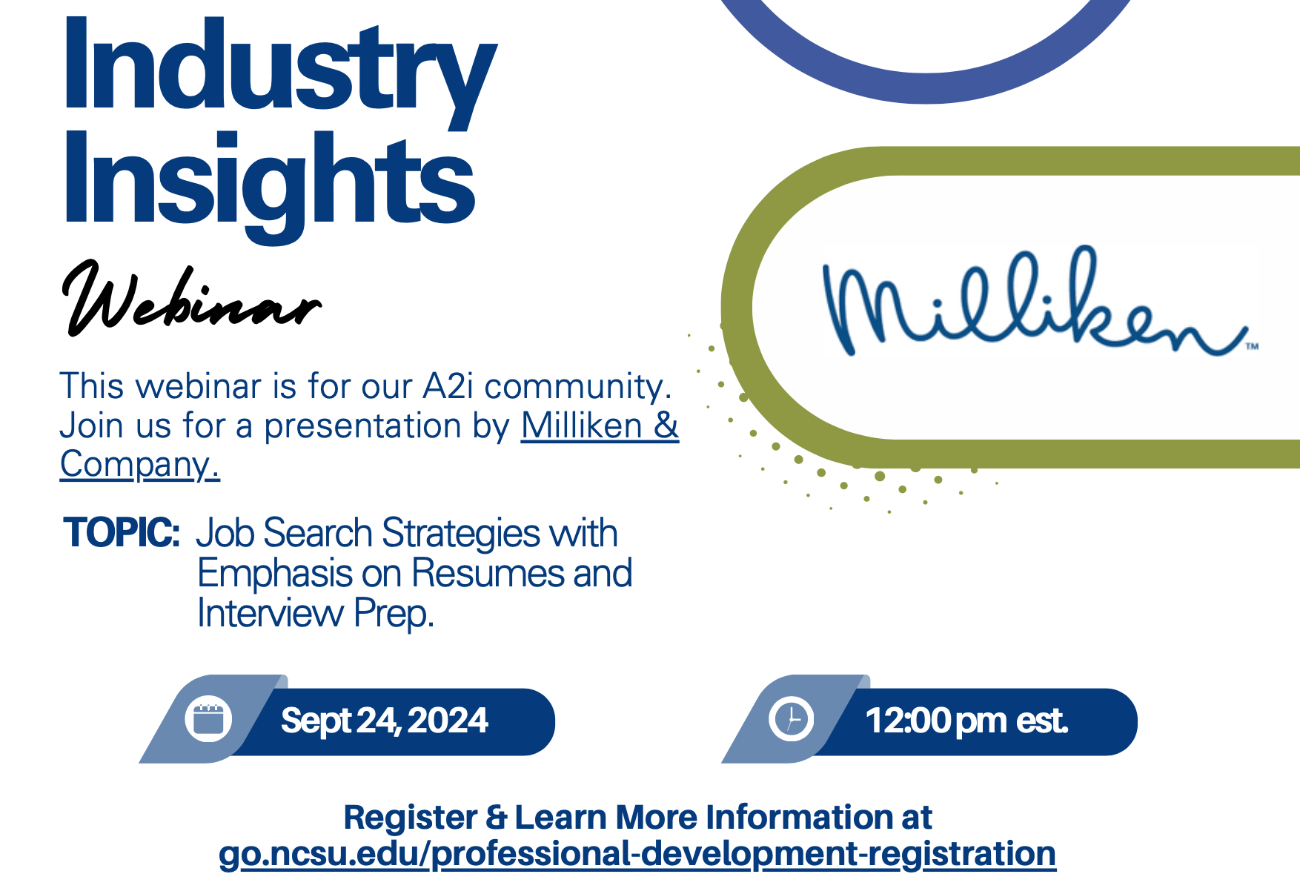

Slide 9
NOVEMBER 13
Thinking Like an Entrepreneur & Exploring Alternative Career Options
This session will blend Money Matters career planning perspectives with A2i content & information.

Slide 10
Happiness
Long-Term Goals
Short-Term Goals
Financial Needs
Family Needs

Slide 11
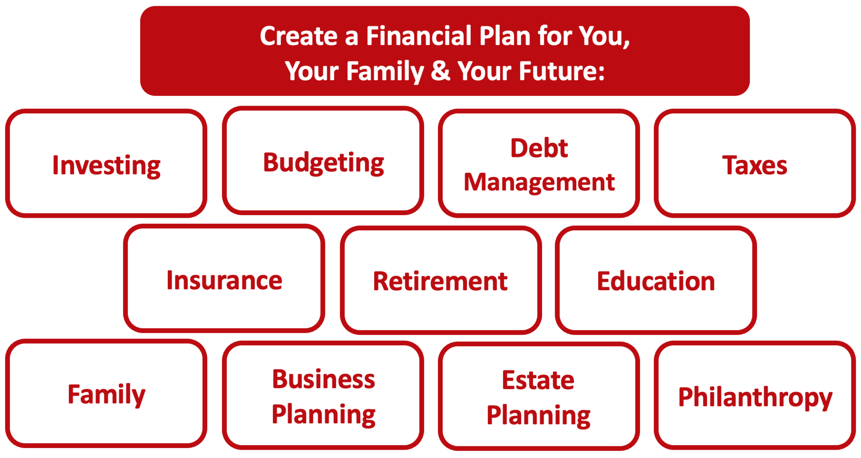

Slide 12
Owning Your Financial Future
YOUR VALUES
YOUR GOALS
Education
Career
Family
FINANCIAL STRATEGIES
Investing
Income & Expense Management
Debt Management
Taxes, Insurance & Other

Slide 13
Owning Your Financial Future
YOUR VALUES
YOUR GOALS
Education
Career
Family
FINANCIAL STRATEGIES
Investing
Income & Expense Management
Debt Management
Taxes, Insurance & Other

Slide 14
School & Education
Money
Family

Slide 15
INDULGENCE is good.
IMPULSE is bad.
PLANNING AHEAD is the key.

Slide 16
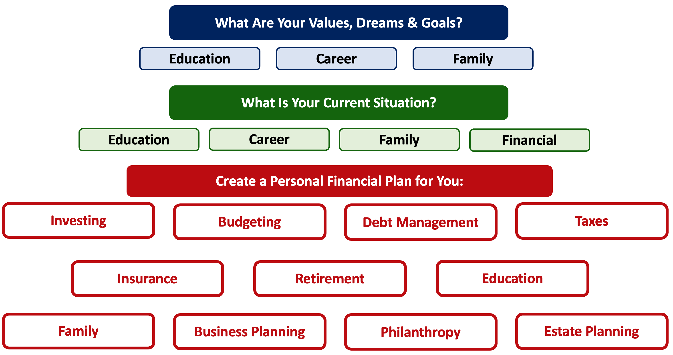
RENT
FOOD
SCHOOL
A FUN VACATION
A NEW CAR
SATURDAY NIGHT

Slide 17
HAPPINESS

Slide 18
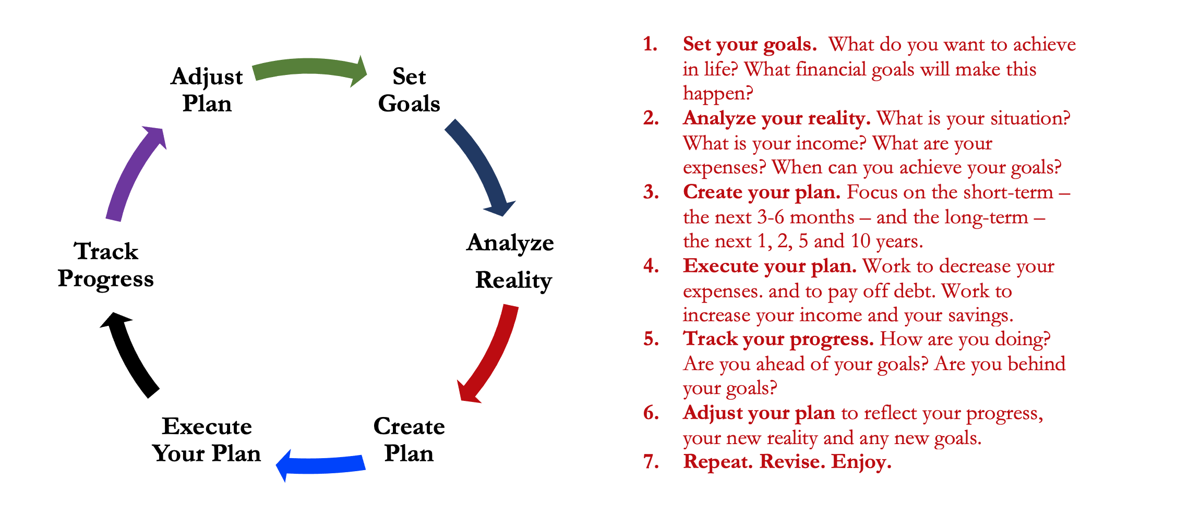

Slide 19
And as you begin to develop your full financial plan – seeing the trade-offs with Budgeting, Investing and Debt Management – you will begin to see how interconnected all of these aspects are.
Finance is just a matter of managing money across time.
And one thing we know about time is that our plans will change – so the better you have control of your initial financial plan, the more you will be able to adjust when life and time give you new goals.
Isn’t this a lot like what you do with your education planning?

Slide 20
Why Are You Here?
Take a few seconds to ask yourself:
Why Are You in Graduate School?
What are your career goals?
To become a teacher or administrator?
To work for Google?
To become a professor?
To design some world-changing invention?

Slide 21
Why Are You Here?
Why do I think you are here?
I think you are here to think about your financial situation.
I think you are here to begin developing a financial plan.
I think you are here today to gain better control over your income and expenses to help you:
Eliminate some stress associated with a grad school budget.
Maximize your goals over the long-term.

Slide 22
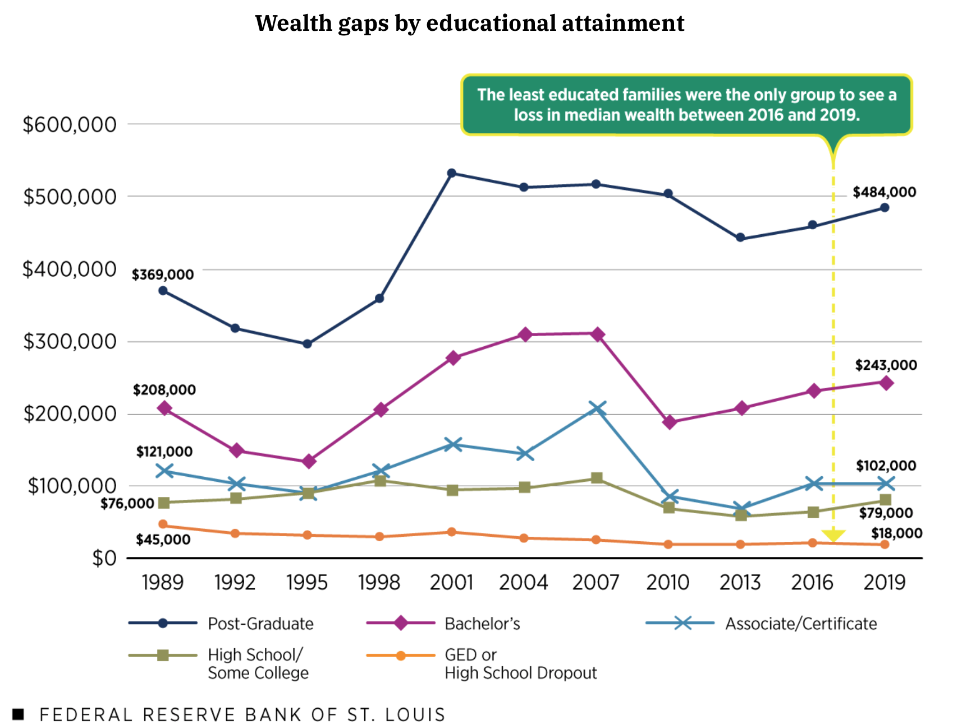
THE WEALTH GAP
IN THE
USA

Slide 23
Preview: A Few Rules About INVESTING
Investing lets COMPOUND INTEREST (or GROWTH) be your friend.
  With compound interest, your interest earns interest.
  Without actively making decisions, your money can grow exponentially.
  Yes, there is risk – the exponential growth rate could be negative.
  Such risk is greatest if you ‘invest’ over very short periods of time.
  Historically, over the past 100+ years, if you invest for 5+ years, you have benefited from positive exponential growth.
  The average return of a common stock over the past 100 years is 10%.
    The word ’average’ is very important here. But, the good news, we can all achieve ‘average’ returns relatively easily (though they may not be 10% in the future)

Slide 24
Opening Quiz – Question #1
If you had invested $1,000 in the S&P 500 at the beginning of 2021
(3+ years years ago), how much would that $1,000 be worth today?
(The S&P 500 is an index of 500 of the largest U.S. companies, generally regarded as the best measure of the overall ‘stock market.’)
A. $775
B. $1,000
C. $1,581
D. $4,043

Slide 25
Opening Quiz – Question #1
If you had invested $1,000 in the S&P 500 at the beginning of 2021
(3+ years years ago), how much would that $1,000 be worth today?
(The S&P 500 is an index of 500 of the largest U.S. companies, generally regarded as the best measure of the overall ‘stock market.’)
A. $775
B. $1,000
$1,581
(that’s a 13.2% annual return)
D. $4,043

Slide 26
Opening Quiz – Question #2
If I had invested $1,000 into the S&P 500, the overall U.S. stock market, on the day that I was born, how much would that be worth today?
A. $1,000
B. $22,257
C. $60,371
C. $95,035

Slide 27
Opening Quiz – Question #2
If I had invested $1,000 into the S&P 500, the overall U.S. stock market, on the day that I was born, how much would that be worth today?
A. $1,000
B. $22,257
$60,371
That’s an annual return of just over 10% per year.
C. $95,035

Slide 28
Let’s Do Some Fake Investing!
Which of these company stocks has performed the best over the past 2 years?
Apple
Disney
Google
JP Morgan Chase
McDonald’s
Microsoft
Nike
Tesla
Visa
Walmart

Slide 29
Let’s Do Some Fake Investing!

Slide 30
Review: A Few Rules About INVESTING
Investing lets COMPOUND INTEREST be your friend.
  With compound interest, your interest earns interest.
  Without actively making decisions, your money can grow exponentially.
  Yes, there is risk – the exponential growth rate could be negative.
  Such risk is greatest if you ‘invest’ over very short periods of time.
  Historically, over the past 100+ years, if you invest for 5+ years, you have benefited from positive exponential growth.
  The average return of a common stock over the past 100 years is 10%.
    The word ’average’ is very important here. But, the good news, we can all achieve ‘average’ returns relatively easily (though they may not be 10% in the future)
Not to be too esoteric or philosophical…
But compound interest doesn’t just apply to investing.
Compound interest applies to all aspects of grad school life:
Time Management
Mental Health
Health Management
Writing Skills
Relationships
And…Of course, Money Management

Slide 31
Review: A Few Rules About INVESTING
Investing lets COMPOUND INTEREST be your friend.
  With compound interest, your interest earns interest.
  Without actively making decisions, your money can grow exponentially.
  Yes, there is risk – the exponential growth rate could be negative.
  Such risk is greatest if you ‘invest’ over very short periods of time.
  Historically, over the past 100+ years, if you invest for 5+ years, you have benefited from positive exponential growth.
  The average return of a common stock over the past 100 years is 10%.
    The word ’average’ is very important here. But, the good news, we can all achieve ‘average’ returns relatively easily (though they may not be 10% in the future)
YOU, as grad students, are better wired and equipped to make long-term plans – education, career, financial & otherwise – than 99% of humanity.
Be confident. Be intentional.
Be diligent. Be awesome.

Slide 32
School & Education
Money
Family

Slide 33
One Rule About BUDGETING
Budgeting is philosophically very easy but practically very difficult because there is just one basic rule that applies to Budgeting:
Spend less than you earn.
Of course, this is much easier said than done…Especially for grad students with limited income and fixed expenses.
If you spend more than you earn, you have to make up the difference somehow - student loans, credit cards, savings.
  And this borrowing will set your goals back when it comes time to repay this borrowing. You are borrowing from your future.

Slide 34
How Do You Succeed at Budgeting
Be intentional. Know what you’re spending. Know what your income is.
Look in the mirror. Analyze yourself.
  This can be painful. You may see some habits you do not like. But recognizing those habits is the first step to correcting them.
Think both short-term and long-term.
  At its core, budgeting is about balancing monthly income and expenses.
  But, be sure to connect your income and expenses to your long-term goals.
When I was getting my PhD, my priority was my degree. I ate more Top Ramen than any human should ever eat (including every night for a month, as part of a bet).
To me, this was a choice and a habit that was critical to fulfilling my goal – my degree.

Slide 35
How Do You Succeed at Budgeting
I do not want all of my life to
be controlled by a budget.
I simply want my budget to be functional.
~ Quote from one of your grad student colleagues

Slide 36
How Do You Succeed at Budgeting
I simply want my budget to be functional.
You want a budget to be a guide, not a rulebook.
You want a budget that is designed for you and nobody else.
You want to identify what is most important to you.
  Yes, you may have to change behavior and make sacrifices – so make sure you are only sacrificing those expenses or parts of your financial life that are least important to you.

Slide 37
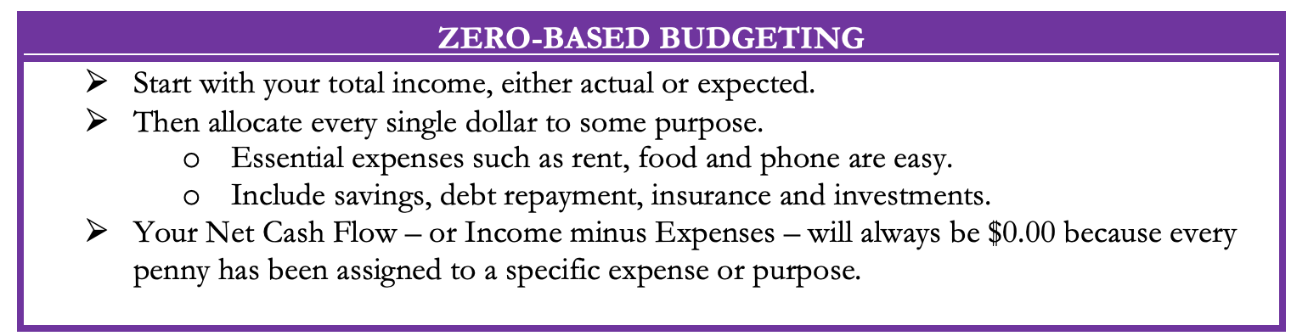
Five Budgeting Models

Slide 38
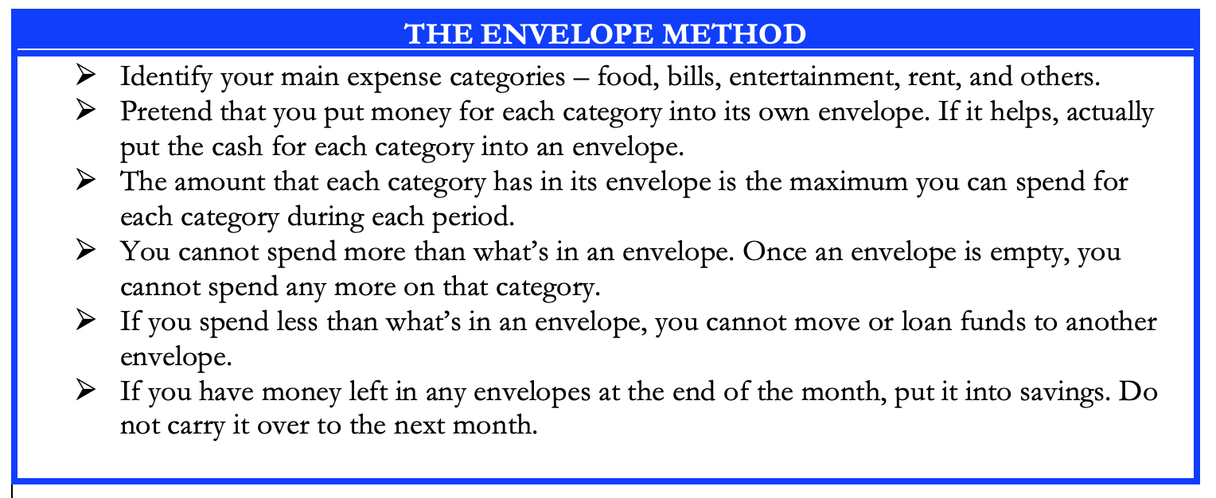
Five Budgeting Models

Slide 39
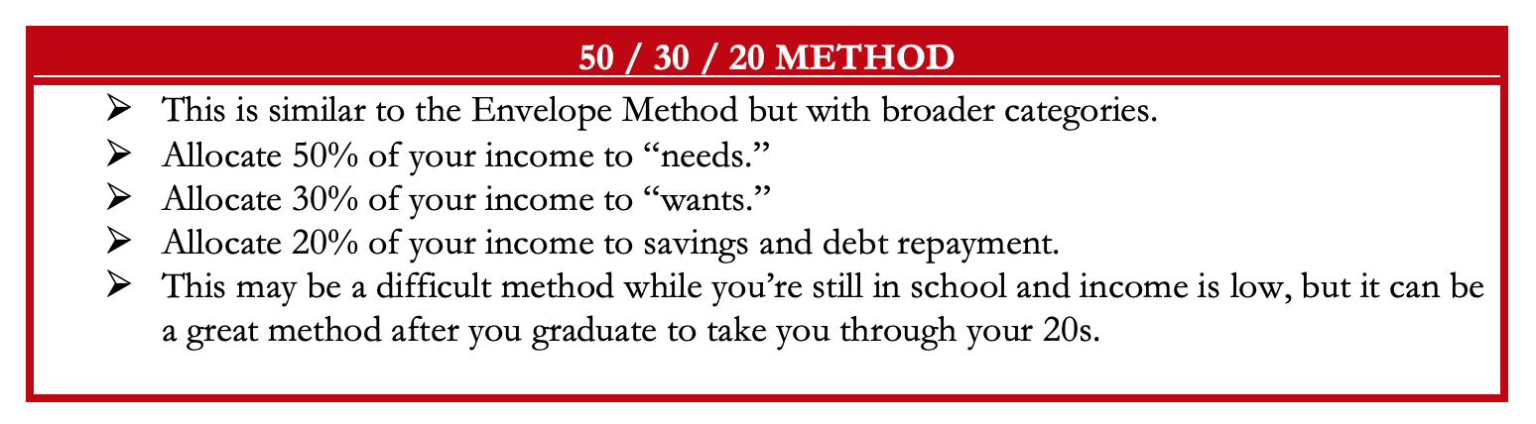
Five Budgeting Models

Slide 40
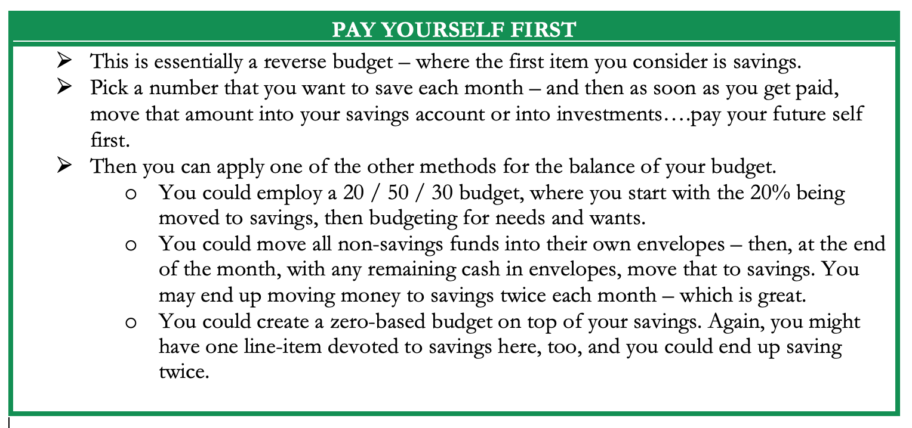
Five Budgeting Models

Slide 41
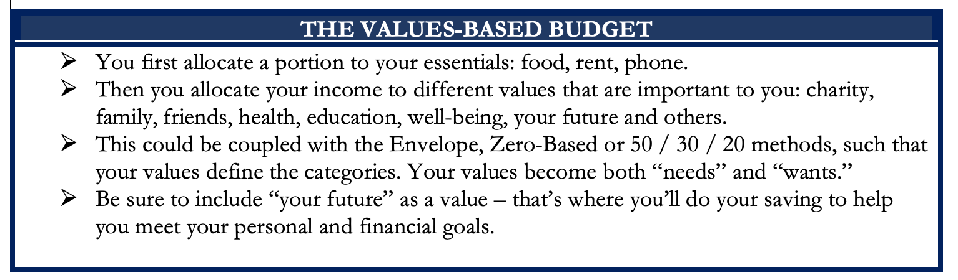
Five Budgeting Models

Slide 42
Five Budgeting Models
Which Budget Model is Best For You?
Only you can answer that.
Budgeting is more of a mental game than a financial process.
You need to select the approach that:
Gives you the least stress and the most confidence;
Best aligns with your short- and long-term goals.
In practice, most people combine different models to best suit
what they are most comfortable with.
(I personally pay myself first and then use a zero-based approach)
(And then, if I can, I pay myself last, too)

Slide 43
Developing A Budgeting Mindset
Budgeting is more of a mental game than a financial process.
Think of budgeting as part of a long-term financial plan.
Think of budgeting in the same way you think of studying, writing or working in the laboratory.
Recognize your own behavior, habits, priorities and goals. Only you know what is best for you. Choose the budgeting approach that works best for you…and for you only.

Slide 44
Developing A Budgeting Mindset
If you have a spouse, partner, family or others who are affected by your budgeting decisions….
….Talk to them. Make budgeting a team effort.
Research on personal finance shows that couples feel more empowered and develop a closer, stronger relationship when they share financial goals, decisions and strategies with each other.
  Financial infidelity – not being open and honest about money – is real and damaging to both your finances and your relationships.

Slide 45
Developing A Budgeting Mindset
Some exercises to help you develop a budgeting mindset.
Track all of your income and expenses – every penny – over an extended period of time (say, 1-2 months).
Write down the last 15 things you spent money on.
Write down the next 15 things you want to spend money on.
Identify your 10 biggest expenses over the past 12 months.
Predict every dollar of income you will earn over the next 12 months.
Predict what your income will be for each of the next 5 years.

Slide 46
Developing A Budgeting Mindset
Some exercises to help you develop a budgeting mindset.
Track all of your income and expenses – every penny – over an extended period of time (say, 1-2 months).
Write down the last 15 things you spent money on.
Write down the next 15 things you want to spend money on.
Identify your 10 biggest expenses over the past 12 months.
Predict every dollar of income you will earn over the next 12 months.
Predict what your income will be for each of the next 5 years.
What is the purpose of this self-analysis?
To ensure that your spending is aligned with your income.
To ensure that your spending and income are part of your plan.
To ensure your budget is driven by wants & needs, and not driven by impulses.
To be intentional.

Slide 47
Developing A Budgeting Mindset
Some actions that may help you better control your spending:
Wait 24 hours before making any purchase over a certain dollar amount
  For me, it’s $100
Don’t make any purchases on certain days or after a certain time
  For me it’s 7:00pm
Only use cash…because studies have found that spending cash causes us more pain than the abstraction of a credit card or debit card
  It’s also why casinos use similarly abstract poker chips…because we don’t feel pain when we lose them.
Take 10 minutes every Sunday to write down what you’re allowed to spend in this week.

Slide 48
Developing A Budgeting Mindset
Some actions that may help you better control your spending:
Wait 24 hours before making any purchase over a certain dollar amount
  For me, it’s $100
Don’t make any purchases on certain days or after a certain time
  For me it’s 9:00pm
Only use cash…because studies have found that spending cash causes us more pain than the abstraction of a credit card or debit card
  It’s also why casinos use similarly abstract poker chips…because we don’t feel pain when we lose them.
Take 10 minutes every Sunday to write down what you’re allowed to spend in this week.
And then reward yourself.
Turn this into a game.
If you predict you will spend $200 this week, and you only spend $150, reward yourself with half the difference.
Take $25 for happy hour or a night out.
Put the other $25 into savings or investing.

Slide 49
Isn’t this a lot like what you do with your education planning?

Slide 50
Making Budgeting a Part of Your Plan
FINANCIAL STRATEGIES
EDUCATION STRATEGIES
BUDGETING
STRATEGIES
GRAD SCHOOL STRATEGIES
Identify Your
Income & Expenses
Identify Your Resources
Identify Your
Priorities & Goals
Identify Your
Priorities & Goals
Do Your Planning
Do Your Planning
Monitor & Modify Budgeting Activities
Monitor & Modify Your Progress & Plan

Slide 51
Making Budgeting a Part of Your Plan
FINANCIAL STRATEGIES
YOU,
as grad students, are better wired and equipped to make long-term plans – education, career, financial & otherwise – than 99% of humanity.
Be confident.
Be intentional.
Be diligent.
Be awesome.
EDUCATION STRATEGIES
BUDGETING
STRATEGIES
GRAD SCHOOL STRATEGIES
Identify Your
Income & Expenses
Identify Your Resources
Identify Your
Priorities & Goals
Identify Your
Priorities & Goals
Do Your Planning
Do Your Planning
Monitor & Modify Budgeting Activities
Monitor & Modify Your Progress & Plan

Slide 52
Again, as you begin to develop your full financial plan – seeing the trade-offs with Budgeting, Investing and Debt Management – you will begin to see how interconnected all of these aspects are.
Finance is just a matter of managing money across time.
And one thing we know about time is that our plans will change – so the better you have control of your initial financial plan, the more you will be able to adjust when life and time give you new goals.
Isn’t this a lot like what you do with your education planning?

Slide 53
Financial Wellness
A goal without a plan is just a dream.
Wealth is largely the result of habit.
The most difficult thing is the decision to act; the rest is mere tenacity.
It takes as much energy to plan as it does to wish.
You cannot escape the responsibility of tomorrow by avoiding it today.

Slide 54
Don’t wait around for other people to be happy for you.
Any happiness you get,
You’ve got to make yourself.
~ Alice Walker, poet & novelist
A goal without a plan is just a dream.
Wealth is largely the result of habit.
The most difficult thing is the decision to act; the rest is mere tenacity.
It takes as much energy to plan as it does to wish.
You cannot escape the responsibility of tomorrow by avoiding it today.

Slide 55
MONEY MATTERS SERIES: FALL 2024
SEPTEMBER 18
Managing Money, Grad School & Life: Balancing All of Your Priorities
OCTOBER 10
Investing for Your Future: Compounding Your Success
OCTOBER 29
Debt, Taxes & Inflation: Navigating Life's Financial Challenges
NOVEMBER 13
Thinking Like an Entrepreneur & Exploring Alternative Career Options

Slide 56

brian.bolton@louisiana.edu http//:business.louisiana.edu/financeispersonal

Slide 57

gradschool@louisiana.edu

Slide 58









Family-Focused Financial Planning

Slide 59
A Few Opening Morals
Personal Finance is…personal.
It’s about you and not about anyone else.
You have to make it about you and your goals.

Slide 60
A Few Opening Morals
There is no judgment in personal finance.
There is no ego in personal finance.
There is no shame in personal finance.
It’s about you and not about anyone else.

Slide 61
A Few Opening Morals
My bias:
Financial transparency is a good thing.

Slide 62
Financial Planning for Families

Slide 63
4 Frequently Asked Questions
When should we begin talking to our children about money & finances?
As soon or early as you are comfortable.
  Young children observe and think about everything. They notice all of your financial behavior.
  Children under 10-12 might earn an allowance for doing chores → This instills habits and the link between work and money.
  Children 10-12 are going to begin having goals and dreams.
    The sooner you talk to them about your financial situation – not necessarily with numbers – the more they will think of these goals and dreams as a partnership, and not just your job.
    They can begin mentally budgeting for their goals and dreams. They can begin thinking about what THEY need to do to make these goals and dreams a reality.
  Children 14+ should have their own budgets…either as a function of the family budget or on their own. Help them have as much agency over their lives as possible.

Slide 64
4 Frequently Asked Questions
When should we open bank and other accounts for our children?
As soon as they have a social security number.
  This creates options, independence and agency.
  You do not have to put a lot of money into any account, but having it open allows you – or them – to work towards their dreams and goals when appropriate.
  When they become independent, they will want their own borrowing potential. This starts with them having a credit score…which you can help with by co-signing for debt when they are young.
    A co-signed credit card with a $300 limit that they only use for gas and groceries, for example.
  Opening an Individual Retirement Account for them or a 529 education savings account – even if you do not put any money into these accounts – also gives them options.
  Trusts are not just for the super-wealthy. They can be creative tools to transfer assets from you to your children…while you still retaining some control (and having unique legal protection for any assets in the trust).

Slide 65
4 Frequently Asked Questions
One side benefit of being proactive in establishing your children’s financial habits and financial planning…
It may help you realize where you can improve your own financial habits and financial planning.

Slide 66
4 Frequently Asked Questions
Should we file taxes as Married Filing Jointly or Separately?
It depends.
It will be different for each family…and it may be different for each year.
  Both spouses are NOT allowed to take the same deductions & credits on their own returns.
  You want to be strategic and do the math to see where your combined tax liability is lowest.
  Perhaps you file separately and the higher-income spouse claims all of the deductions & credits to reduce their income the most.
  If there is a big difference in your incomes, you may be able to strategically lower your tax liability by filing individually (in theory). Look at both options and choose the better one (this year).
  A couple examples:
    The IRS allows us to have professional tax preparation if our income is less than $73,000, regardless of how you file.
    If you are working but your spouse is not, you can open an IRA for them since they cannot…but only if you file MFJ.
  “Head of Household” filing status is generally the most favorable status…but it is a legal status, it is not a description. It is generally reserved for single parents who provide >50% of dependent care.

Slide 67
4 Frequently Asked Questions
Speaking of taxes, what are some tax benefits for families?
There are lots – each family can probably identify 3-10 benefits for them.
  The 2017 tax cuts eliminated the ability to claim a deduction for each dependent…but there are still credits and deductions available.
  The child tax credit – possibly $2,000 credit for each child.
  The dependent care credit – not exclusive to children.
  The adoption credit – can receive up to $14,000+ credit for all adoption-related expenses.
  The earned-income tax credit – available for low-income taxpayers.
  Medical expenses for having a baby may be an above-the-line deduction.
  Education credits & deductions…including the American Opportunity Tax Credit, the Lifetime Learning Credit, and deductions for student loan interest.
  As your family grows, your benefits grow…so talk to Human Resources an reduce your tax withholding.
  With all of the above, there are limitations and rules. Read the fine print.

Slide 68
Financial Planning for the Whole Family
Identify values, dreams & goals for the entire family
  Then identify specific values, dreams & goals for EACH family member.
  These can be somewhat abstract (“retire comfortably”) or specific (“attend private school”).
    The more specific you can be, the easier it becomes to assign numbers to each.
Understand the financial & family situation of the entire family.
  Financial planning is different at different stages of your life.
    Accumulation → Conservation → Distribution
  Understand any unique needs, circumstances or priorities that need attention.
  Understand the financial situation of EACH member of the family.
Create financial plans for the entire family and for each member of the family.

Slide 69
Financial Planning for the Whole Family
Create financial plans for the entire family and for each member of the family.
  What insurance do you need today? What insurance will you need in the future.
    You may not need life insurance before you have your first child. You probably will want it once you have children.
  Create – and analyze – budgets for the entire family and for each individual.
    Identify NON-DISCRETIONARY family expenses (rent, mortgage, insurance, utilities, phones, food…)
    Identify DISCRETIONARY family expenses (clothing?, food?, entertainment, travel…)
    Identify short-term NEEDS and wants (food, clothing, shelter…)
    Identify long-term needs and WANTS (college, new cars, retirement…)
    Merge these 2 analyses to figure out how you are going to achieve your goals – and to understand which goals may not be possible.
    Saving for the long-term is always difficult for families…but it can be the key to achieving financial wellness.

Slide 70
Financial Planning for the Whole Family
As you go through this analysis, you should find a few habits that you want to change.
  For me, when I was in my 20s, comparing my alcohol budget to my income was very eye-opening.
The goal is to give you more control over your future…without having to sacrifice any (or too much) happiness today.
An indirect benefit of that goal is to improve your self-esteem and give you more agency over your day-to-day decisions.

Slide 71
Set up separate savings accounts for each savings goal. And add to each.
Our minds are wacky.
We engage in a behavior economists call “mental budgeting.”
Having $5,000 in 1 account feels different than having $1,000 in 5 different accounts.
  If each account has a purpose or goal, there’s a little governor in our brain that regulates our desire to use money from an account for anything but its intended purpose.
  Some banks will let you do this automatically. If not, do this for yourself, by actually opening up 3-5 different savings accounts.

Slide 72

Set up separate savings accounts for each savings goal.
Contribution from Work
Paycheck
Work Retirement Plan
Bills
Transfer from Savings
Independent Retirement Plan
Short & Medium- Term Goals (0-5 Years)
Long-Term Goals
(5+ Years)

Slide 73
Set up separate savings accounts for each savings goal.
Paycheck
Paycheck
$200
$100
Bills
$50
Savings Account #3:
NEW HOUSE
Savings Account #2:
NEW CAR
Savings Account #1:
VACATION
Short & Medium- Term Goals (0-5 Years)
Long-Term Goals
(5+ Years)

Slide 74
Set up separate savings accounts for each savings goal.
Why does this work?
Because it allows us to align different goals with different accounts.
Checking & Transaction Account
No risk,
0.0% return,
all cash
Short-to-Medium Term Goals
Some risk,
0-3% return goals,
cash + savings
Long-Term
Goals
Some Risk,
3-7% return goals,
savings + investments
Retirement
Accounts
Lots of risk,
8-12% return goals,
all investments

Slide 75
Financial Planning for the Whole Family
Create financial plans for the entire family and for each member of the family.
  What are you investing for?
    Set up 529 or Coverdell Education Savings Accounts for each child as soon as they have a SSN (or before).
    Set up retirement accounts for each family member.
    Make investment decisions a family affair – letting your kids each buy 10 shares of companies they like – Disney or Apple or Coca-Cola – can help them learn about financial planning (and I promise it will not hurt your financial returns much, if at all).
  Debt Management might be a little trickier…you may not want your children to become involved in family or business debt issues, but you probably will want them to know how to manage debt when the time comes for them to be independent.
    Co-signing on a credit card can help children establish a credit history – and for you to teach responsibility.
    Involve children in all student loan applications and decisions.
    Many adults do not fully understand all of their own debt obligations and agreements…use this as an opportunity for YOU to become and expert in your own affairs in order to give your children their own agency.

Slide 76
8 Financial Challenges for The Family

Slide 77
Challenge #1
For 4 or 5 months each year, track every penny you spend. Every single penny.
And do this old school – with a pen and paper (or not-so-old school with Excel). Do not use financial software like Quicken or Quickbooks and do not rely on your bank debit or credit card statement.
Identify your non-discretionary and discretionary expenses.
Are you spending more or less than you want? Where are the pain points? Do you notice any trends. Do you notice any emotion-driven purchases? Are all expenses aligned with your goals?
And now that you’ve seen this, can you do anything about it – can you change your behavior?

Slide 78
Challenge #2
As soon as you get each paycheck, or on the 1st day of each month, explicitly save a certain amount. Maybe it’s 20% or maybe it’s $25.
And, if possible, allocate savings amounts to different accounts and different goals.
The goal is to get in the habit of paying yourself first and investing in your children’s future first. The behavior is the key. Prioritizing the habit will lead to success.

Slide 79
Challenge #3
Make saving a game.
After saving 20% or $25 on the first day of the month, set a goal to save even more during the rest of the month. Maybe you set the goal of saving another $50. If you manage to save $150 instead of $50, celebrate your success by taking the additional $100 and using some of it to treat yourself. Maybe it’s a family dinner or amusement park – and then take what’s leftover from this treat and put it towards savings.

Slide 80
Challenge #3
CHALLENGE #3 - Alternative
Anytime you treat yourself to a purchase over a certain amount, set aside ½ of the amount amount of the purchase to give to charity…if that’s one of your goals.
For me, it’s $200.
If I buy anything over $200 – except food or rent – I immediately set aside ½ of the amount to give to charity. I do not donate the money immediately, but I may pool it over several months to be able to give a bigger donation.

Slide 81
Challenge #4
Check your credit score.
And study your credit report.
You can get a credit report for free from TransUnion, Equifax or Experian. Make sure what’s on the credit report belongs to you. Challenge anything that is wrong. And make a plan to improve your credit score – by cleaning up your credit report or establishing a payment history that will work to your advantage over time.

Slide 82
Challenge #5
Cancel (at least) one subscription this year.
Have each child cancel (at least) one subscription this year.
We all have subscriptions we are not using – or are not getting our money’s worth out of.
The monthly savings may seem minor - $10 or $20 per subscription. But these amounts will add up – over 12 months, over 2-5 children, over years, across multiple subscriptions. And, again, the key is to develop habits and behaviors for your children in the future.

Slide 83
Challenge #6
For 1 month each year, empty your pantry and empty your freezer.
Only buy perishable groceries during that month (and be sure to eat every single penny/ounce of your perishable food).
Throwing out food can be the biggest waste in many budgets. Don’t do it.
It’s financially wasteful…but it’s also a bad habit that can flow over into other behaviors that do not help you achieve your goals
(This challenge brought to us by a former student with 4 teenage boys.)

Slide 84
Challenge #7
For 1 month each year, do not dine out. Nothing.
Maybe 1 whole month is too ambitious.
Maybe you start with a week. Or weekend.
Or maybe you stop dining out on Fridays only.
Or maybe you eliminate or reduce just one family habit…Sunday brunch, coffee, fast food, alcohol. Identify a habit that you know is not aligned with your personal or financial goals…and then take some baby steps to improve it.

Slide 85
Challenge #8
Set 5 financial goals for the next year, the next 3 years and the next 5 years.
Set goals for you and for each child.
You pick your time horizons. Make this work for you. Financial goals are not necessarily just about money. They can be about your work or school. They can be about habits and behaviors.
The key is that if you can improve your habits and behaviors, if you can improve your satisfaction at work and at school, you will feel more empowered to take control over your financial situation, too.
Your children will connect goals with money and with behaviors.
And, by you having your children go through this work, you will improve your agency over your own financial planning.

Slide 86
Happiness
Long-Term Goals
Short-Term Goals
Financial Needs
Family Needs

Slide 87
5 KEY ISSUES FOR INTERNATIONAL STUDENTS
You must file a tax return, each year, whether you earn income or not.
You may be limited in what income you can earn in the U.S. This makes it all the more important that you (a) control your expenses, and (b) finish your degree.
OPT (Optional Practical Training) is a bridge from being a student in the U.S. to being a professional. If you want to stay in the U.S. long-term, begin looking for OPT opportunities early (and budget for the $410 fee).
CPT (Curricular Practical Training) is an opportunity to have a paying job or internship while you are still in school.
Yes, you are (probably) allowed to engage in all the financial activities that any permanent resident can – investing in stocks, bonds, crypto, real estate, anything.

Slide 88
Income Taxes in the U.S.
Filing for income tax:
It’s important to be aware that, as a nonresident student in the US, you’re legally required to file a tax return if you received US income during each year.
And even if you didn’t work or receive income in the US, you’re still obliged to file a Form 8843 with the IRS.
University of Louisiana at Lafayette has arranged discounted access to Sprintax Tax Preparation for you. Check to see if your institution has similar programs. Sprintax will guide you through the tax preparation process, arrange the necessary documents and check if you’re due a tax refund.
Sprintax was used by over 225,000 international students and scholars last year, and the average Federal refund received by eligible students was over $1,185.

Slide 89
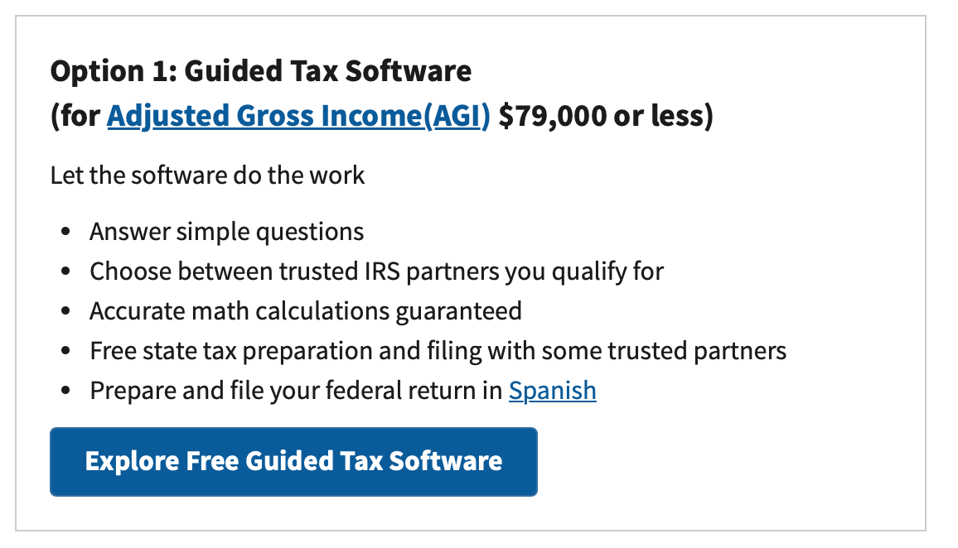
Filing Your Income Taxes for Free – Another Option
This limit of $79,000 is the same regardless of whether you are filing individually or married-jointly. Sorry.
The IRS does not prepare your taxes.
Your return will be prepared by a partner firm of the IRS (HR Block, Jackson-Hewitt, Intuit…).
If you make more than $79,000, most online tax software will cost you anywhere from $30 to $250 to do both federal and state filings.
https://www.irs.gov/filing/free-file-do-your-federal-taxes-for-free

Slide 90
Frequently Asked Question #1
How do I manage my time and finances to become financially comfortable upon graduation?
  There’s no easy way. It’s all about budgeting and planning.
  Sit down and analyze your situation: amount of debt, income, expenses, impulse spending.
  Analyze your bad habits and make plans to change them.
  You may not really become financial comfortable until you get the job you want and your income increases. But having a plan and knowing your numbers is the best place to start.

Slide 91
Frequently Asked Question #2
Are international students allowed to invest in stocks, bonds and financial products with our social security number?
  Yes.
  With a social security number, international students have all the investing and financial privileges as anyone else.

Slide 92
Frequently Asked Question #3
What are our responsibilities with taxes in bank accounts?
  You owe ordinary income taxes on interest earned in a bank account. You do not pay taxes on just the balance.
    If you have $250 in a savings account and you get $15 in interest during the year, you will owe ordinary income taxes on that $15 only.
  If you move beyond a bank account and do some investing, you will owe taxes on any investment gains or income you earn, as with the bank account.
    You may owe ordinary income taxes if your gains are short-term, you may owe capital gains taxes (which are lower) if your gains are long-term.

Slide 93
Frequently Asked Question #4
What about Individual Retirement Accounts (IRA) and Roth IRA - which one is better for international students please?
  I suspect for 95% of international students, a Roth IRA is better for you (now).
  Roth IRAs are best when your income is low and your tax rate is low. Traditional IRAs are best when your income is higher and your tax rate is lower.
  The catch: with a Roth IRA, you pay taxes on income today, so you may have less after-tax cash flow from your salary…which may not be ideal for many cash-strapped graduate students.

Slide 94
Frequently Asked Question #5
How does an international graduate student that does not earn during summer pay for his/her rent?
  CPT – Curricular Practical Training – allows you to have a paying internship while in school.
    The job must be related to your degree.
    The job must be coordinated by your school.
    If you have the job for more than 12 months, you cannot get OPT.
  Beyond that, here’s no easy way. It’s all about budgeting and planning.
  Sit down and analyze your situation: amount of debt, income, expenses, impulse spending.
  Analyze your bad habits and make plans to change them.

Slide 95
Budgeting
Create a budget on how you will spend your money each month
  Fixed expenses (rent, tuition, books, utilities, food, insurance, car payments, phone bill)
  Discretionary expenses (clothing, entertainment, travel, emergencies)
  Unexpected expenses (medical bills, taxes)
Learn to live within your means (avoid going into debt to maintain your lifestyle). Unpaid debt will follow you everywhere you go.
You have limited opportunities to increase your income, which makes controlling your expenses even more important.

Slide 96
Preparing & Investing for YOUR Future
Prepare and invest in your future.
If you’re about to graduate, plan to save $410 USD for your OPT (Optional Practical Training) application fees:
(see next slide for a new, premium processing option)
  OPT is an off-campus employment benefit for F-1 students that have completed their education at an American university.
  Employment has to be related to field of study: https://internationalaffairs.louisiana.edu/current-students/working-usa/optional-practical-training-opt

Slide 97
A Word of Caution
“Prediction is difficult…
…especially about the future.”
–Niels Bohr

Slide 98
A Word of Caution
“Prediction is difficult…especially about the future.”
–Niels Bohr
This conversation includes a variety of predictions, opinions, perspectives & guesses.
Please keep in mind that that is all that they are –
just one guy’s predictions, opinions, perspectives & guesses.
That guy is not Nostradamus. The future is very difficult to predict.
Even if these opinions and perspectives are reasonable, they could still be very wrong.
Please use any and all of these predictions with caution and your own forethought.

Slide 99
A Word of Caution
Today’s conversation includes a variety of predictions, opinions, perspectives & guesses.
Please keep in mind that that is all that they are – just one guy’s predictions, opinions, perspectives & guesses.
That guy is not Nostradamus. The future is very difficult to predict.
Even if these opinions and perspectives are reasonable, they could still be very wrong.
Please use any and all of these predictions with caution and your own forethought.
“The market can stay irrational longer than you can stay solvent.”
–John Maynard Keynes

Slide 100
Let’s Talk About Inflation
Imagine that you are thinking about getting a new refrigerator, sometime in the next year.
The refrigerator you want costs $1,000 today.
You hear reports about inflation being really bad…say, 10%.
You fear that – if you wait a year – your $1,000 refrigerator will cost you $1,100.
So, you buy the $1,000 refrigerator today to avoid a potentially higher cost in the future.
Now, thanks to the laws of supply-and-demand, your purchase drives prices higher TODAY! That is, the fear or expectation of future inflation creates current inflation. Our fear of inflation actually makes realized inflation WORSE. This fear only corrects or moderates very slowly.

Slide 101
Brian’s Brief Explanation for Why Inflation & Interest Rates are So Dang High Right Now
COVID-19!

Slide 102
Brian’s Brief Explanation for Why Inflation & Interest Rates are So Dang High Right Now
In order to get us through the extreme economic uncertainty of 2020, governments and central banks around the world increased the amount of money that was floating around in every economy.
  The U.S. Federal Reserve increased its assets from $4 trillion to $7 trillion during Spring 2020. That’s $3 trillion of extra cash injected into the economy (kind of).
    In 2023, its assets are close to $9 trillion. That’s a huuuuuge change in just 3½ years.
But, the actual economies that are using that money have not increased much at all. So, the value of each dollar bill is less.
  If you cut a pizza into 16 slices instead of just 8, the entire pizza still has the same total calories but you have to eat more slices to get full. That’s inflation.

Slide 103
Brian’s Brief Explanation for Why Inflation & Interest Rates are So Dang High Right Now
In order to try to slow inflation, central banks have tried to:
(a) pull out some of the new cash that was in the economy, and,
(b) discourage spending…by raising interest rates.
  I’m going to borrow more when rates are 3% than when they’re 8%.
  As we borrow less, we buy less, and prices should moderate and decrease (or at least stabilize).
  They want to create a little bit of economic pain in order to avoid a whole lot of economic pain.

Slide 104
Brian’s Brief Explanation for Why Inflation & Interest Rates are So Dang High Right Now
In order to try to slow inflation, central banks have tried to:
(a) pull out some of the new cash that was in the economy, and,
(b) discourage spending…by raising interest rates.
  As of 1:00pm CDT today, the U.S. Federal Reserve is likely to begin decreasing interests rates…
    This suggests that the Federal Reserve is more concerned about creating jobs and stimulating the economy, thinking inflation is under control.

Slide 105
Brian’s Brief Explanation for Why Inflation & Interest Rates are So Dang High Right Now
The U.S. economy and the global economy are not speedboats.
They are enormously massive cargo freighters that take a very long time to turn.
  It took a while for inflation to become a problem following all the new 2020 money.
  And, it has taken a while for higher interest rates to bring down inflation.
  But, now with inflation at 2.5% and possibly headed towards 2.0%, it might be under control, generally.

Slide 106
Brian’s Top 3 Tips for
Navigating an Uncertain Economy
Cut your expenses & Build your emergency fund.
Analyze your budget and cut your discretionary expenses by 25%. Stop dining our, shop in bulk, do potluck dinners, clean out your pantry.
Have a dedicated savings account with the equivalent of 3-6 months of your non-discretionary expenses in it.
Your budget is one of the few things you can (kind of) control in a turbulent economy. This is the perfect time to focus on essentials, behaviors & habits.

Slide 107
Brian’s Top 3 Tips for
Navigating an Uncertain Economy
Cut your expenses & Build your emergency fund.
Take advantage of whatever interest rates are doing.
When they are low, refinance your mortgage, consolidate outstanding loans or credit cards (or stop using credit cards altogether). If you are close to graduating, and close to repaying student loans, learn about Income Driven Repayment or Public Service Loan Forgiveness programs.
When interest rates are high, move savings into CDs and possibly the stock market. Be proactive with your money.
    Most savings accounts are currently paying about 0.50%. If you have a little bit of savings, you can find a Certificate of Deposit that is earning 5.0% or more. That’s a huge difference.
    The stock market has earned close to 15% this year so far. That’s great. (It lost 19% in 2022, so there will always be risk…but it may be an option if you can invest for the long run.)

Slide 108
Brian’s Top 3 Tips for
Navigating an Uncertain Economy
Cut your expenses & Build your emergency fund.
Take advantage of whatever interest rates are doing.
Finish your degree & focus on your career opportunities.
Be proactive with your career planning. Look out for #1. Inflation is a much bigger problem when you’re earning a grad student stipend than when you’re earning a full-time professional salary.
If you are not close to graduation, explore internship and part-time opportunities. If you are an international student, begin exploring CPT and OPT opportunities (Curricular Practical Training, for before graduation, and Optional Practical Training, for after graduation).

Slide 109
Brian’s Economic Predictions for 2024
Inflation has decreased a lot…but it is still higher than most of us are used to. In June 2022, inflation was at 9.1%; it is now at 2.5%.
  My best case estimate is for it to be at 2.0-2.5% in December. It will not be 5+%.
Interest will come down very soon…beginning this afternoon.
  Most of us will see interest rates drift lower through the rest of the year.
  The benchmark rate is currently 5.33%. It will be close to 4.00% in December.
  That should help all of us in different ways – credit cards, investments, student loans, buying a new car or house.
Wages & income have been okay, but not great (and Louisiana’s wages are much worse than the national average). They should get better from here.
NOTE – Use these predictions with caution.
This is just one guy’s perspective / opinion / guess.

Slide 110
Brian’s Economic Predictions for 2024
The job market has been pretty solid for the past 3.5 years.
I expect that to continue…and it may get even better by next summer.
The stock market has gained 19% in 2024. It gained 24% in 2023.
It lost 19% in 2022. It gained 27% in 2021. That’s +51% in 3.5 years.
  I predict (with about 35% confidence) that we will gain another 3-5% thru December.
  We may lose 5% thru December. I do not expect us to lose >10% this year.
We are not in a recession. We have not been in a recession since 2020.
We are a very long way from entering a recession. That’s good news.
NOTE – Use these predictions with caution.
This is just one guy’s perspective / opinion / guess.

Slide 111
Brian’s Economic Predictions for 2024
Plan ahead.
Control what you can control.
NOTE – Use these predictions with caution.
This is just one guy’s perspective / opinion / guess.

Slide 112
4 More Tips for
Navigating an Uncertain Economy
Ignore the media.
Do your own research.
Focus on your own experience.
Control what you can control.

Slide 113
INDULGENCE is good.
IMPULSE is bad.
PLANNING AHEAD is the key.

Slide 114
RENT
FOOD
SCHOOL
A FUN VACATION
A NEW CAR
SATURDAY NIGHT

Slide 115
HAPPINESS

Slide 117
And as you begin to develop your full financial plan – seeing the trade-offs with Budgeting, Investing and Debt Management – you will begin to see how interconnected all of these aspects are.
Finance is just a matter of managing money across time.
And one thing we know about time is that our plans will change – so the better you have control of your initial financial plan, the more you will be able to adjust when life and time give you new goals.
Isn’t this a lot like what you do with your education planning?

Slide 118
Financial Wellness
A goal without a plan is just a dream.
Wealth is largely the result of habit.
The most difficult thing is the decision to act; the rest is mere tenacity.
It takes as much energy to plan as it does to wish.
You cannot escape the responsibility of tomorrow by avoiding it today.

Slide 119
Don’t wait around for other people to be happy for you.
Any happiness you get,
You’ve got to make yourself.
~ Alice Walker, poet & novelist
A goal without a plan is just a dream.
Wealth is largely the result of habit.
The most difficult thing is the decision to act; the rest is mere tenacity.
It takes as much energy to plan as it does to wish.
You cannot escape the responsibility of tomorrow by avoiding it today.

Slide 120
MONEY MATTERS SERIES: FALL 2024
SEPTEMBER 18
Managing Money, Grad School & Life: Balancing All of Your Priorities
OCTOBER 10
Investing for Your Future: Compounding Your Success
OCTOBER 29
Debt, Taxes & Inflation: Navigating Life's Financial Challenges
NOVEMBER 13
Thinking Like an Entrepreneur & Exploring Alternative Career Options

Slide 121
brian.bolton@louisiana.edu http//:business.louisiana.edu/financeispersonal

Slide 122
gradschool@louisiana.edu

