Slide 1


Accelerate Northside
Accelerate
Women’s Entepreneurship

Slide 2
brian.bolton@louisiana.edu http://business.louisiana.edu/financeispersonal
What You Need to Know
About the Numbers
Finance & Accounting
April 10, 2025
Dr. Brian Bolton
Professor of Finance

Slide 3
brian.bolton@louisiana.edu http://business.louisiana.edu/financeispersonal

Slide 4
Finance & Accounting
A little about me, the finance guy:
What are 2 things that I am grateful for:
  I am grateful to have a job where I get to work with and learn from inspiring people who are working to change their lives and to change their worlds.
  I am grateful that my entire family will get together in Texas in 6 weeks for my niece’s wedding (and I’m grateful that I’m going to Spain in 8 days).
Accelerate Northside 2025: What You Need to Know About the Numbers

Slide 5
Finance & Accounting
My plan for the next couple hours:
  We will spend most of our time focused more directly on 3 (hopefully) relevant areas:
    Your Stakeholders
    Tracking Your Income & Expenses
    How is Your Business Performing?
Note: I will talk a little about taxes and tax planning. But a thorough discussion of taxes requires much more time than we have today.
Advice: It is never too soon (or too late) to connect with a tax accountant.
Accelerate Northside 2025: What You Need to Know About the Numbers

Slide 6
Finance & Accounting
There are no ‘right’ answers or perfect ways of understanding finance (and even accounting).
Our goal is to use our finance, accounting and strategy tools to make appropriate & reasonable decisions that help us pursue our mission.
We will go through this material at a pretty high level. Finance and Accounting require getting into the weeds at some point.
Feel free to ask about those weeds and details today or in the future.
Accelerate Northside 2025: What You Need to Know About the Numbers

Slide 7
The meaning of life is to find your gift.
The purpose of life is to give it away.
Pablo Picasso
Spanish artist, 1881-1973

Slide 8
The meaning of life is to find your gift.
The purpose of life is to give it away share it.
Pablo Picasso
Spanish artist, 1881-1973

Slide 9
FREQUENTLY ASKED QUESTION #1
We have been building our business for 3-4 years.
Revenue has been growing. We are not yet profitable, but we have a plan to become profitable within 2-3 years.
In order to become profitable, we think we need to grow and scale… …and we need $100,000 to grow and scale.
Accelerate Northside 2025: What You Need to Know About the Numbers

Slide 10
FREQUENTLY ASKED QUESTION #1
We have been building our business for 3-4 years.
Revenue has been growing. We are not yet profitable, but we have a plan to become profitable within 2-3 years.
In order to become profitable, we think we need to grow and scale… …and we need $100,000 to grow and scale.
An investor has offered us $100,000 in exchange for 25% ownership of the business.
  What does that mean? And should we do it?
Accelerate Northside 2025: What You Need to Know About the Numbers

Slide 11
FREQUENTLY ASKED QUESTION #1
An investor has offered us $100,000 in exchange for 25% ownership of the business.
  What does that mean?
  It means the investor will give you $100,00 cash today.
  You give the investor ownership of 25% of the cash flows.
  You give the investor 25% of the voting rights and control.
  You give the investor 25% of any proceeds if you sell the company.
  PROBABLY – Because all of the above is negotiable and flexible.
Accelerate Northside 2025: What You Need to Know About the Numbers

Slide 12
FREQUENTLY ASKED QUESTION #1
An investor has offered us $100,000 in exchange for 25% ownership of the business.
  What does that mean?
  Everything is negotiable and flexible.
  They might not give you $100,000 in cash today…
    They may give you $30,000 in cash today with an agreement to give you the other $70,000 when you meet certain milestones.
    They may give you $50,000 in cash today with the promise to give you $50,000 worth of in-kind material or supply investments over time.
    They may give you $150,000 today with preferred rights to your first $50,000 in profits (to become a net $100,000 investment).
Accelerate Northside 2025: What You Need to Know About the Numbers

Slide 13
FREQUENTLY ASKED QUESTION #1
An investor has offered us $100,000 in exchange for 25% ownership of the business.
  What does that mean?
  Everything is negotiable and flexible.
  Even if the investor ‘buys’ 25% of the ownership, they can separate ownership into “cash flow rights” and “voting or control rights.”
  When you accept an investment, the investor may require 51% of voting or control rights with 25% of the cash flow rights.
      This means they can fire you. They can sell the company. They can vote to do anything….while still ‘only’ getting 25% of financial proceeds.
Accelerate Northside 2025: What You Need to Know About the Numbers

Slide 14
FREQUENTLY ASKED QUESTION #1
An investor has offered us $100,000 in exchange for 25% ownership of the business.
  What does that mean? And should we do it?
  Should you do it?
    It depends on what your goals are.
    It depends on what your needs are.
    It depends on how much you value control vs. cash.
    It depends on what your alternatives are.
    It depends on what you can negotiate.
    It depends on who the investor is…and what they give you.
Accelerate Northside 2025: What You Need to Know About the Numbers

Slide 15
FREQUENTLY ASKED QUESTION #1
Nothing in finance is free. In exchange for the $100,000, you have to give the investor something.
  Most investors DO NOT care about social impact
  Most investors DO NOT care about economic development
  Most investors DO NOT care about your mission (at least not as much as you do)
  Most investors DO NOT care about philanthropy (they may actually despise it)
  Most investors make investments to make money.
  Most investors’ first and only priority is financial return on investment.
Accelerate Northside 2025: What You Need to Know About the Numbers

Slide 16

FREQUENTLY ASKED QUESTION #1
  Investors invest to get profits.
  Investors invest to get financial returns.
  For most businesses…those profits
  and financial returns come from
  people – customers, employees,
  suppliers, & investors & society.
  Profits DO NOT happen without people.
  Profits happen BECAUSE of people.
  Profits happen BECAUSE of purpose.
  Profits happen BECAUSE you change lives.
Accelerate Northside 2025: What You Need to Know About the Numbers

Slide 17
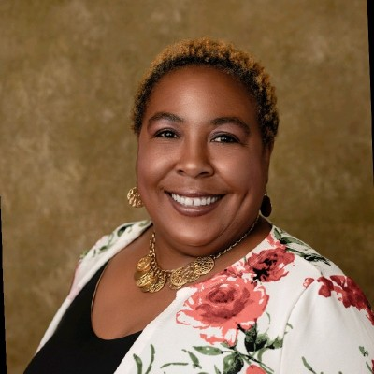
DR. DIONNE DAVIS
REMEMBER ME?

Slide 18
DR. DIONNE DAVIS
“You have to know your number…that is, what is your business worth?
If someone offered to purchase your business, what would you sell it to them for?”

Slide 19
Don’t wait around for other people to be happy for you.
Any happiness you get,
You’ve got to make yourself.
Alice Walker
American Novelist, Poet, Teacher, Leader

Slide 20
FREQUENTLY ASKED QUESTION #2
How do we know what to charge for our products or time?
Cost-Plus Pricing: You can add on a 20-30% margin over what it costs you to make your product.
  This varies by industry. A jewelry store might add 100%. A taco truck might add 15%.
Compare yourself to others in the region in your industry.
  Find other similar companies/products in the area. Price yourself similar to them…but price yourself higher lower depending on what makes you different from the competition.
Accelerate Northside 2025: What You Need to Know About the Numbers

Slide 21
FREQUENTLY ASKED QUESTION #2
How do we know what to charge for our products or time?
WHAT ARE YOUR GOALS?
  Do you want to be profitable today?
Accelerate Northside 2025: What You Need to Know About the Numbers

Slide 22
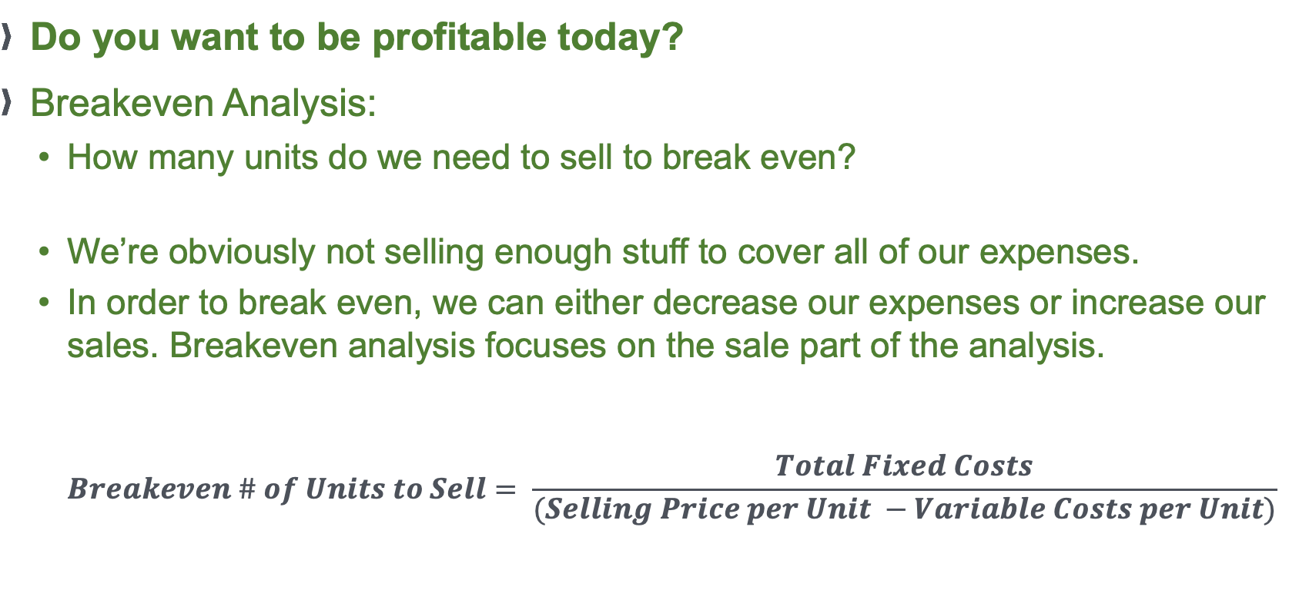
FREQUENTLY ASKED QUESTION #2
Do you want to be profitable today?
Breakeven Analysis:
  How many units do we need to sell to break even?
  We’re obviously not selling enough stuff to cover all of our expenses.
  In order to break even, we can either decrease our expenses or increase our sales. Breakeven analysis focuses on the sale part of the analysis.
  $Breakeven \# of Units to Sell= \frac{Total Fixed Costs}{(Selling Price per Unit −Variable Costs per Unit)}$
Accelerate Northside 2025: What You Need to Know About the Numbers

Slide 23
FREQUENTLY ASKED QUESTION #2
How do we know what to charge for our products or time?
WHAT ARE YOUR GOALS?
  Do you want to be profitable today?
  Do you want to build your customer base?
  Do you want to build your brand & reputation?
  Do you want to be really profitable in 2-4 years?
  You might not be able to do ALL of these simultaneously. Maybe you price your products/time based on what your strategy is.
Accelerate Northside 2025: What You Need to Know About the Numbers

Slide 24


FREQUENTLY ASKED QUESTION #2
Accelerate Northside 2025: What You Need to Know About the Numbers

Slide 25
FREQUENTLY ASKED QUESTION #2
Why was Jet Coffee celebrating its grand opening of its 5th location on Johnston Street by giving away free drinks during the morning & afternoon peak hours?
Accelerate Northside 2025: What You Need to Know About the Numbers

Slide 26
Overheard From an Entrepreneur
Question to Guest Speaker: At what point did you make the decision
to stop trying to do everything by
yourself and to hire employees?
Answer by Guest Speaker: While maybe it didn’t make financial
sense to hire employees, after 3-4
months I realized I couldn’t do it all and
I needed to make that change.
Accelerate Northside 2025: What You Need to Know About the Numbers

Slide 27
Overheard From an Entrepreneur
Question to Guest Speaker: At what point did you make the decision
to stop trying to do everything by
yourself and to hire employees?
Answer by Guest Speaker: While maybe it didn’t make financial
sense to hire employees, after 3-4
months I realized I couldn’t do it all and
I needed to make that change.
Accelerate Northside 2025: What You Need to Know About the Numbers

Slide 28
Overheard From an Entrepreneur
Question to Guest Speaker: At what point did you make the decision
to stop trying to do everything by
yourself and to hire employees?
Answer by Guest Speaker: While maybe it didn’t make financial
sense to hire employees, after 3-4
months I realized I couldn’t do it all and
I needed to make that change.
EVERY CASH OUTFLOW YOU HAVE IN BUSINESS IS A CHOICE.
EVERY CASH OUTFLOW YOU HAVE IN BUSINESS MUST BE CONSIDERED AN INVESTMENT.
THERE IS NO DIFFERENT BETWEEN AN “EXPENSE” AND AN ”INVESTMENT”
Accelerate Northside 2025: What You Need to Know About the Numbers

Slide 29
The 4 Most Important Concepts in Finance & Accounting
EFFECTIVE
REVENUES
EFFICIENT
PROFITS
We are NOT trying to minimize Expenses.
We are NOT trying to minimize Investments.
We are trying to maximize PROFITS, VALUE & IMPACT.
Accelerate Northside 2025: What You Need to Know About the Numbers

Slide 30
QUIZ QUESTION #1
If you give me $100 today…
I will give you $100 in 12 months.
Would any of you be willing to make this trade?
Accelerate Northside 2025: What You Need to Know About the Numbers

Slide 31
QUIZ QUESTION #2
If you give me $100 today…
I will give you $200 in 12 months.
Would any of you be willing to make this trade?
Accelerate Northside 2025: What You Need to Know About the Numbers

Slide 32
QUIZ QUESTION #3
If you give me $100 today…
I will give you $200 in 5 years.
Would any of you be willing to make this trade?
Accelerate Northside 2025: What You Need to Know About the Numbers

Slide 33
Business Finance & Valuation
What is an “INVESTMENT?”
We invest money, time or energy today with the hope of getting something bigger and better back in the future.
But….we never know what or if we are going to get anything back.
Accelerate Northside 2025: What You Need to Know About the Numbers

Slide 34
Prediction is very difficult.
Especially when it’s about the future.
Niels Bohr
Danish Physicist
1922 Nobel Prize laureate

Slide 35
Business Finance & Valuation
But….we never know what or if we are going to get anything back.
Everything is a big risk.
But – as the Entrepreneur in Chief & Founder – you have the most control over turning money today into big, profitable investments in the future.
DO NOT think of ‘investments’ as just MONEY.
As an entrepreneur, your time & energy are (or should be) the most valuable resources you have.
Accelerate Northside 2025: What You Need to Know About the Numbers

Slide 36
Business Finance & Valuation
Question: How do we decide which investments to make?
Answer: We make those investments with the highest
return on investment.
Question: How do we measure return on investment?
Answer: In short… We use some measure of:
Cash Inflows Benefits
Cash Outflows Costs
Accelerate Northside 2025: What You Need to Know About the Numbers

Slide 37
Business Finance & Valuation
For individuals, financial return may not be the goal.
  Should you borrow $1000 to pay for your education?
  How do we account for the experience, the knowledge, the opportunities the networking and everything else that education provides?
Why are you at this program right now? Why are you paying – with time, energy & money – for this experience?
  This is an investment in your business.
  This is an investment in your future.
  This is an investment in your family.
  This is an investment in your purpose.
Accelerate Northside 2025: What You Need to Know About the Numbers

Slide 38

FREQUENTLY ASKED QUESTION #2
In finance – or in business – we never want to make an investment – or spend any money – where the expected benefits are less that the expected costs.
  Think of “benefits” and “costs” as economic benefits and costs, which is NOT necessarily the same as financial inflows and outflows.
  Try to quantify the intangible economic benefits and costs, like time and energy, so you can quantify Return on Investment
  KNOW YOUR NUMBER – KNOW YOUR GOALS!
Accelerate Northside 2025: What You Need to Know About the Numbers

Slide 39
Finance for Entrepreneurs
Financial value is the result of people finding something intrinsically desirable.
The more intrinsically desirable something is to me, the more money I will be willing to pay for it.
  Also applies to non-financial resources – I may be willing to work harder for a cause I believe in than for a cause that doesn’t align with my own values.
Stakeholders will engage with your business because you are offering utility for them. What you are doing aligns with their values.
What you are doing makes their life better.
Accelerate Northside 2025: What You Need to Know About the Numbers

Slide 40
Finance for Entrepreneurs
What you are doing makes their life better.
Most people are not going to give you money just because they like you.
But they will give you money if you and your business make their lives better.
With this in mind, think of 1 simple question…
Accelerate Northside 2025: What You Need to Know About the Numbers

Slide 41
As you think about your businesses, your mission, your dreams, your visions for starting a new business, and what you want to do with what you get out of this program, try to answer one key question:
WHO CARES?
For your businesses, make a list of 3-5 groups of people or entities who care about that project.
Make a list of 3-5 people or entities who will contribute their human or financial resources to make that project successful.

Slide 42
As you think about your businesses, your mission, your dreams, your visions for starting a new business, and what you want to do with what you get out of this program, try to answer one key question:
WHO CARES?
For your businesses, make a list of 3-5 groups of people or entities who care about that project.
Make a list of 3-5 people or entities who will contribute their human or financial resources to make that project successful.

Slide 43
As you think about your businesses, your mission, your dreams, your visions for starting a new business, and what you want to do with what you get out of this program, try to answer one key question:
WHO CARES?
For your businesses, make a list of 3-5 groups of people or entities who care about that project.
Make a list of 3-5 people or entities who will contribute their human or financial resources to make that project successful.

Slide 44
Stakeholders & Entrepreneurs
Family
Investors
Employees
Business Entity
The Community
Customers
Suppliers
The Government
Others: future generations, trade associations, unions, activists, competitors, the media, business partners, the public, society
Accelerate Northside 2025: What You Need to Know About the Numbers

Slide 45
Stakeholders & Entrepreneurs
We care about making money because we want to (or have to) give money to people who make our business happen…who contribute to our business striving to serve its mission:
  Employees, suppliers, partners, the government, investors…
The money we give to these people comes from our Revenues
Every dollar of Revenue that your business will ever make comes from your CUSTOMERS.
  If you run a non-profit, it’s a little different…you have to make both your donors and your beneficiaries’ lives better with your mission.
Accelerate Northside 2025: What You Need to Know About the Numbers

Slide 46
Finance, Accounting & Stakeholders
Revenues
– Cost of Goods Sold
= Gross Margin
– Operating Expenses
= Operating Income
– Other Expenses
= Taxable Income
– Income Taxes
= Net Income
Accelerate Northside 2025: What You Need to Know About the Numbers

Slide 47
Finance, Accounting & Stakeholders
Revenues:
Customers give us money to make their lives better. Every dollar of Revenue any business has ever received has come from Customers.
Revenues
– Cost of Goods Sold
= Gross Margin
– Operating Expenses
= Operating Income
– Other Expenses
= Taxable Income
– Income Taxes
= Net Income
Accelerate Northside 2025: What You Need to Know About the Numbers

Slide 48
Finance, Accounting & Stakeholders
Revenues
– Cost of Goods Sold
= Gross Margin
– Operating Expenses
= Operating Income
– Other Expenses
= Taxable Income
– Income Taxes
= Net Income
Cost of Goods Sold:
We give cash to employees and suppliers to create the goods and services we provide to customers
Accelerate Northside 2025: What You Need to Know About the Numbers

Slide 49
Finance, Accounting & Stakeholders
Revenues
– Cost of Goods Sold
= Gross Margin
– Operating Expenses
= Operating Income
– Other Expenses
= Taxable Income
– Income Taxes
= Net Income
Operating Expenses:
We give cash to employees, the landlord, the advertising agency, the utilities company and others in exchange for giving us the infrastructure to run our business
Accelerate Northside 2025: What You Need to Know About the Numbers

Slide 50
Finance, Accounting & Stakeholders
Revenues
– Cost of Goods Sold
= Gross Margin
– Operating Expenses
= Operating Income
– Other Expenses
= Taxable Income
– Income Taxes
= Net Income
Other Expenses:
We give cash to the bank and other non-recurring, non-operating sources in exchange for certain benefits.
Accelerate Northside 2025: What You Need to Know About the Numbers

Slide 51
Finance, Accounting & Stakeholders
Revenues
– Cost of Goods Sold
= Gross Margin
– Operating Expenses
= Operating Income
– Other Expenses
= Taxable Income
– Income Taxes
= Net Income
Income Taxes:
We give cash to governments because they give us the social infrastructure for our business to succeed (in theory, at least, if not always in practice)
Accelerate Northside 2025: What You Need to Know About the Numbers

Slide 52
Finance, Accounting & Stakeholders
Net Income:
After we make our customers happy and we pay all other stakeholders who made our business possible, whatever cash is leftover is ours to keep, to give to our family, to re-invest in the business, to buy a boat, to return to outside investors.
Revenues
– Cost of Goods Sold
= Gross Margin
– Operating Expenses
= Operating Income
– Other Expenses
= Taxable Income
– Income Taxes
= Net Income
Accelerate Northside 2025: What You Need to Know About the Numbers

Slide 53
As you think about your businesses, your mission, your dreams, your visions for starting a new business, and what you want to do with what you get out of this program, try to answer one key question:
WHO CARES?
For your businesses, make a list of 3-5 groups of people or entities who care about that project.
Make a list of 3-5 people or entities who will contribute their human or financial resources to make that project successful.

Slide 54
ACTUAL HOMEWORK (for you to do, for Jonathan)
Identify your financial goals:
  What financial goals do you want to achieve in the next 3 months?
    These could involve building your team, getting business bank accounts, or achieving revenue milestones. Anything related to your business.
    These could also involve personal finance issues – because those will impact your business, too.
  What financial goals do you want to achieve in the next 12 months?
  What financial goals do you want to achieve in the next 3 years?
Accelerate Northside 2025: What You Need to Know About the Numbers

Slide 55
Finance & Accounting
PERSONAL FINANCE
BUSINESS FINANCE
BOOKKEEPING & ACCOUNTING
BUSINESS FINANCE
FINANCIAL PLANNING & MANAGEMENT
CORPORATE FINANCE
INVESTING & CAPITAL RAISING
Accelerate Northside 2025: What You Need to Know About the Numbers

Slide 56
What Else We Will Cover Today
PERSONAL FINANCE
BUSINESS FINANCE
BOOKKEEPING & ACCOUNTING
BUSINESS FINANCE
FINANCIAL PLANNING & MANAGEMENT
CORPORATE FINANCE
INVESTING & CAPITAL RAISING
Accelerate Northside 2025: What You Need to Know About the Numbers

Slide 57
What Else We Will Cover Today
PERSONAL FINANCE
Your life as an entrepreneur will regularly overlap with your life as an individual.
Knowing where to take advantage of the overlaps (such as in tax planning) and where to create an intentional divide (such as with relationships) can be critical to both your success in business and your happiness as a human. Be intentional with your choices.
Accelerate Northside 2025: What You Need to Know About the Numbers

Slide 58
What Else We Will Cover Today
PERSONAL FINANCE
Your life as an entrepreneur will regularly overlap with your life as an individual.
Knowing where to take advantage of the overlaps (such as in tax planning) and where to create a necessary divide (such as with relationships) can be critical to both your success in business and your happiness as a human.
Be intentional with your choices.
Accelerate Northside 2025: What You Need to Know About the Numbers

Slide 59
Personal Finance for Entrepreneurs
FINANCIAL MANAGEMENT
AS AN ENTREPRENEUR,
ALL OF THESE PERSONAL FINANCE DIMENSIONS ARE
GOING TO BE CONNECTED
TO YOUR BUSINESS.
INVESTMENTS
INSURANCE
TAXES
FAMILY
ESTATE PLANNING
Accelerate Northside 2025: What You Need to Know About the Numbers

Slide 60
Personal Finance for Entrepreneurs
FINANCIAL MANAGEMENT
How much of your savings is necessary to start the business?
Maybe you are using your home as your office.
Maybe you are using your personal computer to run the business.
Maybe your personal car is integral to the business.
INVESTMENTS
INSURANCE
TAXES
FAMILY
ESTATE PLANNING
Accelerate Northside 2025: What You Need to Know About the Numbers

Slide 61
Personal Finance for Entrepreneurs
FINANCIAL MANAGEMENT
How are you going to hire employees and grow the business?
Are you able to make any investments outside of the business?
Can you succeed if you don’t commit everything to the business?
Can you have a retirement account?
What physical investments – office, factory, equipment – will you need to make?
INVESTMENTS
INSURANCE
TAXES
FAMILY
ESTATE PLANNING
Accelerate Northside 2025: What You Need to Know About the Numbers

Slide 62
Personal Finance for Entrepreneurs
FINANCIAL MANAGEMENT
What insurance do you need for the business?
What insurance do you need for YOU, to ensure that the business can succeed?
What liability do YOU have personally for what the business does?
What legal structure will you choose for the business?
INVESTMENTS
INSURANCE
TAXES
FAMILY
ESTATE PLANNING
Accelerate Northside 2025: What You Need to Know About the Numbers

Slide 63
Personal Finance for Entrepreneurs
FINANCIAL MANAGEMENT
What legal structure will you choose for the business?
Will you file taxes as an individual or as a corporation?
What are the tax benefits available to entrepreneurs?
How will the business tax issues impact your family and your long-term personal goals?
INVESTMENTS
INSURANCE
TAXES
FAMILY
ESTATE PLANNING
Accelerate Northside 2025: What You Need to Know About the Numbers

Slide 64
Personal Finance for Entrepreneurs
FINANCIAL MANAGEMENT
How will the business tax issues impact your family and your long-term personal goals?
What are the pros and cons of making your venture a family affair?
How do you manage family relationships AND commit yourself to the business?
What happens to the business when you retire?
INVESTMENTS
INSURANCE
TAXES
FAMILY
ESTATE PLANNING
Accelerate Northside 2025: What You Need to Know About the Numbers

Slide 65
What You Can Do Tomorrow
Build your team. Don’t try to do everything on your own.
  You probably want to have an attorney and a tax accountant on your team. You may want to connect with other advisors, but having an attorney and accountant on your team is essential.
Separate your personal and business lives as much as possible.
  Get separate bank accounts for the business.
  Establish a credit history for the business.
Find an accounting system you like. Quicken, Quickbooks, TaxBot, Zero, Sage, FreshBooks are all decent options. Learn it, live it, love it.
Build your business plan. Tell the narrative of your business.
  Banks will want to see this. Investors will want to see this.
  View this as your roadmap or to-do list. Use it to guide both strategy and decision-making.
Accelerate Northside 2025: What You Need to Know About the Numbers

Slide 66
A Few Finance Principles
Nothing is free in finance & entrepreneurship. Every benefit has a cost. Understand what the benefits are.
Financial institutions and advisors do not exist to be your friends.
They exist to take your money. Protect your money.
Debt can change your life – for better and for worse.
Be careful with how you use debt.
Interest is your friend – when you’re receiving it.
Interest is your enemy – when you’re paying it.
Finance is about trading money across time: short-term vs. long-term. Know the trade-offs you are making.
Cash is Queen (or King). Focus on cash inflows & cash outflows.
Accelerate Northside 2025: What You Need to Know About the Numbers

Slide 67
Every great dream begins with a dreamer. Always remember, you have within you the strength, the patience, and the passion to reach for the stars to change the world.
Harriet Tubman
1822-1913

Slide 68
Finance & Strategy
MISSION
What is your mission?
What is your purpose?
What problem are you trying to solve?
What opportunity are you working to fill?
What are you trying to accomplish?
Accelerate Northside 2025: What You Need to Know About the Numbers

Slide 69
Finance & Strategy
MISSION
STRATEGY
OPERATIONS
FINANCE
Accelerate Northside 2025: What You Need to Know About the Numbers

Slide 70
Finance & Strategy
MISSION
STRATEGY
OPERATIONS
FINANCE
Accelerate Northside 2025: What You Need to Know About the Numbers

Slide 71
Finance & Accounting Statements
In order to plan for the future – to prepare a strategic plan or to prepare a financial plan – we need to know where we are today.
  We need to know what resources we have available today.
  We need to know how we are (or have been) using resources.
  We need to know if our resource use is consistent with our mission and strategy.
  We can accomplish all this by using accounting information and financial statements.
Accelerate Northside 2025: What You Need to Know About the Numbers

Slide 72
Finance & Accounting Statements
Accounting, in general, is backward-looking.
It is an accounting of past financial transactions.
We’ll focus on 2 primary financial statements:
  The BALANCE SHEET – a picture of financial condition at a point in time.
  The INCOME STATEMENT – a summary of financial transactions during some period of time.
Accelerate Northside 2025: What You Need to Know About the Numbers

Slide 73
Finance & Accounting Statements
Accounting, in general, is backward-looking.
It is an accounting of past financial transactions.
But, we will use this accounting of past financial transactions to help us understand, predict and plan for the future
Accelerate Northside 2025: What You Need to Know About the Numbers

Slide 74
History does not repeat itself.
But it does rhyme.
Mark Twain
American author and humorist
Accelerate Northside 2025: What You Need to Know About the Numbers

Slide 75

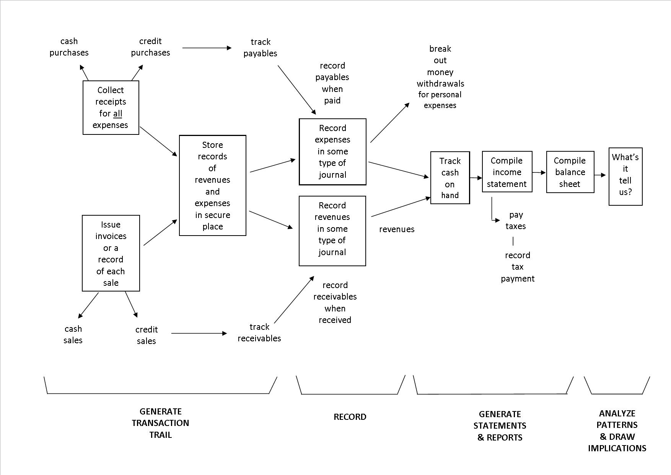
Accounting & Finance
Accelerate St. Landry 2021: What You Need to Know About the Numbers

Slide 76
Finance & Accounting Statements
The BALANCE SHEET – a picture of financial condition at a point in time.
Classifies items as “Assets” and “Liabilities”
Assets – Items or cash flows we OWN.
Liabilities – Items or cash flows we OWE.
The accounting identity:
Assets = Liabilities + Net Worth
Net Worth or Equity is the cash or value the business would have if it sold or liquidated today.
Accelerate Northside 2025: What You Need to Know About the Numbers

Slide 77
Finance & Accounting Statements
What are ASSETS?
  Cash & Cash Equivalents (like investments)
  Receivables – Cash or items that we are expecting to receive from other parties
    Sales we’ve made on credit, loans we’ve made but haven’t been repaid, contract revenues we’ve been promised but haven’t received cash
  Inventory – Materials, supplies or goods used to create revenue that we have on hand
  Prepaid Expenses – Expenses (like rent) that we’ve paid for in advance and will benefit from in the future
  Property & Equipment – Buildings, computers, vehicles and other tangible items that we own
Accelerate Northside 2025: What You Need to Know About the Numbers

Slide 78
Finance & Accounting Statements
What are LIABILITIES?
  Accounts payable – Typically supplies or materials that we’ve received but haven’t paid for yet.
  Accrued liabilities – Expenses we’ve incurred but haven’t paid for yet
    I only receive a paycheck on the last day of the month, but I work all month long. By the 20th of the month, my employer has incurred 2/3 of my paycheck without paying me. This 2/3 is an accrued liability.
  Deferred revenue – When we receive cash for a service prior to providing that service, this is recorded as “deferred revenue.” When we provide the service, we decrease the this account and increase the Revenue account.
  Long-Term Debt – Borrowed money to repay
Accelerate Northside 2025: What You Need to Know About the Numbers

Slide 79
Finance & Accounting Statements
What is NET WORTH?
Net Worth represents the accumulated earnings and investment that is in the business.
  Frequently called equity.
  Frequently called book value.
  Sometimes called market value.
This is what we want to maximize. This is what investors want.
Accelerate Northside 2025: What You Need to Know About the Numbers

Slide 80
Finance & Accounting Statements
The INCOME STATEMENT – a summary of financial transactions during some period of time.
Classifies items as “Revenues” and “Expenses”
  “Operating Support & Revenue” and “Operating Expenses”
Revenues – Inflows or other benefits that the organization receives in exchange for providing goods or services in pursuit of its mission.
  Sales & Service Revenue – Cash inflows you receive in exchange for providing goods or services.
    This is usually the simplest, most obvious financial statement account (except maybe Cash)
Accelerate Northside 2025: What You Need to Know About the Numbers

Slide 81
Finance & Accounting Statements
Classifies items as “Revenues” and “Expenses”
  “Operating Support & Revenue” and “Operating Expenses”
Expenses – Outflows or other costs incurred in producing products or providing services in pursuit of its major operations and central mission.
  Cost of Goods Sold & Variable Expenses (Program Services) – Expenses incurred directly in providing goods and services for customers or stakeholders. Includes raw materials + labor to produce and provide the goods and services.
  Operating Expenses & Fixed Expenses – Expenses incurred by functions performed for the entity as a whole, not tied to specific products (“overhead” or “general and administrative”): rent, salaries, utilities, insurance, advertising, maintenance…
Accelerate Northside 2025: What You Need to Know About the Numbers

Slide 82
Finance & Accounting Statements
Revenues
– Cost of Goods Sold
= Gross Margin
– Operating Expenses (Overhead)
= Operating Income (Operating Margin) – Other Expenses (Interest, Non-Recurring)
= Taxable Income
– Income Taxes
= Net Income or Net Profit
(which is why this is sometimes called a P&L statement, or Profit & Loss statement)
Accelerate Northside 2025: What You Need to Know About the Numbers

Slide 83
Budgets & Financial Planning
Here’s another exercise for you (but it’s not Homework that Jonathan is going to make you turn in and grade you on):
Plan out the next 12 months of cash inflows and cash outflows for your business.
  What do you notice? What are the trends?
  What numbers are you certain about?
  What numbers are just guesses?
  How can you create a plan to survive and thrive over the next 12 months?
If you do not have a business (yet), do this exercise with your own personal finances, for you and your family.
Accelerate Northside 2025: What You Need to Know About the Numbers

Slide 84
Let’s Do Some Math!!!
How do we use financial statements to manage our business?
How do we use financial statements to predict the future?
How do we use financial statements to tell our story?
Let’s analyze a real-life start-up business.
The following financial statements are from its first 3 years in business.
What stands out to you? Would you invest in this business?
Accelerate Northside 2025: What You Need to Know About the Numbers

Slide 86
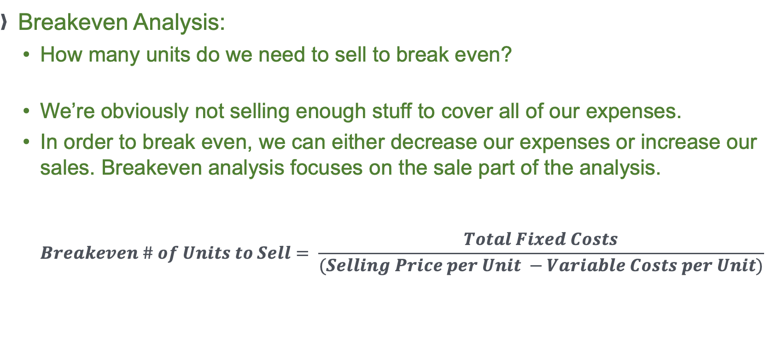
Let’s Do Some Math!!!
Breakeven Analysis:
  How many units do we need to sell to break even?
  We’re obviously not selling enough stuff to cover all of our expenses.
  In order to break even, we can either decrease our expenses or increase our sales. Breakeven analysis focuses on the sale part of the analysis.
  $Breakeven \# of Units to Sell= \frac{Total Fixed Costs}{(Selling Price per Unit −Variable Costs per Unit)}$
Accelerate Northside 2025: What You Need to Know About the Numbers

Slide 87
Accelerate Northside 2025: What You Need to Know About the Numbers

Slide 88
Accelerate Northside 2025: What You Need to Know About the Numbers

Slide 89
Accelerate Northside 2025: What You Need to Know About the Numbers

Slide 90
Accelerate Northside 2025: What You Need to Know About the Numbers

Slide 91
Accelerate Northside 2025: What You Need to Know About the Numbers

Slide 92
Accelerate Northside 2025: What You Need to Know About the Numbers

Slide 93
Let’s Do Some Math!!!
How is this company doing?
What stands out on the Income Statement?
What stands out on the Balance Sheet?
Would you invest in this company?
Why or why not?
Accelerate Northside 2025: What You Need to Know About the Numbers

Slide 94
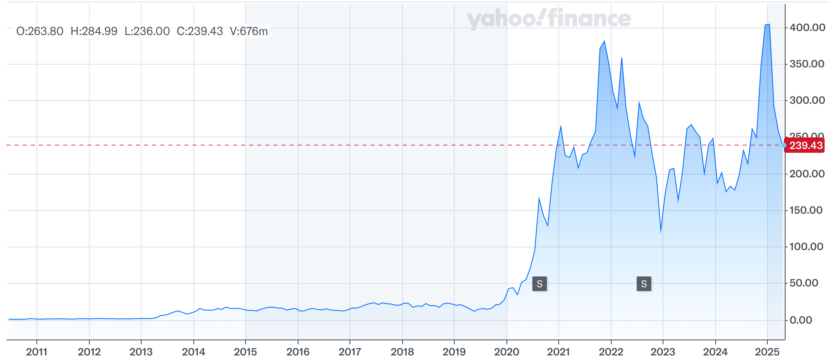
Let’s Do Some Math!!!

Slide 95
Let’s Do Some Math!!!
How is this company doing?
  The company is Tesla for 2009-2011.
  The stock was trading at $1.90 in 2011.
  The stock price reached $410 in November 2021.
  The stock price is currently around $240.

Slide 96
Let’s Do Some Math!!!
How is this company doing?
  The company is Tesla for 2009-2011.
  The stock was trading at $1.90 in 2011.
  The stock price reached $410 in November 2021.
  The stock price is currently around $240.
Elon getting distracted with Twitter, SpaceX, Starlink
MISSION DRIFT???

Slide 97
Financial Statements & Valuation
What is your mission? What is your purpose?
The benefits of pursuing this mission are probably obvious to us all.
The financial returns associated with this mission may not be so obvious.
The key is people. Stakeholders.
Accelerate Northside 2025: What You Need to Know About the Numbers

Slide 98
Stakeholders & Entrepreneurs
What you are doing makes their life better.
Most people are not going to give you money just because they like you.
But they will give you money if you and your business make their lives better.
It all comes back to your mission.
Accelerate Northside 2025: What You Need to Know About the Numbers

Slide 99
Stakeholders & Entrepreneurs
It all comes back to your mission.
  Stakeholders engage with – and contribute resources to – a business because they value what the business’s mission is.
  For a non-profit, people value the mission to alleviate suffering, fight for justice or to help rescue pets.
  For Apple and Walmart, people value different aspects related to their missions: products, prices, convenience, technology, jobs…
  Mission → Strategy → Operations → Finance
Accelerate Northside 2025: What You Need to Know About the Numbers

Slide 100
Finance & Strategy
MISSION
STRATEGY
OPERATIONS
FINANCE
Accelerate Northside 2025: What You Need to Know About the Numbers

Slide 101
ACTUAL HOMEWORK
(FOR YOU TO DO, FOR JONATHAN, FOR NEXT WEEK)
Identify your financial goals:
  What financial goals do you want to achieve in the next 3 months?
    These could involve building your team, getting business bank accounts, or achieving revenue milestones. Anything related to your business.
    These could also involve personal finance issues – because those will impact your business, too.
  What financial goals do you want to achieve in the next 12 months?
  What financial goals do you want to achieve in the next 3 years?
Accelerate Northside 2025: What You Need to Know About the Numbers

Slide 102
MORE HOMEWORK (not for Jonathan, just for you)
At least once a week….
  Write down – on paper, on your phone, in Excel, in Quicken – all of your cash INFLOWS from the previous week and all of your expected cash INFLOWS for the upcoming week.
  Write down – on paper, on your phone, in Excel, in Quicken – all of your cash OUTFLOWS from the previous week and all of your expected cash OUTFLOWS for the upcoming week.
Accelerate Northside 2025: What You Need to Know About the Numbers

Slide 103
MORE HOMEWORK (not for Jonathan, just for you)
At least once a week….
  Write down – on paper, on your phone, in Excel, in Quickbooks – all of your cash INFLOWS from the previous week and all of your expected cash INFLOWS for the upcoming week.
  Write down – on paper, on your phone, in Excel, in Quickbooks – all of your cash OUTFLOWS from the previous week and all of your expected cash OUTFLOWS for the upcoming week.
Personal finance suggestion:
Do this same exercise for your family and personal finances, too. Looking in the mirror like this can really help you appreciate what your cash flows are & what decisions you are making.
Accelerate Northside 2025: What You Need to Know About the Numbers

Slide 104
MORE HOMEWORK!!! (again, just for you, not Jonathan)
Once a month or once a year, take an hour to write down your values.
Write down the 10-15 priorities in your life that guide who you are and what you want.
  For personal finance, being intentional about what your values are will help you make sure your financial decisions are consistent with your personal values.
  For your business, being intentional about what your business values are will help you make sure your business decisions are aligned with your mission & goals.
  Check out https://www.think2perform.com/values/ for practice and perspective
Accelerate Northside 2025: What You Need to Know About the Numbers

Slide 105
If you can’t fly, then run.
If you can’t run, then walk.
If you can’t walk, then crawl.
But whatever you do,
You have to keep moving forward.
Reverend Dr. Martin Luther King, Jr.
1964 Nobel Prize laureate

Slide 106
brian.bolton@louisiana.edu http://business.louisiana.edu/financeispersonal

