Slide 1
UL SYSTEM FINANCIAL WELLNESS SERIES
Reflections on Resilience
How Can Money Become a Source of Empowerment and not an Emotional Anchor
December 13, 2022

Slide 2
Brian Bolton Professor of Finance brian.bolton@louisiana.edu http://business.louisiana.edu/financeispersonal

Slide 3
Happiness
Long-Term Goals
Short-Term Goals
Financial Needs
Family Needs

Slide 5
Owning Your Financial Future
YOUR VALUES
YOUR GOALS
Education
Career
Family
FINANCIAL STRATEGIES
Investing
Income & Expense Management
Debt Management
Taxes, Insurance & Other

Slide 6
Owning Your Financial Future
YOUR VALUES
YOUR GOALS
Education
Career
Family
FINANCIAL STRATEGIES
Investing
Income & Expense Management
Debt Management
Taxes, Insurance & Other

Slide 7
Owning Your Financial Future
YOUR VALUES
YOUR GOALS
Education
Career
Family
FINANCIAL STRATEGIES
Investing
Income & Expense Management
Debt Management
Taxes, Insurance & Other

Slide 8
Let’s Take a Quick Quiz
Please define the following word: VALUES
Now define this word: VALUE
THESE ARE THE SAME WORDS

Slide 9
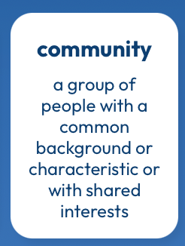
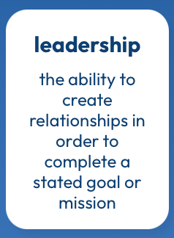
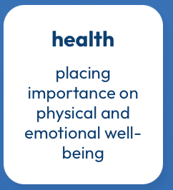
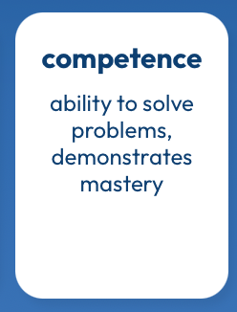
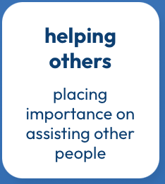
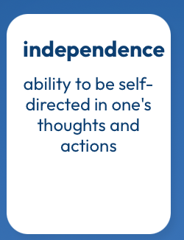
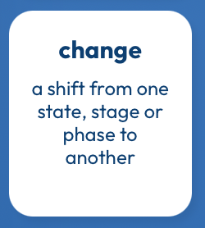
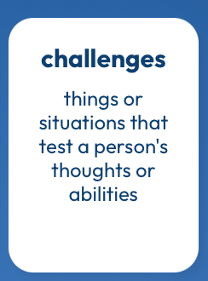
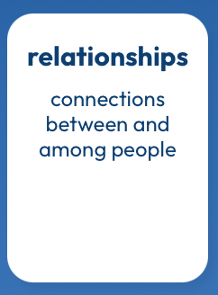
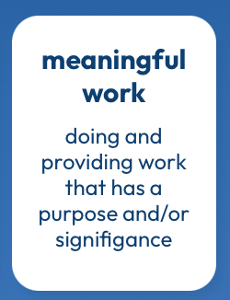
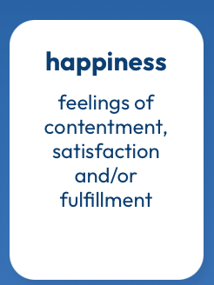
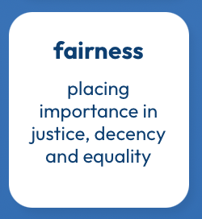
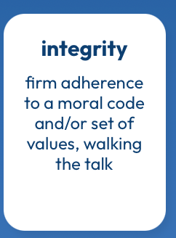
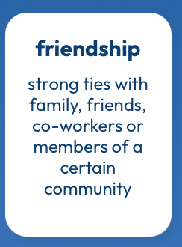
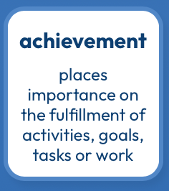
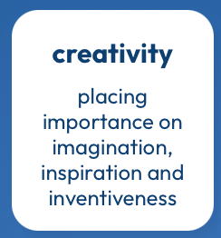
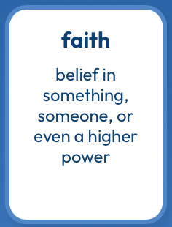
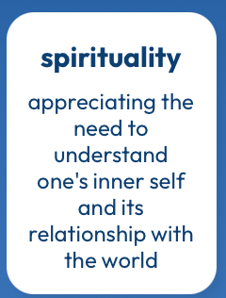
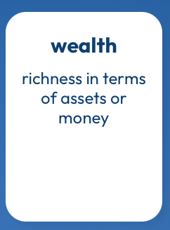
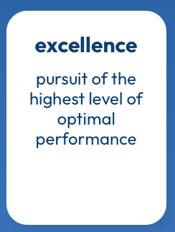
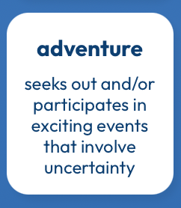
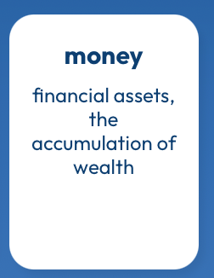
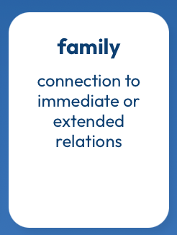
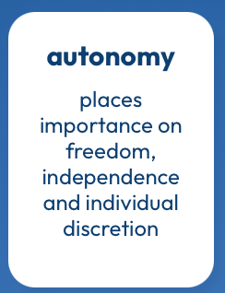
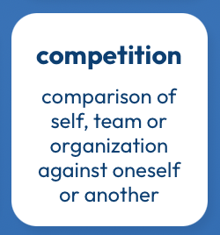
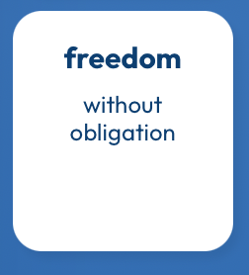
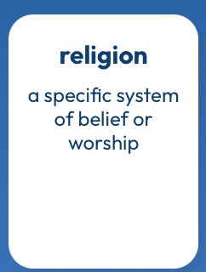
What Are Your Values?
https://www.think2perform.com/values#start

Slide 10
What Are MY Values?
What values are part of my DNA?
What Am I Looking For in MY LIFE?
What Am I Looking For in A JOB?
https://www.think2perform.com/values#start

Slide 11
What Are MY Values?
What values are part of my DNA?
https://www.think2perform.com/values#start

Slide 12
What Are MY Values?
What Am I Looking For in MY LIFE?
https://www.think2perform.com/values#start

Slide 13
What Are MY Values?
What Am I Looking For in A JOB?
https://www.think2perform.com/values#start

Slide 14
What Am I Looking For in A JOB?
These are the values that give my work energy and purpose.
I need to find a job, a career, projects, programs, activities or hobbies that give me the opportunity to embrace with and connect with these values.
https://www.think2perform.com/values#start

Slide 15
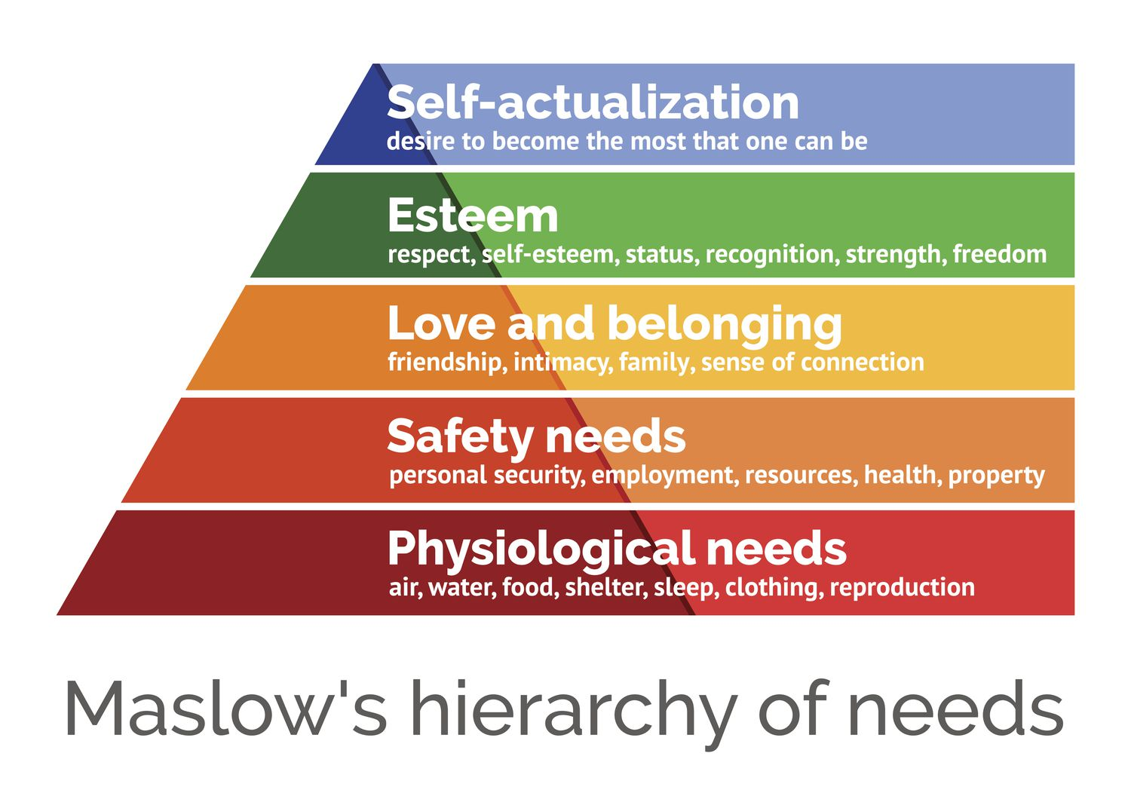
What Am I Looking For in A JOB?
https://www.think2perform.com/values#start

Slide 16
Some Homework for You
Make a list of the 5-10 most important criteria you are looking for in a job or career.
Rank these criteria.
Connect these criteria to your long-term and short-term goals. Connect these criteria to your values.

Slide 17
Some Homework for You
Once a week: Make a list of the money you are going to spend this week.
Once a month: Make a list of how your job serves your values.
Once a year: Revisit your values and identify your short- and long-term goals.

Slide 18
Financial Wellness & Resilience
Holiday spending
New Year’s Resolutions
Resetting your financial plan
Tax planning
Revisiting your family, personal & career goals

Slide 19
Financial Wellness & Resilience
Holiday spending
Set a budget & make lots of lists
Make a list of what you are going to buy
Make a list of what you are NOT going to buy
Have open conversations about money with your family
There is no better time than the holidays to be intentional with connecting your values to your actions.

Slide 20
Financial Wellness & Resilience
New Year’s Resolutions
Create specific financial goals
For example…Eliminate 3 subscriptions this year
Create generic financial goals
For example…Improve my credit score
Think about how financial resolutions relate to other resolutions
If you want to exercise, travel or read more, what will it cost?

Slide 21
Financial Wellness & Resilience
New Year’s Resolutions
Create specific financial goals
Create generic financial goals
Think about how financial resolutions relate to other resolutions
All progress is good progress. Celebrate all improvements.
Don’t let the calendar control your money – Embrace these resolutions throughout the year.

Slide 22
Financial Wellness & Resilience
Resetting your financial plan
Revisit your values and identify your short- and long-term goals
Analyze your insurance, phone, subscription and other expenses
Should you look for a new job?
Start a money journal – note your behaviors, feelings and emotions related to how you spend money
Share your financial goals with your family

Slide 23
TODAY THE NEXT 6 MONTHS THE NEXT 12 MONTHS 2 YEARS AFTER GRADUATION 3 YEARS AFTER GRADUATION
ONCE EVERY SEMESTER:
TRACK EVERY PENNY THAT YOU SPEND & TRACK EVERY PENNY THAT YOU EARN
IN THE NEXT 3 MONTHS:
IDENTIFY WAYS TO DECREASE YOUR DISCRETIONARY SPENDING BY 25%
IN THE NEXT 6 MONTHS:
MAKE A PLAN TO MANAGE – AND PAY OFF – YOUR DEBT
IN THE NEXT 6-12 MONTHS:
OPEN MULTIPLE SAVINGS ACCOUNTS, 1 FOR EACH GOAL
IN THE NEXT 12 MONTHS, OPEN AN IRA OR ROTH IRA
WITHIN 2 YEARS OF GRADUATION:
HAVE AN “EMERGENCY FUND” ACCOUNT, WITH 3-6 MONTHS OF NON-DISCRETIONARY EXPENSES
WITHIN 3 YEARS OF GRADUATION:
ELIMINATE ALL OF YOUR BAD DEBT.

Slide 24
Financial Wellness & Resilience
Tax planning
Do you want to make any charitable donations before year-end (or wait until January)?
Should you recognize any investment gains or losses before year-end?
Do you know all of the deductions and credits that you are eligible for?
Did you receive a tax refund this year? Do you really want a tax refund each year?

Slide 25
Financial Wellness & Resilience
Revisiting your family, personal & career goals
What do you want to achieve over the next 1-2 years?
What do you want to achieve over the next 3-5 years?
What do you want to achieve over the next 10 years?
As you revisit your goals, be sure to communicate with your family and anyone else affected by your goals.

Slide 26
Happiness
Long-Term Goals
Short-Term Goals
Financial Needs
Family Needs

Slide 27
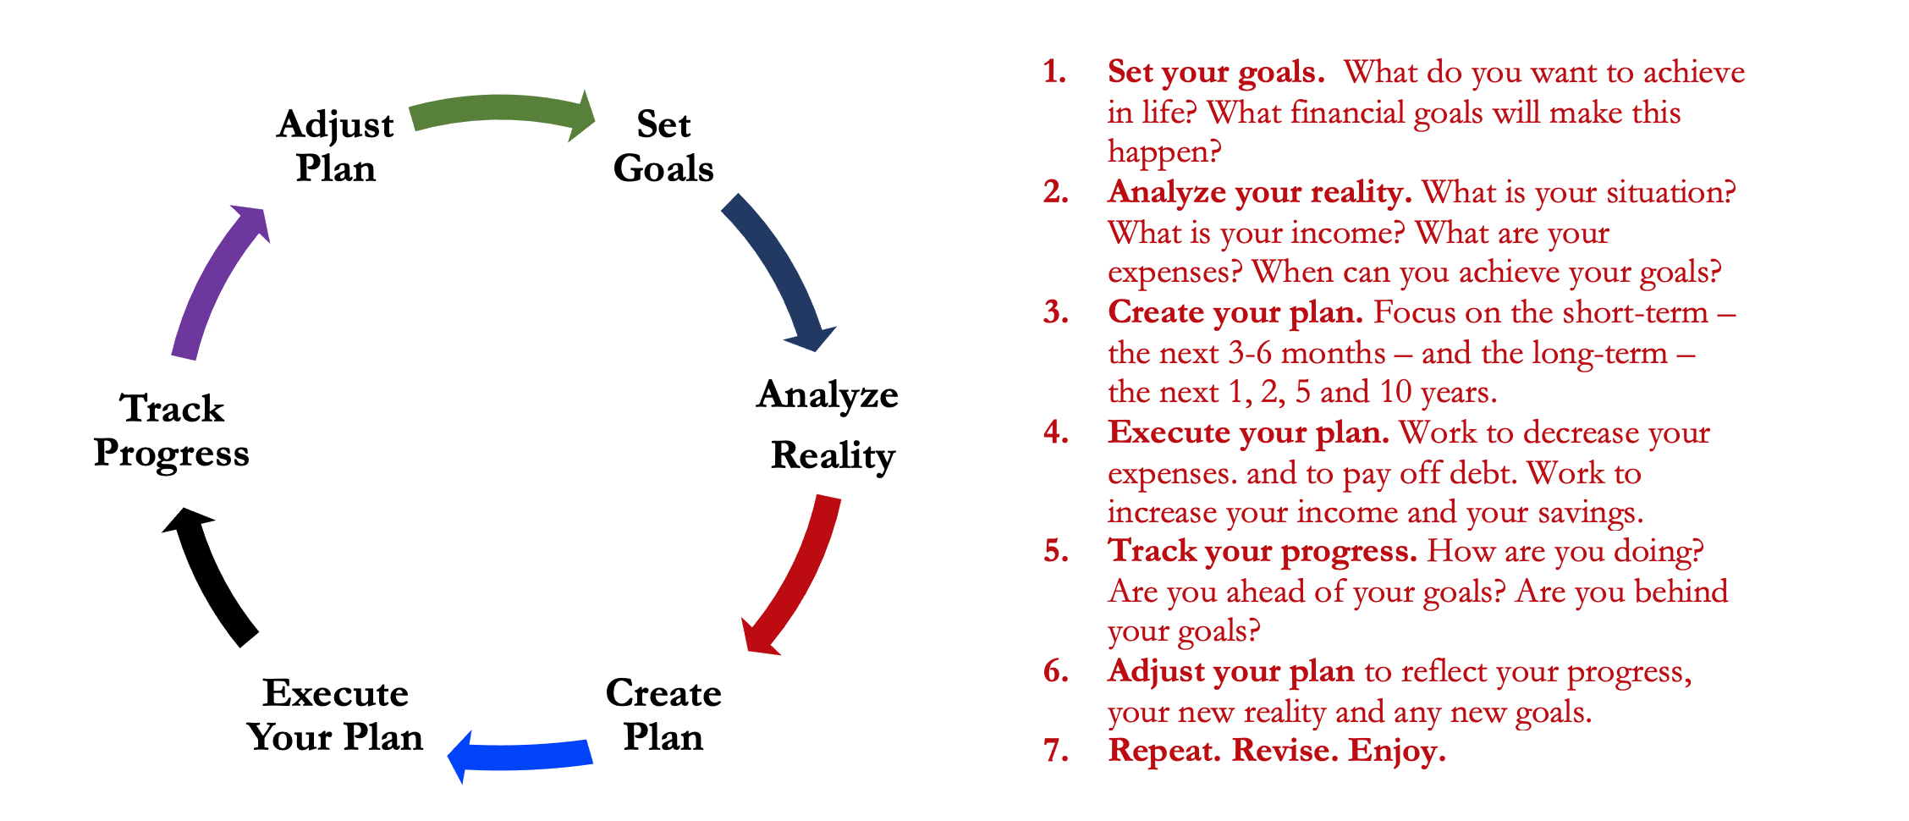
Isn’t this a lot like what you do with your education planning?

Slide 28
Financial Wellness
A goal without a plan is just a dream.
Wealth is largely the result of habit.
The most difficult thing is the decision to act; the rest is mere tenacity.
It takes as much energy to plan as it does to wish.
You cannot escape the responsibility of tomorrow by avoiding it today.

Slide 29
Don’t wait around for other people to be happy for you.
Any happiness you get,
You’ve got to make yourself.
~ Alice Walker, poet & novelist
A goal without a plan is just a dream.
Wealth is largely the result of habit.
The most difficult thing is the decision to act; the rest is mere tenacity.
It takes as much energy to plan as it does to wish.
You cannot escape the responsibility of tomorrow by avoiding it today.

Slide 30
brian.bolton@louisiana.edu http//:business.louisiana.edu/financeispersonal

