Slide 1


MONEY MATTERS 2023:
UL SYSTEM FINANCIAL WELLNESS SERIES
Session #13:
Financial Planning for the Fun Stuff:
Vacations, Home Improvements, New Vehicles
July 26, 2023

Slide 2
Brian Bolton
Professor of Finance brian.bolton@louisiana.edu http://business.louisiana.edu/financeispersonal

Slide 3
Owning Your Financial Future
Adults Returning to Finish a Degree: Financial & Other Concerns
June 6, 2023
Financial Planning for Graduate Students
June 7, 2023
Financial & Tax Planning for International Students
June 8, 2023
The Financial Aspects of Your Side-
Hustle #1 – Planning, Strategies, Legal, Resources
June 20, 2023
Family Financial Planning: Making Finances Work for the Whole Family
June 23, 2023
Family Financial Planning: Sending Your Loved-Ones Off to College
June 27, 2023
Family Financial Planning: Caring for Adult Dependents
June 28, 2023
Changing Careers: The Financial & Personal Issues
July 13, 2023
Building Savings Accounts & Emergency Funds
July 14, 2023
Financial Planning for Veterans
July 18, 2023
Financial Planning When Retirement is Getting Close
(5-7 years out)
July 19, 2023
The Financial Aspects of Your Side-
Hustle #2 – Taxes, Profitability, Expansion, Success
July 25, 2023
Financial Planning for the Fun Stuff: Vacations, Home Improvements, New Vehicles
June 26, 2023
Investing 101
August 1, 2023
Navigating the Impacts of Inflation & Turbulent Economic Times
August 2, 2023
Remaining sessions are from 12:00-1:00pm

Slide 4
Happiness
Long-Term Goals
Short-Term Goals
Financial Needs
Family Needs

Slide 5
Happiness
Long-Term Goals
Short-Term Goals
Financial Needs
Family Needs

Slide 6
Personal Finance is…personal.
It’s about you and not about anyone else.
You have to make it about you and your goals.

Slide 7
INDULGENCE is good.
IMPULSE is bad.

Slide 8
Because personal finance is personal, it is virtually impossible for me to give you any specific advice.
However, there is one word of advice that applies to 99% of people working on their finances:
SAVE

Slide 9
SAVINGS
INVESTING
OWNERSHIP
WEALTH

Slide 10
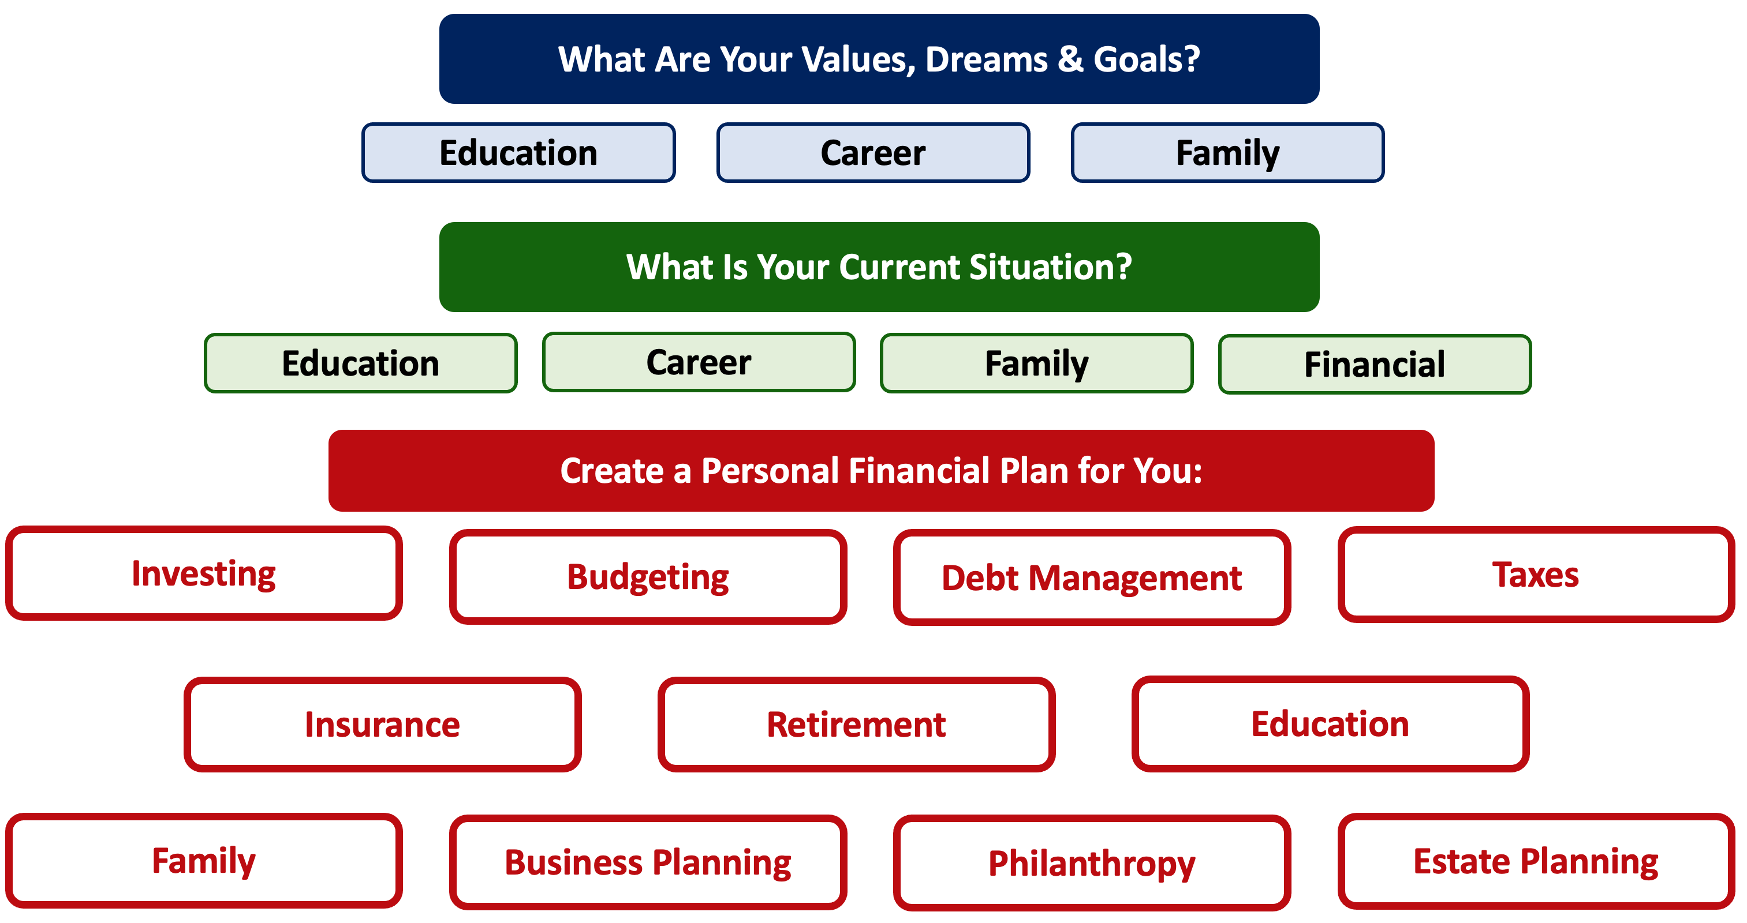

Slide 11
HAPPINESS
A FUN VACATION
A NEW CAR
SATURDAY NIGHT

Slide 12
TODAY THE NEXT 6 MONTHS THE NEXT 12 MONTHS 2 YEARS AFTER GRADUATION 3 YEARS AFTER GRADUATION
ONCE EVERY SEMESTER:
TRACK EVERY PENNY THAT YOU SPEND & TRACK EVERY PENNY THAT YOU EARN
IN THE NEXT 3 MONTHS:
IDENTIFY WAYS TO DECREASE YOUR DISCRETIONARY SPENDING BY 25%
IN THE NEXT 6 MONTHS:
MAKE A PLAN TO MANAGE – AND PAY OFF – YOUR DEBT
IN THE NEXT 6-12 MONTHS:
OPEN MULTIPLE SAVINGS ACCOUNTS, 1 FOR EACH GOAL
IN THE NEXT 12 MONTHS, OPEN AN IRA OR ROTH IRA
WITHIN 2 YEARS OF GRADUATION:
HAVE AN “EMERGENCY FUND” ACCOUNT, WITH 3-6 MONTHS OF NON-DISCRETIONARY EXPENSES
WITHIN 3 YEARS OF GRADUATION:
ELIMINATE ALL OF YOUR BAD DEBT.

Slide 13
Savings Goals
Spend an afternoon going through your budget. Pick a month. Identify every penny that you spent. Track and know everything.
Categorize each expense as either “Non-Discretionary” (essential) or “Discretionary” (less essential).
For next month, add an ‘expense’ line for Savings. And pay yourself first – move some money, however much you can live without, from your checking or operating account to 1 or more savings accounts on the first day of the month.

Slide 14
Savings Goals

Slide 15
Savings Goals

Slide 16
Savings Goals
IN THE NEXT 3 MONTHS:
IDENTIFY WAYS TO DECREASE YOUR DISCRETIONARY SPENDING BY 25%
How can you decrease your discretionary spending by 25% over time?
Cut subscriptions?
Cut impulse purchases?
Coffee? Fast food? Entertainment?

Slide 17
Savings Goals
Can you decrease your non-discretionary, essential spending by 10% over time?
Change insurance or phone carriers? Buy groceries in bulk? Empty your freezer and pantry?

Slide 18
GOAL: Set up separate savings accounts for each savings goal. And add to each.
Our minds are wacky.
We engage in a behavior economists call “mental budgeting.”
Having $10,000 in one account feels different than having $2,000 in five different accounts.
  If each account has a purpose or goal, there’s a little governor in our brain that regulates our desire to use money from an account for anything but its intended purpose.
  Some banks will let you do this automatically. If not, do this for yourself, by actually opening up 3-5 different savings accounts.

Slide 19

Mental Budgeting & Savings Accounts
Contribution from ULL
Paycheck
Work Retirement Plan
Bills
Transfer from Savings
Independent Retirement Plan
Short & Medium- Term Goals (0-5 Years)
Long-Term Goals
(5+ Years)

Slide 20
Mental Budgeting & Savings Accounts
Paycheck
Paycheck
$200
$100
Bills
$50
Savings Account #3:
NEW HOUSE
Savings Account #2:
NEW CAR
Savings Account #1:
VACATION
Short & Medium- Term Goals (0-5 Years)
Long-Term Goals
(5+ Years)

Slide 21
Mental Budgeting & Savings Accounts
I utilize 4-5 different accounts on a regular basis, as defined below. This allows me to mentally align my finances with my goals, kind of like how I use 3 credit cards with 3 different purposes each.
Checking & Transaction Account
No risk,
0.0% return,
all cash
Short-to-Medium Term Goals
Some risk,
0-3% return goals,
cash + savings
Long-Term
Goals
Some Risk,
3-7% return goals,
savings + investments
Retirement
Accounts
Lots of risk,
8-12% return goals,
all investments

Slide 22
Mental Budgeting & Savings Accounts
Maybe the money for these goals sits in a savings account, earning 0.25% interest. Maybe I buy a Certificate of Deposit and lock up this money for 3 months to 2 years, earning 3.00% to 5.00%. Maybe I invest in a government, municipal or corporate bond and earn a little bit more (and take on a little bit more risk).
The key is liquidity. I have to be able to comfortably and confidently convert these investments to cash when it’s time to enjoy my goals.
Short-to-Medium Term Goals
Some risk,
0-3% return goals,
cash + savings

Slide 23
Mental Budgeting & Savings Accounts
Maybe I want to buy a new house in 10 years and need to save $50,000. I really want the house, but the timing and amount are flexible.
Maybe I just had my first child and want to start a 529 Savings Plan for their college in 18 years.
Liquidity is less of the priority with these goals. I can take more risk, which should lead to higher returns over the longer-term. Now maybe I choose index funds or mutual funds. Maybe I choose individual stocks. Maybe the real estate is the risk. Patience is the key.
Long-Term
Goals
Some Risk,
3-7% return goals,
savings + investments

Slide 24
Mental Budgeting & Savings Accounts
A company-sponsored 403(b) or 401(k) will give me the structure to invest for my retirement.
It will limit my investment options, but I should have plenty of index fund and mutual fund options.
These are tax-preferred accounts, so the IRS doesn’t want me using this money for a new house or my kids’ college. If I withdraw the money before I turn 59 ½, I pay all taxes and a 10% penalty.
Retirement
Accounts
Lots of risk,
8-12% return goals,
all investments

Slide 25
Mental Budgeting & Savings Accounts
Liquidity is not the issue, again.
I care about:
Capital appreciation
Minimizing taxes (both today and in the future)
Getting the maximum company match.
Meeting any vesting period requirements.
Retirement
Accounts
Lots of risk,
8-12% return goals,
all investments

Slide 26
12 Financial Challenges for This Year

Slide 27
12 Simple Challenges for This Year
For 1 or 2 months this year, track every penny you spend. Every single penny.
Stop spending money after a certain time at night.
For any purchases over a certain amount, wait 24 hours before buying. For me, it’s $100.
As soon as you get each paycheck, or on the 1st day of each month, explicitly save $25.
Are you expecting a tax refund this year? If so, get rid of it.
Cancel (at least) one subscription this year.
For 1 month each year, empty your pantry and empty your freezer.
For 1 month each year, do not dine out. Nothing.

Slide 28
12 Simple Challenges for This Year
CHALLENGE #5
Make saving a game.
After saving $25 on the first day of the month, set a goal to save even more during the rest of the month. Maybe you set the goal of saving another $50. If you manage to save $150 instead of $50, celebrate your success by taking the additional $100 and using some of it to treat yourself. Maybe it’s a spa day or a nice dinner – and then take what’s leftover from this treat and put it towards savings.

Slide 29
12 Simple Challenges for This Year
CHALLENGE #5 - Alternative
Make saving a game.
Anytime you treat yourself to a purchase over a certain amount, set aside ½ of the amount amount of the purchase to give to charity. For me, it’s $200.
If I buy anything over $200 – except food or rent – I immediately set aside ½ of the amount to give to charity. I do not donate the money immediately, but I may pool it over several months to be able to give a bigger donation.

Slide 30
12 Simple Challenges for This Year
CHALLENGE #12
Set 5 financial goals for the next year, the next 3 years and the next 5 years.
You pick your time horizons. Make this work for you.
Financial goals are not necessarily just about money. They can be about your work or school. They can be about habits and behaviors.
The key is that if you can improve your habits and behaviors, if you can improve your satisfaction at work and at school, you will feel more empowered to take control over your financial situation, too.

Slide 31
12 Simple Challenges for This Year
CHALLENGE #12
Set 5 financial goals for the next year, the next 3 years and the next 5 years.
You pick your time horizons. Make this work for you.
Financial goals are not necessarily just about money. They can be about your work or school. They can be about habits and behaviors.
The key is that if you can improve your habits and behaviors, if you can improve your satisfaction at work and at school, you will feel more empowered to take control over your financial situation, too.
Be sure to include the fun stuff in your list of goals.
Yes, a new car or a vacation or a Saturday night can be financial goals.
We choose these goals because they make our lives better.
And only you can know what goals and activities do that.

Slide 32
SAVINGS
INVESTING
OWNERSHIP
WEALTH

Slide 33
SAVINGS
HAPPINESS

Slide 34
INDULGENCE is good.
IMPULSE is bad.

Slide 35


Slide 36
Financial Wellness
A goal without a plan is just a dream.
Wealth is largely the result of habit.
The most difficult thing is the decision to act; the rest is mere tenacity.
It takes as much energy to plan as it does to wish.
You cannot escape the responsibility of tomorrow by avoiding it today.

Slide 37
Financial Wellness
A goal without a plan is just a dream.
Wealth is largely the result of habit.
The most difficult thing is the decision to act; the rest is mere tenacity.
It takes as much energy to plan as it does to wish.
You cannot escape the responsibility of tomorrow by avoiding it today.

Slide 38
Owning Your Financial Future
Adults Returning to Finish a Degree: Financial & Other Concerns
June 6, 2023
Financial Planning for Graduate Students
June 7, 2023
Financial & Tax Planning for International Students
June 8, 2023
The Financial Aspects of Your Side-
Hustle #1 – Planning, Strategies, Legal, Resources
June 20, 2023
Family Financial Planning: Making Finances Work for the Whole Family
June 23, 2023
Family Financial Planning: Sending Your Loved-Ones Off to College
June 27, 2023
Family Financial Planning: Caring for Adult Dependents
June 28, 2023
Changing Careers: The Financial & Personal Issues
July 13, 2023
Building Savings Accounts & Emergency Funds
July 14, 2023
Financial Planning for Veterans
July 18, 2023
3:00pm ***
Financial Planning When Retirement is Getting Close
(5-7 years out)
July 19, 2023
3:00pm ***
The Financial Aspects of Your Side-
Hustle #2 – Taxes, Profitability, Expansion, Success
July 25, 2023
Financial Planning for the Fun Stuff: Vacations, Home Improvements, New Vehicles
June 26, 2023
Investing 101
August 1, 2023
Navigating the Impacts of Inflation & Turbulent Economic Times
August 2, 2023
Most sessions are from 12:00-1:00pm
*** Sessions on July 18 & 19 are from 3:00-4:00pm.

Slide 39
Brian Bolton
Professor of Finance brian.bolton@louisiana.edu http://business.louisiana.edu/financeispersonal

