Slide 1
MONEY MATTERS
AND CAREER INNOVATION
EMPOWERING GRADUATE STUDENTS
AND BUILDING COMMUNITY
THROUGH A FINANCIAL PLANNING APPROACH
Conference of Southern Graduate Schools
Dallas . March 21, 2025
Brian Bolton, Ph.D.
Dwight W. Andrus Jr./BORSF Eminent Scholar and Endowed Chair in Finance
Mary Farmer-Kaiser, Ph.D.
Dean of the Graduate School
Professor of History

Slide 2
The University of Louisiana
at Lafayette

Slide 3
Money Matters
Money cannot buy happiness. But money can
create options and opportunities.
Mastering the tips and tools in this program will help you sleep better at night, will make you less anxious about money, and will help you make decisions that take your life forward. It is designed
to help you turn money from a source of stress to a source of control.
How do we empower grad students with financial knowledge while also fostering career innovation and interdisciplinary community building?
Presented by Brian Bolton . Mary Farmer-Kaiser

Slide 4
Why we created Money Matters
The financial challenges grad students face (debt, budgeting, long-term financial security) are real.
The career-related decisions grad students make come with financial implications.
The mental and emotional stress tied to financial instability affect retention.
Presented by Brian Bolton . Mary Farmer-Kaiser

Slide 5
Expanded into specialized focus areas:
International Students
Taxes
Career Planning
Post-Covid webinar format launched focused on grad student money management (budgeting, debt, investing)
Expanded into another specialized focus area:
Entrepreneurship
How we started
Jan. 2021
Spring 2022
Nov. 2023
Summer 2021
Feb. 2023
Fall 2020
Content formalized into the Personal Financial Planning for Graduate Students Guidebook & Workbook
Aligning Values and Career Discernment with PhD University Fellows Community
Brian, member of the University Committee for Graduate Student Success and Retention, approached us about a developing a partnership
Presented by Brian Bolton . Mary Farmer-Kaiser

Slide 6
Connection to retention and student well-being
Retention committee data identifies financial instability as a key stressor.
Shifting Mindsets
Initial push back and lessons learned
Some faculty and students questioned were hesitant about the approach.
Shifting mindsets from financial survival to financial strategy
Takes a proactive, structured approach
Frames financial literacy as an academic and professional life skill, not just an economic necessity
Helps grad students see financial planning as a career enabler, not a burden

Slide 8
The Workbook
Understanding money is more than just numbers—it’s about mindset, planning, and long-term security. The workbook is structured into six chapters that guide grad students through financial literacy, from understanding personal money habits to mastering long-term financial strategies.
The Foundations
Building
the Basics
Debt and Wealth
Life’s Uncertainties
Chapters 1 and 6 help you think about money and financial planning.
behaviors, emotions and actions
philosophy of money
We challenge you to think about your own personal relationship with money.
Budgeting, Income & Expenses
How to track income & expenses
Strategies for creating & sticking to a budget
The importance of cash flow management in grad school
Smart Borrowing & Investing for the Future
Borrowing: student loans, debt reduction, credit management
Saving & Investing: Roth IRAs, risk tolerance, long-term wealth-building strategies
Protecting Finances & Preparing for the Future
Insurance - the different types & what you need
Taxes - how to minimize
Retirement and other key financial considerations
This workbook is a public good. Nothing in here is proprietary. Please print it, copy it, share it, use it.
(And please credit Dr. Brian Bolton as you do so.)

Slide 9
Budgeting & Cash Flow
Investing & Roth IRAs
living within a stipend
planning for irregular income
early career investing
wealth-building strategies
Debt & Credit
Tax Planning
smart student loan repayment
credit building
understanding stipends, tuition/fee waivers
(and, for international student, U.S. tax returns)
Negotiating Offers
Side Hustles
salary negotiation
benefits evaluation
entrepreneurship
creative income generation for scholars
Core Financial Literacy Topics
Presented by Brian Bolton . Mary Farmer-Kaiser

Slide 10
Career & Life Planning
Career Discernment
Long-term Wealth
values, goals, and planning
comparing academic, industry, non-profit, government sector career paths
retirement planning from year one
International Students
Major Life Events
work limitations, OPT and CPT
establishing a financial presence in the US
investing, IRAs
grad students as caregivers, parents
planning for relocation
Career and Life Planning Topics
Presented by Brian Bolton . Mary Farmer-Kaiser

Slide 11
Analysis
Money Matters as a Community Building Tool, 2023-2024
Initial gap in cross-program connection (Fall 2023, avg. rating 6.95) changed in Spring 2024, with increased improvement (8.15).
What changed? In Spring, we administered the survey midway, and added the question: “During the second half of this session, what aspects of career planning as a graduate student would you like to learn more about?”
This added engagement has also supported the interdisciplinary networking goal of the program.
Each Money Matters session is designed to address specific financial challenges and opportunities, providing practical advice and strategies to help students manage their finances effectively. By addressing the specific needs of graduate students and offering expert-led advice, the series aims to empower students to make informed financial decisions and achieve financial stability during and after their academic journey. To assess the impact of current graduate school programming, a feedback survey was piloted during the Fall 2023 academic semester
Participants, 2023-2024
205 registrants, 155 sign-ins, 76 surveys completed.
9 unique sessions covering financial topics relevant to graduate students.
48% increase in survey responses from Fall 2023 to Spring 2024, showing increased engagement.
Money Matters as a Retention Tool, 2023-2024
96% of students who attended at least one session in Fall 2023 were still enrolled in Spring 2024
19.5% of attendees graduated within the same academic year
We see this engagement and focus on financial literacy as tied to student persistence and success.
Presented by Brian Bolton . Mary Farmer-Kaiser

Slide 12
CGS will launch an updated GradSense
in April 2025 with support from TIAA
Grad$ense
Moving Forward
Connecting A2I™ at UL
Presented by Brian Bolton . Mary Farmer-Kaiser

Slide 13
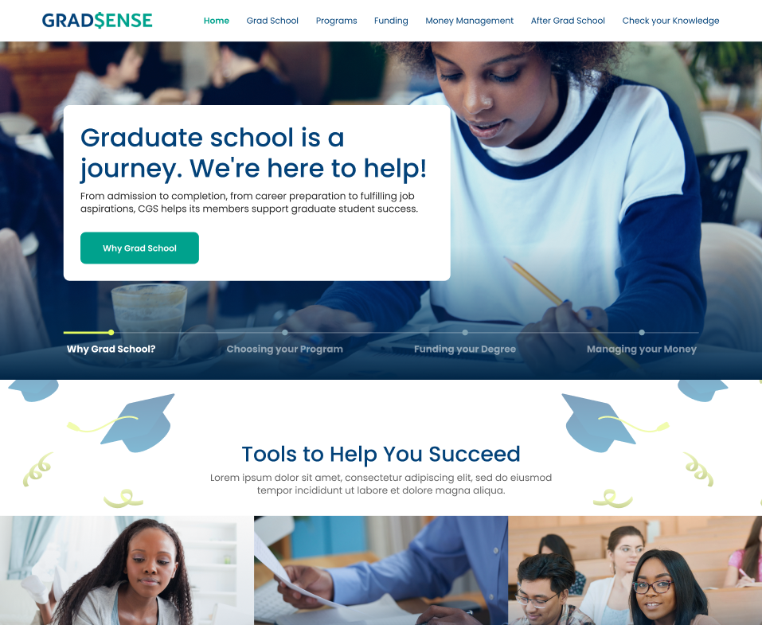
Originally launched in 2015, the site provides current and prospective students with financial information about pursing a graduate degree
Informed by feedback from students, program administrators, and graduate school leadership
Text is representative and not accurate to final content.
Notes:
Updated GradSense will launch in April 2025 with support from TIAA
National Financial Literacy Month occurs in April
Resolution Regarding Graduate Scholars, Fellows, Trainees, & Assistants (April 15th resolution) - an agreement among signatory CGS member graduate schools to provide graduate program applicants until April 15 to consider offers of admission that also include financial support
Based on previous traffic estimates, the goal is to receive 10,000 visitors per month within a year of relaunch
Supports CGS’s strategic priority to lead the graduate education community in identifying and exploring challenges in graduate education, including updating and expanding CGS student-facing financial literacy resources

Slide 14
We want your feedback and partnership as we think about what’s next for this initiative.
CGS will launch an updated GradSense
in April 2025 with support from TIAA
Grad$ense
CTA
Moving Forward
Connecting A2I™ at UL
As a new Accelerate to Industry (A2i™) academic partner, we see opportunities to build programming connections.
Presented by Brian Bolton . Mary Farmer-Kaiser

Slide 15
Thank you.
Feel free to reach out.
The Graduate School
University of Louisiana at Lafayette
Personal Finance Planning
https://louisiana.edu/graduateschool/tools-success/personal-finance-planning
brian.bolton@louisiana.edu
mary.farmer-kaiser@louisiana.edu

