Slide 1

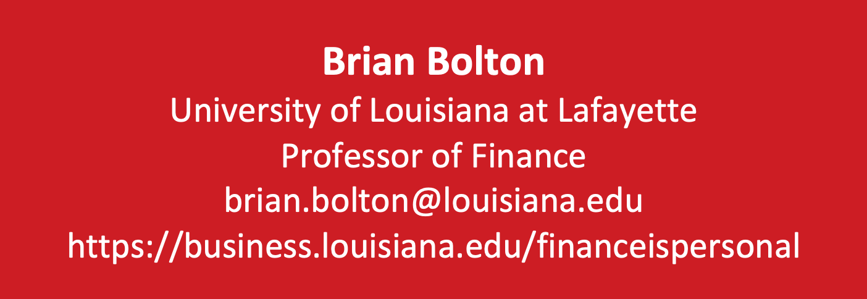
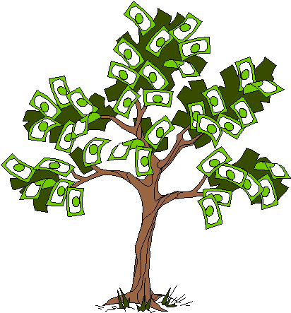


Slide 2
Financial Wellness
If you don’t know where you’ve come from, you can’t know where you’re going.
- Maya Angelou

Slide 3
A Few Opening Morals
Personal Finance is…personal.
It’s about you and not about anyone else.
You have to make it about you and your goals.

Slide 4
A Few Opening Morals
There is no judgment in personal finance.
There is no ego in personal finance.
There is no shame in personal finance.
It’s about you and not about anyone else.

Slide 5
A Few Opening Morals
Because personal finance is personal, it is virtually impossible for me to give you any specific advice.
However, there is one word of advice that applies to 99% of people working on their finances:
SAVE

Slide 6
A Few Opening Morals
SAVINGS
INVESTING
OWNERSHIP
WEALTH

Slide 7
Financial Wellness
Becoming an owner allows you to be the architect of your own future.
- Leigha Porter
Entrepreneur, Dancer, Choreographer, Founder of the Creole Nutcracker, PARC Village
and FIRE Expressions Conservatory, UL Lafayette grad, Northside High School grad

Slide 8
Owning Your Financial Future
What Are Your Values, Dreams & Goals?
Education
Career
Family
What Is Your Current Situation?
Education
Career
Family
Financial
Create a Personal Financial Plan for You:
Investing
Budgeting
Debt Management
Taxes
Insurance
Retirement
Education
Family
Business Planning
Estate Planning
Philanthropy

Slide 9
Let’s Take a Quick Quiz
Please define the following word:
VALUES
Now define this word:
VALUE
THESE ARE THE SAME WORDS!

Slide 10
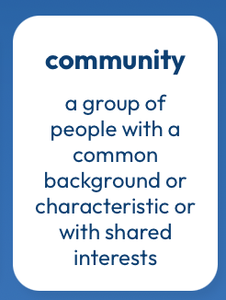
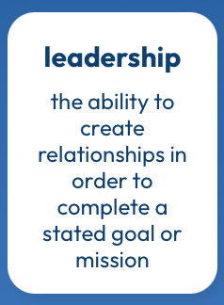
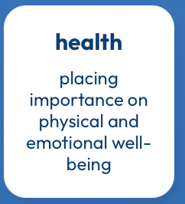
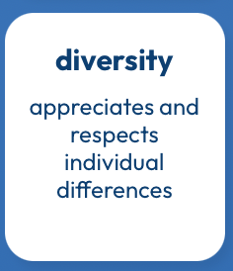

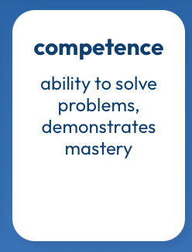
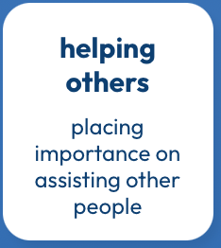
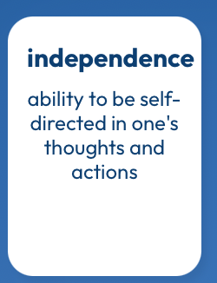
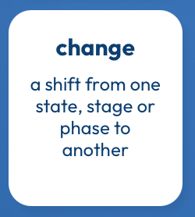
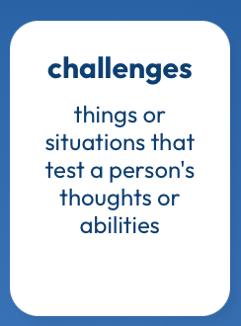
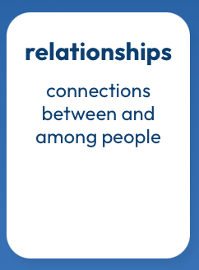
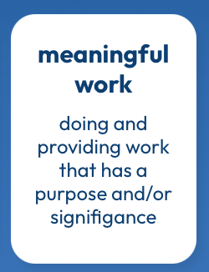

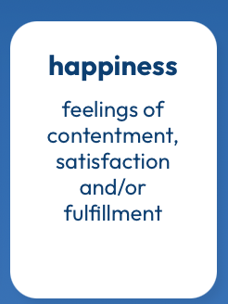
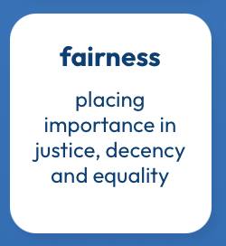
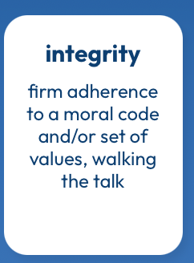
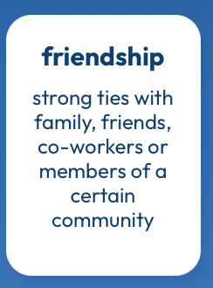
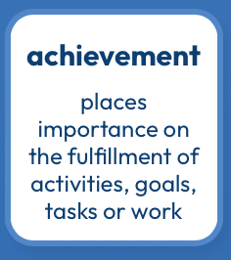
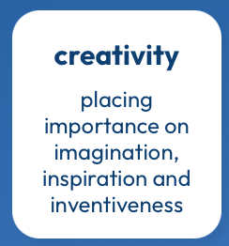
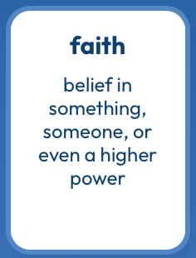

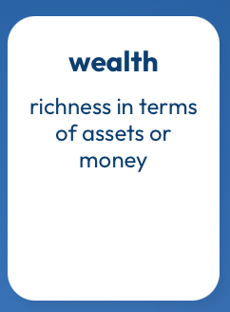
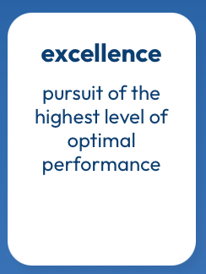
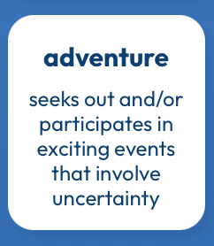
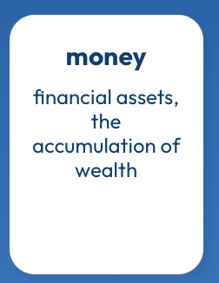
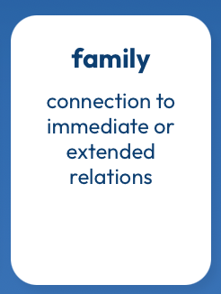
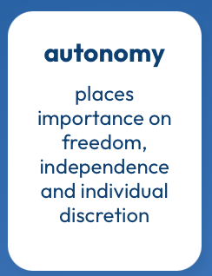
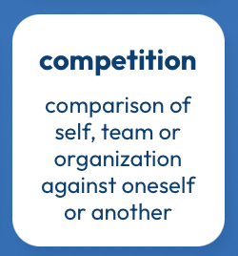
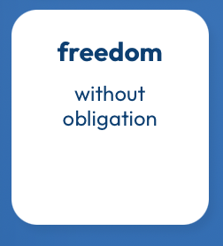
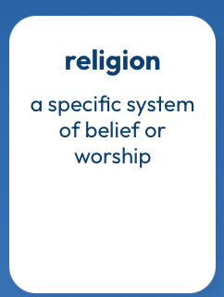
What Are Your Values?
https://www.think2perform.com/values#start

Slide 11
What Am I Looking For in A JOB?
These are the values that give my work energy and purpose.
I need to find a job, a career, projects, programs, activities or hobbies that give me the opportunity to embrace with and connect with these values.
https://www.think2perform.com/values#start

Slide 12
Some Homework for You
Make a list of the 5-10 most important criteria you are looking for in a job or career.
Rank these criteria.
Connect these criteria to your long-term and
short-term goals. Connect these criteria to your values.
(And if you don’t know what your values are, take 30 minutes to identify them and commit to them.)

Slide 13
More Homework for You
Once a week: Make a list of the money you are
going to spend this week.
Once a month: Make a list of how your ideal job serves
your values – or how school serves
your values over the long-term.
Once a year: Revisit your values and identify
your short- and long-term goals.

Slide 14
Owning Your Financial Future
What Are Your Values, Dreams & Goals?
Education
Career
Family
What Is Your Current Situation?
Education
Career
Family
Financial
Create a Personal Financial Plan for You:
Investing
Budgeting
Debt Management
Taxes
Insurance
Retirement
Education
Family
Business Planning
Estate Planning
Philanthropy

Slide 15
TODAY THE NEXT 6 MONTHS THE NEXT 12 MONTHS 2 YEARS AFTER GRADUATION 3 YEARS AFTER GRADUATION
ONCE EVERY SEMESTER:
TRACK EVERY PENNY THAT YOU SPEND & TRACK EVERY PENNY THAT YOU EARN
IN THE NEXT 3 MONTHS:
IDENTIFY WAYS TO DECREASE YOUR DISCRETIONARY SPENDING BY 25%
IN THE NEXT 6 MONTHS:
MAKE A PLAN TO MANAGE – AND PAY OFF – YOUR DEBT
IN THE NEXT 6-12 MONTHS:
OPEN MULTIPLE SAVINGS ACCOUNTS, 1 FOR EACH GOAL
IN THE NEXT 12 MONTHS, OPEN AN IRA OR ROTH IRA
WITHIN 2 YEARS OF GRADUATION:
HAVE AN “EMERGENCY FUND” ACCOUNT, WITH 3-6 MONTHS OF NON-DISCRETIONARY EXPENSES
WITHIN 3 YEARS OF GRADUATION:
ELIMINATE ALL OF YOUR BAD DEBT.

Slide 16
TODAY THE NEXT 6 MONTHS THE NEXT12 MONTHS 2 YEARS AFTER GRADUATION 3 YEARS AFTER GRADUATION
ONCE EVERY SEMESTER:
TRACK EVERY PENNY THAT YOU SPEND
TRACK EVERY PENNY THAT YOU EARN
CATEGORIZE YOUR SPENDING AS EITHER:
NON-DISCRETIONARY (Essential): rent, food, phone, insurance…
DISCRETIONARY (Not Essential): clothes, dining out, entertainment…
Use this as a foundation for thinking about what flexibility you have in your budget.
How can you decrease discretionary expenses by 25%?
How can you decrease non-discretionary expenses by 10%?

Slide 17
TODAY THE NEXT 6 MONTHS THE NEXT12 MONTHS 2 YEARS AFTER GRADUATION 3 YEARS AFTER GRADUATION
ONCE EVERY SEMESTER:
TRACK EVERY PENNY THAT YOU SPEND & TRACK EVERY PENNY THAT YOU EARN
IN THE NEXT 3 MONTHS:
IDENTIFY WAYS TO CUT YOUR DISCRETIONARY SPENDING BY 25%
BONUS: ALSO DECREASE YOUR NON-DISCRETIONARY SPENDING BY 10%
Can you switch insurance companies? Can you switch cell phone carriers? Can you drive less? Can you bring your lunch to school instead of buying fast food?

Slide 18
TODAY THE NEXT 6 MONTHS THE NEXT12 MONTHS 2 YEARS AFTER GRADUATION 3 YEARS AFTER GRADUATION
ONCE EVERY SEMESTER:
TRACK EVERY PENNY THAT YOU SPEND & TRACK EVERY PENNY THAT YOU EARN
IN THE NEXT 3 MONTHS:
IDENTIFY WAYS TO DECREASE YOUR DISCRETIONARY SPENDING BY 25%
IN THE NEXT 6 MONTHS:
MAKE A PLAN TO MANAGE – AND PAY OFF – YOUR DEBT
IN THE NEXT 6-12 MONTHS:
OPEN MULTIPLE SAVINGS ACCOUNTS, 1 FOR EACH GOAL
IN THE NEXT 12 MONTHS, OPEN AN IRA OR ROTH IRA
WITHIN 2 YEARS OF GRADUATION:
HAVE AN “EMERGENCY FUND” ACCOUNT, WITH 3-6 MONTHS OF NON-DISCRETIONARY EXPENSES
WITHIN 3 YEARS OF GRADUATION:
ELIMINATE ALL OF YOUR BAD DEBT.

Slide 19
One Rule About BUDGETING
Budgeting is philosophically very easy but practically very difficult because there is just one basic rule that applies to Budgeting:
Spend less than you earn.
Of course, this is much easier said than done…Especially for students with limited income and fixed expenses.
If you spend more than you earn, you have to make up the difference somehow - student loans, credit cards, savings.
  And this borrowing will set your goals back when it comes time to repay this borrowing. You are borrowing from your future.

Slide 20
How Do You Succeed at Budgeting
Be intentional. Know what you’re spending. Know what your income is.
Look in the mirror. Analyze yourself.
  This can be painful. You may see some habits you do not like. But recognizing those habits is the first step to correcting them.
Think both short-term and long-term.
  At its core, budgeting is about balancing monthly income and expenses.
  But, be sure to connect your income and expenses to your long-term goals.
When I was in college and in grad school, my priority was my degree. I ate more Top Ramen than any human should ever eat (including every night for a month, as part of a bet). To me, this was a choice and a habit that was critical to fulfilling my goal – my degree.

Slide 21
How Do You Succeed at Budgeting
I do not want all of my life to
be controlled by a budget.
I simply want my budget to be functional.
~ Quote from one of your student colleagues last summer

Slide 22
How Do You Succeed at Budgeting
I simply want my budget to be functional.
You want a budget to be a guide, not a rulebook.
You want a budget that is designed for you and nobody else.
You want to identify what is most important to you.
  Yes, you may have to change behavior and make sacrifices – so make sure you are only sacrificing those expenses or parts of your financial life that are least important to you.

Slide 23
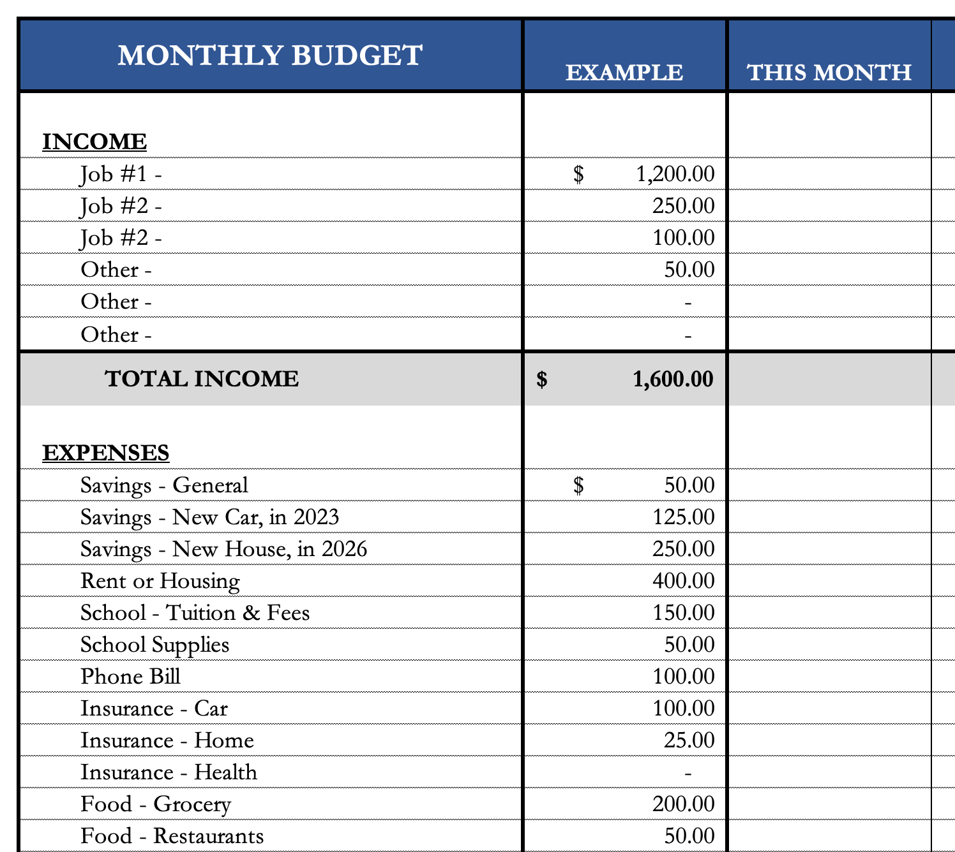
How Do You Succeed at Budgeting
I simply want my budget to be functional.
You want a budget to be a guide, not a rulebook.
You want a budget that is designed for you and nobody else.
You want to identify what is most important to you.
  Yes, you may have to change behavior and make sacrifices – so make sure you are only sacrificing those expenses or parts of your financial life that are least important to you.
You can download them from the MCOBA website, search for “Personal Financial Planning.”
Or you can email me and I will send them to you.

Slide 24
Owning Your Financial Future
How many of these could you do over the next 3 months?
Move to a better bank account
Give up your television
Give up a subscription
Sign up for free customer loyalty programs
Always make a shopping list
Stop eating out
Shop at a thrift store
Shop at a yard sale
Stop buying new video games
Cut your coffee purchases in half
Drink more water
Avoid convenience stores
Avoid fast food
Avoid alcohol
Quit smoking
Buy food and staples in bulk
Make a gift for friend or family member
No online purchases
Cancel unused memberships
Share your dreams with a close friend
Shop for new car insurance
Spend your free time volunteering
Avoid the mall
Only walk to places within 1 mile
Cancel magazine subscriptions
Eat breakfast
Eat leftovers
Bring your lunch to work or school
Only go to free entertainment events
Take public transportation
Carpool
Pack food for road trips
Eliminate cell phone services
Eliminate cable services
Spend 10 hours a week at the library
Learn about employee offers at work
Only drive within 3 MPH of the speed limit
Drive a different route to work
Eat less meat
Use coupons
Exercise more
Pay bills online through your bank

Slide 25
Owning Your Financial Future
How many of these could you do over the next 3 months?
Move to a better bank account
Give up your television
Give up a subscription
Sign up for free customer loyalty programs
Always make a shopping list
Stop eating out
Shop at a thrift store
Shop at a yard sale
Stop buying new video games
Cut your coffee purchases in half
Drink more water
Avoid convenience stores
Avoid fast food
Avoid alcohol
Quit smoking
Buy food and staples in bulk
Make a gift for friend or family member
No online purchases
Cancel unused memberships
Share your dreams with a close friend
Shop for new car insurance
Spend your free time volunteering
Avoid the mall
Only walk to places within 1 mile
Cancel magazine subscriptions
Eat breakfast
Eat leftovers
Bring your lunch to work or school
Only go to free entertainment events
Take public transportation
Carpool
Pack food for road trips
Eliminate cell phone services
Eliminate cable services
Spend 10 hours a week at the library
Learn about employee offers at work
Only drive within 3 MPH of the speed limit
Drive a different route to work
Eat less meat
Use coupons
Exercise more
Pay bills online through your bank
Focus on habits, not just dollars.
While you’re in college, many of these ideas may not help you – such as eating leftovers.
But if you develop the mindset now, the benefits will grow and compound and lead to real dollar savings (or income) when you are on your own and paying for your own meals.

Slide 26
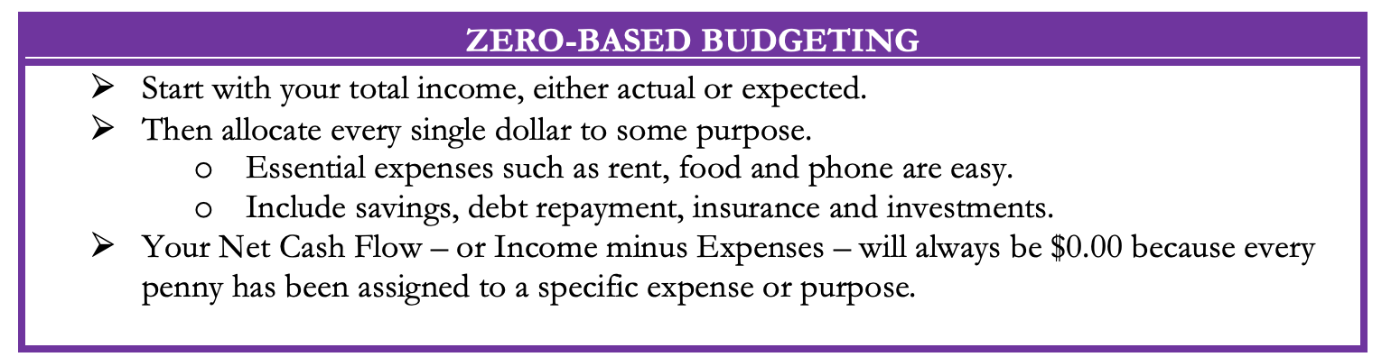
Five Budgeting Models

Slide 27
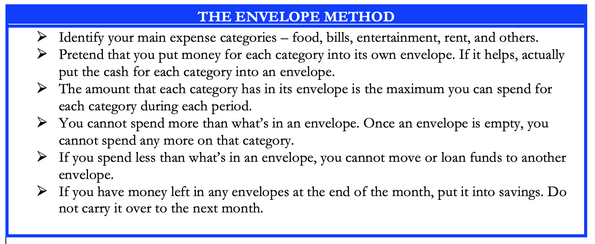
Five Budgeting Models

Slide 28
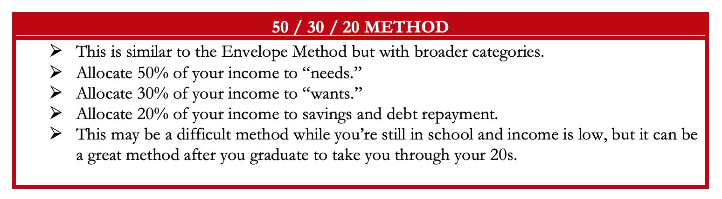
Five Budgeting Models

Slide 29
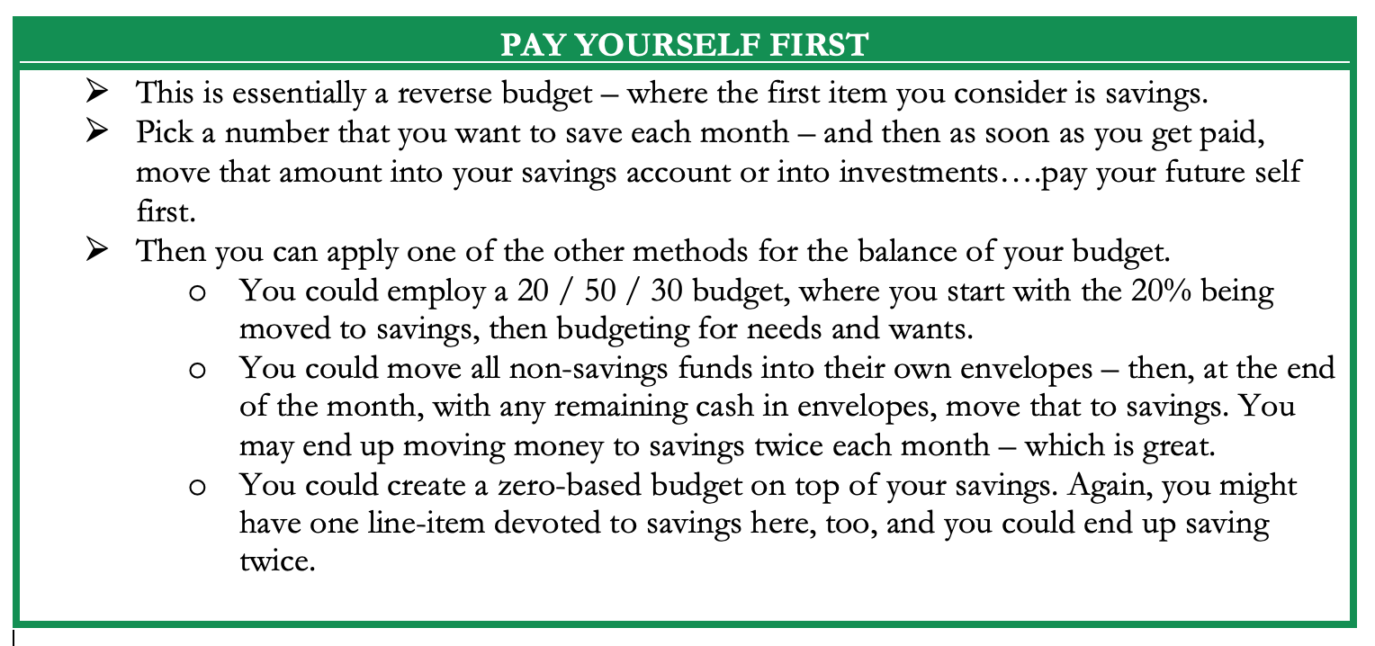
Five Budgeting Models

Slide 30
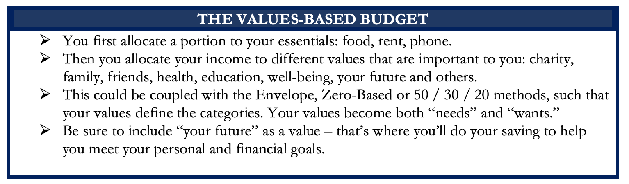
Five Budgeting Models

Slide 31
Five Budgeting Models
Which Budget Model is Best For You?
Only you can answer that.
Budgeting is more of a mental game than a financial process.
You need to select the approach that:
Gives you the least stress and the most confidence;
Best aligns with your short- and long-term goals.
In practice, most people combine different models to best suit
what they are most comfortable with.
(I personally pay myself first and then use a zero-based approach)
(And then, if I can, I pay myself last, too)

Slide 32
Developing A Budgeting Mindset
Some exercises to help you develop a budgeting mindset.
Track all of your income and expenses – every penny – over an extended period of time (say, 1-2 months).
Write down the last 15 things you spent money on.
Write down the next 15 things you want to spend money on.
Identify your 10 biggest expenses over the past 12 months.
Predict every dollar of income you will earn over the next 12 months.
Predict what your income will be for each of the next 5 years.

Slide 33
Developing A Budgeting Mindset
Some exercises to help you develop a budgeting mindset.
Track all of your income and expenses – every penny – over an extended period of time (say, 1-2 months).
Write down the last 15 things you spent money on.
Write down the next 15 things you want to spend money on.
Identify your 10 biggest expenses over the past 12 months.
Predict every dollar of income you will earn over the next 12 months.
Predict what your income will be for each of the next 5 years.
What is the purpose of this self-analysis?
To ensure that your spending is aligned with your income.
To ensure that your spending and income are part of your plan.
To ensure your budget is driven by wants & needs, and not driven by impulses.
To be intentional.

Slide 34
TODAY THE NEXT 6 MONTHS THE NEXT12 MONTHS 2 YEARS AFTER GRADUATION 3 YEARS AFTER GRADUATION
ONCE EVERY SEMESTER:
TRACK EVERY PENNY THAT YOU SPEND & TRACK EVERY PENNY THAT YOU EARN
IN THE NEXT 3 MONTHS:
IDENTIFY WAYS TO DECREASE YOUR DISCRETIONARY SPENDING BY 25%
IN THE NEXT 6 MONTHS:
MAKE A PLAN TO MANAGE –
AND PAY OFF – YOUR DEBT
WHICH DEBT IS YOUR WORST DEBT?
HIGH INTEREST RATE? HIGH FEES? OPPRESSIVE TERMS?
CAN YOU GET RID OF THIS DURING SCHOOL?
Which debt is more flexible?
How will you pay it off over the next 5-10 years?

Slide 35
TODAY THE NEXT 6 MONTHS THE NEXT12 MONTHS 2 YEARS AFTER GRADUATION 3 YEARS AFTER GRADUATION
ONCE EVERY SEMESTER:
TRACK EVERY PENNY THAT YOU SPEND & TRACK EVERY PENNY THAT YOU EARN
IN THE NEXT 3 MONTHS:
IDENTIFY WAYS TO DECREASE YOUR DISCRETIONARY SPENDING BY 25%
IN THE NEXT 6 MONTHS:
MAKE A PLAN TO MANAGE – AND PAY OFF – YOUR DEBT
IN THE NEXT 6-12 MONTHS:
OPEN MULTIPLE SAVINGS ACCOUNTS…ONE FOR EACH OF YOUR FINANCIAL GOALS
Maybe each account has a different time horizon.
Maybe each account has a different specific goal.
Our brains engage in “mental budgeting,” which means we mentally manage money better when it is assigned to specific purposes.

Slide 36
TODAY THE NEXT 6 MONTHS THE NEXT12 MONTHS 2 YEARS AFTER GRADUATION 3 YEARS AFTER GRADUATION
What is a useful way to use different accounts to achieve different goals?
Me? I have 6 bank and investing accounts.
A basic checking & transactions account. My paycheck is deposited here. And all bills are paid out of this account.
2 savings accounts…1 as my Emergency Fund for short-term crises and 1 as my saving for short-to-medium term goals, such as a new car or vacation.
An investment account. This is dedicated to long term goals, such as buying a house, children’s education or even retirement.
And 2 retirement accounts: 1 through work and 1 that I manage outside of my work retirement account.

Slide 37

TODAY THE NEXT 6 MONTHS THE NEXT12 MONTHS 2 YEARS AFTER GRADUATION 3 YEARS AFTER GRADUATION
Paycheck
Bills
$200
$100
$50
Savings Account #3:
NEW HOUSE
Savings Account #2:
NEW CAR
Emergency Fund:
3-6 Months of Discretionary Expenses
Savings Account #1:
VACATION

Slide 38
TODAY THE NEXT 6 MONTHS THE NEXT12 MONTHS 2 YEARS AFTER GRADUATION 3 YEARS AFTER GRADUATION
Paycheck
Bills
Emergency Fund:
3-6 Months of Discretionary Expenses
Short & Medium- Term Goals
(0-5 Years)
Long-Term Goals
(5+ Years)

Slide 39
TODAY THE NEXT 6 MONTHS THE NEXT12 MONTHS 2 YEARS AFTER GRADUATION 3 YEARS AFTER GRADUATION
What is a useful way to use different accounts to achieve different goals?
I have 6 bank and investing accounts.
Why does this work for me?
Research has found that humans engage in “mental budgeting.”
Imagine that you have $10,000.
You might manage (or spend) this $10,000 differently if you have it one account for “My Money” versus having $2,000 in a
checking account + $8,000 in different savings & investment accounts.

Slide 40
TODAY THE NEXT 6 MONTHS THE NEXT12 MONTHS 2 YEARS AFTER GRADUATION 3 YEARS AFTER GRADUATION
Why does this work?
Because it allows me to align different goals with different accounts.
Checking & Transaction Account
No risk,
0.0% return,
all cash
Short-to-Medium Term Goals
Some risk,
0-3% return goals,
cash + savings
Long-Term
Goals
Some Risk,
3-7% return goals,
savings + investments
Retirement
Accounts
Lots of risk,
8-12% return goals,
all investments

Slide 41
TODAY THE NEXT 6 MONTHS THE NEXT12 MONTHS 2 YEARS AFTER GRADUATION 3 YEARS AFTER GRADUATION
ONCE EVERY SEMESTER:
TRACK EVERY PENNY THAT YOU SPEND & TRACK EVERY PENNY THAT YOU EARN
IN THE NEXT 3 MONTHS:
IDENTIFY WAYS TO DECREASE YOUR DISCRETIONARY SPENDING BY 25%
IN THE NEXT 6 MONTHS:
MAKE A PLAN TO MANAGE – AND PAY OFF – YOUR DEBT
IN THE NEXT 6-12 MONTHS:
OPEN A SAVINGS ACCOUNT, ONE FOR EACH OF YOUR GOALS
IN THE NEXT 12 MONTHS:
OPEN AN IRA OR A ROTH IRA (INDIVIDUAL RETIREMENT ACCOUNT)
You can contribute $6,500 per year and invest in a wide variety of options.
You get to avoid capital gains taxes and possibly defer income taxes.
You get to benefit from compound investment returns over the long-term..and that’s one of the key hacks to building wealth.
Open a Roth IRA if your income is very low today – the tax benefits are huge.

Slide 42
TODAY THE NEXT 6 MONTHS THE NEXT12 MONTHS 2 YEARS AFTER GRADUATION 3 YEARS AFTER GRADUATION
ONCE EVERY SEMESTER:
TRACK EVERY PENNY THAT YOU SPEND & TRACK EVERY PENNY THAT YOU EARN
IN THE NEXT 3 MONTHS:
IDENTIFY WAYS TO DECREASE YOUR DISCRETIONARY SPENDING BY 25%
IN THE NEXT 6 MONTHS:
MAKE A PLAN TO MANAGE – AND PAY OFF – YOUR DEBT
IN THE NEXT 6-12 MONTHS:
OPEN A SAVINGS ACCOUNT, ONE FOR EACH OF YOUR GOALS
IN THE NEXT 12 MONTHS, OPEN AN IRA OR ROTH IRA
WITHIN 2 YEARS OF GRADUATION:
HAVE AN “EMERGENCY FUND” ACCOUNT, WITH 3-6 MONTHS OF NON-DISCRETIONARY EXPENSES IN IT
THIS IS REALLY DIFFICULT FOR ANYONE TO DO. BUT MAKE IT A PRIORITY.
Commit to paying yourself first with every paycheck. Commit to building your financial safety cushion…once you have this, then all other goals get easier and you will sleep better every night.

Slide 43
TODAY THE NEXT 6 MONTHS THE NEXT12 MONTHS 2 YEARS AFTER GRADUATION 3 YEARS AFTER GRADUATION
ONCE EVERY SEMESTER:
TRACK EVERY PENNY THAT YOU SPEND & TRACK EVERY PENNY THAT YOU EARN
IN THE NEXT 3 MONTHS:
IDENTIFY WAYS TO DECREASE YOUR DISCRETIONARY SPENDING BY 25%
IN THE NEXT 6 MONTHS:
MAKE A PLAN TO MANAGE – AND PAY OFF – YOUR DEBT
IN THE NEXT 6-12 MONTHS:
OPEN A SAVINGS ACCOUNT, ONE FOR EACH OF YOUR GOALS
IN THE NEXT 12 MONTHS, OPEN AN IRA OR ROTH IRA
WITHIN 2 YEARS OF GRADUATION:
HAVE AN “EMERGENCY FUND” ACCOUNT, WITH 3-6 MONTHS OF NON-DISCRETIONARY EXPENSES IN IT
WITHIN 3 YEARS OF GRADUATION:
ELIMINATE ALL OF YOUR BAD DEBT.
EARNING 10% ON YOUR INVESTMENTS IF YOU ARE PAYING 19.99% ON A CREDIT CARD. ELIMINATING HIGH-COST AND HIGH-FEE DEBT IS THE BEST BUDGET HACK POSSIBLE.
And begin working towards executing your overall debt plan. Do not be in a hurry to pay off your good & manageable debt. Simply having control over it will give you peace of mind.

Slide 44
TODAY THE NEXT 6 MONTHS THE NEXT12 MONTHS 2 YEARS AFTER GRADUATION 3 YEARS AFTER GRADUATION
ONCE EVERY SEMESTER:
TRACK EVERY PENNY THAT YOU SPEND & TRACK EVERY PENNY THAT YOU EARN
IN THE NEXT 3 MONTHS:
IDENTIFY WAYS TO DECREASE YOUR DISCRETIONARY SPENDING BY 25%
IN THE NEXT 6 MONTHS:
MAKE A PLAN TO MANAGE – AND PAY OFF – YOUR DEBT
IN THE NEXT 6-12 MONTHS:
OPEN MULTIPLE SAVINGS ACCOUNTS, 1 FOR EACH GOAL
IN THE NEXT 12 MONTHS, OPEN AN IRA OR ROTH IRA
WITHIN 2 YEARS OF GRADUATION:
HAVE AN “EMERGENCY FUND” ACCOUNT, WITH 3-6 MONTHS OF NON-DISCRETIONARY EXPENSES
WITHIN 3 YEARS OF GRADUATION:
ELIMINATE ALL OF YOUR BAD DEBT.

Slide 45
WHAT IS DEBT
Debt is borrowing from YOUR future.
We borrow because we want something today that we cannot afford today.
We make a promise to pay for that something in the future.
The entity we borrow from wants to make money. They are not our friends.
We have to pay them helping us get what we want today.
  At a minimum, we pay them interest on our debt.
  Depending on the type of debt, we may have to pay them much more (fees, collateral, earnings, control, etc.)

Slide 46
WHAT IS DEBT
Debt is borrowing from YOUR future.
If your debt is keeping you up at night…
If your debt is preventing you from achieving your goals…
If your debt is damaging your relationships…
…Then you may have too much debt.
(we will return to this issue later)

Slide 47
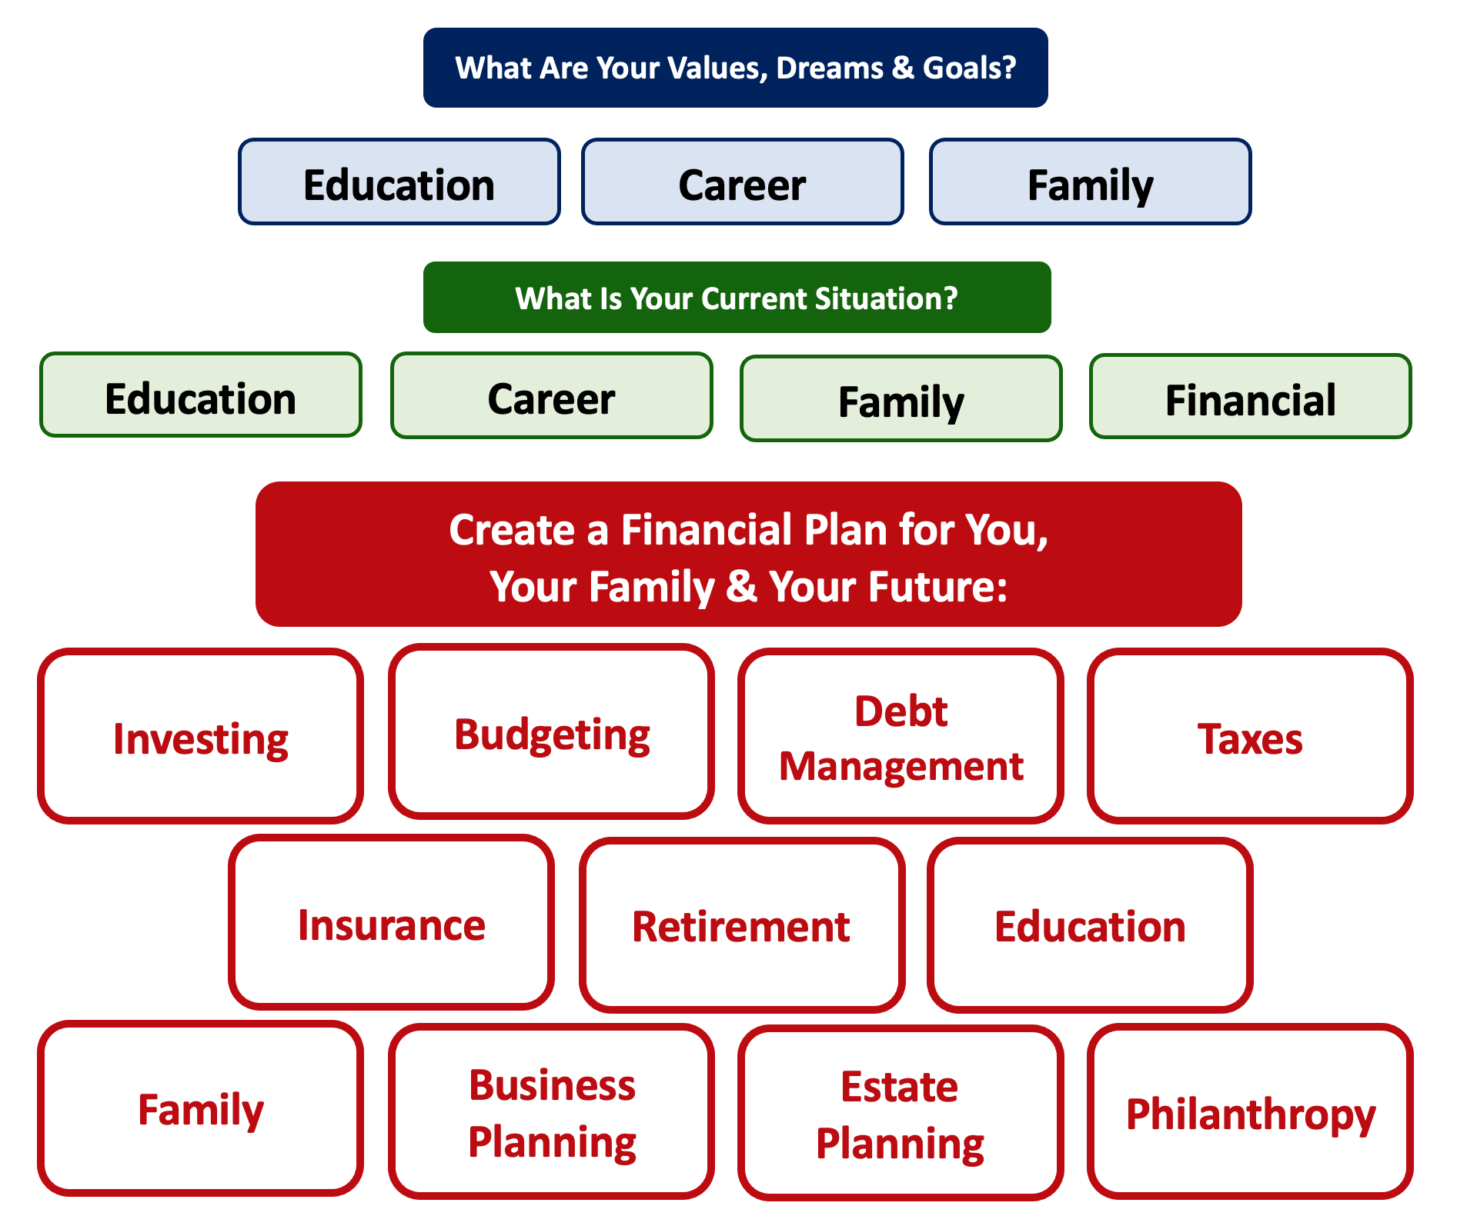
Debt is NOT a bad thing.
Debt can help us achieve our goals, depending on our current situations and what those goals are.
Debt is also called “leverage” – because it gives us the ability do things we might not be able to do otherwise.

Slide 48
Debt is NOT a bad thing.
My one primary piece of advice:
Whenever borrow money – whether it’s $20 for a Friday night pizza on your credit card or a $10,000 student loan – have a plan for paying it back.
Know why you are borrowing and where you will get the money to repay it.

Slide 49




Good Debt vs. Bad Debt
High cost, both in $$$ and opportunity
Lots of uncertainty
Potential for enormous return
Perfectly aligned with values, goals & dreams
High cost, both in $ and opportunity
Lots of uncertainty
Potential for some return
Usually aligned with values, goals & dreams
Very high cost
Short-term fulfillment
No future return
Unrelated to values, goals & dreams

Slide 50
Good Debt vs. Bad Debt
$100,000 of principal
$45,435 of interest
Repaid over 20 years @ 4% interest

Slide 51
Good Debt vs. Bad Debt
$100,000 of principal
$216,030 of interest
Repaid over 20 years @ 15% interest

Slide 52
Good Debt vs. Bad Debt
Is this debt aligned with my values, goals & dreams?
How am I going to repay this debt?

Slide 53
Good Debt vs. Bad Debt
NOTE:
Using a credit card is not necessarily a bad idea.
Only racking up loads of credit card debt is a bad idea.
I regularly use 3 credit cards.
Here’s how and here’s why…

Slide 54
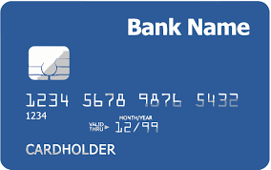
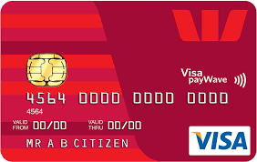
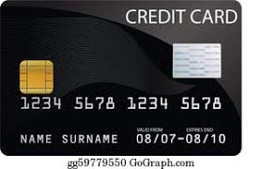
Credits Cards as Tools for Financial Planning
Card #1: Automatic bill payment of recurring monthly expenses (phone, insurance, cable, utilities)
Card #2: Living and discretionary expenses (gas, groceries, coffee, pizza, new shoes)
Card #3: Non-recurring big expenses (vacation, holidays, charity, new refrigerator)
Card #3 frequently has a $0.00 balance

Slide 55
Credits Cards as Tools for Financial Planning
WHY DO I DO THIS?
Mental Budgeting: This helps me mentally be aware of what I’m spending and why I’m spending.
  Instead of just knowing that I’m putting $1,000 on my credit cards in a month, separating the expenses across cards forces me to be aware of what I’m spending money on.
  When I review my statements and budgets at the end of each month, this gives me an easy opportunity to judge myself and to analyze my own behavior.
Card #1: Automatic bill payment of recurring monthly expenses (phone, insurance, cable, utilities)
Card #2: Living and discretionary expenses (gas, groceries, coffee, pizza, new shoes)
Card #3: Non-recurring big expenses (vacation, holidays, charity, new refrigerator)

Slide 56
LET’S MAKE THIS PERSONAL…
WHAT IMPACTS YOUR CREDIT RATING AS A CONSUMER?

Slide 57
LET’S MAKE THIS PERSONAL…
WHAT IMPACTS YOUR CREDIT RATING AS A CONSUMER?
35% Payment History – This is perhaps this simplest category, as it looks at how well you repay all borrowed amounts on credit cards, retail accounts, auto loans, utilities and phone bills, other installment loans and other debts. The better you are at repaying, the better your Payment History. Pay your bills on time.

Slide 58
LET’S MAKE THIS PERSONAL…
WHAT IMPACTS YOUR CREDIT RATING AS A CONSUMER?
30% Amounts Owed –The amount you owe is not simply about how much money you owe, but it’s also about how much of your available credit you use. If you have a credit card limit of $5,000 and your balance is $4,000, that’s worse than having a limit of $20,000 and a balance of $10,000. There are many trade-offs within this category and it can be confusing.
Pro-tip if you are using more than 30% of your available balance: Pay it off or down before the end of your reporting cycle and the credit agencies will never know it existed.

Slide 59
LET’S MAKE THIS PERSONAL…
WHAT IMPACTS YOUR CREDIT RATING AS A CONSUMER?
30% Amounts Owed –The amount you owe is not simply about how much money you owe, but it’s also about how much of your available credit you use. If you have a credit card limit of $5,000 and your balance is $4,000, that’s worse than having a limit of $20,000 and a balance of $10,000. There are many trade-offs within this category and it can be confusing.
Pro-tip if you are using more than 30% of your available balance: Pay it off or down before the end of your reporting cycle and the credit agencies will never know it existed.
One thing you can do tomorrow that might improve your credit score:
Ask for a credit limit increase on all of your credit cards or outstanding lines of credit.

Slide 60
LET’S MAKE THIS PERSONAL…
WHAT IMPACTS YOUR CREDIT RATING AS A CONSUMER?
15% Length of Credit History – This is also pretty simple – the longer your history of paying bills and loans, the better off you’ll be. Yes, this does bias against younger borrowers – but if your behavior in the other categories is strong, you should be okay. Be patient – you’ll build your history.

Slide 61
LET’S MAKE THIS PERSONAL…
WHAT IMPACTS YOUR CREDIT RATING AS A CONSUMER?
10% Credit Mix – Perhaps ironically, it can be better to have 5 different accounts that you repay regularly than it is to have just 2 different accounts. The greater the variety of accounts you have, the more opportunity you have to indicate that you are a low credit risk. Of course, if you have 5 accounts and you miss your payments, that will be doubly bad. Pay your bills on time and the Credit Mix will take care of itself.

Slide 62
LET’S MAKE THIS PERSONAL…
WHAT IMPACTS YOUR CREDIT RATING AS A CONSUMER?
10% New Credit – Opening a large number of new accounts in a short period of time may indicate that you are a higher risk. So, is the moral to never open new accounts? No – because then you can never indicate that you are a low risk. Be mindful of opening too many accounts in a short period of time, pay all your bills on time, and the New Credit category will not be a big issue.

Slide 63
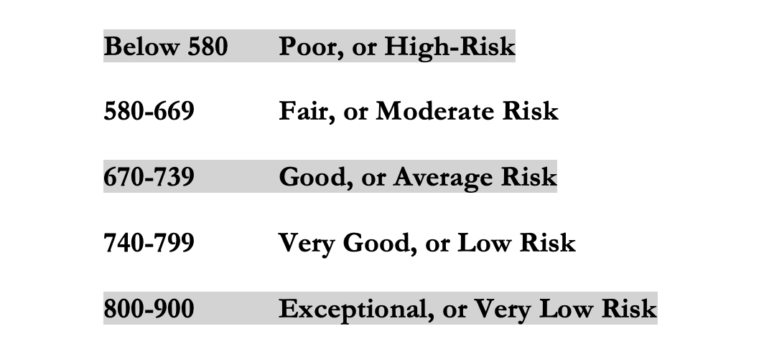
LET’S MAKE THIS PERSONAL…
WHAT IMPACTS YOUR CREDIT RATING AS A CONSUMER?
Your FICO Score will become an actual number: between 250 and 900.
The higher your Score, the lower interest rates you will pay on most loans.
The average FICO Score for Americans is just over 700.
The average in Louisiana is 677, the second lowest in the 50 U.S. states; only Mississippi has a lower average FICO Score.

Slide 64
LET’S MAKE THIS PERSONAL…
WHAT SHOULD YOU BE FOCUSED ON WITH RESPECT TO YOUR CREDIT SCORE?
If your FICO Score is below 600, there are probably 1 or 2 areas where you have significant weaknesses in your history.
Commit to correcting these weaknesses and not creating any new weaknesses.
If your FICO Score is between 600-700, there are probably 1 or 2 areas that can be improved – or where you used to have significant weaknesses.
Keep doing what you’re doing – and commit to not creating any new concerns.
If your FICO Score is over 700, keep doing what you’re doing and time will eventually get you the best score possible.

Slide 65
TODAY THE NEXT 6 MONTHS THE NEXT12 MONTHS 2 YEARS AFTER GRADUATION 3 YEARS AFTER GRADUATION
ONCE EVERY SEMESTER:
TRACK EVERY PENNY THAT YOU SPEND & TRACK EVERY PENNY THAT YOU EARN
IN THE NEXT 3 MONTHS:
IDENTIFY WAYS TO DECREASE YOUR DISCRETIONARY SPENDING BY 25%
IN THE NEXT 6 MONTHS:
MAKE A PLAN TO MANAGE – AND PAY OFF – YOUR DEBT
IN THE NEXT 6-12 MONTHS:
OPEN MULTIPLE SAVINGS ACCOUNTS, 1 FOR EACH GOAL
IN THE NEXT 12 MONTHS, OPEN AN IRA OR ROTH IRA
WITHIN 2 YEARS OF GRADUATION:
HAVE AN “EMERGENCY FUND” ACCOUNT, WITH 3-6 MONTHS OF NON-DISCRETIONARY EXPENSES
WITHIN 3 YEARS OF GRADUATION:
ELIMINATE ALL OF YOUR BAD DEBT.

Slide 66
Why Should A 20-Year Old
Begin Saving for Retirement?
SAVINGS
INVESTING
OWNERSHIP
WEALTH

Slide 67
If you save or invest $5,000 per year….
With a 1% investment return, you will have a total of $325,539 after 50 years.
This includes $75,539 of passive income.

Slide 68
If you save or invest $5,000 per year….
With a 4% investment return, you will have a total of $793,869 after 50 years.
This includes $543,869 of passive income.

Slide 69
If you save or invest $5,000 per year….
With a 7% investment return, you will have a total of $2,174,930 after 50 years.
This includes $1,924,930 of passive income.

Slide 70
If you save or invest $5,000 per year….
With an 11% investment return, you will have a total of $9,261,680 after 50 years.
This includes $9,011,680 of passive income.
If you save or invest $5,000 per year….
With a 11% investment return, you will have a total of $9,261,680 after 50 years.
This includes $9,011,680 of passive income.

Slide 71
If we invest for 20 years instead of 50 years:
At 1%: $100,000 ➔ $111,196
At 4%: $100,000 ➔ $154,846
At 7%: $100,000 ➔ $219,326
At 11%: $100,000 ➔ $356,326

Slide 72
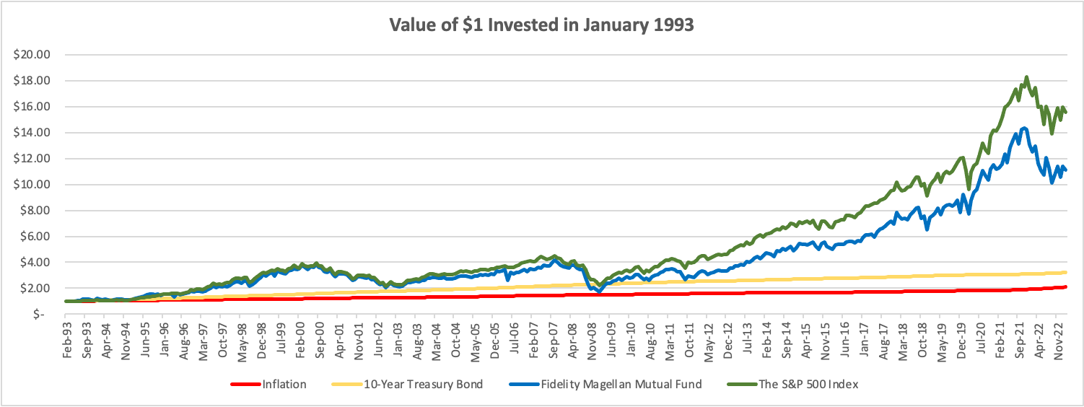
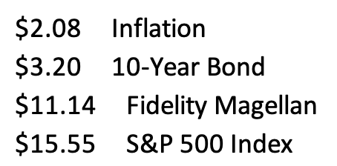

Slide 73
A Few Opening Morals
Begin investing as early as you can.
Get comfortable taking some risks with your investing so you can earn bigger returns.
Get comfortable playing the long game.

Slide 74
Opening a Roth IRA – Why Do It?
Conceptually, the earlier we begin saving for retirement, the more we will benefit from compound interest when we get to retirement age.
  If you invest $6,000 per year from age 25 to age 60, you would have $1,300,000 in your account at age 60 (assuming a 9% annual return).
  If you wait 10 years and invest $6,000 per year from age 35 to age 60, you would have $500,000 in your account at age 60 (assuming a 9% annual return).

Slide 75
Planning for Retirement – Why do it NOW?
Conceptually, the earlier we begin saving for retirement, the more we will benefit from compound interest when we get to retirement age.
  If you invest $6,000 per year from age 25 to age 60, you would have $1,300,000 in your account at age 60 (assuming a 9% annual return).
  If you wait 10 years and invest $6,000 per year from age 35 to age 60, you would have $500,000 in your account at age 60 (assuming a 9% annual return).

Slide 76
Planning for Retirement – How to do it?
A taxable-brokerage account (with Robinhood, Fidelity or some other brokerage)
    You contribute/invest after-tax cash flow (what is leftover from your paycheck)
    Your investments should grow over time
    You pay income taxes today, before investing, and then capital gains when you withdraw the money in the future
    This is the most flexible…but has the fewest tax benefits
A company-sponsored retirement plan: 401(k) or 403(b), in most cases.
    Your employer may match some of your contributions (= “free money”)
    Your investments should grow over time
    You will pay income taxes when you withdraw the money in retirement, only
    You never pay capital gains taxes on the growth – that’s good

Slide 77
Planning for Retirement – How to do it?
An IRA – Individual Retirement Account, designed for people without a company sponsored retirement plan
    Available through Robinhood, Fidelity or most other brokerages
    You contribute/invest PRE-TAX cash flow today
    Your investments should grow over time
    You pay income taxes in retirement
A Roth IRA
    Available through Robinhood, Fidelity or most other brokerages
    You contribute/invest AFTER-TAX cash flow today
    Your investments should grow over time
    You pay income taxes today, but never again
    Roth IRAs are ideal for people with relatively low income today,
    who expect their income to increase in the future

Slide 78
Opening a Roth IRA – The Fine Print
But what is an IRA? Why the Roth IRA?
  An IRA is an Individual Retirement Account.
  You are allowed to contribute $7,000 per year
  An IRA has tax advantages to a regular brokerage account, in that it allows you avoid capital gains taxes
    With a Roth IRA, you use after-tax money to invest today. The money should grow over time, but then when you with withdraw the money in retirement, you do NOT pay income taxes
    With a traditional IRA, you get a tax-deduction today for the amount that you invest. So you do not pay taxes today on that amount of income. But then you will pay income taxes when you withdraw the money in retirement.
    The key decision is based on whether you think your tax rate will be higher today or in the future.
    This is why we recommend a Roth IRA to graduate students: Your income tax rate is probably lower today than it will be in the future, so you want to pay taxes today and avoid taxes in the future. The Roth lets you do this.
  The bad news is that the money you put into an IRA cannot be withdrawn, unless you pay a 10% penalty, until you turn 59 ½ years old
  There is more fine print that we are skipping over here and some minor exceptions to this overview, but this should cover most of you and most situations.

Slide 79
Opening a Roth IRA – A Checklist
  Research – and pick – a brokerage or financial institution to use.
      Functionally & legally, as far as managing your account and investments, they are going to be similar.
      However, the user interfaces will be different…including how you use the account and resources available. That’s the decision – which interface do you like best.
      And, some brokerages may not offer certain types of accounts.
      Robinhood, Fidelity, Charles Schwab, JP Morgan Chase, Bank of America, TD Ameritrade and many others are all good.
  Establish and open your Roth IRA account.
      This will require your Social Security number and other personal information, but not too much. It should take 5-10 minutes.
  Fund your Roth IRA account.
      Link a bank account to your Roth IRA to allow online transfers. It may take 1-2 weeks initially to get the money transferred as the Roth IRA account verifies your bank accounts.
      Your brokerage may allow wire transfers for a fee, but the initial transfer may still take 1-2 weeks
      You may be able to upload an electronic copy of a personal check to deposit funds into your Roth IRA account.
      You may be able to go old school and visit a branch of your brokerage to do everything in person.
  Begin investing and saving for your retirement.

Slide 80
The Magic of Compound Returns

Slide 81
The Magic of Compound Returns

Slide 82
The Magic of Compound Returns
Quiz Question on Compound Returns:
Under which of the following scenarios will you have more money saved when you turn 65?
Investing $100 per month from age 25-35 (and then nothing from 35-65)
With an 8% return, you will have $185,000 accumulated at 65.
Investing $100 per month from age 35-65 (but nothing from 25-35)
With an 8% return, you will have $150,000 accumulated at 65.
Note: If the returns on your investments are less than 6%, (B) will lead to greater wealth.
There’s a similar but different problem on page 37 of your handbook.

Slide 83
The Magic of Compound Returns
Quiz Question on Compound Returns:
Under which of the following scenarios will you have more money saved when you turn 65?
Investing $100 per month from age 25-35 (and then nothing from 35-65)
With an 8% return, you will have $185,000 accumulated at 65.
Investing $100 per month from age 35-65 (but nothing from 25-35)
With an 8% return, you will have $150,000 accumulated at 65.
Note: If the returns on your investments are less than 6%, (B) will lead to greater wealth.
There’s a similar but different problem on page 37 of your handbook.

Slide 84
Review: A Few Rules About INVESTING
Investing lets COMPOUND INTEREST be your friend.
  With compound interest, your interest earns interest.
  Without actively making decisions, your money can grow exponentially.
  Yes, there is risk – the exponential growth rate could be negative.
  Such risk is greatest if you ‘invest’ over very short periods of time.
  Historically, over the past 100+ years, if you invest for 5+ years, you have benefited from positive exponential growth.
  The average return of a common stock over the past 100 years is 10%.
    The word ’average’ is very important here. But, the good news, we can all achieve ‘average’ returns relatively easily (though they may not be 10% in the future)

Slide 85
Review: A Few Rules About INVESTING
Investing lets COMPOUND INTEREST be your friend.
  With compound interest, your interest earns interest.
  Without actively making decisions, your money can grow exponentially.
  Yes, there is risk – the exponential growth rate could be negative.
  Such risk is greatest if you ‘invest’ over very short periods of time.
  Historically, over the past 100+ years, if you invest for 5+ years, you have benefited from positive exponential growth.
  The average return of a common stock over the past 100 years is 10%.
    The word ’average’ is very important here. But, the good news, we can all achieve ‘average’ returns relatively easily (though they may not be 10% in the future)
Not to be too esoteric or philosophical…
But compound interest doesn’t just apply to investing.
Compound interest applies to all aspects of college life:
Time Management
Mental Health
Health Management
Writing Skills
Relationships
And…Of course, Money Management

Slide 86
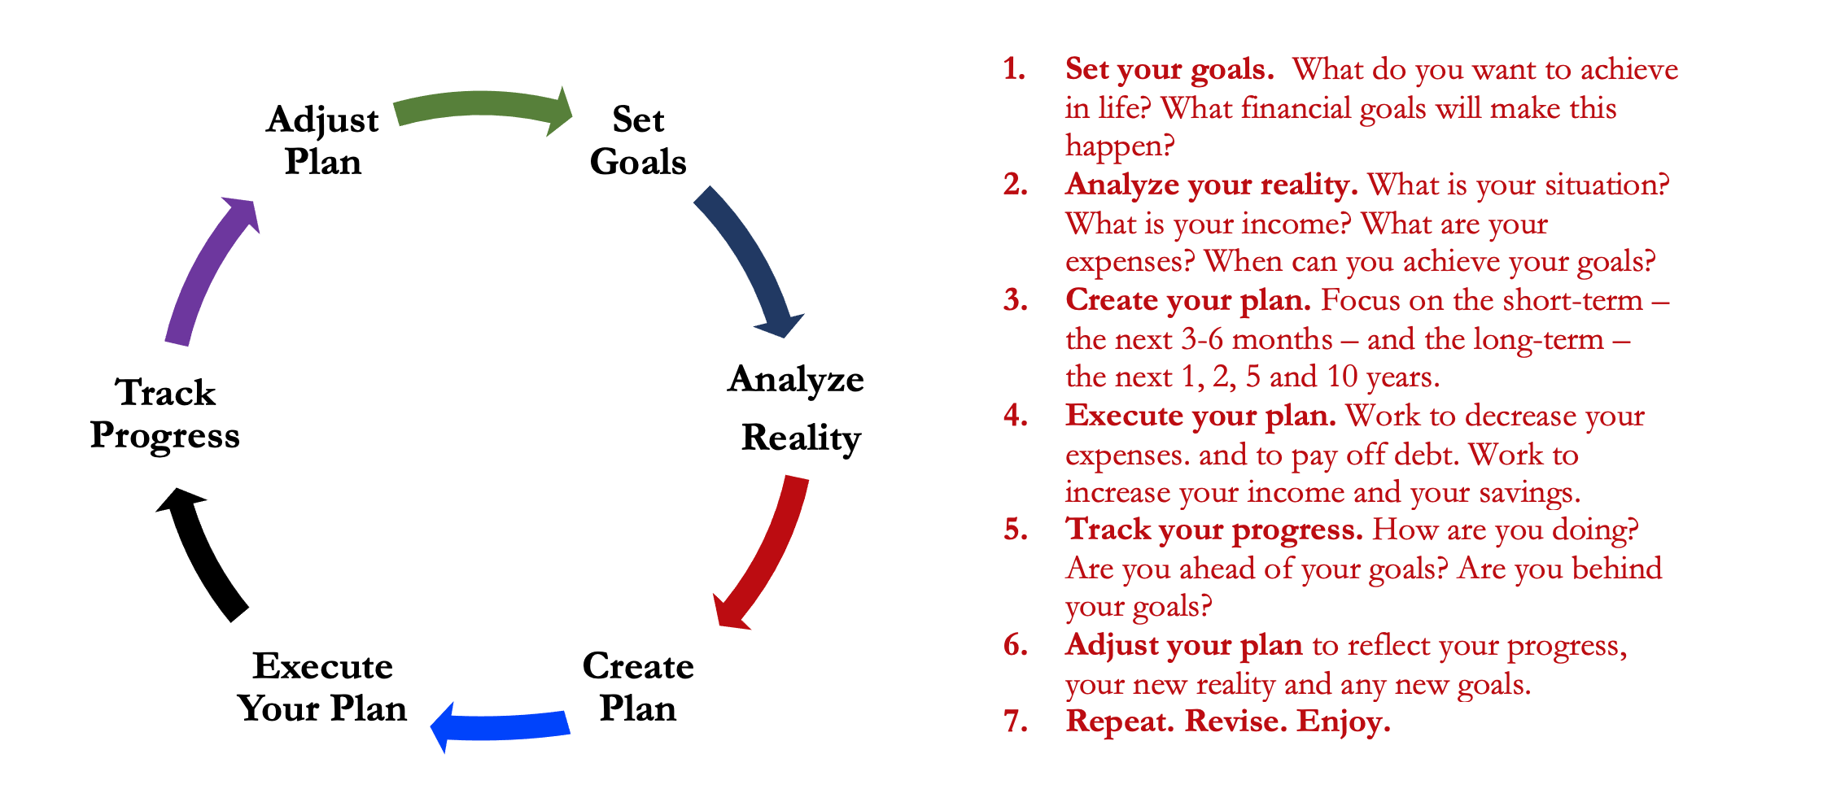
Isn’t this a lot like what you do with your education planning?

Slide 87
Some Parting Words
Nothing in finance is free. Do not think some institution is giving you a super deal just because they like you. There will be costs.
Investment companies work really hard to get your money. They hire psychologists to figure out how to get you addicted to your products. Your money pays for their commercials, buildings, fancy cars and vacation homes.
I check my bank, savings & investment accounts daily. I do not make changes daily (or even monthly). I just don’t want any surprises.

Slide 88
Some Parting Words
If you ever invest based on personal relationships, be prepared for losses.
Nobody – NOBODY – can predict the future. And investing is all about predicting the future. Be careful about thinking you can predict the future. Make sure your investments align with your goals.
Be your own boss. Take control of your money and your investments. Nobody else is going to do it for you. Own your financial future.

Slide 89
Financial Wellness
Don’t wait around for other people to be happy for you.
Any happiness you get,
You’ve got to make yourself.
~ Alice Walker, poet & novelist

Slide 90
Brian Bolton
Professor of Finance brian.bolton@louisiana.edu

