Slide 1
Imagine that you won $1,000 playing a scratch-off lottery ticket. Congratulations!
And now you want to invest this $1,000 to work towards achieving your personal goals.
Which of the following are you going to invest in?
Please select up to 3 of these options and discuss your selection with a neighbor.
Stock of Amazon.
Stock of Tesla.
Stock of Bank of America.
Stock of Bed, Bath & Beyond
Bitcoin.
2 pairs of vintage Air Jordan shoes.
U.S. Treasury bills.
Stock of Gazprom, Russia’s largest energy company.
A fractional share of a time-share condo in Barbados.
A fractional share of your cousin’s friend’s new technology start-up venture.
Oil. Several barrels of crude oil.
Cash. Just put it in an envelope under your mattress.

Slide 2
Opening Quiz – Question #1
The U.S. stock markets had a terrible 2022. But that was just 1 year.
If you had invested $1,000 in the S&P 500 at the beginning of 2021
(2 years years ago), how much would that $1,000 be worth today?
A. $557
B. $755
C. $1,058
D. $3,149

Slide 3
Opening Quiz – Question #1
The U.S. stock markets had a terrible 2022. But that was just 1 year.
If you had invested $1,000 in the S&P 500 at the beginning of 2021
(2 years years ago), how much would that $1,000 be worth today?
A. $557
B. $755
C. $1,058
D. $3,149

Slide 4
Opening Quiz – Question #2
The U.S. stock markets had a terrible 2022. But that was just 1 year.
If you had invested $1,000 in the S&P 500 at the beginning of 2013
(10 years ago), how much would that $1,000 be worth today?
A. $557
B. $755
C. $1,058
D. $3,149

Slide 5
Opening Quiz – Question #2
The U.S. stock markets had a terrible 2022. But that was just 1 year.
If you had invested $1,000 in the S&P 500 at the beginning of 2013
(10 years ago), how much would that $1,000 be worth today?
A. $557
B. $755
C. $1,058
D. $3,149
That’s an average annual return of 12% of over 10 years.

Slide 6
Opening Quiz – Question #3
Which of these 4 countries currently
has the highest inflation rate?
United States
England
Germany
Mexico

Slide 7
Opening Quiz – Question #3
Which of these 4 countries currently
has the highest inflation rate?
United States
England
Germany
Mexico

Slide 8
Opening Quiz – Question #4
Which of these 4 countries
currently has the LOWEST inflation rate?
United States
England
Germany
Mexico

Slide 9
Opening Quiz – Question #4
Which of these 4 countries
currently has the LOWEST inflation rate?
United States (6.5%)
England (10.2%)
Germany (8.6%)
Mexico (7.8%)

Slide 10
Opening Quiz – Question #5
If you sold cookies out of your apartment during 2022 and made $500 from those sales, and spent $200 making those cookies, what do you owe taxes on?
$500
$300
$200
$0

Slide 11
Opening Quiz – Question #5
If you sold cookies out of your apartment during 2022 and made $500 from those sales, and spent $200 making those cookies, what do you owe taxes on?
$500
$300
$200
$0

Slide 12
Opening Quiz – Question #6
If you spend $2,500 (or more) on education expenses that are required for your degree – including tuition, books, supplies, maybe a computer – you might be able to receive a $2,500 credit on your tax return.
TRUE
FALSE

Slide 13
Opening Quiz – Question #6
If you spend $2,500 (or more) on education expenses that are required for your degree – including tuition, books, supplies, maybe a computer – you might be able to receive a $2,500 credit on your tax return.
Check out the American Opportunity Tax Credit (up to $2,500) and the Lifetime Learning Credit (up to $2,000) to see if you are eligible for either credit.
Credits directly reduce the taxes you owe…which is really nice.
TRUE
FALSE

Slide 14
Opening Quiz – Question #7 – Last One
If I had invested $1,000 into the S&P 500, the overall U.S. stock market, on the day that I was born, how much would that be worth today?
A. $1,000
B. $12,257
C. $43,656
C. $85,035

Slide 15
Opening Quiz – Question #7 – Last One
If I had invested $1,000 into the S&P 500, the overall U.S. stock market, on the day that I was born, how much would that be worth today?
A. $1,000
B. $12,257
$43,656
That’s an annual return of just over 10% per year.
C. $85,035

Slide 16

STUDENT SUPPORT SERVICES
FINANCIAL WELLNESS SERIES 2023
Session #4
Investing & Tax Issues
March 22, 2023

Slide 17
Brian Bolton
Professor of Finance brian.bolton@louisiana.edu http://business.louisiana.edu/financeispersonal

Slide 18
Owning Your Financial Future
INVESTING GOALS, HABITS & STRATEGIES
Today, January 23
CREDIT SCORES & DEBT MANAGEMENT
Wednesday, March 8
CREATING AN INVESTMENT STRATEGY
Wednesday, March 15

Slide 19
Owning Your Financial Future
OPENING AN INDIVIDUAL RETIREMENT ACCOUNT
Wednesday, March 22
TAX STRATEGIES
Wednesday, April 5
CAREER PLANNING: YOUR MONEY & YOUR FUTURE
Wednesday, April 26

Slide 20
Owning Your Financial Future
Structure of each session:
  Open question & answer session
  Brian presents general update on investing and any relevant current events
  Brian presents specific guidance and ideas for the session’s topic
  Open question & answer session…about any topics you wish to discuss

Slide 21
Happiness
Long-Term Goals
Short-Term Goals
Financial Needs
Family Needs

Slide 22
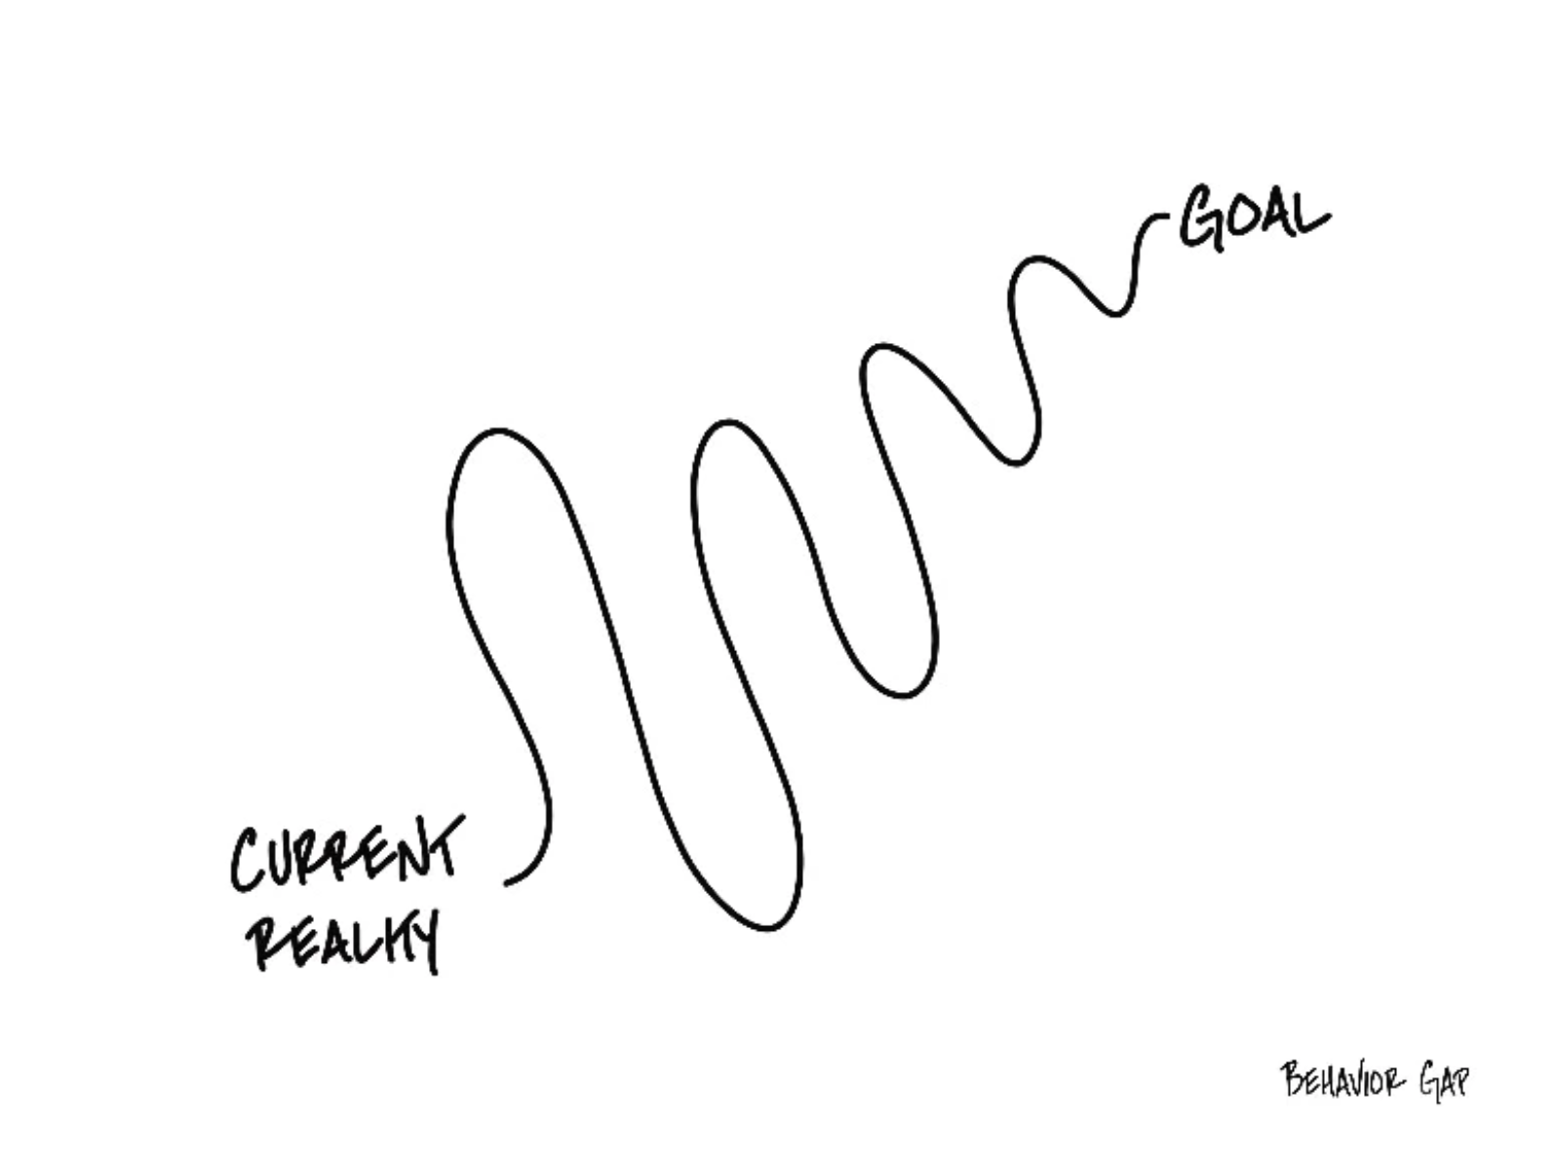

Slide 23
Financial Wellness
A goal without a plan is just a dream.
Wealth is largely the result of habit.
The most difficult thing is the decision to act; the rest is mere tenacity.
It takes as much energy to plan as it does to wish.
You cannot escape the responsibility of tomorrow by avoiding it today.

Slide 24
This is exactly how most of us think about other priorities in our lives: family, career, education.
Let’s try to have the same thinking for our financial lives.
A goal without a plan is just a dream.
Wealth is largely the result of habit.
The most difficult thing is the decision to act; the rest is mere tenacity.
It takes as much energy to plan as it does to wish.
You cannot escape the responsibility of tomorrow by avoiding it today.

Slide 25
Owning Your Financial Future
What Are Your Values, Dreams & Goals?
Education
Career
Family
What Is Your Current Situation?
Education
Career
Family
Financial
Create a Personal Financial Plan for You:
Investing
Budgeting
Debt Management
Taxes
Insurance
Retirement
Education
Family
Business Planning
Estate Planning
Philanthropy

Slide 26

Isn’t this a lot like what you do with your education planning?

Slide 27
Financial Wellness
If you don’t know where you’ve come from, you can’t know where you’re going.
- Maya Angelou

Slide 28
TODAY THE NEXT 6 MONTHS THE NEXT 12 MONTHS 2 YEARS AFTER GRADUATION 3 YEARS AFTER GRADUATION
ONCE EVERY SEMESTER:
TRACK EVERY PENNY THAT YOU SPEND & TRACK EVERY PENNY THAT YOU EARN
IN THE NEXT 3 MONTHS:
IDENTIFY WAYS TO DECREASE YOUR DISCRETIONARY SPENDING BY 25%
IN THE NEXT 6 MONTHS:
MAKE A PLAN TO MANAGE – AND PAY OFF – YOUR DEBT
IN THE NEXT 6-12 MONTHS:
OPEN MULTIPLE SAVINGS ACCOUNTS, 1 FOR EACH GOAL
IN THE NEXT 12 MONTHS, OPEN AN IRA OR ROTH IRA
WITHIN 2 YEARS OF GRADUATION:
HAVE AN “EMERGENCY FUND” ACCOUNT, WITH 3-6 MONTHS OF NON-DISCRETIONARY EXPENSES
WITHIN 3 YEARS OF GRADUATION:
ELIMINATE ALL OF YOUR BAD DEBT.

Slide 29
TODAY THE NEXT 6 MONTHS THE NEXT 12 MONTHS 2 YEARS AFTER GRADUATION 3 YEARS AFTER GRADUATION
ONCE EVERY SEMESTER:
TRACK EVERY PENNY THAT YOU SPEND & TRACK EVERY PENNY THAT YOU EARN
IN THE NEXT 3 MONTHS:
IDENTIFY WAYS TO DECREASE YOUR DISCRETIONARY SPENDING BY 25%
IN THE NEXT 6 MONTHS:
MAKE A PLAN TO MANAGE – AND PAY OFF – YOUR DEBT
IN THE NEXT 6-12 MONTHS:
OPEN MULTIPLE SAVINGS ACCOUNTS, 1 FOR EACH GOAL
IN THE NEXT 12 MONTHS, OPEN AN IRA OR ROTH IRA
WITHIN 2 YEARS OF GRADUATION:
HAVE AN “EMERGENCY FUND” ACCOUNT, WITH 3-6 MONTHS OF NON-DISCRETIONARY EXPENSES
WITHIN 3 YEARS OF GRADUATION:
ELIMINATE ALL OF YOUR BAD DEBT.

Slide 30
I DO NOT GIVE INVESTMENT ADVICE
But here are some investment issues to think about:
Do you want to pick individual stocks (or other securities) and monitor them regularly?
  This can help you feel more control, more connection and more personal interest in your investments.
  Advantages: Potential for big gains, maybe a personal connection to the companies, you feel more engaged with the process.
  Disadvantages: Potential for big losses, requires more time and energy, transaction costs (trading, taxes) can add up, there are 1000s to choose from, potential loss of sleep and hair.

Slide 31
I DO NOT GIVE INVESTMENT ADVICE
But here are some investment issues to think about:
Or, would you be content investing in mutual funds and/or market indexes that pool dozens or hundreds of stocks?
  Advantages: Potential for moderate gains, lower risk (through diversification), lower trading and tax costs, you can narrow down the selection pretty quickly, less loss of sleep and hair
  Disadvantages: Lots of singles and doubles but no home runs, no emotional connection to your investments, susceptible to big market downturns (but not necessarily more than individual stocks)

Slide 32
I DO NOT GIVE INVESTMENT ADVICE
If you want to invest in individual stocks, I cannot help you.
But if you are interested in market indexes, here are some ideas:
  SPY – The S&P 500 index. 500 of the largest U.S. firms, from all industries.
  SPYD – The same as above, with a focus on those companies that pay regular dividends out to investors from their earnings. You will get more income, but possibly lower long-term capital gains.
  IWM – The Russell 2000. 2000 smaller U.S. firms (the 2000 firms after the 1000 largest firms). More volatility, possibly higher returns.
  EFA – Index of non-US firms (Europe, Far East, Australasia). Big firms.
  EEM – Index of non-US, emerging market stocks. Bigger firms in developing countries. More risk than any of the above.
  GBTC – A Bitcoin index. Invest in Bitcoin without mining or owning. Big Risk.

Slide 33
Investing – How Do You Do It?
When you’re just getting started with investing, there are a few approaches you can take:
  Start with a small amount of money – whether that’s $20 or $2,000 – and just go for it. Pick a few investments, track them regularly and be prepared to buy more or sell more should you feel comfortable doing either.

Slide 34
Investing – How Do You Do It?
When you’re just getting started with investing, there are a few approaches you can take:
  Start with a small amount of money – whether that’s $20 or $2,000 – and just go for it. Pick a few investments, track them regularly and be prepared to buy more or sell more should you feel comfortable doing either.
  Determine how much you have to invest.
    Put ½ of that into an index fund or a specific mutual fund. This will provide some security, generally with less or moderate risk.
    Put the other ½ into individual stocks or securities that intrigue you. If you’re interested in the companies, you might be more likely to follow them as investments.
    This half-half approach will help you figure out what kind of investor you are. In 1-2 years, you might gravitate more to either of the approaches that interest you more.

Slide 35
Investing – How Do You Do It?
When you’re just getting started with investing, there are a few approaches you can take:
  Start with a small amount of money – whether that’s $20 or $2,000 – and just go for it. Pick a few investments, track them regularly and be prepared to buy more or sell more should you feel comfortable doing either.
  Determine how much you have to invest.
    Put ½ of that into an index fund or a specific mutual fund. This will provide some security, generally with less or moderate risk.
    Put the other ½ into individual stocks or securities that intrigue you. If you’re interested in the companies, you might be more likely to follow them as investments.
    This half-half approach will help you figure out what kind of investor you are. In 1-2 years, you might gravitate more to either of the approaches that interest you more.
  Talk to a financial advisor. Note that they generally do not (initially) tell you which specific investments to make, but they will work talk through your options with you and help you better understand what you’re getting into.
    They will ask you 2 questions – what are your goals and what is your risk tolerance – and then work with you to find the investments that best align with your answers to these questions.

Slide 36
Opening Question From One of You
What are some things to look out for when investing, especially when investing with a start-up?
Focus on the team.
  Who are the people behind the start-up? Do you trust them with your money?
Focus on the product or service.
  Is this something the world needs? Can this disrupt (in a good way) existing markets? Will a big competitor want to acquire this product?
Focus on the return possibilities.
  Are you able to be patient & wait several years to get a return?
  Are you willing (or able) to invest again in a future financing round?
  Are you willing to lose 100% of your investment?

Slide 37
Brian’s Economic Predictions for 2023
Inflation is decreasing…but it is still very high. Inflation was at 9.1% in June 2022; it is now at 6.5%.
  My best case estimate is for it to be at 3-4% in December. It might be 8-9%.

Slide 38
Brian’s Economic Predictions for 2023
Inflation was at 9.1% in June 2022; it is now at 6.5%.
  My best case estimate is for it to be at 3-4% in December. It might be 8-9%.
Interest rates have gone up. This will affect future borrowing costs.
  Interest rates on savings accounts are the last to go up when rates increase.
  This has slowed down inflation….a lot. We should see interest rates level off soon.

Slide 39
Brian’s Economic Predictions for 2023
Inflation was at 9.1% in June 2022; it is now at 6.5%.
  My best case estimate is for it to be at 3-4% in December. It might be 8-9%.
Interest rates have gone up. This will affect future borrowing costs.
  Interest rates on savings accounts are the last to go up when rates increase.
  This has slowed down inflation….a lot. We should see interest rates level off soon.
Macro-global issues are still worth watching. And may cause turbulence.
  Russia is still invading Ukraine.
  Covid is still in our midst. Another surge would be a problem.
  Turbulence = Uncertainty, disruption to supply chains, shocks out of nowhere.

Slide 40
Brian’s Economic Predictions for 2023
Inflation was at 9.1% in June 2022; it is now at 6.5%.
  My best case estimate is for it to be at 3-4% in December. It might be 8-9%.
Interest rates have gone up. This will affect future borrowing costs.
  Interest rates on savings accounts are the last to go up when rates increase.
  This has slowed down inflation….a lot. We should see interest rates level off soon.
Macro-global issues are still worth watching. And may cause turbulence.
  Russia is still invading Ukraine.
  Covid is still in our midst. Another surge would be a problem.
  Turbulence = Uncertainty, disruption to supply chains, shocks out of nowhere.
The job market has been strong…but may struggle during early-2023.
  You have heard about some high-profile layoffs recently. Many other companies are still hiring.
  Salaries for college graduates are at all-time highs. I expect this to continue.
  But, there will be unexpected shocks…as companies try to figure out how to do business in 2023.

Slide 41
Financial Advice for Turbulent Times
What can YOU do today to make tomorrow less stressful.
  Finish your degree. It’s the best financial investment you can make.
  Cut your discretionary expenses.
  Save when you can. Build your emergency fund.

Slide 42
Financial Advice for Turbulent Times
What can YOU do today to make tomorrow less stressful.
  Finish your degree. It’s the best financial investment you can make.
  Cut your discretionary expenses.
  Save when you can. Build your emergency fund.
  Find extra income. Sell your old books, clothes, accessories.

Slide 43
Financial Advice for Turbulent Times
What can YOU do today to make tomorrow less stressful.
  Finish your degree. It’s the best financial investment you can make.
  Cut your discretionary expenses.
  Save when you can. Build your emergency fund.
  Find extra income. Sell your old books, clothes, accessories.
  Stocks lost 15% in 2022, a truly terrible year. If you are comfortable with some risk, this may be a buying opportunity.

Slide 44
Financial Advice for Turbulent Times
What can YOU do today to make tomorrow less stressful.
  Finish your degree. It’s the best financial investment you can make.
  Cut your discretionary expenses.
  Save when you can. Build your emergency fund.
  Find extra income. Sell your old books, clothes, accessories.
  Stocks lost 15% in 2022, a truly terrible year. If you are comfortable with some risk, this may be a buying opportunity.
  My savings account is paying 0.40%.
  A 1-year certificate of deposit is paying 4.65%.

Slide 45
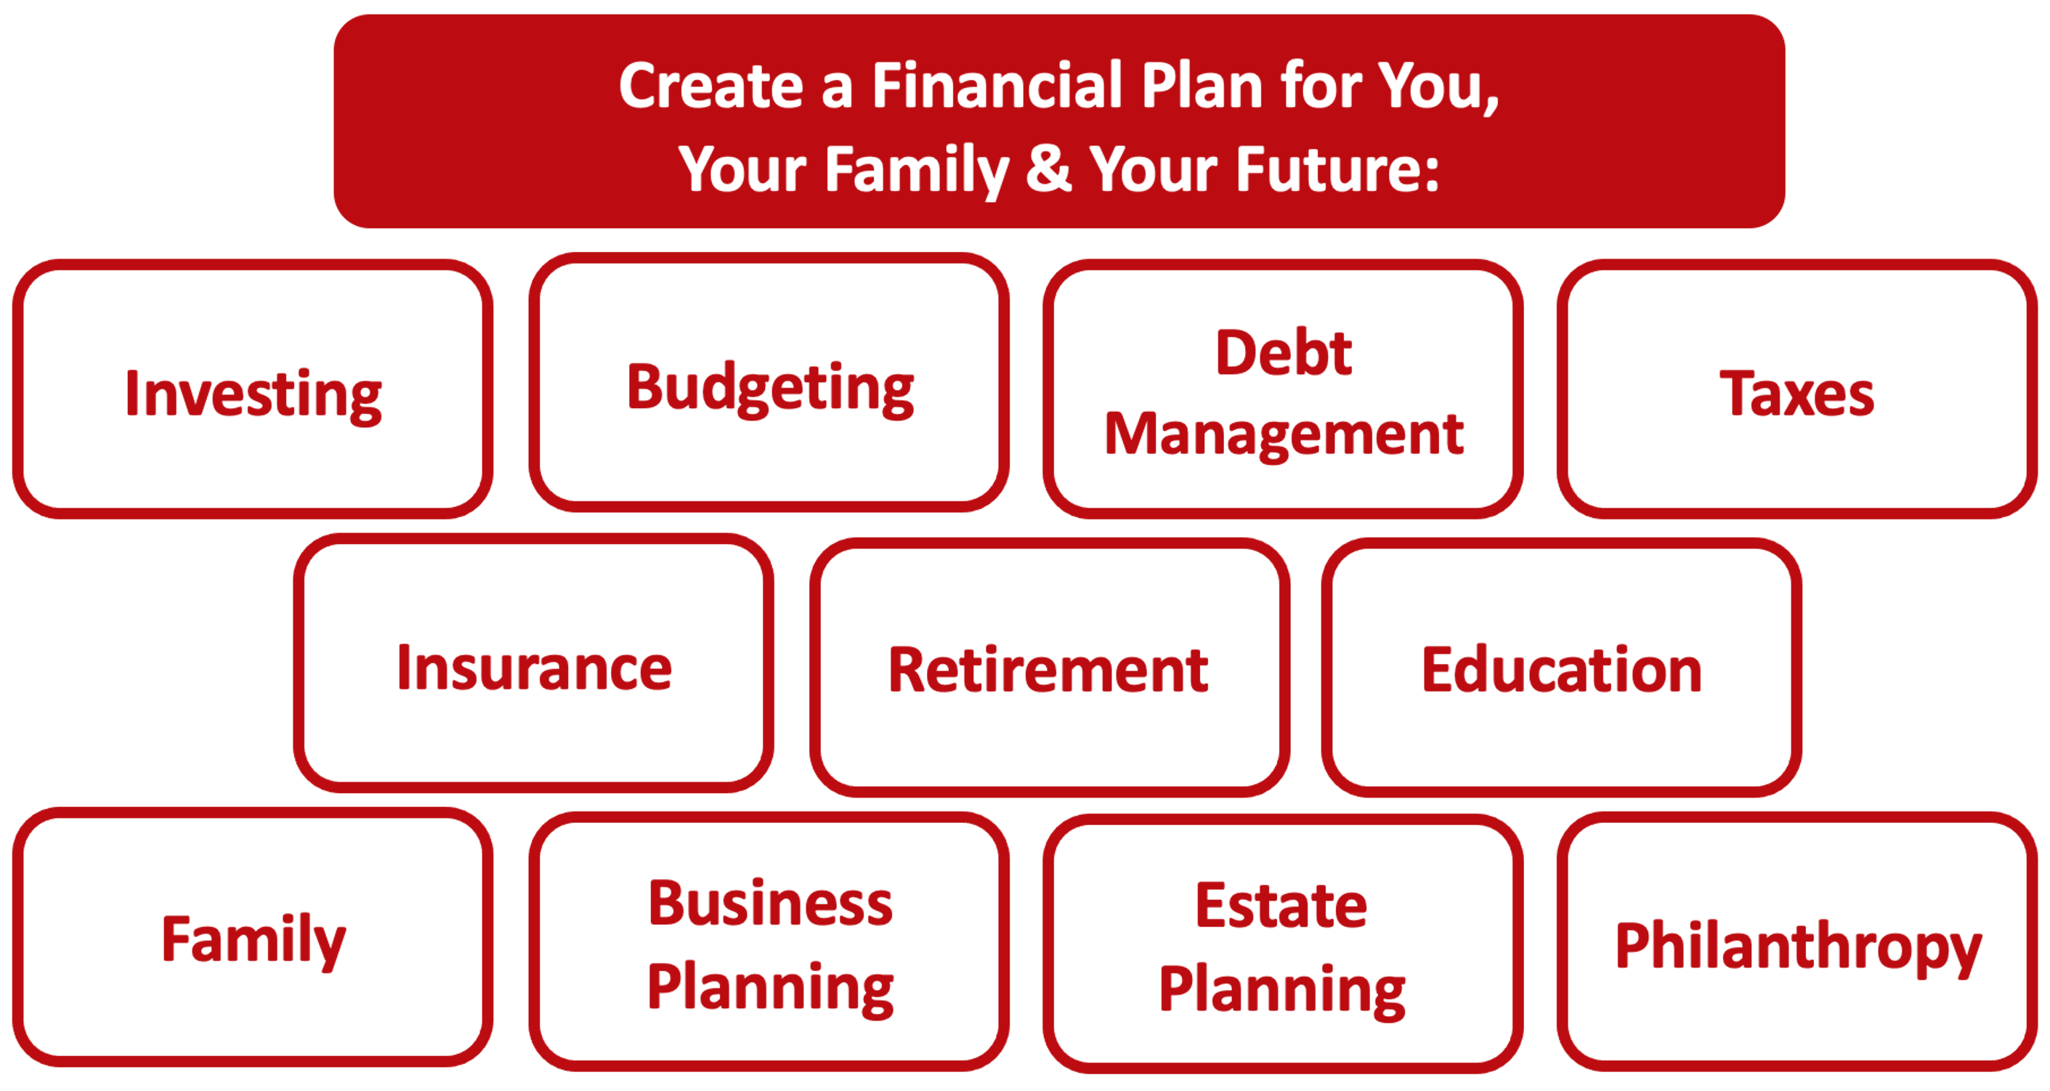

Slide 46
Owning Your Financial Future
YOUR VALUES
YOUR GOALS
Education
Career
Family
FINANCIAL STRATEGIES
Investing
Income & Expense Management
Debt Management
Taxes, Insurance & Other

Slide 47
Owning Your Financial Future
YOUR VALUES
YOUR GOALS
Education
Career
Family
FINANCIAL STRATEGIES
Investing
Income & Expense Management
Debt Management
Taxes, Insurance & Other

Slide 48
Note to INTERNATIONAL STUDENTS
Most of you should be eligible to do everything that we will introduce today.
  The U.S. government may prohibit students from certain countries from investing in the U.S.
  Your visa status may prohibit you from opening an investment or bank account in the U.S.
  But, most of you can invest exactly as any U.S. citizen can
The fine print:
  If you return home following graduation, you do not have to close the account.
    The money still belongs to you and only you can access it.
    However, you are also still subject to the rules of the account. With a Roth IRA, you cannot access the funds until you turn 59 ½ years old or you will pay a 10% penalty.
    There are not any future tax implications with a Roth IRA in the U.S. Whether you pay taxes in your home country depends on that country’s policies.
  If you stay in the U.S. following graduation, then nothing changes – the account is yours and you can keep contributing to it and changing your investments just as anyone else can.
To me, the financial planning decision comes down to this: You may not want to lock-up some of your precious cash flow in a U.S. retirement account given that you may need that precious cash flow to navigate your future career and home uncertainty.

Slide 49
Opening a Roth IRA – Why Do It?
Conceptually, the earlier we begin saving for retirement, the more we will benefit from compound interest when we get to retirement age.
  If you invest $6,000 per year from age 25 to age 60, you would have $1,300,000 in your account at age 60 (assuming a 9% annual return).
  If you wait 10 years and invest $6,000 per year from age 35 to age 60, you would have $500,000 in your account at age 60 (assuming a 9% annual return).

Slide 50
Opening a Roth IRA – Why Do It?
But what is an IRA? Why the Roth IRA?
  An IRA is an Individual Retirement Account.
  You are allowed to contribute $6,500 per year
  An IRA has tax advantages to a regular brokerage account, in that it allows you avoid capital gains taxes
    With a Roth IRA, you use after-tax money to invest today. The money should grow over time, but then when you with withdraw the money in retirement, you do NOT pay income taxes
    With a traditional IRA, you get a tax-deduction today for the amount that you invest. So you do not pay taxes today on that amount of income. But then you will pay income taxes when you withdraw the money in retirement.
    The key decision is based on whether you think your tax rate will be higher today or in the future.
    This is why we recommend a Roth IRA to graduate students: Your income tax rate is probably lower today than it will be in the future, so you want to pay taxes today and avoid taxes in the future. The Roth lets you do this.
  The bad news is that the money you put into an IRA cannot be withdrawn, unless you pay a 10% penalty, until you turn 59 ½ years old
  There is some fine print that we are skipping over here and some minor exceptions to this overview, but this should cover most of you and most situations.

Slide 51
Opening a Roth IRA – A Checklist
  Research – and pick – a brokerage or financial institution to use.
      Functionally, as far as managing your account and investments, they are going to be similar.
      However, the user interfaces will be different…including how you use the account and resources available.
      And, some brokerages may not offer certain types of accounts. For example, Robinhood does not (yet) allow you to open a Roth IRA.
      Fidelity, Charles Schwab, JP Morgan Chase, Bank of America, TD Ameritrade and many others are all good.
  Establish and open your Roth IRA account.
      This will require your Social Security number and other personal information, but not too much. It should take 5-10 minutes.
  Fund your Roth IRA account.
      Link a bank account to your Roth IRA to allow online transfers. It may take 1-2 weeks initially to get the money transferred as the Roth IRA account verifies your bank accounts.
      Your brokerage may allow wire transfers for a fee, but the initial transfer may still take 1-2 weeks
      You may be able to upload an electronic copy of a personal check to deposit funds into your Roth IRA account.
      You may be able to go old school and visit a branch of your brokerage to do everything in person.
  Begin investing and saving for your retirement.

Slide 52
Opening a Roth IRA – A Checklist
  Research – and pick – a brokerage or financial institution to use.
  Establish and open your Roth IRA account.
  Fund your Roth IRA account.
  Begin investing and saving for your retirement.
  This all begins with understanding who you are and what your investment goals are.
  And this all begins with your Investment Policy Statement, the investing roadmap we created back in Session #3

Slide 53
Your INVESTMENT POLICY STATEMENT
An Investment Policy Statement is your personal investing roadmap and strategy.
It includes a holistic perspective on what your investing goals are and what your investing preferences are.
  It does not include specific details, like your income or stocks you own or want to buy. It’s focused on big-picture strategy, not on execution.
It is about you, your family and your preference.
We want you to be able to use this today and after you graduate and your income (hopefully) increases.
We want you to be able to share this with your family or with a financial advisor who might be able to help you execute your strategy.
Even if you do not have the excess money to invest today, thinking about these issues today can help you be prepared for making such decisions when you are capable.

Slide 54
Your INVESTMENT POLICY STATEMENT
Let’s revisit what we did in Session #3: Creating an Investing Roadman
It includes a holistic perspective on what your investing goals are and what your investing preferences are.
  It does not include specific details, like your income or stocks you own or want to buy. It’s focused on big-picture strategy, not on execution.
We want you to be able to use this today and after you graduate and your income (hopefully) increases.
We want you to be able to share this with your family or with a financial advisor who might be able to help you execute your strategy.
Even if you do not have the excess money to invest today, thinking about these issues today can help you be prepared for making such decisions when you are capable.

Slide 55
Your INVESTMENT POLICY STATEMENT
An Investment Policy Statement is your personal investing roadmap and strategy.
It includes the following information:
  Some brief personal information, about you and your situation
  Your risk tolerance
  Your investing goals
  Your tax, liquidity and income preferences
  How you want to handle your investments
  How you want to allocate your investments across different asset classes (stocks vs. bonds)
  Any other personal or situational issues that may impact your ability to invest or your investment strategy

Slide 56
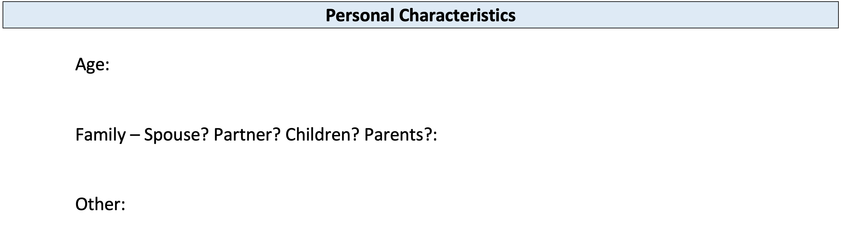
Your INVESTMENT POLICY STATEMENT

Slide 57
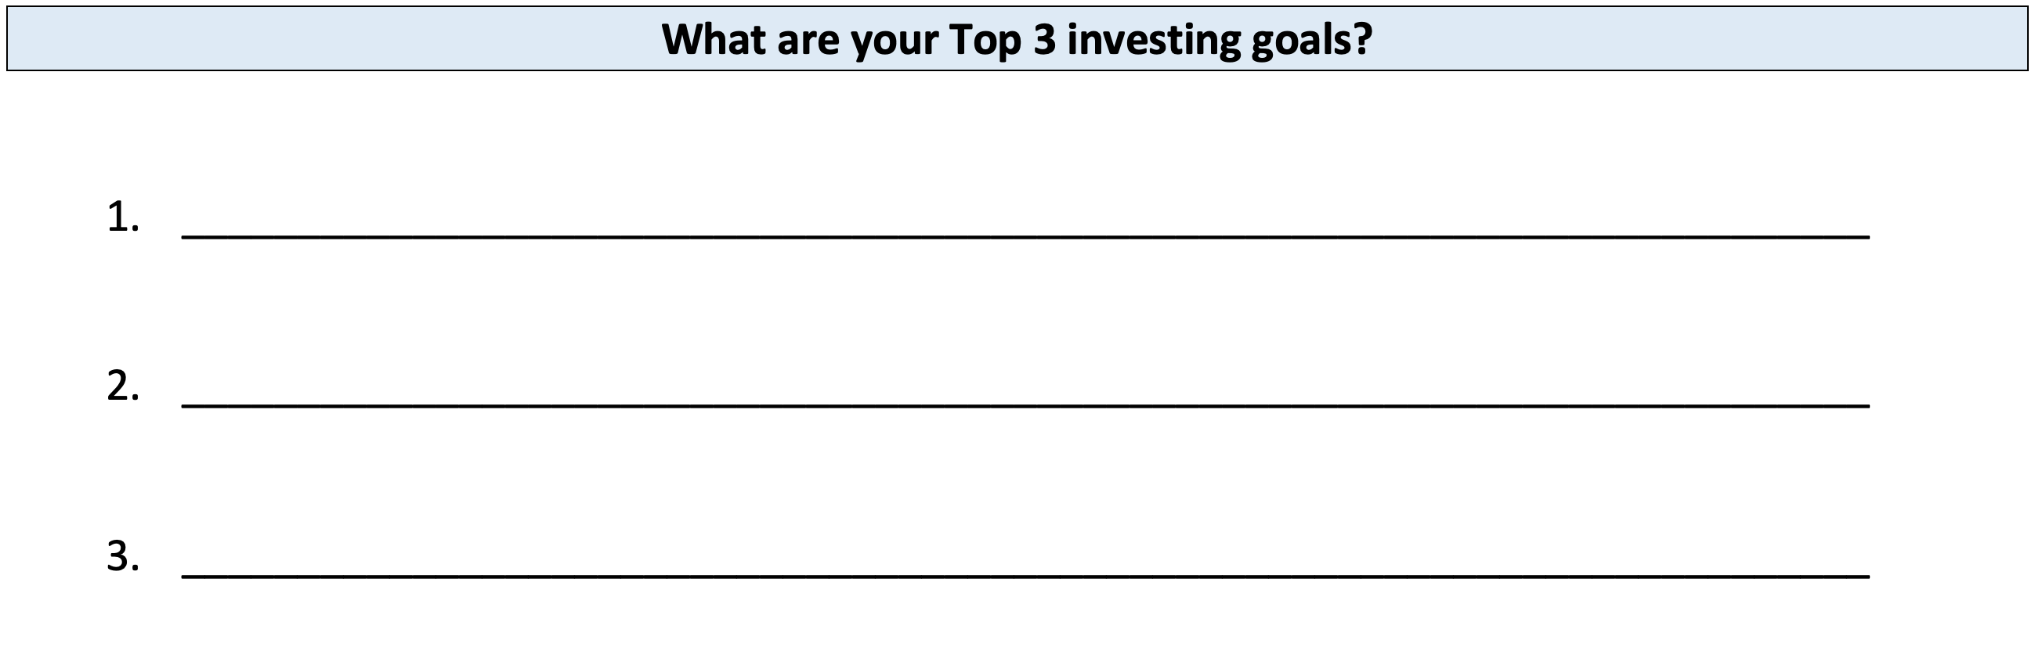
Your INVESTMENT POLICY STATEMENT

Slide 58
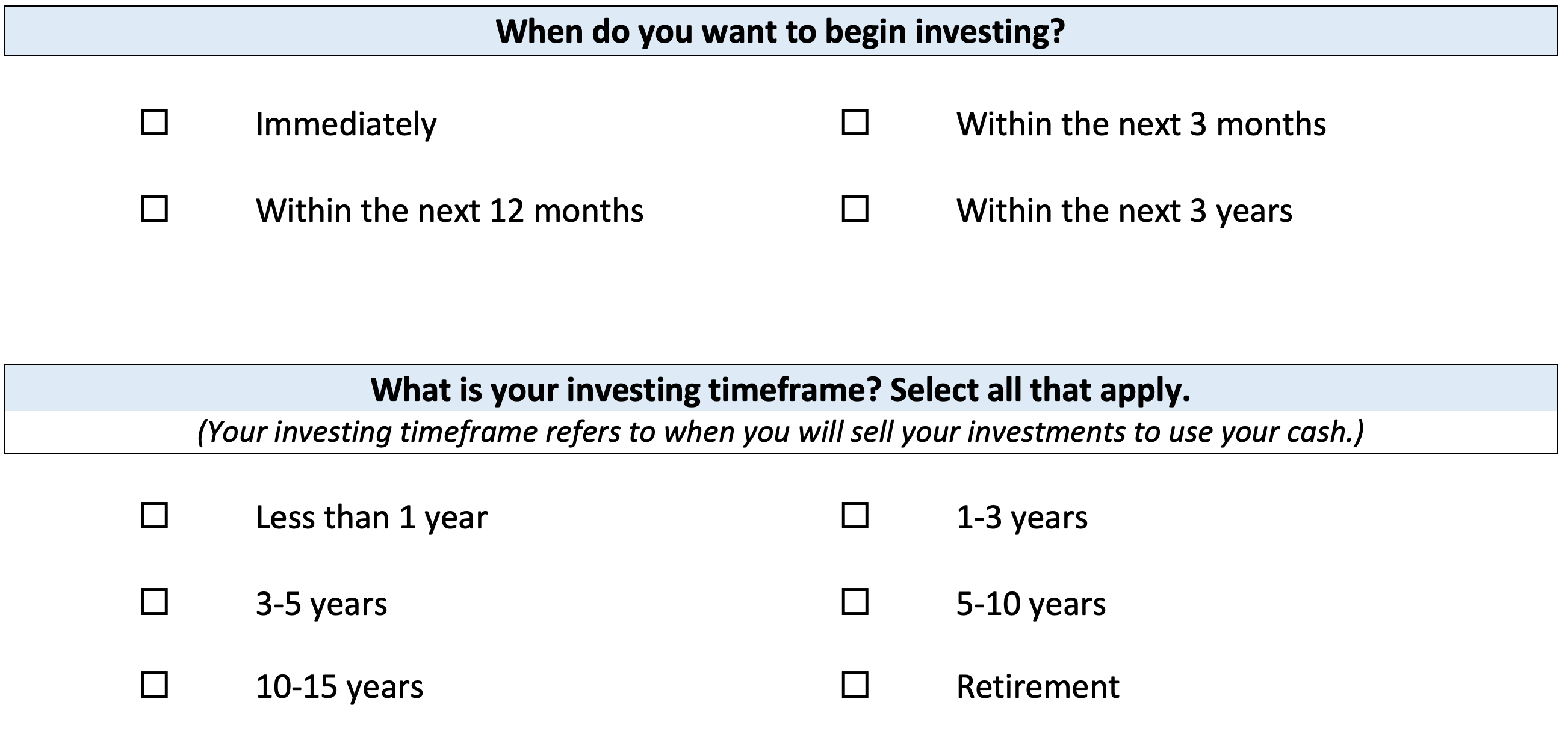
Your INVESTMENT POLICY STATEMENT

Slide 59
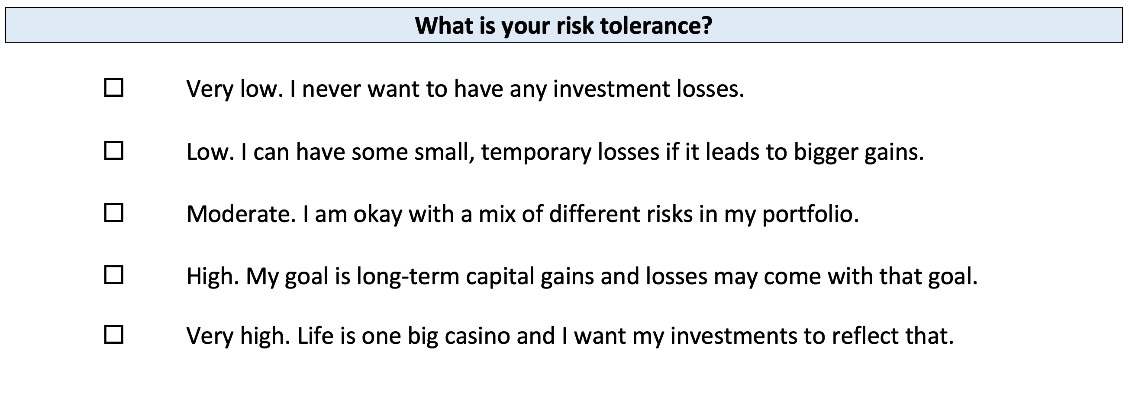
Your INVESTMENT POLICY STATEMENT

Slide 60
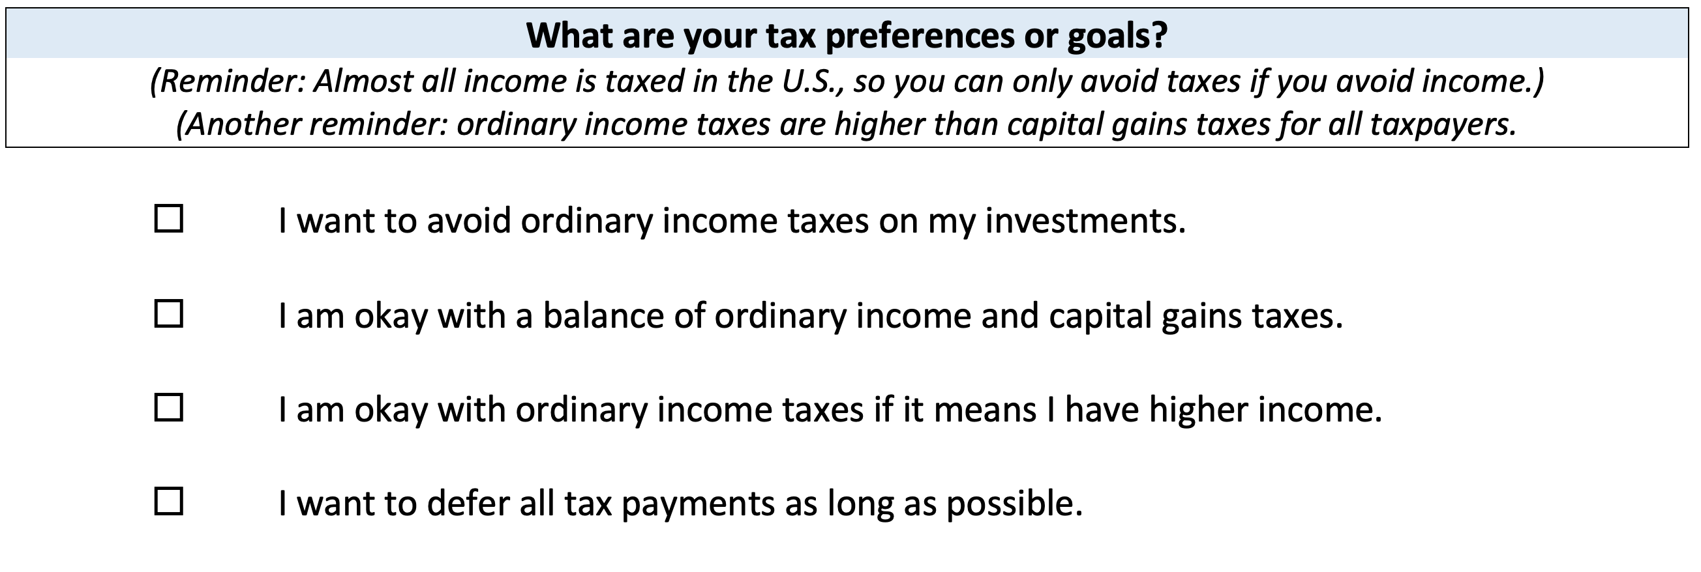
Your INVESTMENT POLICY STATEMENT

Slide 61
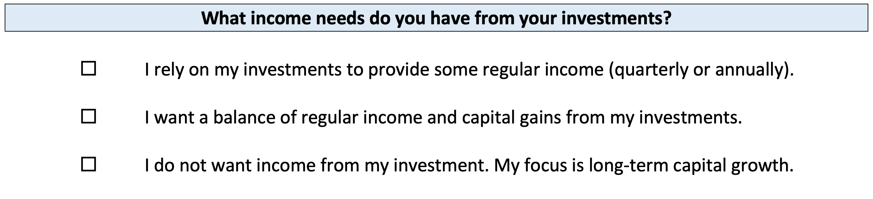
Your INVESTMENT POLICY STATEMENT

Slide 62
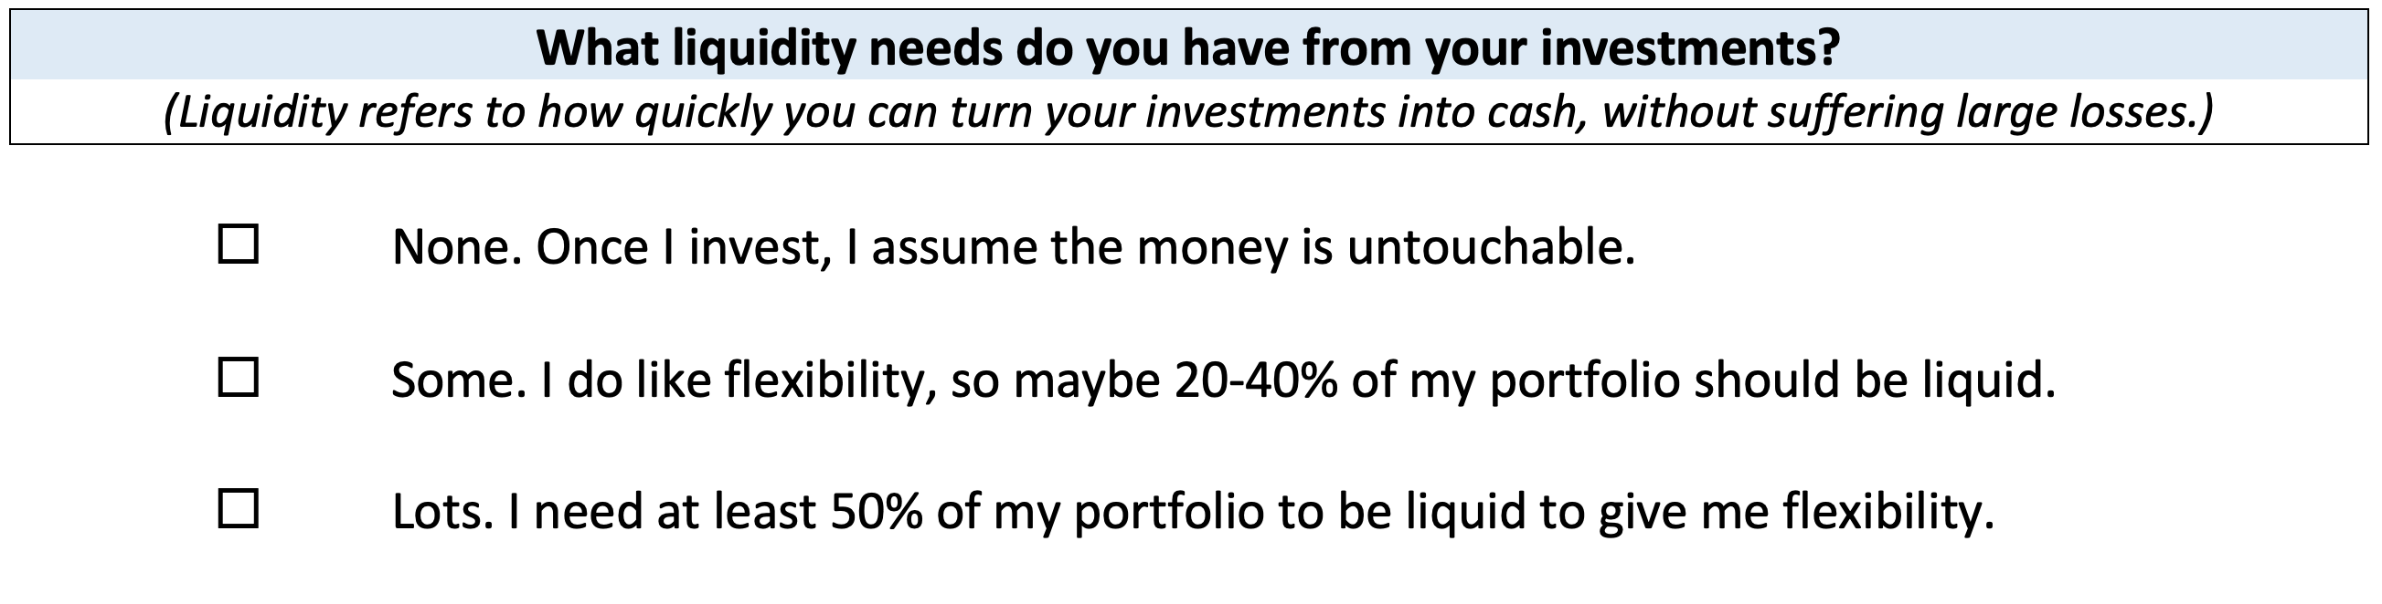
Your INVESTMENT POLICY STATEMENT

Slide 63
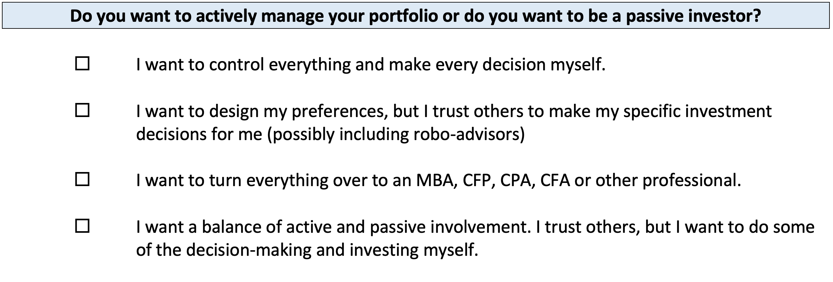
Your INVESTMENT POLICY STATEMENT

Slide 64
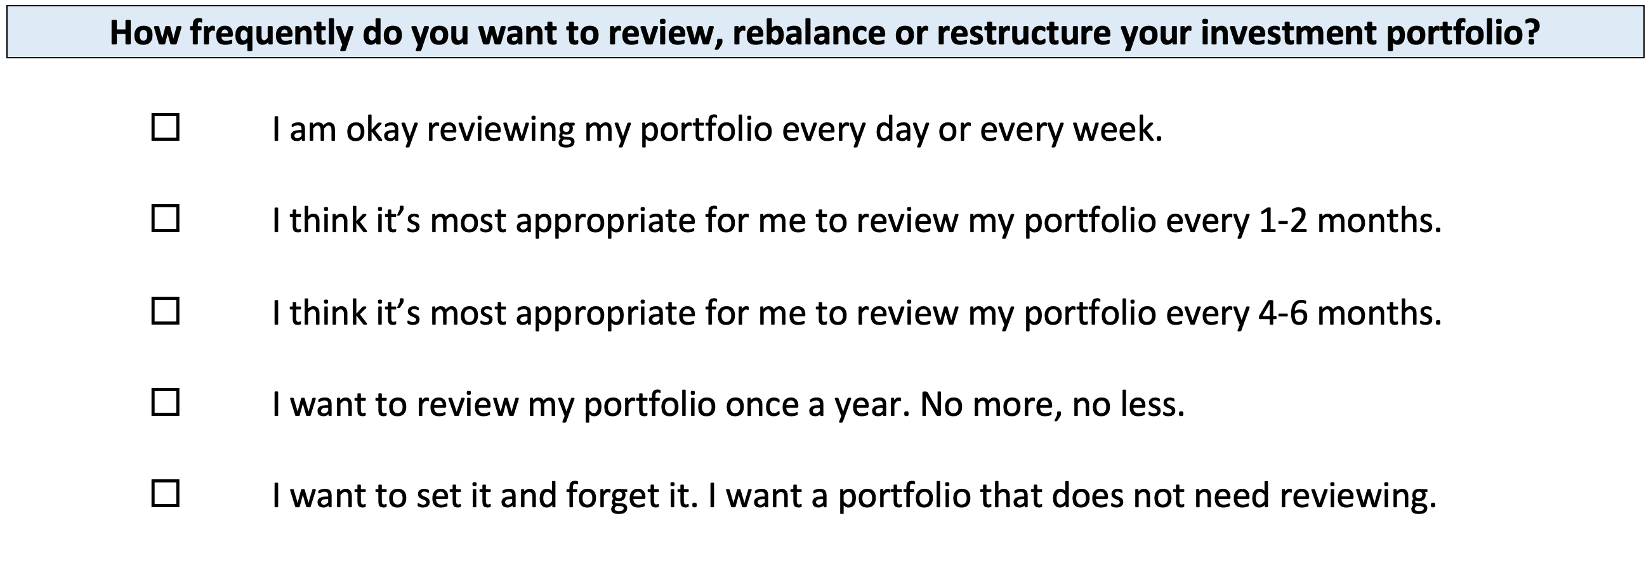
Your INVESTMENT POLICY STATEMENT

Slide 65
Your INVESTMENT POLICY STATEMENT
ASSET ALLOCATION
We know that the asset classes or categories you choose are responsible for 90% of portfolio returns, while specific security selection within classes is responsible for 10% of returns.
This means that how you decide to allocate your investments is the primary driver of your investment returns.
  Think about which geographic regions you want to invest in.
  Think about how to distribute your investment across asset categories.
    Stocks, bonds, currency, real estate, crypto, value stocks, growth stocks,
    large companies, small companies, oil, gold…

Slide 66
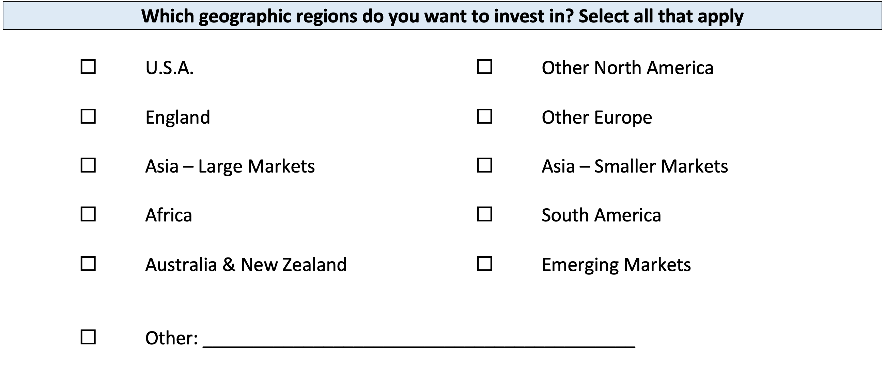
Your INVESTMENT POLICY STATEMENT

Slide 67
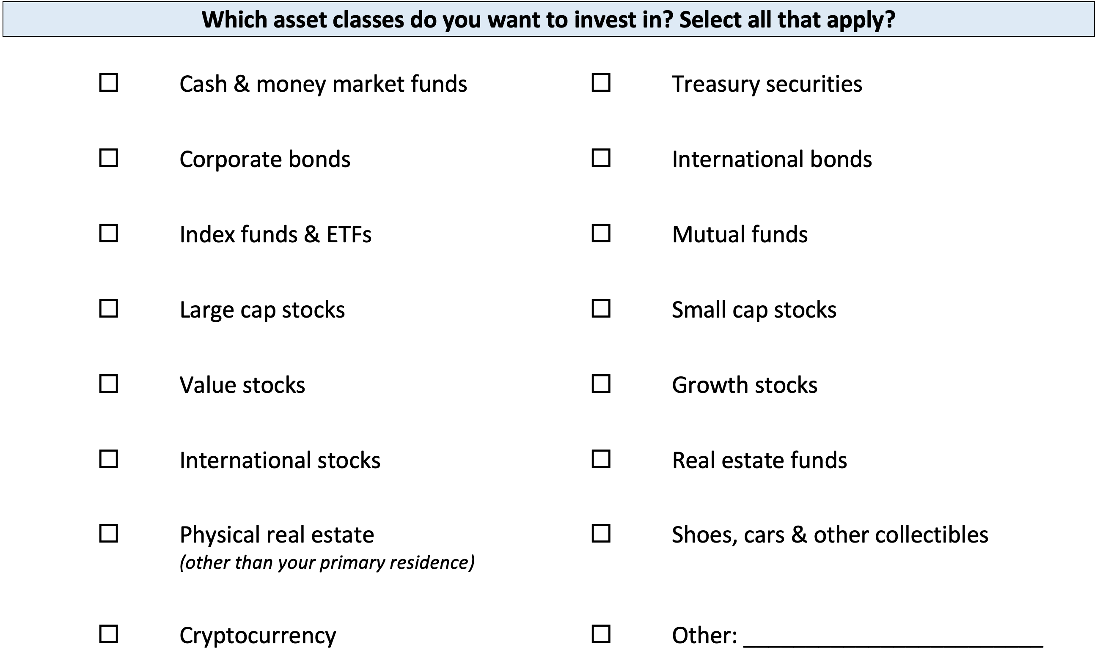
Your INVESTMENT POLICY STATEMENT

Slide 68
Your INVESTMENT POLICY STATEMENT

Slide 69
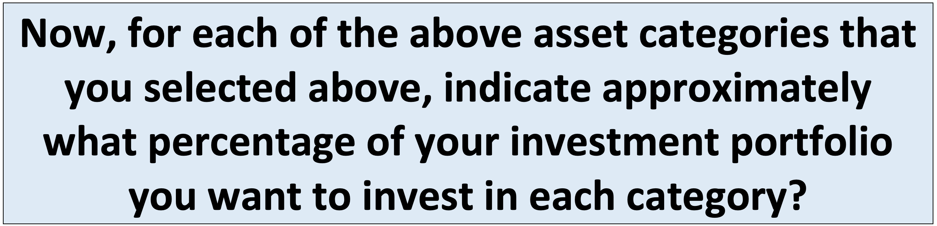
Your INVESTMENT POLICY STATEMENT

Slide 70
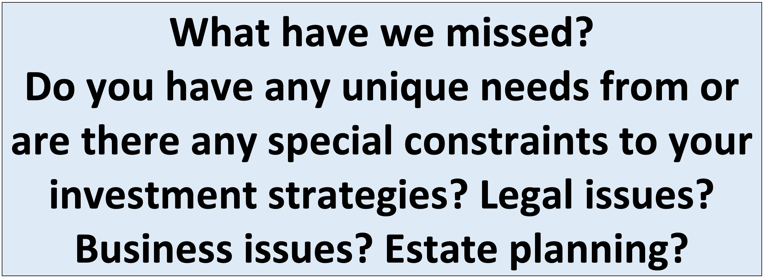
Your INVESTMENT POLICY STATEMENT

Slide 71
Your INVESTMENT POLICY STATEMENT
Once you complete this worksheet….
And once you open your Roth IRA account…
You are ready to begin investing. Now you just have to decide which of the 10,000+ securities to invest in.
Work on this with your spouse or family.
Revise and update it after you graduate.
Continue refining it throughout your investing life…make it about you and your goals.

Slide 72
Making Financial Planning a Priority
EDUCATION STRATEGIES
SCHOOL STRATEGIES
Identify Your Resources
Identify Your
Priorities & Goals
Do Your Planning
Monitor & Modify Your Progress & Plan

Slide 73
Making Financial Planning a Priority
FINANCIAL STRATEGIES
EDUCATION STRATEGIES
BUDGETING
STRATEGIES
SCHOOL STRATEGIES
Identify Your
Income & Expenses
Identify Your Resources
Identify Your
Priorities & Goals
Identify Your
Priorities & Goals
Do Your Planning
Do Your Planning
Monitor & Modify Budgeting Activities
Monitor & Modify Your Progress & Plan

Slide 74
Making Financial Planning a Priority
FINANCIAL STRATEGIES
YOU,
as students, are better wired and equipped to make long-term plans – education, career, financial & otherwise – than 99% of humanity.
Be confident.
Be intentional.
Be diligent.
Be awesome.
EDUCATION STRATEGIES
BUDGETING
STRATEGIES
SCHOOL STRATEGIES
Identify Your
Income & Expenses
Identify Your Resources
Identify Your
Priorities & Goals
Identify Your
Priorities & Goals
Do Your Planning
Do Your Planning
Monitor & Modify Budgeting Activities
Monitor & Modify Your Progress & Plan

Slide 75
Isn’t this a lot like what you do with your education planning?

Slide 76
Owning Your Financial Future
INVESTING GOALS, HABITS & STRATEGIES
Today, January 23
CREDIT SCORES & DEBT MANAGEMENT
Wednesday, March 8
CREATING AN INVESTMENT STRATEGY
Wednesday, March 15

Slide 77
Owning Your Financial Future
INVESTING & TAX STRATEGIES
Wednesday, March 22
TAX STRATEGIES
Wednesday, April 5
CAREER PLANNING: YOUR MONEY & YOUR FUTURE
Wednesday, April 26

Slide 78
Don’t wait around for other people to be happy for you.
Any happiness you get,
You’ve got to make yourself.
~ Alice Walker, poet & novelist
A goal without a plan is just a dream.
Wealth is largely the result of habit.
The most difficult thing is the decision to act; the rest is mere tenacity.
It takes as much energy to plan as it does to wish.
You cannot escape the responsibility of tomorrow by avoiding it today.

Slide 79
Brian Bolton
Professor of Finance brian.bolton@louisiana.edu http://business.louisiana.edu/financeispersonal

