Slide 1
THIS IS:
STUDENT SUPPORT SERVICES
FINANCIAL WELLNESS SERIES 2024
Session #3:
Investing for Your Future:
How to Build Generational Wealth
I’m Brian. I’ll be your host. We’ll start around 6:02.
I don’t have much of a voice tonight, but we’ll make the most of it
and try to learn some stuff about money and investing.

Slide 2

STUDENT SUPPORT SERVICES
FINANCIAL WELLNESS SERIES 2024
Session #3:
Investing for Your Future:
How to Build Generational Wealth
April 3, 2024

Slide 3
Brian Bolton
Professor of Finance brian.bolton@louisiana.edu http://business.louisiana.edu/financeispersonal

Slide 4
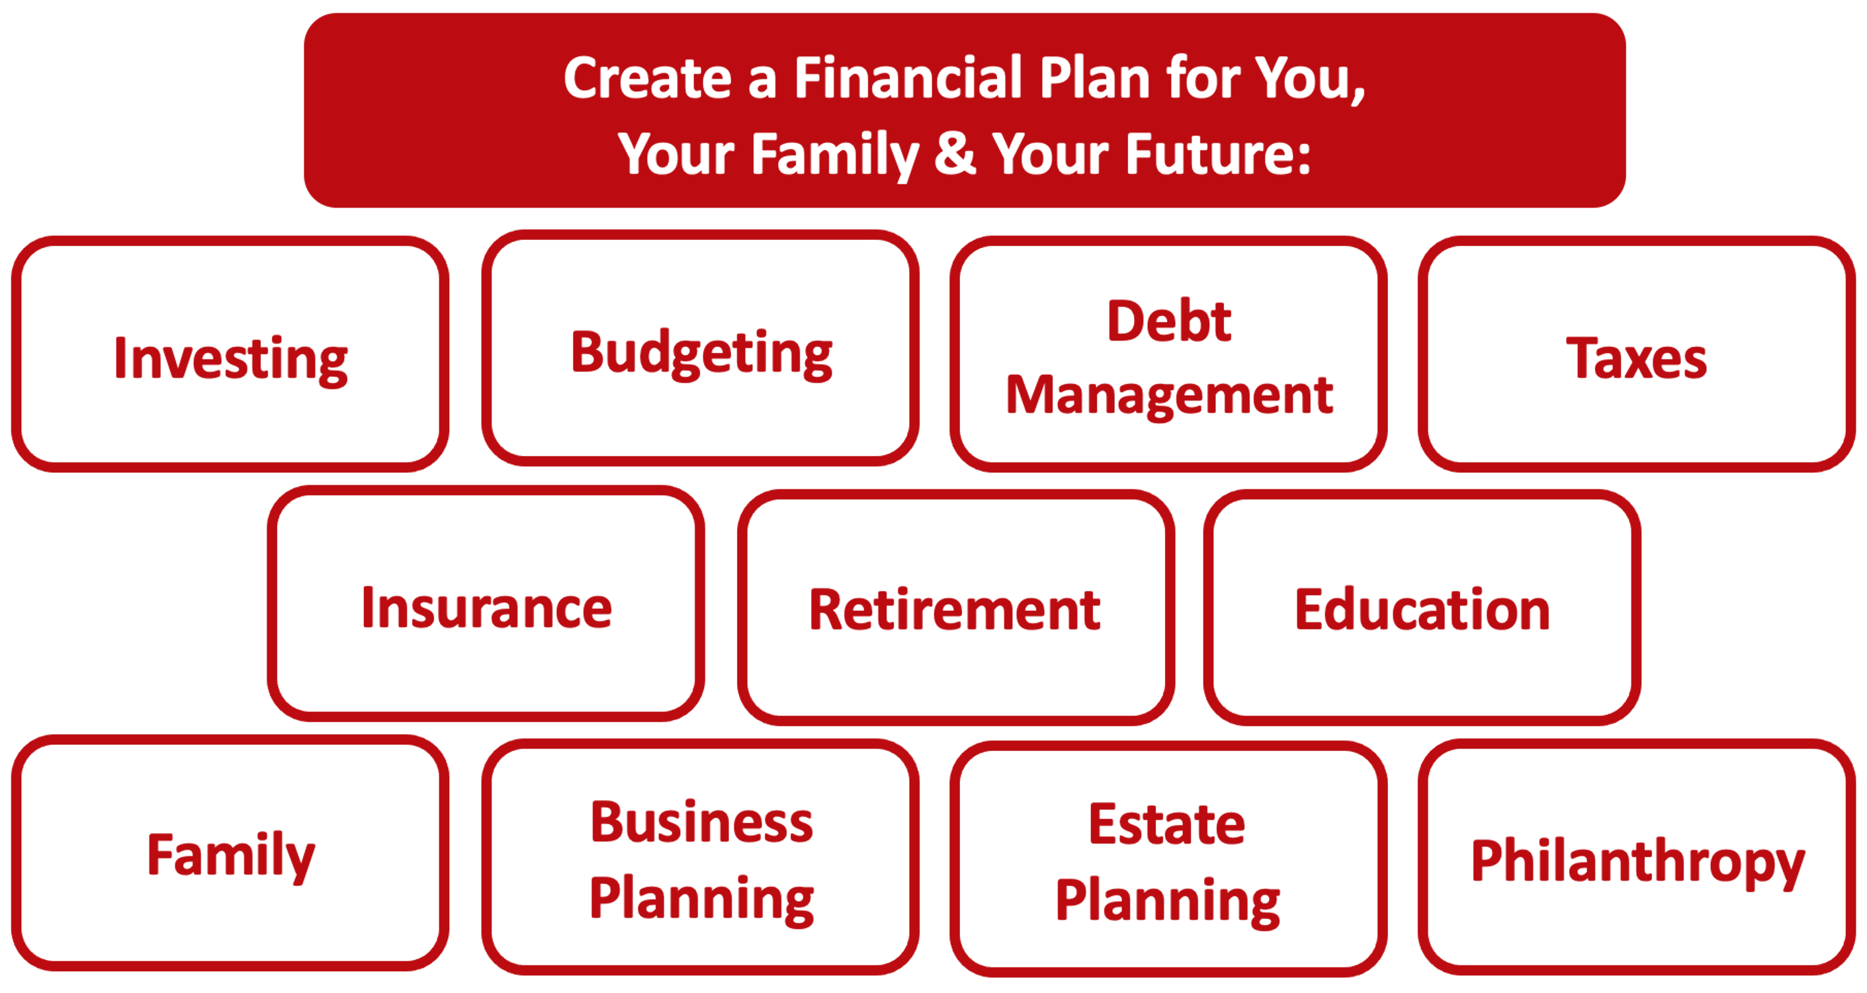

Slide 5
Owning Your Financial Future
YOUR VALUES
YOUR GOALS
Education
Career
Family
FINANCIAL STRATEGIES
Investing
Income & Expense Management
Debt Management
Taxes, Insurance & Other

Slide 6
Owning Your Financial Future
YOUR VALUES
YOUR GOALS
Education
Career
Family
FINANCIAL STRATEGIES
Investing
Income & Expense Management
Debt Management
Taxes, Insurance & Other

Slide 7
Owning Your Financial Future
YOUR VALUES
YOUR GOALS
Education
Career
Family
FINANCIAL STRATEGIES
Investing
Income & Expense Management
Debt Management
Taxes, Insurance & Other

Slide 8
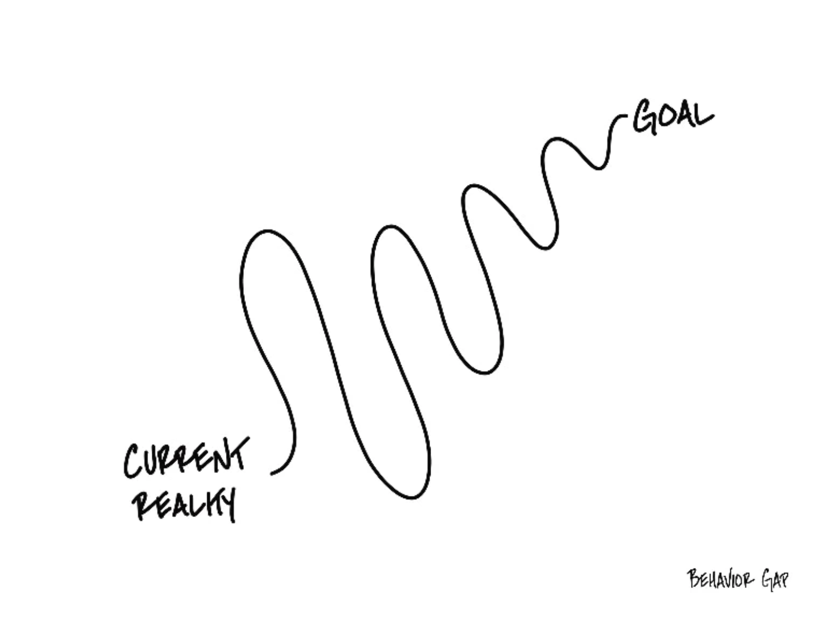

Slide 9
Opening Quiz – Question #1
The U.S. stock markets had a terrible 2022. But that was just 1 year.
If you had invested $1,000 in the S&P 500 at the beginning of 2021
(3+ years years ago), how much would that $1,000 be worth today?
A. $557
B. $755
C. $1,386
D. $2,815

Slide 10
Opening Quiz – Question #1
The U.S. stock markets had a terrible 2022. But that was just 1 year.
If you had invested $1,000 in the S&P 500 at the beginning of 2021
(3+ years years ago), how much would that $1,000 be worth today?
A. $557
B. $755
C. $1,386
D. $2,815

Slide 11
Opening Quiz – Question #2
The U.S. stock markets had a terrible 2022. But that was just 1 year.
If you had invested $1,000 in the S&P 500 at the beginning of 2014
(10+ years ago), how much would that $1,000 be worth today?
A. $557
B. $755
C. $1,386
D. $2,815

Slide 12
Opening Quiz – Question #2
The U.S. stock markets had a terrible 2022. But that was just 1 year.
If you had invested $1,000 in the S&P 500 at the beginning of 2014
(10 years ago), how much would that $1,000 be worth today?
A. $557
B. $755
C. $1,386
D. $2,815
That’s an average annual return of 11% of over 10 years.

Slide 13
Opening Quiz – Question #3
Which of these 4 stocks had
the HIGHEST RETURN during 2023?
Amazon
Tesla
Bank of America
Bed, Bath & Beyond

Slide 14
Opening Quiz – Question #3
Which of these 4 stocks had
the HIGHEST RETURN during 2023?
Amazon
Tesla (+102%)
(And it’s now down34% in 2024)
Bank of America
Bed, Bath & Beyond

Slide 15
Opening Quiz – Question #4
Which of these 4 stocks had
the LOWEST RETURN during 2023?
Amazon
Tesla
Bank of America
Bed, Bath & Beyond

Slide 16
Opening Quiz – Question #4
Which of these 4 stocks had
the LOWEST RETURN during 2023?
Amazon +81%
Tesla +102%
Bank of America
+2%
Bed, Bath & Beyond
-100%

Slide 17
Opening Quiz – Question #5
Which of these 4 securities has high had
the highest return over the past 5 years?
Amazon
Tesla
Bank of America
Bitcoin

Slide 18
Opening Quiz – Question #5
Which of these 4 securities has high had
the highest return over the past 5 years?
Amazon +85%
Tesla +942%
Bank of America
+24%
Bitcoin
+1,118%

Slide 19
Opening Quiz – Question #6 – Last One
If I had invested $1,000 into the S&P 500, the overall U.S. stock market, on the day that I was born, how much would that be worth today?
A. $1,000
B. $12,257
C. $43,656
D. $85,035

Slide 20
Opening Quiz – Question #6 – Last One
If I had invested $1,000 into the S&P 500, the overall U.S. stock market, on the day that I was born, how much would that be worth today?
A. $1,000
B. $12,257
$43,656
That’s an annual return of just over 10% per year.
D. $85,035

Slide 21
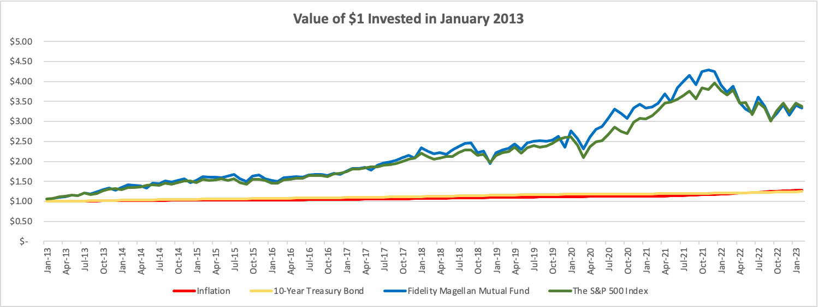
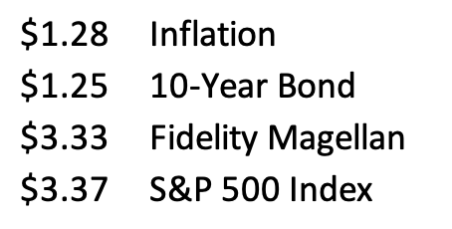

Slide 22
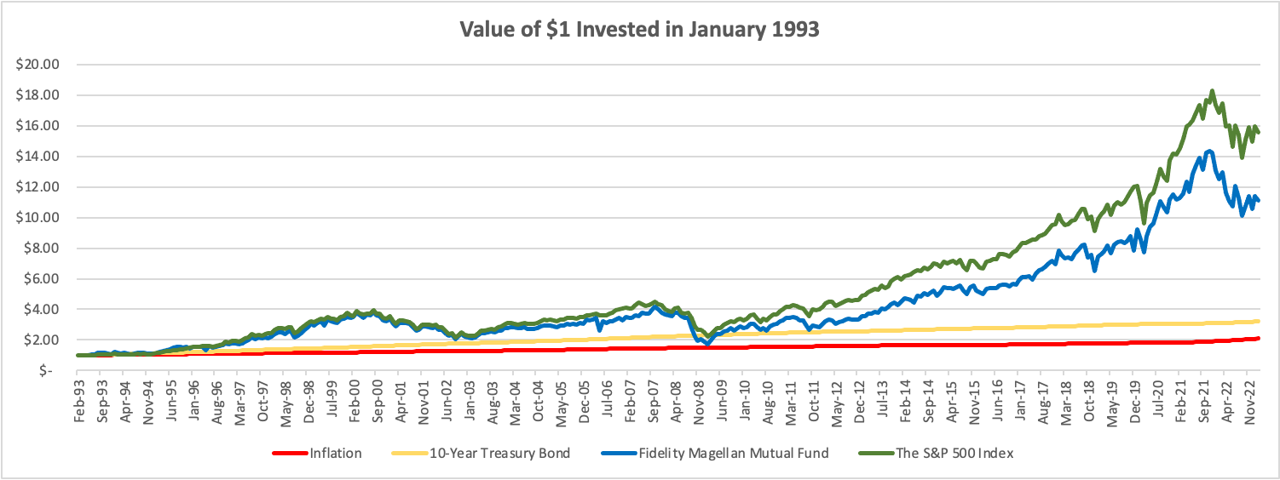
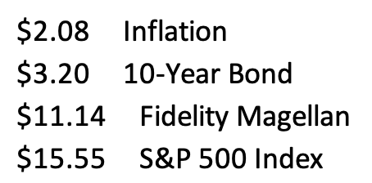

Slide 23
Happiness
Long-Term Goals
Short-Term Goals
Financial Needs
Family Needs

Slide 24
You cannot escape the responsibility
of tomorrow by avoiding it today.

Slide 25
INDULGENCE is good.
IMPULSE is bad.

Slide 26
Planning for Retirement – Why do it NOW?
Conceptually, the earlier we begin saving for retirement, the more we will benefit from compound interest when we get to retirement age.
  If you invest $6,000 per year from age 25 to age 60, you would have $1,300,000 in your account at age 60 (assuming a 9% annual return).
  If you wait 10 years and invest $6,000 per year from age 35 to age 60, you would have $500,000 in your account at age 60 (assuming a 9% annual return).

Slide 27
Planning for Retirement – How to do it?
A taxable-brokerage account (with Robinhood, Fidelity or some other brokerage)
    You contribute/invest after-tax cash flow (what is leftover from your paycheck)
    Your investments should grow over time
    You pay income taxes today, before investing, and then capital gains when you withdraw the money in the future
    This is the most flexible…but has the fewest tax benefits
A company-sponsored retirement plan: 401(k) or 403(b), in most cases.
    Your employer may match some of your contributions (= “free money”)
    Your investments should grow over time
    You will pay income taxes when you withdraw the money in retirement, only
    You never pay capital gains taxes on the growth – that’s good

Slide 28
Planning for Retirement – How to do it?
An IRA – Individual Retirement Account, designed for people without a company sponsored retirement plan
    Available through Robinhood, Fidelity or most other brokerages
    You contribute/invest PRE-TAX cash flow today
    Your investments should grow over time
    You pay income taxes in retirement
A Roth IRA
    Available through Robinhood, Fidelity or most other brokerages
    You contribute/invest AFTER-TAX cash flow today
    Your investments should grow over time
    You pay income taxes today, but never again
    Roth IRAs are ideal for people with relatively low income today,
    who expect their income to increase in the future

Slide 29
Opening a Roth IRA – The Fine Print
But what is an IRA? Why the Roth IRA?
  An IRA is an Individual Retirement Account.
  You are allowed to contribute $6,500 per year
  An IRA has tax advantages to a regular brokerage account, in that it allows you avoid capital gains taxes
    With a Roth IRA, you use after-tax money to invest today. The money should grow over time, but then when you with withdraw the money in retirement, you do NOT pay income taxes
    With a traditional IRA, you get a tax-deduction today for the amount that you invest. So you do not pay taxes today on that amount of income. But then you will pay income taxes when you withdraw the money in retirement.
    The key decision is based on whether you think your tax rate will be higher today or in the future.
    This is why we recommend a Roth IRA to graduate students: Your income tax rate is probably lower today than it will be in the future, so you want to pay taxes today and avoid taxes in the future. The Roth lets you do this.
  The bad news is that the money you put into an IRA cannot be withdrawn, unless you pay a 10% penalty, until you turn 59 ½ years old
  There is more fine print that we are skipping over here and some minor exceptions to this overview, but this should cover most of you and most situations.

Slide 30
Opening a Roth IRA – A Checklist
  Research – and pick – a brokerage or financial institution to use.
      Functionally & legally, as far as managing your account and investments, they are going to be similar.
      However, the user interfaces will be different…including how you use the account and resources available. That’s the decision – which interface do you like best.
      And, some brokerages may not offer certain types of accounts.
      Robinhood, Fidelity, Charles Schwab, JP Morgan Chase, Bank of America, TD Ameritrade and many others are all good.
  Establish and open your Roth IRA account.
      This will require your Social Security number and other personal information, but not too much. It should take 5-10 minutes.
  Fund your Roth IRA account.
      Link a bank account to your Roth IRA to allow online transfers. It may take 1-2 weeks initially to get the money transferred as the Roth IRA account verifies your bank accounts.
      Your brokerage may allow wire transfers for a fee, but the initial transfer may still take 1-2 weeks
      You may be able to upload an electronic copy of a personal check to deposit funds into your Roth IRA account.
      You may be able to go old school and visit a branch of your brokerage to do everything in person.
  Begin investing and saving for your retirement.

Slide 31
Opening a Roth IRA – A Checklist
  Research – and pick – a brokerage or financial institution to use.
  Establish and open your Roth IRA account.
  Fund your Roth IRA account.
  Begin investing and saving for your retirement.
  This all begins with understanding who you are and what your investment goals are.
  And this all begins with your Investment Policy Statement.

Slide 32
Your INVESTMENT POLICY STATEMENT
An Investment Policy Statement is your personal investing roadmap and strategy.
It includes a holistic perspective on what your investing goals are and what your investing preferences are.
  It does not include specific details, like your income or stocks you own or want to buy. It’s focused on big-picture strategy, not on execution.
It is about you, your family and your preference.
We want you to be able to use this today and after you graduate and your income (hopefully) increases.
We want you to be able to share this with your family or with a financial advisor who might be able to help you execute your strategy.
Even if you do not have the excess money to invest today, thinking about these issues today can help you be prepared for making such decisions when you are capable.

Slide 33
Your INVESTMENT POLICY STATEMENT
An Investment Policy Statement is your personal investing roadmap and strategy.
It includes the following information:
  Some brief personal information, about you and your situation
  Your risk tolerance
  Your investing goals
  Your tax, liquidity and income preferences
  How you want to handle your investments
  How you want to allocate your investments across different asset classes (stocks vs. bonds)
  Any other personal or situational issues that may impact your ability to invest or your investment strategy

Slide 34
Your INVESTMENT POLICY STATEMENT
Let’s create your own, personal Investing Roadmap
It includes a holistic perspective on what your investing goals are and what your investing preferences are.
  It does not include specific details, like your income or stocks you own or want to buy. It’s focused on big-picture strategy, not on execution.
We want you to be able to use this today and after you graduate and your income (hopefully) increases.
We want you to be able to share this with your family or with a financial advisor who might be able to help you execute your strategy.
Even if you do not have the excess money to invest today, thinking about these issues today can help you be prepared for making such decisions when you are capable.

Slide 35
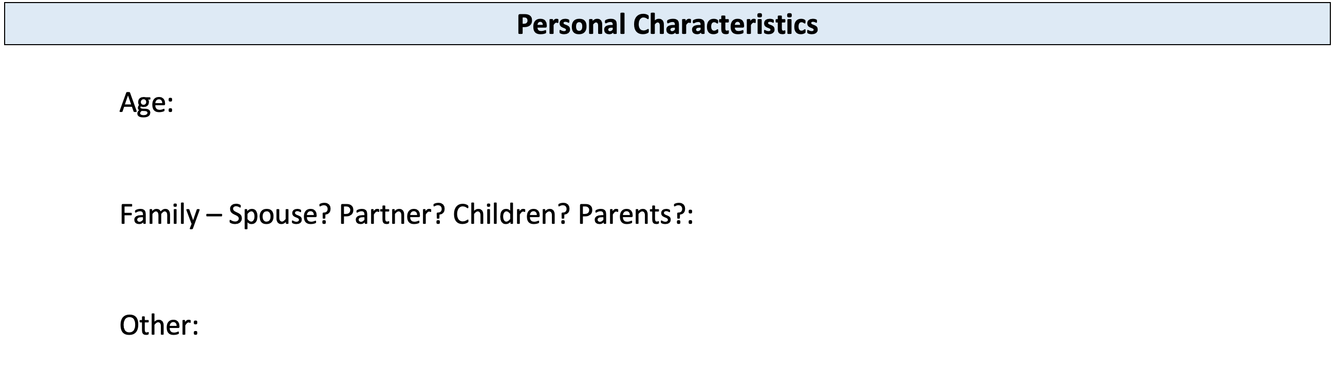
Your INVESTMENT POLICY STATEMENT

Slide 36
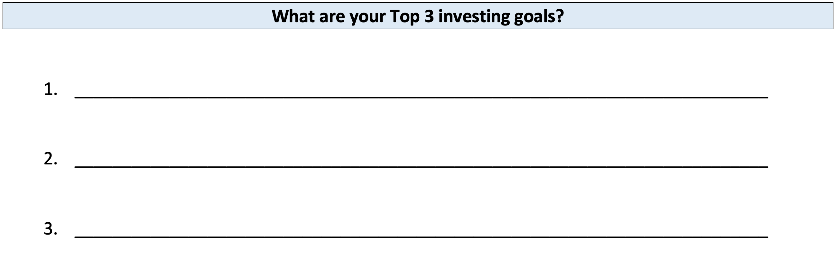
Your INVESTMENT POLICY STATEMENT

Slide 37
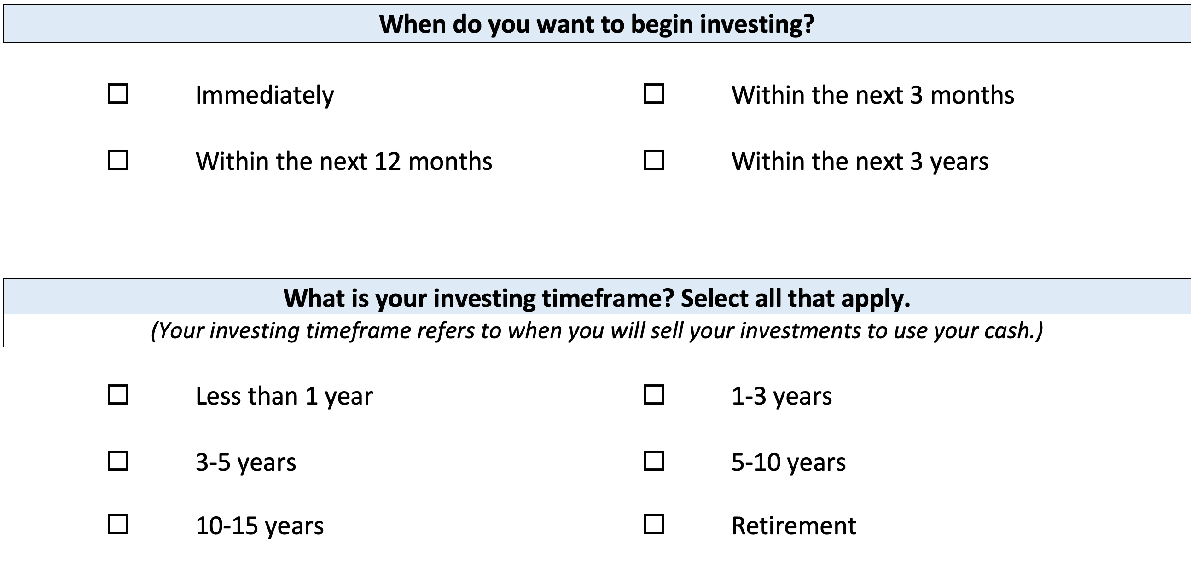
Your INVESTMENT POLICY STATEMENT

Slide 38
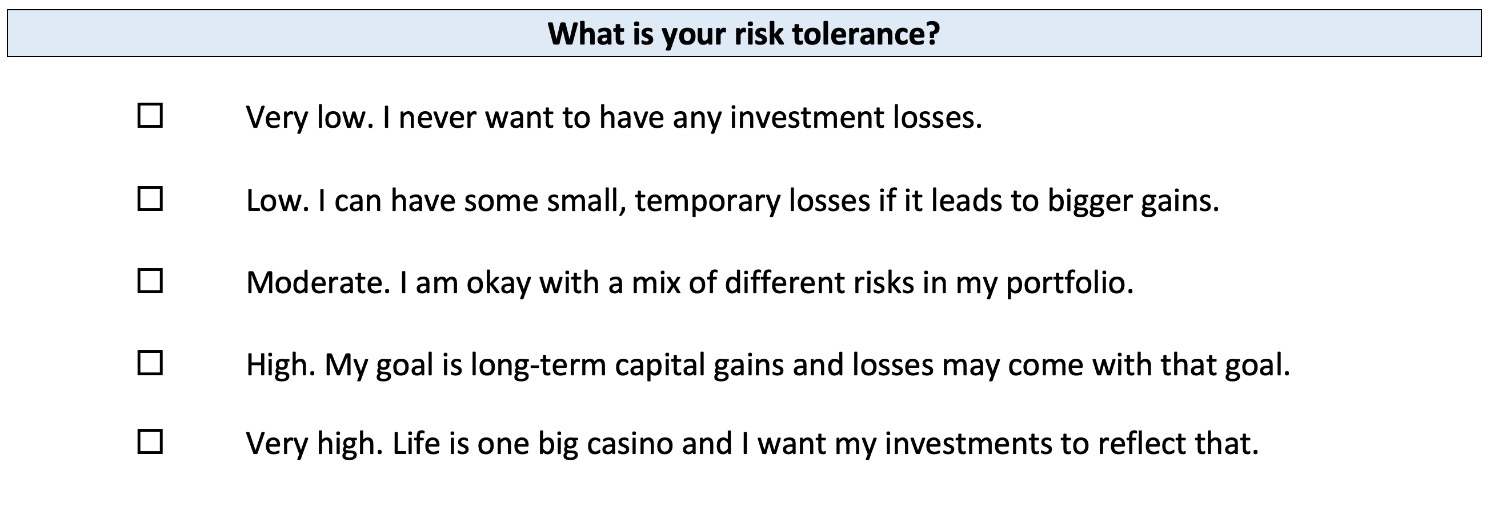
Your INVESTMENT POLICY STATEMENT

Slide 39
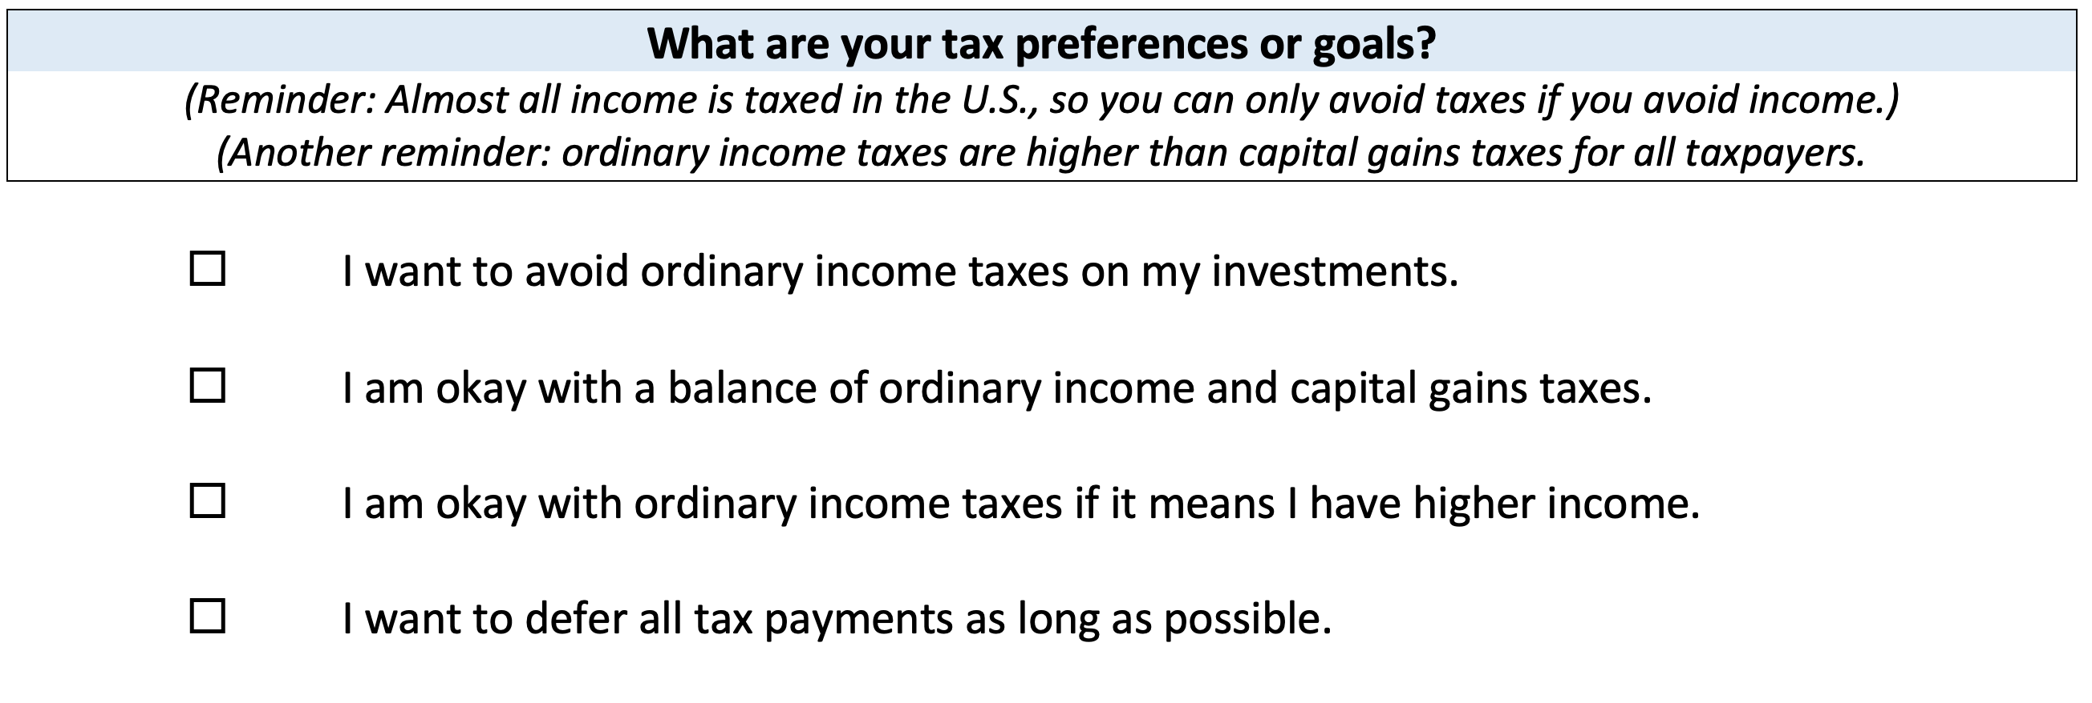
Your INVESTMENT POLICY STATEMENT

Slide 40
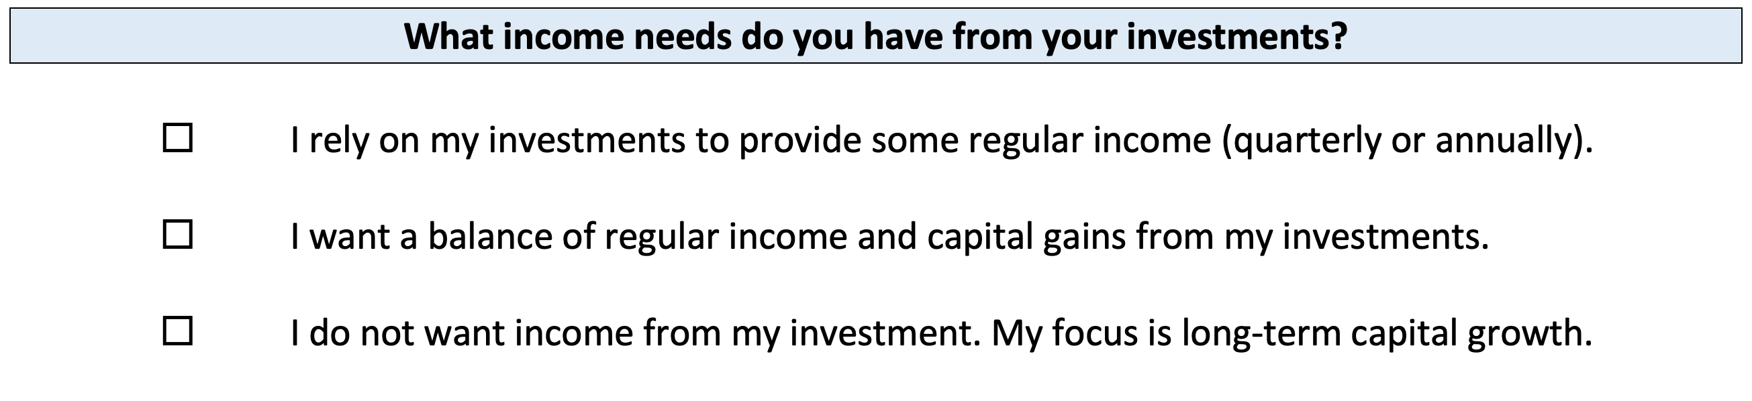
Your INVESTMENT POLICY STATEMENT

Slide 41
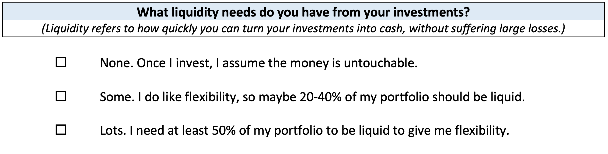
Your INVESTMENT POLICY STATEMENT

Slide 42
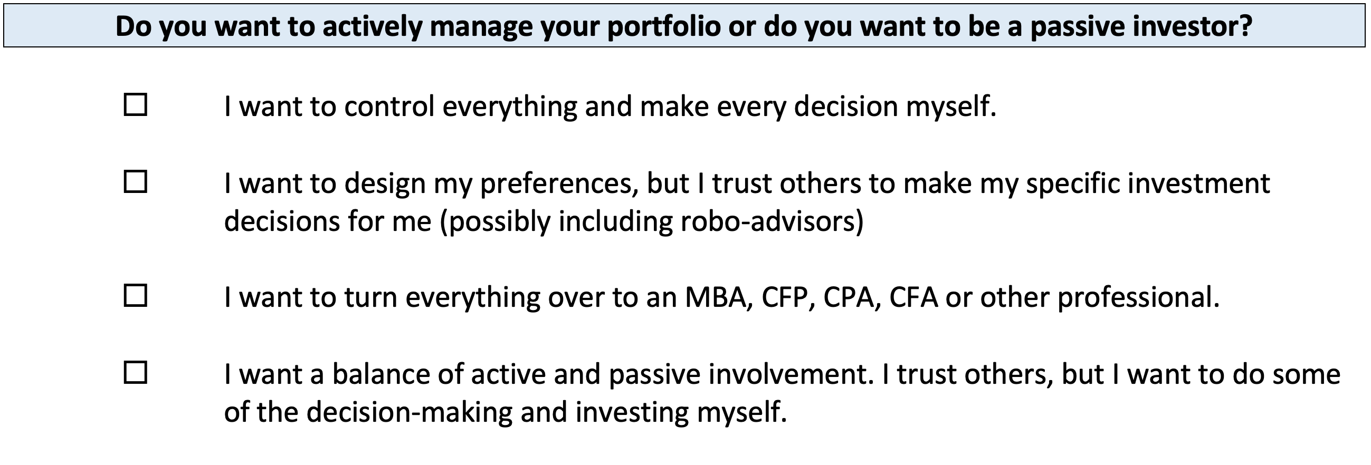
Your INVESTMENT POLICY STATEMENT

Slide 43
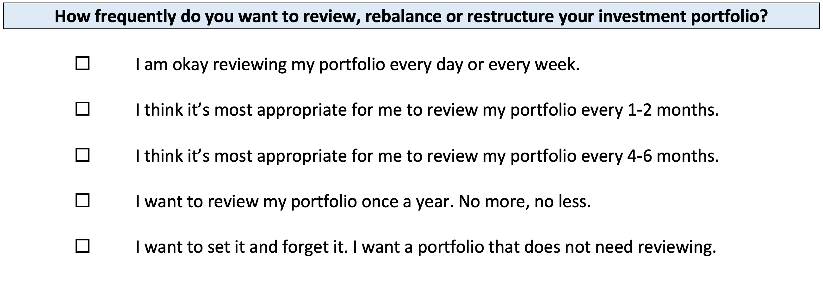
Your INVESTMENT POLICY STATEMENT

Slide 44
Your INVESTMENT POLICY STATEMENT
ASSET ALLOCATION
We know that the asset classes or categories you choose are responsible for 90% of portfolio returns, while specific security selection within classes is responsible for 10% of returns.
This means that how you decide to allocate your investments is the primary driver of your investment returns.
  Think about which geographic regions you want to invest in.
  Think about how to distribute your investment across asset categories.
    Stocks, bonds, currency, real estate, crypto, value stocks, growth stocks,
    large companies, small companies, oil, gold…

Slide 45
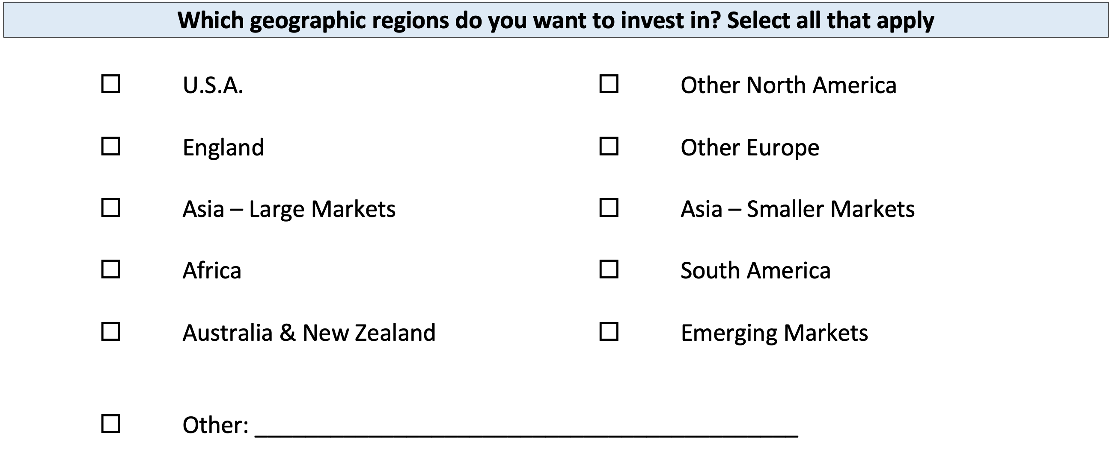
Your INVESTMENT POLICY STATEMENT

Slide 46
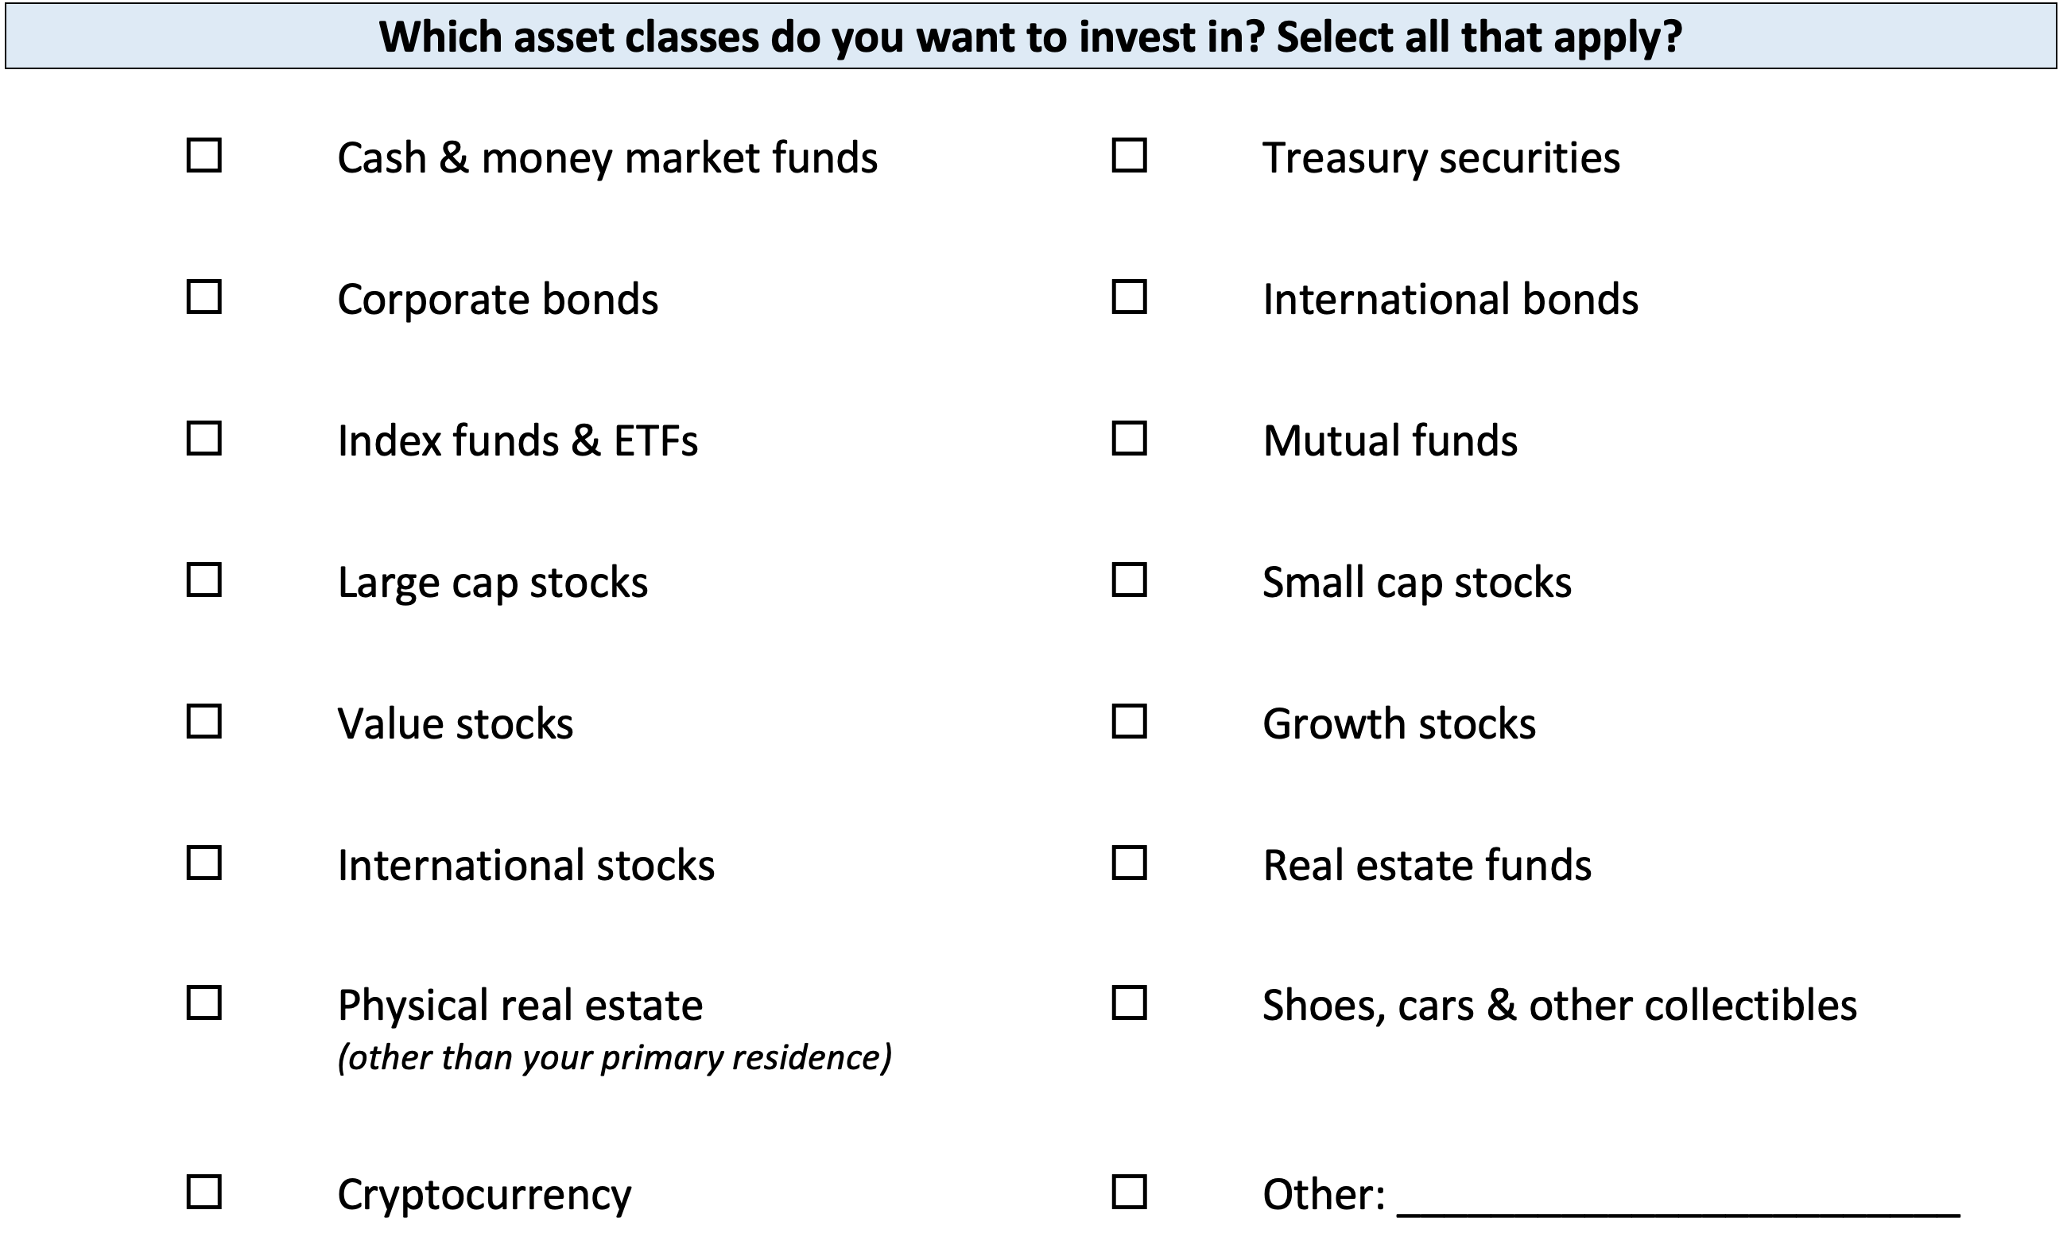
Your INVESTMENT POLICY STATEMENT

Slide 47
Your INVESTMENT POLICY STATEMENT

Slide 48
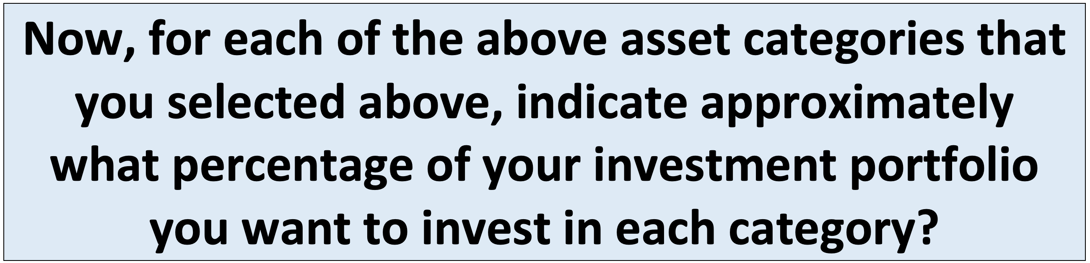
Your INVESTMENT POLICY STATEMENT

Slide 49
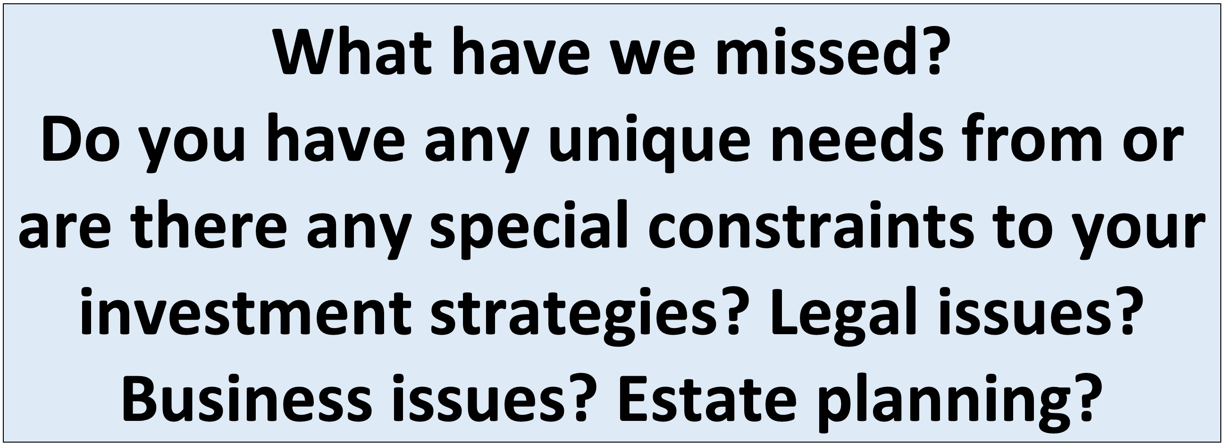
Your INVESTMENT POLICY STATEMENT

Slide 50
Your INVESTMENT POLICY STATEMENT
Once you complete this worksheet….
And once you open your Roth IRA account…
You are ready to begin investing. Now you just have to decide which of the 10,000+ securities to invest in.
Work on this with your spouse or family.
Revise and update it after you graduate.
Continue refining it throughout your investing life…make it about you and your goals.

Slide 51
I DO NOT GIVE INVESTMENT ADVICE
But here are some investment issues to think about:
Do you want to pick individual stocks (or other securities) and monitor them regularly?
  This can help you feel more control, more connection and more personal interest in your investments.
  Advantages: Potential for big gains, maybe a personal connection to the companies, you feel more engaged with the process.
  Disadvantages: Potential for big losses, requires more time and energy, transaction costs (trading, taxes) can add up, there are 1000s to choose from, potential loss of sleep and hair.

Slide 52
I DO NOT GIVE INVESTMENT ADVICE
But here are some investment issues to think about:
Or, would you be content investing in mutual funds and/or market indexes that pool dozens or hundreds of stocks?
  Advantages: Potential for moderate gains, lower risk (through diversification), lower trading and tax costs, you can narrow down the selection pretty quickly, less loss of sleep and hair
  Disadvantages: Lots of singles and doubles but no home runs, no emotional connection to your investments, susceptible to big market downturns (but not necessarily more than individual stocks)

Slide 53
I DO NOT GIVE INVESTMENT ADVICE
If you want to invest in individual stocks, I cannot help you.
But if you are interested in market indexes, here are some ideas:
  SPY – The S&P 500 index. 500 of the largest U.S. firms, from all industries.
  SPYD – The same as above, with a focus on those companies that pay regular dividends out to investors from their earnings. You will get more income, but possibly lower long-term capital gains.
  IWM – The Russell 2000. 2000 smaller U.S. firms (the 2000 firms after the 1000 largest firms). More volatility, possibly higher returns.
  EFA – Index of non-US firms (Europe, Far East, Australasia). Big firms.
  EEM – Index of non-US, emerging market stocks. Bigger firms in developing countries. More risk than any of the above.
  GBTC – A Bitcoin index. Invest in Bitcoin without mining or owning. Big Risk.

Slide 54
Investing – How Do You Do It?
When you’re just getting started with investing, there are a few approaches you can take:
  Start with a small amount of money – whether that’s $20 or $2,000 – and just go for it. Pick a few investments, track them regularly and be prepared to buy more or sell more should you feel comfortable doing either.

Slide 55
Investing – How Do You Do It?
When you’re just getting started with investing, there are a few approaches you can take:
  Start with a small amount of money – whether that’s $20 or $2,000 – and just go for it. Pick a few investments, track them regularly and be prepared to buy more or sell more should you feel comfortable doing either.
  Determine how much you have to invest.
    Put ½ of that into an index fund or a specific mutual fund. This will provide some security, generally with less or moderate risk.
    Put the other ½ into individual stocks or securities that intrigue you. If you’re interested in the companies, you might be more likely to follow them as investments.
    This half-half approach will help you figure out what kind of investor you are. In 1-2 years, you might gravitate more to either of the approaches that interest you more.

Slide 56
Investing – How Do You Do It?
When you’re just getting started with investing, there are a few approaches you can take:
  Start with a small amount of money – whether that’s $20 or $2,000 – and just go for it. Pick a few investments, track them regularly and be prepared to buy more or sell more should you feel comfortable doing either.
  Determine how much you have to invest.
    Put ½ of that into an index fund or a specific mutual fund. This will provide some security, generally with less or moderate risk.
    Put the other ½ into individual stocks or securities that intrigue you. If you’re interested in the companies, you might be more likely to follow them as investments.
    This half-half approach will help you figure out what kind of investor you are. In 1-2 years, you might gravitate more to either of the approaches that interest you more.
  Talk to a financial advisor. Note that they generally do not (initially) tell you which specific investments to make, but they will work talk through your options with you and help you better understand what you’re getting into.
    They will ask you 2 questions – what are your goals and what is your risk tolerance – and then work with you to find the investments that best align with your answers to these questions.

Slide 57
Long-Term Investment Planning
YOUR VALUES
YOUR GOALS
FINANCIAL STRATEGIES
INVESTMENT STRATEGIES
Identify Your Risk Tolerance
Identify Your Time Horizons
Select Investments
Monitor & Modify Investments

Slide 58
Long-Term Investment Planning
FINANCIAL STRATEGIES
EDUCATION STRATEGIES
INVESTMENT STRATEGIES
GRAD SCHOOL STRATEGIES
Identify Your Risk Tolerance
Identify Your Risk Tolerance
Identify Your Time Horizons
Identify Your Time Horizons
Select Investments
Select Your Field, Program, Specialization, Thesis
Monitor & Modify Investments
Monitor & Modify Your Progress & Plan

Slide 59

Isn’t this a lot like what you do with your education planning?

Slide 60
Long-Term Investment Planning
FINANCIAL GOALS
YOU,
as college students, are better wired and equipped to make long-term plans – education, career, financial & otherwise – than 99% of humanity.
Be confident.
Be intentional.
Be diligent.
Be awesome.
EDUCATION GOALS
INVESTMENT STRATEGIES
EDUCATION STRATEGIES
Identify Your Risk Tolerance & Priorities
Identify Your Risk Tolerance & Priorities
Identify Your Time Horizons
Identify Your Time Horizons
Select Investments
Select Your Field, Program, Specialization, Thesis
Monitor & Modify Investments
Monitor & Modify Your Progress & Plan

Slide 61
Owning Your Financial Future
YOUR VALUES
YOUR GOALS
Education
Career
Family
FINANCIAL STRATEGIES
Investing
Income & Expense Management
Debt Management
Taxes, Insurance & Other

Slide 62
What is INVESTING?
Investing is saving for the future.
We typically think of investing as long-term – anywhere from 1 or 2 years all the way through retirement.
Saving vs. Investing
  Saving can be short-term, Investing is typically long-term.
  Saving is passive, Investing is dedicated…it could be relatively passive or extremely active.
    Passive: Mutual funds. Extremely Active: Owning an apartment complex.
  Saving is typically very low risk, Investing generally has more risk.
  Saving provides low returns on investment (currently about 0.0%)
  Inflation is risky…You can lose 100% or realize huge positive returns.

Slide 63
What Is Your Investing Goal?
Take a few seconds to ask yourself:
Why Are You Investing?
What are your investing goals?
To buy a house?
To buy a car?
To pay off debt?
To retire?

Slide 64
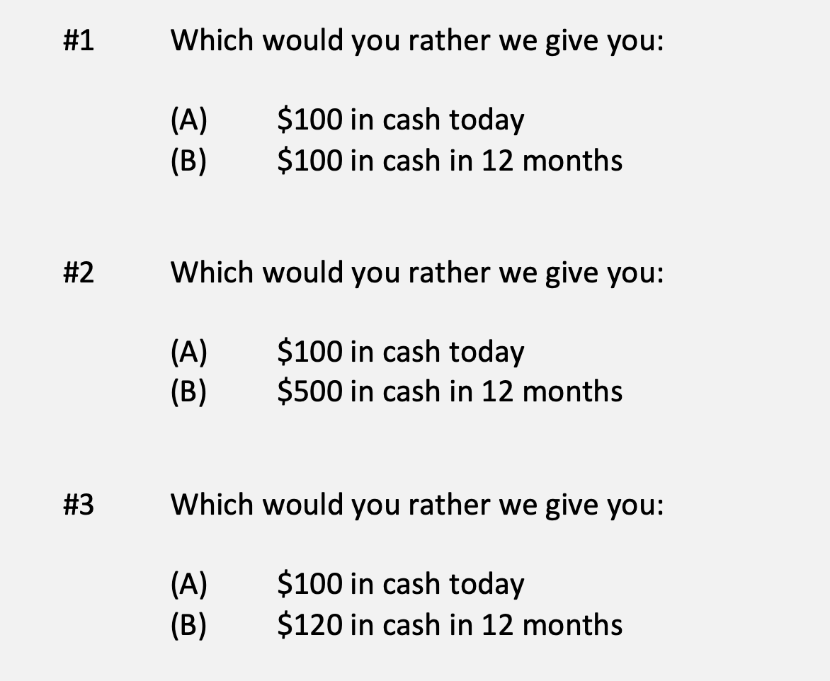
A Few Rules About INVESTING
Investing is about Trade-Offs. Using money today to get (hopefully more) money in the future:

Slide 65
A Few Rules About INVESTING
Risk matters. Know your risk tolerance.
Goals matter. Be intentional about what you are saving for.
  Maybe create 3-5 different investment accounts for different goals.
  This is what I do – I’ll show you why in a bit.
Transaction costs matter. You can pay a lot of fees for not much benefit or service. Be careful.
Experts rarely have tips or secrets. Investing is about predicting the future, and none of us can predict the future (perfectly). Be careful.
  If there really were sure-things or get-rich-quick schemes, the experts would be using them themselves, not sharing them with you.
Communicate with your family. Achieving goals is a family affair.

Slide 66
A Few Rules About INVESTING
Investing lets COMPOUND INTEREST be your friend.
  With compound interest, your interest earns interest.
  Without actively making decisions, your money can grow exponentially.
  Yes, there is risk – the exponential growth rate could be negative.
  Such risk is greatest if you ‘invest’ over very short periods of time.
  Historically, over the past 100+ years, if you invest for 5+ years, you have benefited from positive exponential growth.
  The average return of a common stock over the past 100 years is 10%.
    The word ’average’ is very important here. But, the good news, we can all achieve ‘average’ returns relatively easily (though they may not be 10% in the future)

Slide 67
A Few Rules About INVESTING
Investing lets COMPOUND INTEREST be your friend.
  Invest $100 at 10% interest or growth:
  Year 1: $100 x (1 + 10%) = $110
  Year 2: $110 x (1 + 10%) = $121
  $100 x (1 + 10%)² = $121
  Year 1: $10 of interest
  Year 2: $10 of interest on your original $100
  + $1 of interest on year 1 interest

Slide 68
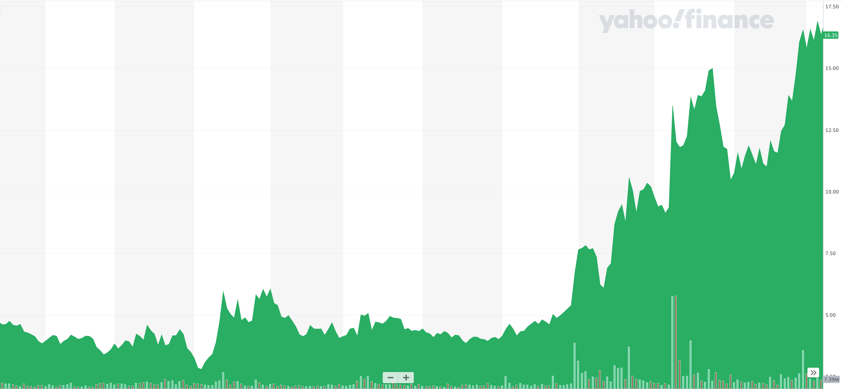
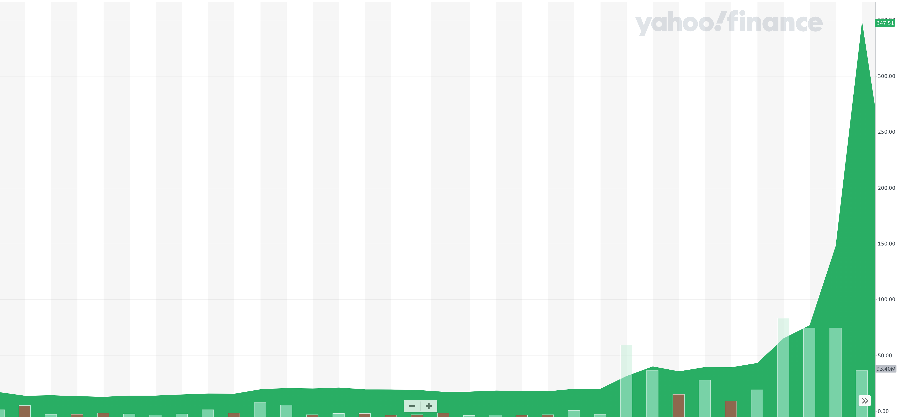
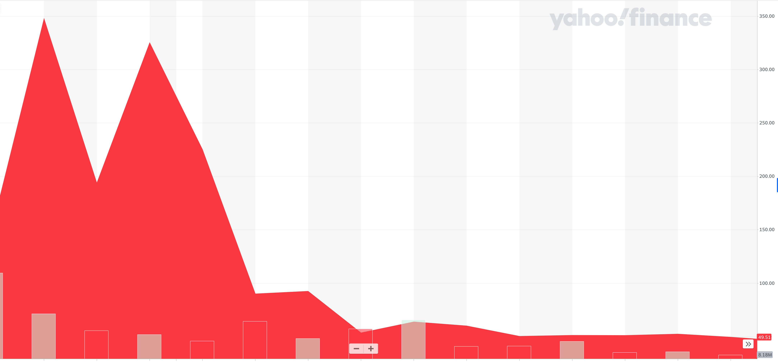
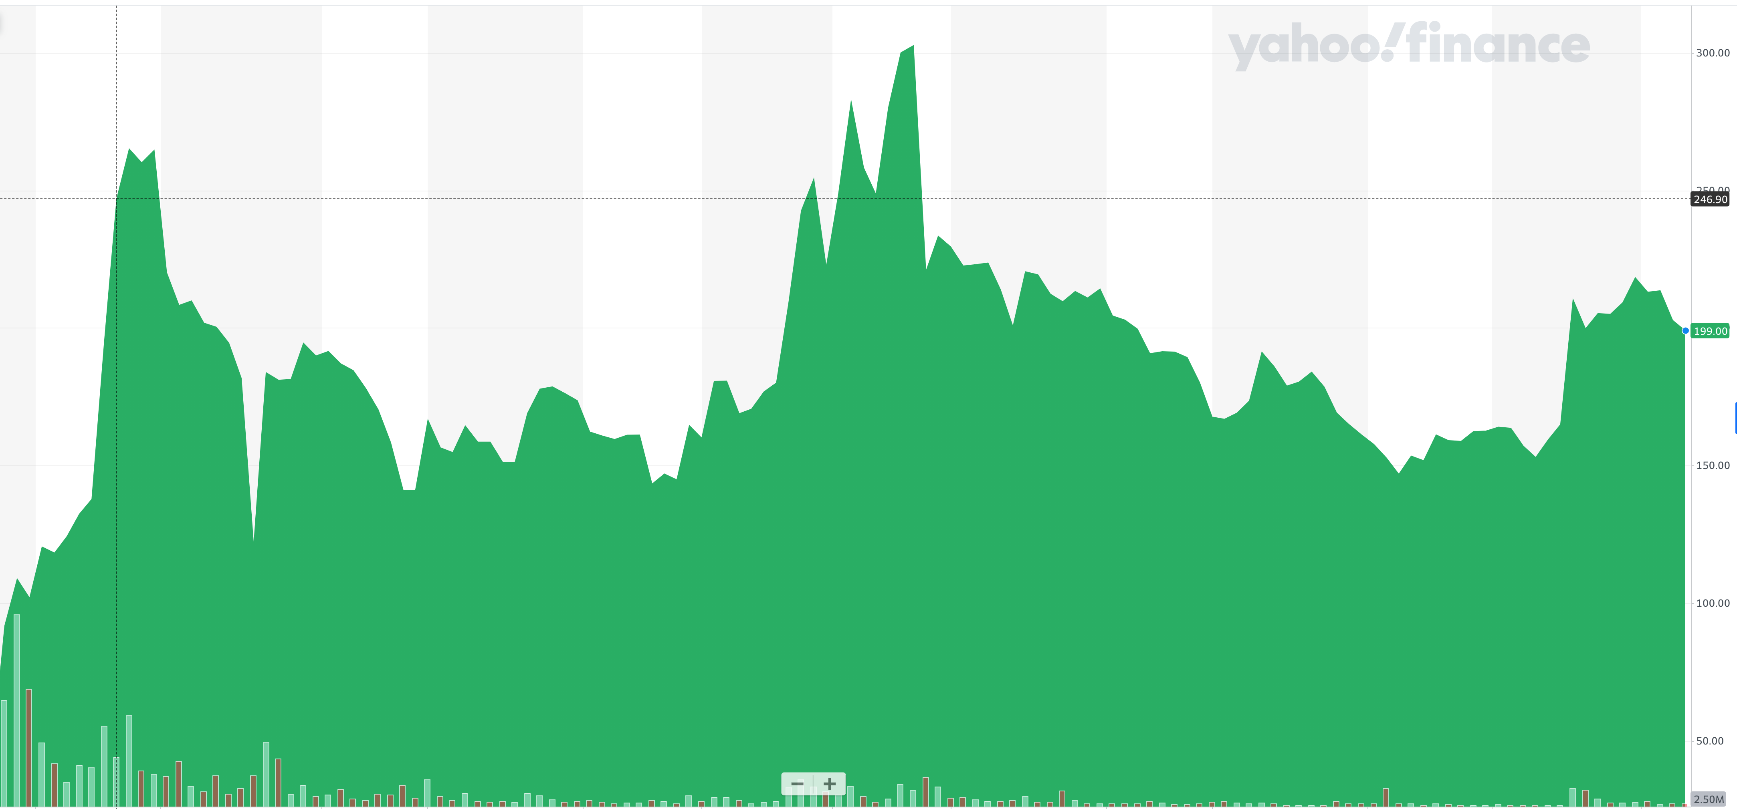
+100%
+3120%
-92%
+300%

Slide 69
All 4 charts are for Gamestop – Just over different periods of time.
First 11 Months in 2020
December 2020 to January 27
January 27 to February 18
February 18 to today

Slide 70
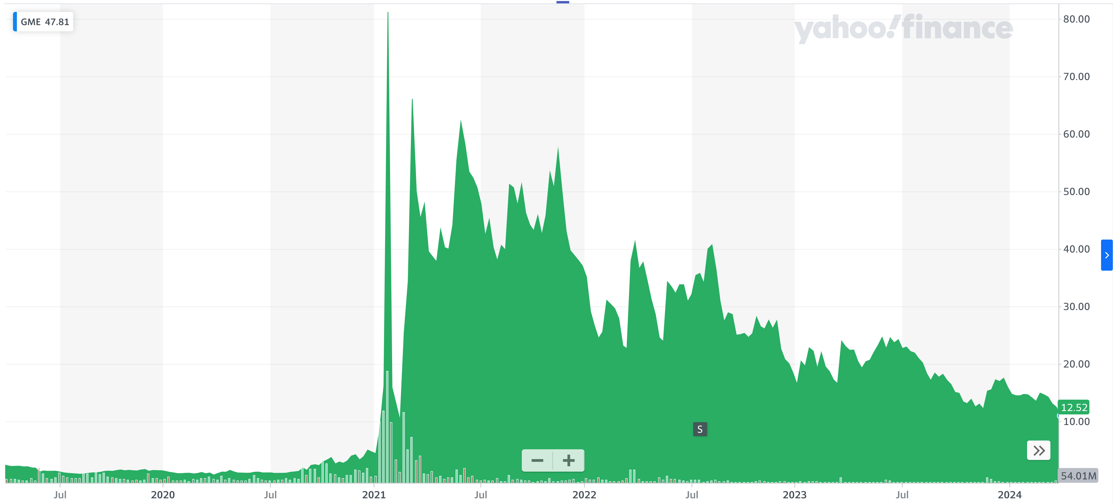
GAMESTOP
From January 2020 to Today
+625%
If you had invested $1000 in Gamestop at the beginning of 2020, that investment would be worth $7250 today.

Slide 71
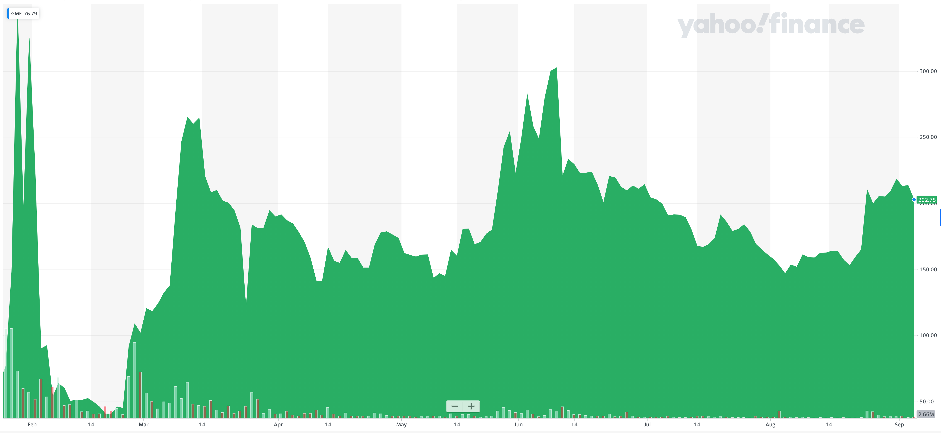
GAMESTOP
If you had invested $100 in Gamestop on January 26, 2021, it would have been worth $8 three weeks later.
It would be worth $45 today.

Slide 72
Timing Matters
We could tell similar stories about ups-and-downs for Bitcoin, Tesla, Dogecoin, AMC, Viacom and many other investments
It is very, very, very, very, very, very, very, very, very, very, difficult to consistently have perfect timing when making investments
  People who research this phenomenon for a living will tell you it’s impossible
Do you think you’re unique and that you will be able to consistently time the market so you gain from the up moves and never lose from the down moves?

Slide 73
Expertise Matters
Take a minute to think about the following question:
What do YOU do better than 99.9% of humanity?
Think about what you’re studying. Think about what you’ve been working on for years. Think about what you know that I do not know.
I’ve probably only spent 1-2 hours studying what you have dedicated your life to studying and becoming an expert in.
  Could I do your job as well as you do it?

Slide 74
Expertise Matters
Of course, I couldn’t do your job as well as you.
Now connect this logic to investing: there are many professionals who have dedicated their lives to making investments. They are good.
  Yes, there are many amateurs involved in trading stocks – but they (usually) account for a very minor portion of the total money invested.
Remind yourself of this old gambling maxim:
When you are sitting at the poker or gambling table, take a look around and see if you can figure out who the sucker is. If you cannot identify who the sucker is, then the sucker is probably you.

Slide 75
Isn’t this a lot like what you do with your education planning?

Slide 76
Determining Your Risk Tolerance
High Risk Attitude
I want to summer in Paris and winter in Hawaii
Medium-High Risk Attitude
I will work through normal retirement age, but I want my spouse to retire early - and we want to visit Paris & Hawaii
Medium-Low Risk Attitude
I want my children to have a college education
Low Risk Attitude
I want food on the table and a roof over my head

Slide 77
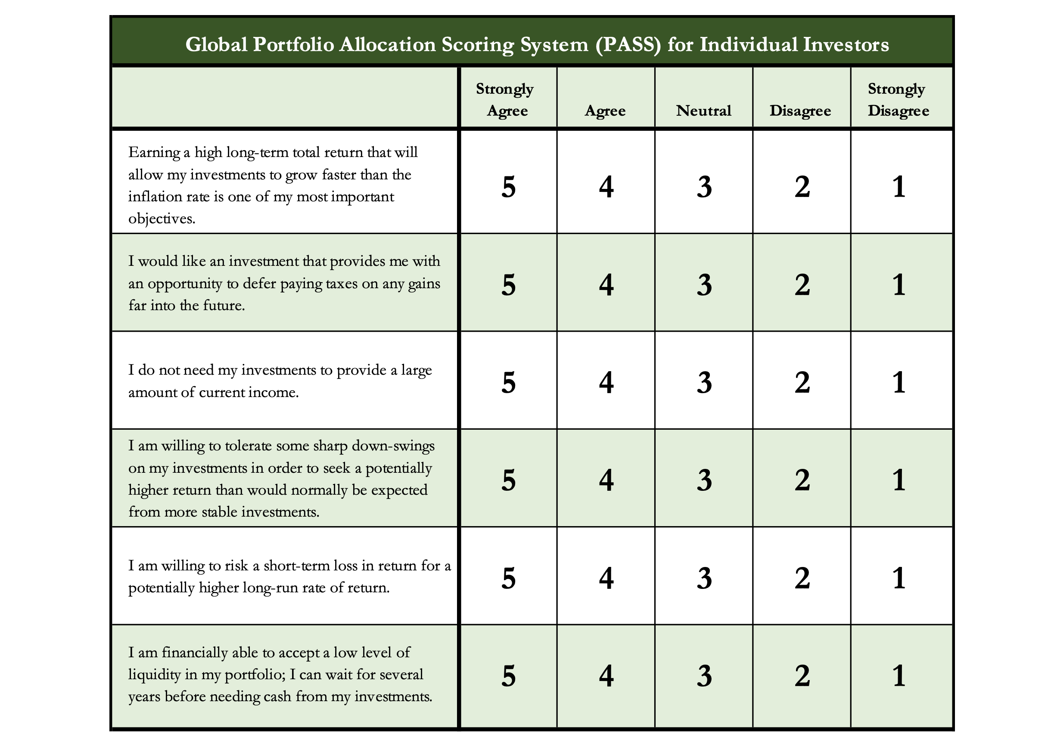
Determining Your Risk Tolerance

Slide 78
Comparing Different Investments

Slide 79
Comparing Different Investments

Slide 80
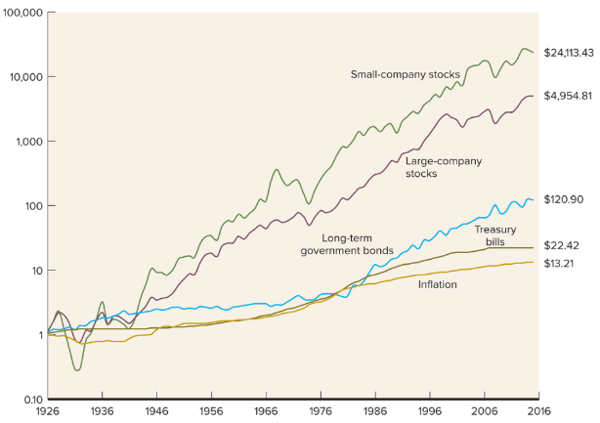
Comparing Different Investments

Slide 81
The Magic of Compound Returns

Slide 82
The Magic of Compound Returns

Slide 83
The Magic of Compound Returns
Quiz Question on Compound Returns:
Under which of the following scenarios will you have more money saved when you turn 65?
Investing $100 per month from age 25-35 (and then nothing from 35-65)
With an 8% return, you will have $185,000 accumulated at 65.
Investing $100 per month from age 35-65 (but nothing from 25-35)
With an 8% return, you will have $150,000 accumulated at 65.
Note: If the returns on your investments are less than 6%, (B) will lead to greater wealth.
There’s a similar but different problem on page 37 of your handbook.

Slide 84
The Magic of Compound Returns
Quiz Question on Compound Returns:
Under which of the following scenarios will you have more money saved when you turn 65?
Investing $100 per month from age 25-35 (and then nothing from 35-65)
With an 8% return, you will have $185,000 accumulated at 65.
Investing $100 per month from age 35-65 (but nothing from 25-35)
With an 8% return, you will have $150,000 accumulated at 65.
Note: If the returns on your investments are less than 6%, (B) will lead to greater wealth.
There’s a similar but different problem on page 37 of your handbook.

Slide 85
Review: A Few Rules About INVESTING
Investing lets COMPOUND INTEREST be your friend.
  With compound interest, your interest earns interest.
  Without actively making decisions, your money can grow exponentially.
  Yes, there is risk – the exponential growth rate could be negative.
  Such risk is greatest if you ‘invest’ over very short periods of time.
  Historically, over the past 100+ years, if you invest for 5+ years, you have benefited from positive exponential growth.
  The average return of a common stock over the past 100 years is 10%.
    The word ’average’ is very important here. But, the good news, we can all achieve ‘average’ returns relatively easily (though they may not be 10% in the future)

Slide 86
Review: A Few Rules About INVESTING
Investing lets COMPOUND INTEREST be your friend.
  With compound interest, your interest earns interest.
  Without actively making decisions, your money can grow exponentially.
  Yes, there is risk – the exponential growth rate could be negative.
  Such risk is greatest if you ‘invest’ over very short periods of time.
  Historically, over the past 100+ years, if you invest for 5+ years, you have benefited from positive exponential growth.
  The average return of a common stock over the past 100 years is 10%.
    The word ’average’ is very important here. But, the good news, we can all achieve ‘average’ returns relatively easily (though they may not be 10% in the future)
Not to be too esoteric or philosophical…
But compound interest doesn’t just apply to investing.
Compound interest applies to all aspects of college life:
Time Management
Mental Health
Health Management
Writing Skills
Relationships
And…Of course, Money Management

Slide 87
Investing – Some Perspective
I am biased because I am a finance professor. I study investing and I teach investing. My perspective on risk may be meaningless to you.
Do not take my advice on what level of risk you should take. Be thoughtful, be prudent.
Avoid doing things that you know are stupid and that you know will cause you stress.
But don’t be afraid of taking risks just because they scare you. You have already taken many, many risks in your life. Taking informed and measured risks will continue to open many doors and opportunities for you – in both your personal and financial lives.

Slide 88
A Few Opening Morals
SAVINGS
INVESTING
OWNERSHIP
WEALTH

Slide 89
Isn’t this a lot like what you do with your education planning?

Slide 90
Some Parting Words
Nothing in finance is free. Do not think some institution is giving you a super deal just because they like you. There will be costs.
Investment companies work really hard to get your money. They hire psychologists to figure out how to get you addicted to your products. Your money pays for their commercials, buildings, fancy cars and vacation homes.
I check my bank, savings & investment accounts daily. I do not make changes daily (or even monthly). I just don’t want any surprises.

Slide 91
Some Parting Words
If you ever invest based on personal relationships, be prepared for losses.
Nobody – NOBODY – can predict the future. And investing is all about predicting the future. Be careful about thinking you can predict the future. Make sure your investments align with your goals.
Be your own boss. Take control of your money and your investments. Nobody else is going to do it for you. Own your financial future.

Slide 92
Financial Wellness
A goal without a plan is just a dream.
Wealth is largely the result of habit.
The most difficult thing is the decision to act; the rest is mere tenacity.
It takes as much energy to plan as it does to wish.
You cannot escape the responsibility of tomorrow by avoiding it today.

Slide 93
Don’t wait around for other people to be happy for you.
Any happiness you get,
You’ve got to make yourself.
~ Alice Walker, poet & novelist
A goal without a plan is just a dream.
Wealth is largely the result of habit.
The most difficult thing is the decision to act; the rest is mere tenacity.
It takes as much energy to plan as it does to wish.
You cannot escape the responsibility of tomorrow by avoiding it today.

Slide 94
brian.bolton@louisiana.edu http//:business.louisiana.edu/financeispersonal

