Slide 1
STUDENT SUPPORT SERVICES
FINANCIAL WELLNESS SERIES 2024
Session #1
Your Financial Planning To-Do List
February 28, 2024

Slide 2
Brian Bolton Professor of Finance brian.bolton@louisiana.edu http://business.louisiana.edu/financeispersonal

Slide 3
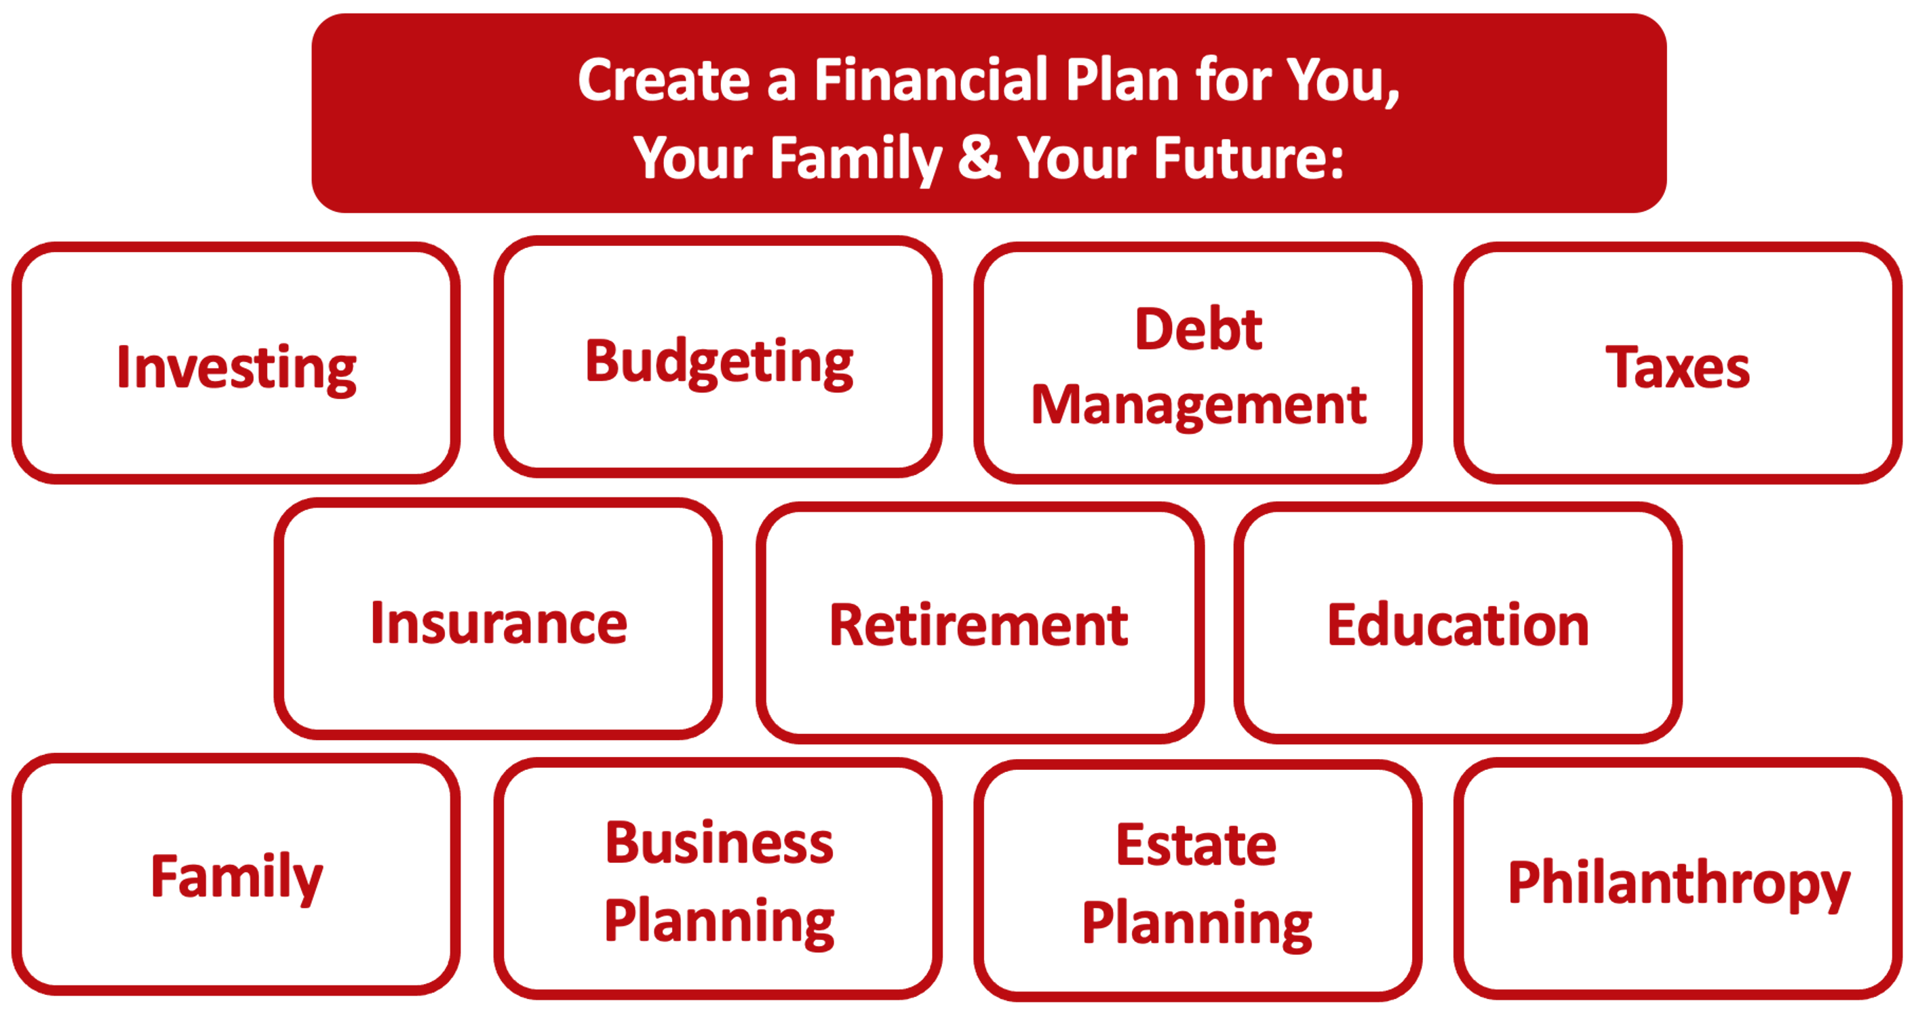

Slide 4
Owning Your Financial Future
YOUR VALUES
YOUR GOALS
Education
Career
Family
FINANCIAL STRATEGIES
Investing
Income & Expense Management
Debt Management
Taxes, Insurance & Other

Slide 5
Owning Your Financial Future
YOUR VALUES
YOUR GOALS
Education
Career
Family
FINANCIAL STRATEGIES
Investing
Income & Expense Management
Debt Management
Taxes, Insurance & Other

Slide 6
Owning Your Financial Future
YOUR VALUES
YOUR GOALS
Education
Career
Family
FINANCIAL STRATEGIES
Investing
Income & Expense Management
Debt Management
Taxes, Insurance & Other

Slide 7
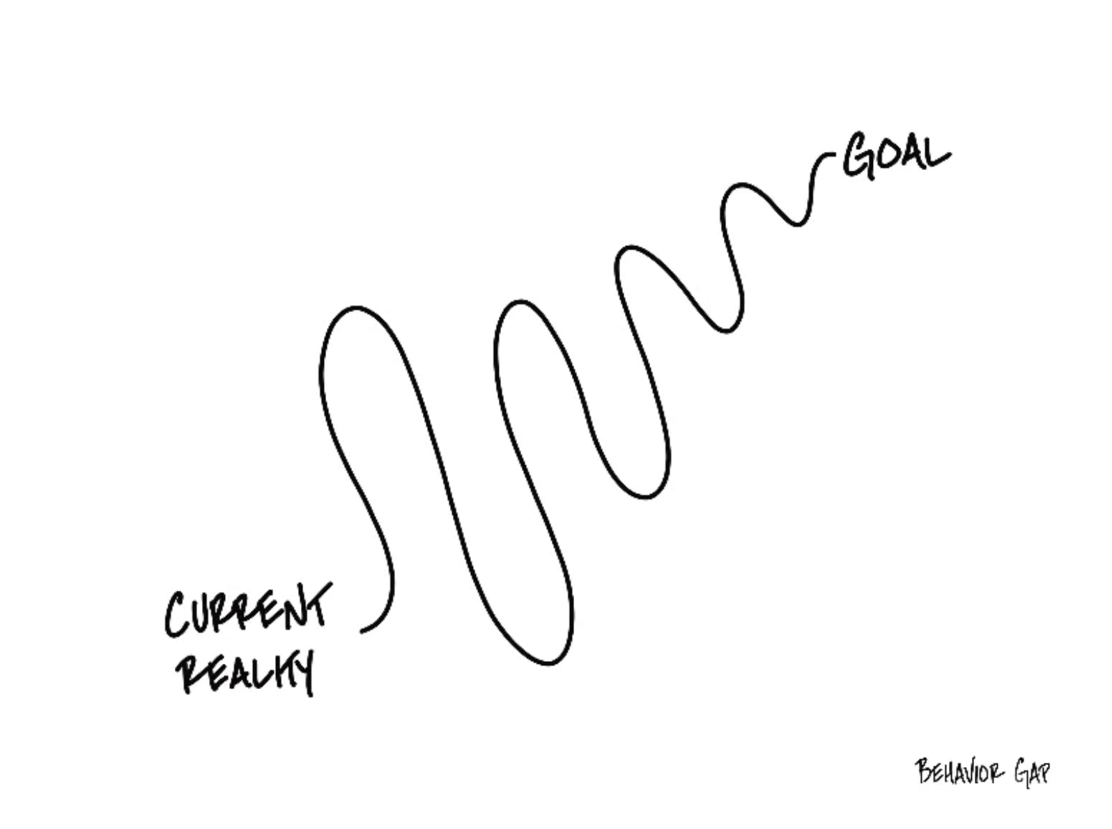

Slide 8
TODAY THE NEXT 6 MONTHS THE NEXT 12 MONTHS 2 YEARS AFTER GRADUATION 3 YEARS AFTER GRADUATION
ONCE EVERY SEMESTER:
TRACK EVERY PENNY THAT YOU SPEND & TRACK EVERY PENNY THAT YOU EARN
IN THE NEXT 3 MONTHS:
IDENTIFY WAYS TO DECREASE YOUR DISCRETIONARY SPENDING BY 25%
IN THE NEXT 6 MONTHS:
MAKE A PLAN TO MANAGE – AND PAY OFF – YOUR DEBT
IN THE NEXT 6-12 MONTHS:
OPEN MULTIPLE SAVINGS ACCOUNTS, 1 FOR EACH GOAL
IN THE NEXT 12 MONTHS, OPEN AN IRA OR ROTH IRA
WITHIN 2 YEARS OF GRADUATION:
HAVE AN “EMERGENCY FUND” ACCOUNT, WITH 3-6 MONTHS OF NON-DISCRETIONARY EXPENSES
WITHIN 3 YEARS OF GRADUATION:
ELIMINATE ALL OF YOUR BAD DEBT.

Slide 9
Personal Finance is…personal.
It’s about you and not about anyone else.
You have to make it about you and your goals.

Slide 10
Because personal finance is personal, it is virtually impossible for me to give you any specific advice.
However, there is one word of advice that applies to 99% of people working on their finances:
SAVE

Slide 11
INDULGENCE is good.
IMPULSE is bad.

Slide 13
HAPPINESS
A FUN VACATION
A NEW CAR
SATURDAY NIGHT

Slide 14
January Activities
TRACK EVERY PENNY THAT YOU SPEND & TRACK EVERY PENNY THAT YOU EARN.
CATEGORIZE EVERY EXPENSE AS EITHER ‘NON-DISCRETIONARY’ (needs) or ‘DISCRETIONARY’ (wants).
IDENTIFY WAYS TO DECREASE YOUR DISCRETIONARY SPENDING BY 25%.
REVISIT YOUR COMPANY-SPONSORED RETIREMENT PLAN CONTRIBUTIONS
Are you maximizing the company match?
MAKE A LIST OF YOUR FINANCIAL GOALS FOR THE YEAR….AND IDENTIFY HOW YOU ARE GOING TO ACHIEVE EACH GOAL?
BEGIN THINKING ABOUT AND AGGREGATING INFORMATION TO COMPLETE LAST YEAR’S TAX RETURN

Slide 15
February Activities
UNDERSTAND ALL OF YOUR DEBT.
IDENTIFY YOUR GOOD DEBT AND YOUR BAD DEBT.
MAKE A PLAN TO PAY DOWN YOUR BAD DEBT.
BEGIN PAYING $10 or $100 MORE THAN YOU NEED TO FOR EACH BAD DEBT.
IDENTIFY WAYS TO DECREASE YOUR NON-DISCRETIONARY SPENDING BY 10%
CANCEL AT LEAST 1 SUBSCRIPTION.
PREPARE LAST YEAR’S TAX RETURN.
FILE IF YOU ARE GETTING A REFUND.
WAIT UNTIL APRIL IF YOU OWE.
IF YOU ARE GETTING A TAX REFUND, CONSIDER TALKING TO HUMAN RESOURCES AND DECREASING YOUR WITHHOLDING.

Slide 16
March Activities
DO NOT GO TO THE GROCERY STORE – Except for beverages and perishables.
See if you can empty your pantry and freezer.
CHECK YOUR CREDIT SCORE.
CHECK YOUR CREDIT REPORT.
Verify that what is in the Report belongs to you. Make a plan to improve your Score.
SET A BUDGET FOR SPRING & SUMMER.
MAKE SURE YOU KNOW WHAT INCOME & EXPENSES YOU WILL HAVE DURING THE NEXT 6 MONTHS.
REVISIT SOME OF YOUR NON-DISCRETIONARY EXPENSES TO SEE IF YOU CAN DECREASE THEM – Insurance, Cable, Phone, Subscriptions.
IF YOU HAVE RECEIVED YOUR TAX REFUND, DO SOMETHING POSITIVE WITH IT – Pay down debt, invest it, put it in an IRA, donate it.
It’s not free money – it’s yours!

Slide 17
April Activities
TRY A DRY APRIL.
NO ALCOHOL ALL MONTH
Alternatively, only drink at home. Or do the same with coffee.
PAY AN EXTRA $100 ON AT LEAST 1 DEBT BALANCE.
REVIEW YOUR INVESTMENT PORTFOLIOS.
DO YOU WANT MORE RISK?
NEW SECURITIES?
NEW ADVISORS?
MAKE SURE YOU HAVE A BASIC ESTATE PLAN.
MAKE SURE YOU HAVE A WILL. THINK ABOUT WHETHER YOU NEED TRUSTS FOR THE MOST EFFICIENT TRANSFER OR ASSETS.
IF YOU OWE TAXES, PUT YOUR RETURN AND CHECK IN SNAIL MAIL ON APRIL 15.
WAIT AS LONG AS POSSIBLE.

Slide 18
May Activities
TRACK EVERY PENNY THAT YOU SPEND & TRACK EVERY PENNY THAT YOU EARN.
SET UP A NEW SAVINGS ACCOUNT FOR DIFFERENT GOALS – Vacation, Car, House, Retirement.
Having different accounts utilizes ‘mental budgeting.’
SET UP AUTOMATIC TRANSFERS SO YOU PAY YOURSELF FIRST WITH EACH PAYCHECK. AUTOMATICALLY MOVE $XXX FROM DEBIT TO SAVINGS ACCOUNTS.
GET SAVINGS, INVESTING & POSSIBLY EDUCATION & RETIREMENT ACCOUNTS FOR YOUR CHILDREN. Help them begin learning how to own their financial futures.
INVENTORY ALL OF YOUR PERSONAL ASSETS (maybe do this twice a year).
TAKE PHOTOS & VIDEOS. REVIEW YOUR INSURANCE POLICIES.

Slide 19
June Activities
REVISIT YOUR FINANCIAL GOALS FOR THE YEAR.
MAKE ADJUSTMENTS TO MOVE FORWARD THE REST OF THE YEAR.
PERFORM A MID-YEAR CHECK ON ALL OF YOUR ACCOUNTS & ACTIVITIES.
IS EVERYTHING ON TRACK.
OPEN AN INDIVIDUAL RETIREMENT ACCOUNT OR ROTH IRA.
NO DINING OUT.
(Or, no fast food, or coffee, or only on weekends, or only for dinner …anything to improve habits & spending)
HAVE FUN.
ENJOY YOUR SUMMER.
THE PURPOSE OF PLANNING IS TO BE HAPPY & INDULGE (AND TO AVOID IMPULSES)

Slide 20
July Activities
FIND A PERSONAL FINANCE PODCAST, VIDEO OR BOOK TO ENGAGE WITH.
Finance is personal. Find the tools that help you most.
HAVE A FINANCIAL HEART-TO-HEART WITH YOUR SPOUSE.
OR PARENTS.
OR CHILDREN.
ASK FOR A CREDIT LIMIT INCREASE ON ALL OF YOUR CREDIT CARDS TO IMPROVE YOUR CREDIT SCORE.**
** DO NOT do this if it will lead to more spending.
DO YOU HAVE AN EMERGENCY FUND? DO YOU HAVE A FUND WITH 3-6 MONTHS OF NON-DISCRETIONARY EXPENSES SAVED? CAN YOU?
HAVE FUN.
ENJOY YOUR SUMMER.
THE PURPOSE OF PLANNING IS TO BE HAPPY & INDULGE (AND TO AVOID IMPULSES)

Slide 21
August Activities
ASK FOR A RAISE.
PREPARE A BACK-TO-SCHOOL BUDGET.
REVIEW YOUR SUMMER BUDGETS AND SPENDING.
WHAT CAN YOU LEARN FROM THIS FOR THE REST OF THE YEAR OR FOR NEXT YEAR?
REVISIT ANY INSURANCE and/or LIFE INSURANCE POLICIES.
DO YOU HAVE THE COVERAGE YOU NEED FOR THE TIME PERIODS YOU NEED?
START YOUR OWN BUSINESS.
IT CAN BE VERY EASY – WHETHER YOU ARE SELLING SOMETHING OR CONSULTING – TO CREATE ANOTHER INCOME STREAM

Slide 22
September Activities
TRACK EVERY PENNY THAT YOU SPEND & TRACK EVERY PENNY THAT YOU EARN.
CREATE SAVINGS GAMES FOR YOU AND YOUR CHILDREN.
If we save $XXX this month, we will reward ourselves with…
REVIEW YOUR INVESTMENT & RETIREMENT PORTFOLIOS. REBALANCE FOR THE REST OF THE YEAR.
BUDGET FOR YOUR ANNUAL CHARITABLE DONATIONS.
ALIGN YOUR GOALS WITH YOUR PLANS. MAKE SURE THE MONEY IS AVAILABLE.
PAY AN EXTRA $100 ON AT LEAST 1 DEBT BALANCE.

Slide 23
October Activities
OCTOBER IS USUALLY HEALTH INSURANCE OPEN ENROLLMENT MONTH, WHEN YOU CAN CHANGE PLANS – MAKE SURE YOU HAVE THE RIGHT PLAN FOR YOU & YOUR FAMILY.
EVALUATE ANY CONTRIBUTIONS TO AN HSA (Health Savings Account) or FSA (Flexible Spending Account).
Make sure you are optimizing these benefits.
COMPLETE THE FAFSA – FREE APPLICATION FOR FEDERAL STUDENT AID – FOR YOU and/or YOUR CHILDREN IN SCHOOL.
BUDGET FOR YOUR HOLIDAY SPENDING. MAKE SURE THE MONEY IS AVAILABLE.
MAKE A LIST OF WHAT YOU ARE NOT GOING TO SPEND, TOO.
IF YOU REQURESTED A 6-MONTH INCOME TAX FILING EXTENSION…FILE YOUR TAXES.

Slide 24
November Activities
FOR YOUR HOLIDAY SPENDING, BEGIN LOOKING FOR THE BEST DEALS.
(THE FIRST DEALS ARE NOT ALWAYS THE BEST.)
PAY AN EXTRA $100 ON AT LEAST 1 DEBT ACCOUNT.
(BEFORE YOU BECOME FOCUSED ON HOLIDAY SPENDING.)
IDENTIFY YOUR TOP 5-10 VALUES IN LIFE.
How do these values connect to your family? How do these values connect to your finances?
DO YOU NEED A NEW JOB?
DID YOUR CURRENT JOB HELP YOU ACHIEVE YOUR PERSONAL, PROFESSIONAL & FINANCIAL GOALS?
CAN YOU MAKE YOUR SIDE-HUSTLE OR BUSINESS MORE PROFESSIONAL?
FILE FOR AN LLC WITH THE STATE? HIRE EMPLOYEES? NEW BUSINESS PLAN?
REVIEW YOUR LIST OF FINANCIAL GOALS FOR THE YEAR.
HOW DID YOU DO?
CAN YOU DO BETTER?

Slide 25
December Activities
PRIORITIZE YOUR MENTAL AND PERSONAL HEALTH.
Without mental wellness, nothing else in this conversation matters.
MAKE 2-3 FINANCIAL NEW YEAR RESOLUTIONS.
Make sure your goals are aligned with your values.
DON’T JUST BUY GIFTS FOR OTHERS. TREAT YOURSELF, TOO.
HAVE ANY OF YOUR INVESTMENTS LOST MONEY THIS YEAR? DO YOU WANT TO SELL THEM TO RECOGNIZE THE LOSSES (AND THE TAX BENEFITS)?
IF IT’S IMPORTANT TO YOU, DONATE TIME AND/OR MONEY.
For many recipients, your time is just as valuable as your money.
CELEBRATE ALL OF YOUR SUCCESS FOR THE YEAR.

Slide 26
Making Financial Planning a Priority
EDUCATION STRATEGIES
SCHOOL STRATEGIES
Identify Your Resources
Identify Your Priorities & Goals
Do Your Planning
Monitor & Modify Your Progress & Plan

Slide 27
Making Financial Planning a Priority
FINANCIAL STRATEGIES
EDUCATION STRATEGIES
BUDGETING
STRATEGIES
SCHOOL STRATEGIES
Identify Your Income & Expenses
Identify Your Resources
Identify Your Priorities & Goals
Identify Your Priorities & Goals
Do Your Planning
Do Your Planning
Monitor & Modify Budgeting Activities
Monitor & Modify Your Progress & Plan

Slide 28
Making Financial Planning a Priority
FINANCIAL STRATEGIES
YOU,
as students, are better wired and equipped to make long-term plans – education, career, financial & otherwise – than 99% of humanity.
Be confident. Be intentional.
Be diligent.
Be awesome.
EDUCATION STRATEGIES
BUDGETING
STRATEGIES
SCHOOL STRATEGIES
Identify Your Income & Expenses
Identify Your Resources
Identify Your Priorities & Goals
Identify Your Priorities & Goals
Do Your Planning
Do Your Planning
Monitor & Modify Budgeting Activities
Monitor & Modify Your Progress & Plan

Slide 29
SAVINGS
INVESTING
OWNERSHIP
WEALTH

Slide 30
SAVINGS
HAPPINESS

Slide 31
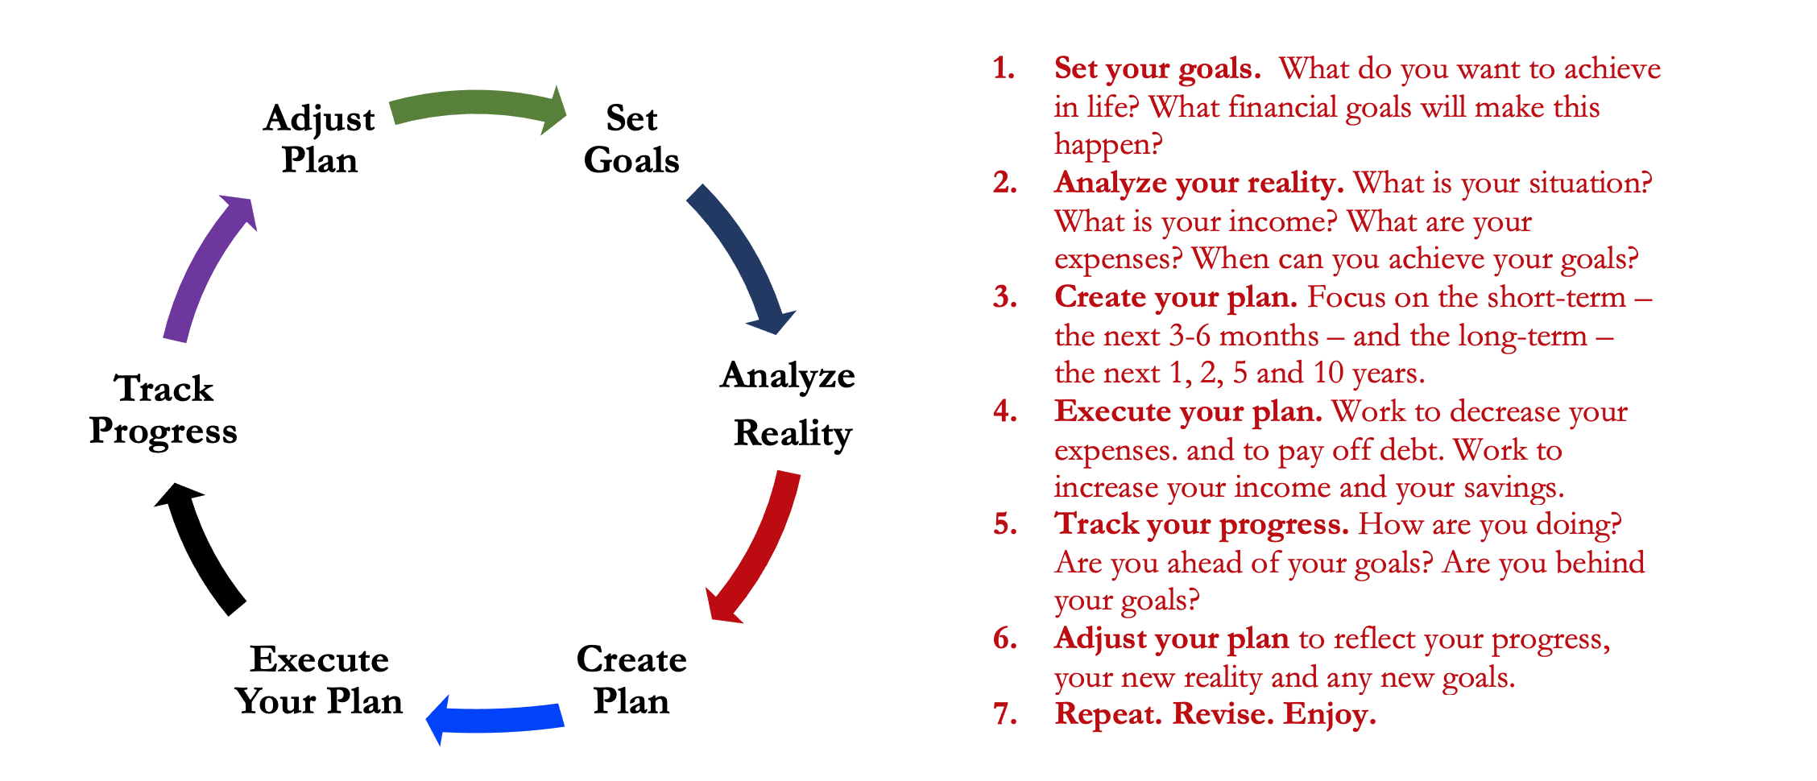
Isn’t this a lot like what you do with your education planning?

Slide 32
And as you begin to develop your full financial plan – seeing the trade-offs with Budgeting, Investing and Debt Management – you will begin to see how interconnected all of these aspects are.
Finance is just a matter of managing money across time.
And one thing we know about time is that our plans will change – so the better you have control of your initial financial plan, the more you will be able to adjust when life and time give you new goals.
Isn’t this a lot like what you do with your education planning?

Slide 33
Financial Wellness
A goal without a plan is just a dream.
Wealth is largely the result of habit.
The most difficult thing is the decision to act; the rest is mere tenacity.
It takes as much energy to plan as it does to wish.
You cannot escape the responsibility of tomorrow by avoiding it today.

Slide 34
Don’t wait around for other people to be happy for you.
Any happiness you get,
You’ve got to make yourself.
~ Alice Walker, poet & novelist
A goal without a plan is just a dream.
Wealth is largely the result of habit.
The most difficult thing is the decision to act; the rest is mere tenacity.
It takes as much energy to plan as it does to wish.
You cannot escape the responsibility of tomorrow by avoiding it today.

Slide 35
brian.bolton@louisiana.edu http//:business.louisiana.edu/financeispersonal

