Slide 1
Opening Quiz – Question #1
If you sold cookies out of your apartment during 2022 and made $500 from those sales, you owe taxes on that $500 of income.
TRUE
FALSE

Slide 2
Opening Quiz – Question #1
If you sold cookies out of your apartment during 2022 and made $500 from those sales, you owe taxes on that $500 of income.
TRUE
FALSE
Maybe

Slide 3
Opening Quiz – Question #2
If you sold cookies out of your apartment during 2022 and made $500 from those sales, and spent $200 making those cookies, what do you owe taxes on?
$500
$300
$200
$0

Slide 4
Opening Quiz – Question #2
If you sold cookies out of your apartment during 2022 and made $500 from those sales, and spent $200 making those cookies, what do you owe taxes on?
$500
$300
$200
$0

Slide 5
Opening Quiz – Question #3
If you sold cookies out of your apartment during 2022 and made $500 from those sales, and spent $700 making those cookies, what do you owe taxes on?
$500
$700
$0
You get a refund for the $200 loss

Slide 6
Opening Quiz – Question #3
If you sold cookies out of your apartment during 2022 and made $500 from those sales, and spent $700 making those cookies, what do you owe taxes on?
$500
$700
$0
You get a refund for the $200 loss

Slide 7
Opening Quiz – Question #4
If you earned $13,500 of income in 2022, which of the following applies to you:
You owe taxes on the entire $13,500.
It depends on whether someone else claims you as a dependent.
You do not owe any taxes and you do not have to file a tax return.
You do not owe any taxes but you have to file a tax return.

Slide 8
Opening Quiz – Question #4
If you earned $13,500 of income in 2022, which of the following applies to you:
You owe taxes on the entire $13,500.
It depends on whether someone else claims you as a dependent.
You do not owe any taxes and you do not have to file a tax return.
You do not owe any taxes but you have to file a tax return.

Slide 9
Opening Quiz – Question #5
Imagine you put $1,000 into a Roth IRA today.
Imagine this grows to become $25,000 over the next 35 years.
When you withdraw that $25,000 at age 60, what income will be taxed?
NONE
$25,000
$24,000
$1,000

Slide 10
Opening Quiz – Question #5
Imagine you put $1,000 into a Roth IRA today.
Imagine this grows to become $25,000 over the next 35 years.
When you withdraw that $25,000 at age 60, what income will be taxed?
NONE
$25,000
$24,000
$1,000

Slide 11
MONEY MATTERS
2022-2023 SESSION #8
March 7, 2023
INCOME TAX PLANNING
Designing strategies to keep as much of your income as possible.
Manage Your Money Today
Maximize Your Money in the Future

Slide 12
Happiness
Long-Term Goals
Short-Term Goals
Financial Needs
Family Needs

Slide 13
Owning Your Financial Future: Spring 2023
FINANCIAL PLANNING FOR INTERNATIONAL STUDENTS
Thursday, January 19
INVESTING, PART 1
TODAY – Wednesday, February 1
TAX PLANNING STRATEGIES
Tuesday, February 28
INVESTING, PART 2
Tuesday, March 21
CAREER PLANNING & FINANCIAL PLANNING
Thursday, April 20

Slide 14
Owning Your Financial Future: Spring 2023
FINANCIAL PLANNING FOR INTERNATIONAL STUDENTS
Thursday, January 19
INVESTING, PART 1
TODAY – Wednesday, February 1
TAX PLANNING STRATEGIES
Tuesday, February 28
INVESTING, PART 2
Tuesday, March 21
CAREER PLANNING & FINANCIAL PLANNING
Thursday, April 20

Slide 15
Owning Your Financial Future: Spring 2023
FINANCIAL PLANNING FOR INTERNATIONAL STUDENTS
Thursday, January 19
INVESTING, PART 1
TODAY – Wednesday, February 1
TAX PLANNING STRATEGIES
Tuesday, February 28
INVESTING, PART 2
Tuesday, March 21
CAREER PLANNING & FINANCIAL PLANNING
Thursday, April 20

Slide 16
Owning Your Financial Future: Spring 2023
FINANCIAL PLANNING FOR INTERNATIONAL STUDENTS
Thursday, January 19
INVESTING, PART 1
TODAY – Wednesday, February 1
TAX PLANNING STRATEGIES
Tuesday, February 28
INVESTING, PART 2
Tuesday, March 21
CAREER PLANNING & FINANCIAL PLANNING
Thursday, April 20

Slide 17
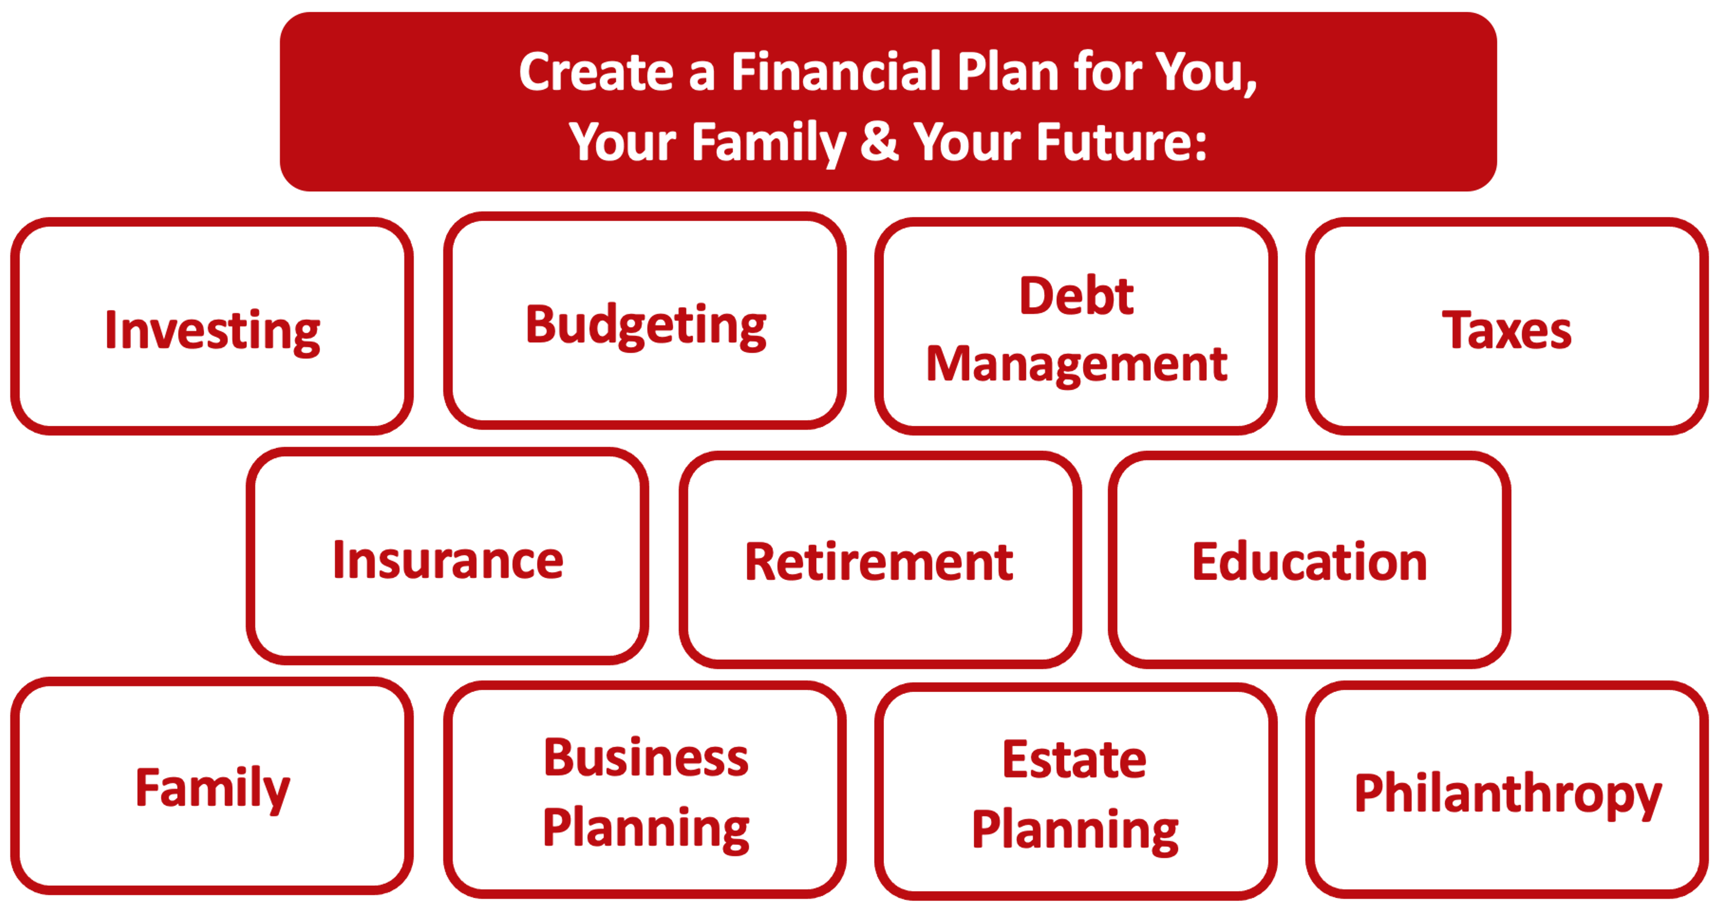

Slide 18
Owning Your Financial Future
YOUR VALUES
YOUR GOALS
Education
Career
Family
FINANCIAL STRATEGIES
Investing
Income & Expense Management
Debt Management
Taxes, Insurance & Other

Slide 19
Owning Your Financial Future
YOUR VALUES
YOUR GOALS
Education
Career
Family
FINANCIAL STRATEGIES
Investing
Income & Expense Management
Debt Management
Taxes, Insurance & Other

Slide 20
Making Financial Planning a Priority
EDUCATION STRATEGIES
GRAD SCHOOL STRATEGIES
Identify Your Resources
Identify Your Priorities & Goals
Do Your Planning
Monitor & Modify Your Progress & Plan

Slide 21
Making Financial Planning a Priority
FINANCIAL STRATEGIES
EDUCATION STRATEGIES
BUDGETING
STRATEGIES
GRAD SCHOOL STRATEGIES
Identify Your Income & Expenses
Identify Your Resources
Identify Your Priorities & Goals
Identify Your Priorities & Goals
Do Your Planning
Do Your Planning
Monitor & Modify Budgeting Activities
Monitor & Modify Your Progress & Plan

Slide 22
Making Financial Planning a Priority
FINANCIAL STRATEGIES
YOU,
as grad students, are better wired and equipped to make long-term plans – education, career, financial & otherwise – than 99% of humanity.
Be confident. Be intentional.
Be diligent.
Be awesome.
EDUCATION STRATEGIES
BUDGETING
STRATEGIES
GRAD SCHOOL STRATEGIES
Identify Your Income & Expenses
Identify Your Resources
Identify Your Priorities & Goals
Identify Your Priorities & Goals
Do Your Planning
Do Your Planning
Monitor & Modify Budgeting Activities
Monitor & Modify Your Progress & Plan

Slide 23
TODAY THE NEXT 6 MONTHS THE NEXT 12 MONTHS 2 YEARS AFTER GRADUATION 3 YEARS AFTER GRADUATION
ONCE EVERY SEMESTER:
TRACK EVERY PENNY THAT YOU SPEND & TRACK EVERY PENNY THAT YOU EARN
IN THE NEXT 3 MONTHS:
IDENTIFY WAYS TO DECREASE YOUR DISCRETIONARY SPENDING BY 25%
IN THE NEXT 6 MONTHS:
MAKE A PLAN TO MANAGE – AND PAY OFF – YOUR DEBT
IN THE NEXT 6-12 MONTHS:
OPEN MULTIPLE SAVINGS ACCOUNTS, 1 FOR EACH GOAL
IN THE NEXT 12 MONTHS, OPEN AN IRA OR ROTH IRA
WITHIN 2 YEARS OF GRADUATION:
HAVE AN “EMERGENCY FUND” ACCOUNT, WITH 3-6 MONTHS OF NON-DISCRETIONARY EXPENSES
WITHIN 3 YEARS OF GRADUATION:
ELIMINATE ALL OF YOUR BAD DEBT.

Slide 24
Financial Wellness
If you don’t know where you’ve come from, you can’t know where you’re going.
- Maya Angelou

Slide 25
Being a Professional
Being an Entrepreneur
Being an Academic

Slide 26
Being a Professional
Being an Entrepreneur
Being an Academic
Regardless of what you do in the future, a lot of what you do will make you feel like you’re an entrepreneur – from managing your own lab or grant program, to creating a research stream, to finding the career that fulfills you the most.

Slide 27
5 Things You Can Do To Reduce Your Taxes
Save as much as you can. Your cash flow might be unpredictable. You never know how long your cash flow is going to last.
Separate your personal and business activities. Get business bank accounts and credit cards.
Track every dollar you spend and every dollar you earn…both for your own goals and for tax planning.
Learn what tax issues are important to you. You have many obligations and responsibilities to pay taxes from your income; but there are also many opportunities to reduce your tax burden as an entrepreneur.

Slide 28
5 Things You Can Do To Reduce Your Taxes
Think about the type of legal entity you run. Sole proprietorships and partnerships are the default – but creating an LLC or corporation might protect you from liability.
Set up an Individual Retirement Account as soon as possible. Invest a little when you can – and watch it grow.
Develop your team. Who can help you achieve your mission? What advisors can make your life easier?
Create your personal biography. People want to know who you are and how you can make their life better.

Slide 29
5 Things You Can Do To Reduce Your Taxes
Open an Individual Retirement Account or Roth IRA
You can defer income tax and avoid capital gains tax altogether
Talk to HR and reduce your tax withholding
If you get a refund, you are loaning your income to the government
Cluster your income so you make less than $13,850 in a year
If possible, shift income between years to get the maximum deduction
Scan tax code and identify 3-5 deductions & credits you qualify for
Child tax credit, education expenses (tuition, books…), student loan interest, charitable deductions, small business or hobby-related expenses
Get rid of your income

Slide 30
Income Taxes in the U.S.
A few rules and definitions:
We only owe income taxes on income.
If you invest $1,000 and it grows to $1,500, you owe taxes on $500 only…when you sell.
There may be years when your taxable income – your income less deductible expenses – is negative. You may be able to apply these losses to the income you make in other years.
File and pay. There are penalties if you do not.
Taxes are based on cash. If cash changes hands, there are likely taxes owed. (You do not owe taxes when your $1,000 rises to $1,500; you owes taxes if you sell at $1,500 and recognize that $500 profit.)
You may need to file personal and business taxes as an entrepreneur.
The discussion that follows is only for U.S. federal tax policy. Most states have their own policies which will impose taxes in addition to those discussed here. Sorry.

Slide 31
Income Taxes in the U.S.
This limit of $73,000 is the same regardless of whether you are filing individually or married-jointly. Sorry.
If you make more than $73,000, most online tax software will cost you anywhere from $30 to $100 to do both federal and state filings.

Slide 32
Income Taxes in the U.S.
A few rules and definitions:
Tax Credits
A dollar-for-dollar reduction in taxes owed.
If you owe $2,500 in taxes for the year and find a $1,000 credit, your taxes owed will be reduced to $1,500.
We really really like tax credits.

Slide 33
Income Taxes in the U.S.
A few rules and definitions:
Tax Deductions
Qualifying reductions to your Taxable Income that will reduce how much Taxable Income you have…that may reduce the taxes you owe.
All filers are allowed the standard deduction ($13,850 for single, $27,700 for married). If your Taxable Income is less than this, you do not owe taxes.
Some deductions are above-the-line, reducing your Gross Income.
We really like these because we can also take the standard deduction.
We really like these because they lower the income we receive that may allow us to receive certain credits.
Examples: school tuition, fees, some student loan interest, some moving expenses, some health care expenses, contributions to an IRA

Slide 34
Income Taxes in the U.S.
Filing for income tax:
If you earn income in any given you, you are required to file an income tax return by the deadline (usually April 15, April 18 this year).
You are required to FILE, even if you do not OWE any taxes.
You might not OWE any taxes if your income is less than the standard deduction or allowance ($13,850 for single filers, $27,700 for married filers)
In general, we only owe taxes on income…or any compensation of value.
If your employer gives you a $50 Applebee’s gift card, that’s taxable income
And, as many of you know, stipends and tuition waivers for graduate students are generally considered taxable income (subject to limits and other fine-print).
You can reduce your taxable income with qualified deductions and credits.

Slide 35
Income Taxes in the U.S.
Filing for income tax – FOR INTERNATIONAL STUDENTS:
It’s important to be aware that, as a nonresident student in the US, you’re legally required to file a tax return if you received US income during 2022.
And even if you didn’t work or receive income in the US, you’re still obliged to file a Form 8843 with the IRS.
University of Louisiana at Lafayette has arranged discounted access to Sprintax Tax Preparation for you. Sprintax will guide you through the tax preparation process, arrange the necessary documents and check if you’re due a tax refund.
Sprintax was used by over 225,000 international students and scholars last year, and the average Federal refund received by eligible students was over $1,126.

Slide 36
Income Taxes in the U.S. (Cont.)
All you need to do is:
Register and follow the simple instructions
Complete the online questionnaire
Enter your unique discount code: 22ULL100F5 in the box on the ‘Review your order’ page
Sprintax will prepare your tax return here: https://taxprep.sprintax.com/?utm_ref=louisiana-edu

Slide 37
Tax Questions for International Students
Dr. Rose Honegger
Associate Director of Global Engagement
UL Lafayette Office of International Affairs
roseh@louisiana.edu

Slide 38
Example #1
You receive $15,000 of stipend as a graduate assistant.
You receive $12,000 of tuition forgiveness as a graduate assistant.
It is possible that you will have $27,000 of taxable income.
You pay $7,000 of course-related qualifying education expenses. These include tuition, fees, books, supplies and other required expenses.
It is possible that you now have $20,000 of taxable income.
Room, board, travel, personal research are not qualifying expenses.

Slide 39
Example #2
You are a graduate student.
You are 23 years old.
Your parents claim you as a dependent.
That helps them and they get the good deductions & credits.
You will still have to file a return – and possibly pay taxes – if your income exceeds a certain amount (but you will not get the good deductions & credits that your parents take).

Slide 40
Example #3
You are a graduate student.
You had a baby this year.
First, I admire your bravery having a child while in grad school.
Second, you are now eligible for bigger & better credits and deductions.
You do not (really) get any “graduate student having a child” benefits…other than the benefits any non-graduate student would receive.
You now have a dependent that can improve your tax status.
You may get a Child Tax Credit ($2,000 per child under 17).
This has changed in the past year and the amount has been reduced. So be careful.

Slide 41
Example #3
You are a graduate student.
You had a baby this year.
First, I admire your bravery having a child while in grad school.
Second, you are now eligible for bigger & better credits and deductions.
If you’re single, you might become a Head of Household instead of Single
You may qualify for the Child & Dependent Care Credit ($1,050 per dependent).
Lower income taxpayers may receive the Earned Income Credit.
Your hospital bills/fees may be above-the-line deductions.

Slide 42
Example #3
You are a graduate student.
You had a baby this year.
First, I admire your bravery having a child while in grad school.
Second, you are now eligible for bigger & better credits and deductions.
Your key to getting these benefits: get the kid a social security number.
Tell your employer. Change your withholding.
If you think your child is going to go to college, consider establishing a 529 savings plan as soon as possible…even if you don’t have much money to contribute yet.
A Coverdell Education Savings Account is another option…which can be used to pay for elementary and high school expenses (not just tuition).

Slide 43
Example #4
You are a graduate student.
You are also a full-time employee (not at UL).
You have been working remotely since March 2020.
Can you take receive home office deductions and benefits?
Nope, probably not.
If an employer is paying you, they get the deduction for your remoteness.
They should be paying to set up any facilities or technology.
If the home office is required for the purpose of the work, you may be eligible for savings…such as a hotel manager having to live at the hotel to be the manager.
For entrepreneurs, the home office must be the primary place of work. And the work must be regular and exclusive. This is pretty rare.

Slide 44
Example #5
You are a graduate student.
What credits and deductions are available in general?
The Lifetime Learning Credit, which refunds 20 percent of up to $10,000 of qualified expenses, providing students with up to $2,000.
The Tuition and Fees Deduction, which allows students to deduct up to $4,000 of qualified higher education expenses. The IRS defines qualified higher education expenses as tuition and fees paid directly to the institution. The cost of books, supplies and other equipment is generally not deductible under this rule unless this money is paid directly to the institution as a condition of enrollment and attendance. We mentioned this earlier.

Slide 45
Example #5a
You are a graduate student.
What credits and deductions are available in general?
Is a computer a “qualified higher education expense?”
This is a gray area. Here’s the IRS answer to this question.
If the computer is a personal use asset that you use as a student for convenience and to enhance your education, then it is probably NOT a qualified education expense.
If the computer is required by the institution, if it is essential to being a student, if you would not have the computer if you were not in school, then you may be able to take a credit or deduction for the expense of the computer.
Online program students might be able to make a better case that the computer is essential.
All students might be able to justify unique software they had to purchase for their program, as it is less likely they would have had the software if not in the program.

Slide 46
Example #6
You are a graduate student.
You file as a single taxpayer (thus, have a $1,850 standard deduction).
What are some tax planning / clustering strategies?
Imagine you want to donate $10,000 to your favorite charity every year.
If you donate $10,000 each year and do not have any other allowable deductions, you will claim the standard deduction of $13,850 every year. That’s okay.
If you donate $20,000 this year and $0 next year, you will claim $20,000 in itemized deductions this year and the standard deduction of $13,850 next year. That’s much better.
The point is…by clustering deductions and credits, when you have a choice, you may be able to get larger benefits without any significant costs on your part. Tax strategy is not tax evasion.

Slide 47
Example #7
You are a graduate student or any other type of taxpayer.
Do you really want a tax refund?
Of the two scenarios on the following slide, which do you prefer?

Slide 48
Example #7
January $1,200
February $1,200
March $1,200
April $1,200
May $1,200
June $1,200
July $1,200
August $1,200
September $1,200
October $1,200
November $1,200
December $1,200
January $0
February $0
March $3,600
Total Income
$18,000

Slide 49
Example #7
January $1,500
February $1,500
March $1,500
April $1,500
May $1,500
June $1,500
July $1,500
August $1,500
September $1,500
October $1,500
November $1,500
December $1,500
January $0
February $0
March $0
Total Income
$18,000

Slide 50
Example #7
January $1,200
February $1,200
March $1,200
April $1,200
May $1,200
June $1,200
July $1,200
August $1,200
September $1,200
October $1,200
November $1,200
December $1,200
January $0
February $0
March $3,600
January $1,500
February $1,500
March $1,500
April $1,500
May $1,500
June $1,500
July $1,500
August $1,500
September $1,500
October $1,500
November $1,500
December $1,500
January $0
February $0
March $0
Total Income
$18,000
Total Income
$18,000

Slide 51
Example #7
You are a graduate student or any other type of taxpayer.
Do you really want a tax refund?
I do not want a tax refund.
I get the same amount of money either way.
I would rather get MY money sooner and not make an interest-free loan to the government.
The sooner I get MY money, the sooner I can invest it or use it to pay down debt.
HOWEVER….if your brain is not good at saving and investing relatively small amounts, and you’re more likely to take the $3,600 refund in the previous example and invest it in savings or debt reduction, then maybe getting the tax refund makes some sense.
But please do try to get to the point where you can save and invest smaller amounts regularly.

Slide 52
Example #8
You are a graduate student.
You are married.
Should you file each individually or married-filing-jointly?
As always, it depends…It depends on the income of each spouse and the deductions & credits that each spouse is eligible for.
Both spouses are NOT allowed to take the same deductions & credits on their own returns.
So you want to be strategic and do the math to see where your combined tax liability is lowest.
Perhaps you file individually and the higher-income spouse claims all of the deductions & credits to reduce their income the most.
If there is a big difference in your incomes, you may be able to strategically lower your tax liability by filing individually (in theory).
It all depends on your situations. My advice: Look at both options and choose the better one.

Slide 53
Some General Rules & Advice
Track & categorize every penny that you earn. If you’re getting it, assume someone else is claiming it as an expense.
Track & categorize every penny that you spend…for school and for any side-hustles you may have. You may be able to claim these as business or qualifying deductions that can lower your tax bill.
Taxes are based on cash – things are taxable when cash is exchanged.
This means your academic year expenses will spread across 2 tax years.
Having a baby on December 31 is better than having one on January 1.
Think about clustering cash flows – if possible – to benefit across tax years.
Maybe make 1 big charitable donation in 1 year rather than 2 smaller donations in years.
Communicate and plan with your family.

Slide 54
Turning a Side Hustle Into a Business
Separate Your Business & Personal Lives
Build Your Team – Accounting, Tax, Law
Create a Business Plan
Write Your Personal Biography
Establish Finance & Accounting Systems
Document & Track Everything
Create Business & Personal Financial Plans
We want to create this structure so that we can benefit as much as possible from business tax deductions

Slide 55
Happiness
Long-Term Goals
Short-Term Goals
Financial Needs
Family Needs

Slide 56
One Very Common Question
I have short-term wants and needs…including school, family, rent.
I have long-term wants and needs…including a new house, a family, education for my children and my own retirement.
As a graduate student, it is very difficult to focus on all of these right now. How do I balance the financial planning of each goal?

Slide 57
One Very Common Question
I have short-term wants and needs…including school, family, rent.
I have long-term wants and needs…including a new house, a family, education for my children and my own retirement.
As a graduate student, it is very difficult to focus on all of these right now. How do I balance the financial planning of each goal?
Right now, it’s about priorities.
Your immediate priorities my be your education and your family.
The balance will come from the habits you develop during graduate school.
The balance will come from you creating different plans for your education, your family, your career and your finances.
Being aware of the trade-offs is a big first step.

Slide 58
One Very Common Question
I have short-term wants and needs…including school, family, rent.
I have long-term wants and needs…including a new house, a family, education for my children and my own retirement.
Just like with your education, your goals will not achieve themselves. You have to make them happen.
But you are all expert at time management and focusing on priorities: research, exams, thesis, family. You are all expert at balancing your short-term and longer-term graduate school priorities.
As you develop your financial goals and plans, the habits you’ve developed with your education can be applied to all other plans you have in life…including your financial plans.
Be aware, be thoughtful, be intentional, be patient.

Slide 59
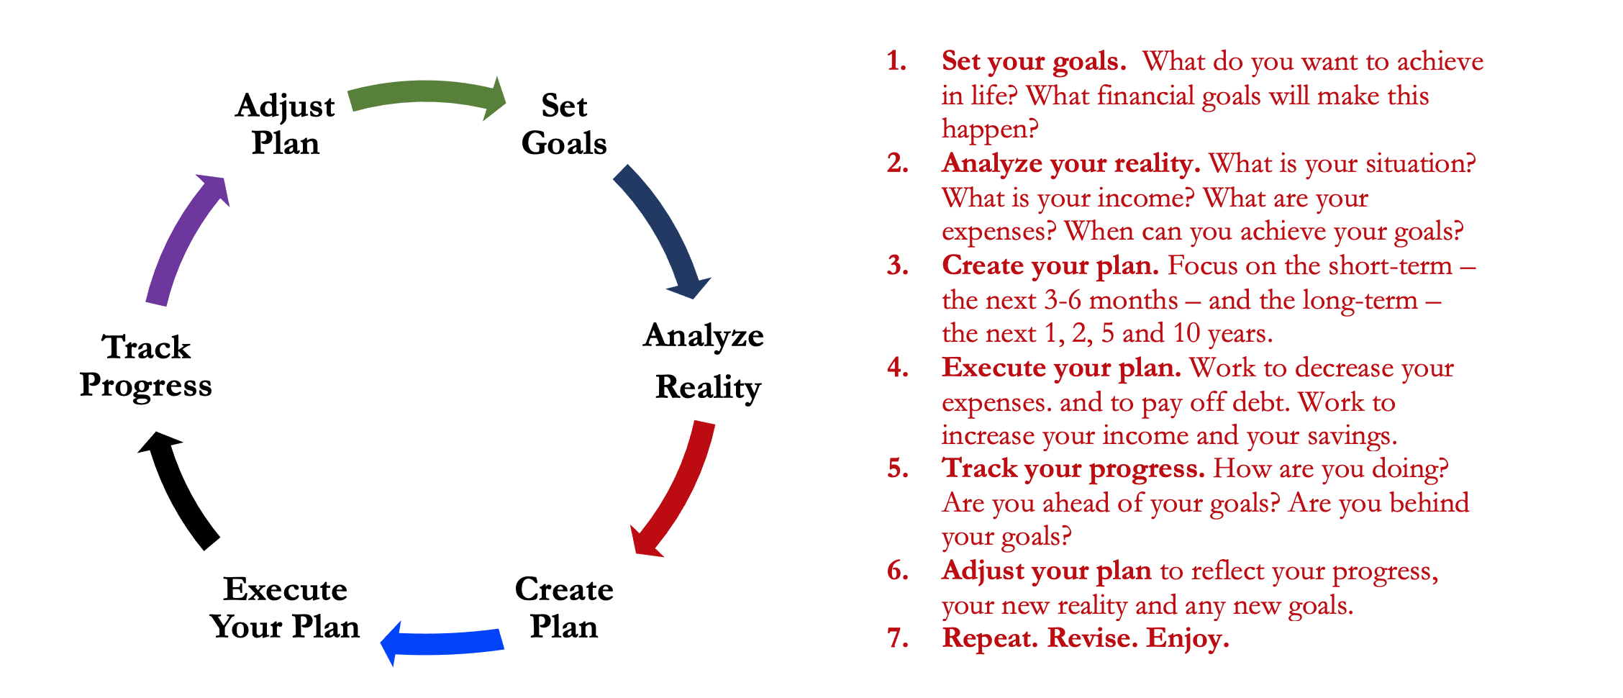
Isn’t this a lot like what you do with your education planning?

Slide 60
You’ve been doing this with your education for years.
You’re about to begin doing this with your career…and you will continue working through this process for the next 30 or 40 years.
Whether it’s education planning or career planning, by now we know that all of our personal decisions with have financial implications.
The more we plan ahead and integrate our decision-making process, the more control we will have over our futures…and the less money will be a source of stress and the more money will be a source of empowerment.
Isn’t this a lot like what you do with your education planning?

Slide 61
Making Debt Management a Part of Your Plan
FINANCIAL STRATEGIES
EDUCATION STRATEGIES
BUDGETING
STRATEGIES
GRAD SCHOOL STRATEGIES
Identify Your Income & Expenses
Identify Your Resources
Identify Your Priorities & Goals
Identify Your Priorities & Goals
Do Your Planning
Do Your Planning
Monitor & Modify Budgeting Activities
Monitor & Modify Your Progress & Plan

Slide 62
Making Debt Management a Part of Your Plan
FINANCIAL STRATEGIES
YOU,
as grad students, are better wired and equipped to make long-term plans – education, career, financial & otherwise – than 99% of humanity.
Be confident. Be intentional.
Be diligent.
Be awesome.
EDUCATION STRATEGIES
BUDGETING
STRATEGIES
GRAD SCHOOL STRATEGIES
Identify Your Income & Expenses
Identify Your Resources
Identify Your Priorities & Goals
Identify Your Priorities & Goals
Do Your Planning
Do Your Planning
Monitor & Modify Budgeting Activities
Monitor & Modify Your Progress & Plan

Slide 63
FINAL TAX TIPS
Tax returns (and payments) due by Tuesday, April 18.
You may be eligible for an extension…but you have to request it.
If you have income of any kind, you must file a return.
There are penalties if you do not file or pay.
Track every penny of income and of expenses…you never know when it will help you lower your tax return.
If you live in Louisiana, you might owe state income taxes, too.
Think strategically. Being proactive can make your life much better.

Slide 64
Owning Your Financial Future: Spring 2023
FINANCIAL PLANNING FOR INTERNATIONAL STUDENTS
Thursday, January 19
INVESTING, PART 1
TODAY – Wednesday, February 1
TAX PLANNING STRATEGIES
Tuesday, February 28
INVESTING, PART 2
Tuesday, March 21
CAREER PLANNING & FINANCIAL PLANNING
Thursday, April 20

Slide 65
Don’t wait around for other people to be happy for you.
Any happiness you get,
You’ve got to make yourself.
~ Alice Walker, poet & novelist
A goal without a plan is just a dream.
Wealth is largely the result of habit.
The most difficult thing is the decision to act; the rest is mere tenacity.
It takes as much energy to plan as it does to wish.
You cannot escape the responsibility of tomorrow by avoiding it today.

Slide 66
brian.bolton@louisiana.edu http//:business.louisiana.edu/financeispersonal

Slide 67
gradschool@louisiana.edu

