Slide 1

MONEY MATTERS
SESSION #7 – INVESTING
Growing your assets to achieve your personal & professional goals.
Manage Your Money Today
Maximize Your Money in the Future
March 30, 2022

Slide 2
Owning Your Financial Future
YOUR VALUES
YOUR GOALS
Education
Career
Family
FINANCIAL STRATEGIES
Investing
Income & Expense Management
Debt Management
Taxes, Insurance & Other

Slide 3
Owning Your Financial Future: Spring 2022
FINANCIAL PLANNING FOR INTERNATIONAL STUDENTS
Today, January 19
TAX PLANNING
Wednesday, February 9
DEBT & STUDENT LOAN MANAGEMENT
Tuesday, March 15
INVESTING
Wednesday, March 30
CAREER PLANNING & FINANCIAL PLANNING
Wednesday, April 13

Slide 4
Owning Your Financial Future: Spring 2022
FINANCIAL PLANNING FOR INTERNATIONAL STUDENTS
Today, January 19
TAX PLANNING
Wednesday, February 9
DEBT & STUDENT LOAN MANAGEMENT
Tuesday, March 15
INVESTING
Wednesday, March 30
CAREER PLANNING & FINANCIAL PLANNING
Wednesday, April 13

Slide 5
Owning Your Financial Future
YOUR VALUES
YOUR GOALS
Education
Career
Family
FINANCIAL STRATEGIES
Investing
Income & Expense Management
Debt Management
Taxes, Insurance & Other

Slide 6
Brian’s Economic Predictions for 2022
Inflation is at a 40-year high. It’s at 8% now.
  My best case estimate is for it to be at 5% in 12 months. It could be 12%.
Interest rates are going up. This will affect future borrowing costs.
  Interest rates on savings accounts are the last to go up when rates increase.
The Russian invasion of Ukraine will continue to cause economic turbulence through the year.
  Turbulence = Uncertainty, disruption to supply chains, shocks out of nowhere.
The job market will continue to be very strong.
  Salaries for college graduates are at all-time highs. I expect this to continue.
  But, there will be unexpected shocks…as companies try to figure out how to do business in 2022.

Slide 7
Brian’s Economic Predictions for 2022
Inflation is at a 40-year high. It’s at 8% now.
  My best case estimate is for it to be at 5% in 12 months. It could be 12%.
Interest rates are going up. This will affect future borrowing costs.
  Interest rates on savings accounts are the last to go up when rates increase.
The Russian invasion of Ukraine will continue to cause economic turbulence through the year.
  Turbulence = Uncertainty, disruption to supply chains, shocks out of nowhere.
The job market will continue to be very strong.
  Salaries for college graduates are at all-time highs. I expect this to continue.
  But, there will be unexpected shocks…as companies try to figure out how to do business in 2022.
PLAN
AHEAD

Slide 8
Today’s Agenda
Some strategies for investing
  Getting started
  Different investment options
  The importance of investing
The questions you submitted
Some investing advice from Andrew Tregre
More questions from you

Slide 9
Why Are You Here?
Take a few seconds to ask yourself these 2 questions:
Why Are You in Graduate School?
What will you be doing in 5 years?

Slide 10
Why Are You Here?
Why do I think you are here?
I think you are here to think about your financial situation.
I think you are here to begin developing a financial plan.
I think you are here today to gain better control over your income and expenses to help you:
Eliminate some stress associated with being a grad student.
Maximize your goals over the long-term.

Slide 11
Investing – How Do You Do It?
When you’re just getting started with investing, there are a few approaches you can take:
  Start with a small amount of money – whether that’s $20 or $2,000 – and just go for it. Pick a few investments, track them regularly and be prepared to buy more or sell more should you feel comfortable doing either.

Slide 12
Investing – How Do You Do It?
When you’re just getting started with investing, there are a few approaches you can take:
  Start with a small amount of money – whether that’s $20 or $2,000 – and just go for it. Pick a few investments, track them regularly and be prepared to buy more or sell more should you feel comfortable doing either.
  Determine how much you have to invest.
    Put ½ of that into an index fund or a specific mutual fund. This will provide some security, generally with less or moderate risk.
    Put the other ½ into individual stocks or securities that intrigue you. If you’re interested in the companies, you might be more likely to follow them as investments.
    This half-half approach will help you figure out what kind of investor you are. In 1-2 years, you might gravitate more to either of the approaches that interest you more.

Slide 13
Investing – How Do You Do It?
When you’re just getting started with investing, there are a few approaches you can take:
  Start with a small amount of money – whether that’s $20 or $2,000 – and just go for it. Pick a few investments, track them regularly and be prepared to buy more or sell more should you feel comfortable doing either.
  Determine how much you have to invest.
    Put ½ of that into an index fund or a specific mutual fund. This will provide some security, generally with less or moderate risk.
    Put the other ½ into individual stocks or securities that intrigue you. If you’re interested in the companies, you might be more likely to follow them as investments.
    This half-half approach will help you figure out what kind of investor you are. In 1-2 years, you might gravitate more to either of the approaches that interest you more.
  Talk to a financial advisor. Note that they generally do not (initially) tell you which specific investments to make, but they will work talk through your options with you and help you better understand what you’re getting into.
    They will ask you 2 questions – what are your goals and what is your risk tolerance – and then work with you to find the investments that best align with your answers to these questions.

Slide 14
Long-Term Investment Planning
YOUR VALUES
YOUR GOALS
FINANCIAL STRATEGIES
INVESTMENT STRATEGIES
Identify Your Risk Tolerance
Identify Your Time Horizons
Select Investments
Monitor & Modify Investments

Slide 15
Long-Term Investment Planning
FINANCIAL STRATEGIES
INVESTMENT STRATEGIES
Identify Your Risk Tolerance
Identify Your Time Horizons
Select Investments
Monitor & Modify Investments

Slide 16
Long-Term Investment Planning
FINANCIAL STRATEGIES
EDUCATION STRATEGIES
INVESTMENT STRATEGIES
GRAD SCHOOL STRATEGIES
Identify Your Risk Tolerance
Identify Your Risk Tolerance
Identify Your Time Horizons
Identify Your Time Horizons
Select Investments
Select Your Field, Program, Specialization, Thesis
Monitor & Modify Investments
Monitor & Modify Your Progress & Plan

Slide 17
Long-Term Investment Planning
FINANCIAL STRATEGIES
YOU,
as grad students, are better wired and equipped to make long-term plans – education, career, financial & otherwise – than 99% of humanity.
Be confident.
Be intentional.
Be diligent.
Be awesome.
EDUCATION STRATEGIES
INVESTMENT STRATEGIES
GRAD SCHOOL STRATEGIES
Identify Your Risk Tolerance
Identify Your Risk Tolerance
Identify Your Time Horizons
Identify Your Time Horizons
Select Investments
Select Your Field, Program, Specialization, Thesis
Monitor & Modify Investments
Monitor & Modify Your Progress & Plan

Slide 18
I DO NOT GIVE INVESTMENT ADVICE
But here are some investment issues to think about:
Do you want to pick individual stocks (or other securities) and monitor them regularly?
  This can help you feel more control, more connection and more personal interest in your investments.
  Advantages: Potential for big gains, maybe a personal connection to the companies, you feel more engaged with the process.
  Disadvantages: Potential for big losses, requires more time and energy, transaction costs (trading, taxes) can add up, there are 1000s to choose from, potential loss of sleep and hair.

Slide 19
I DO NOT GIVE INVESTMENT ADVICE
But here are some investment issues to think about:
Or, would you be content investing in mutual funds and/or market indexes that pool dozens or hundreds of stocks?
  Advantages: Potential for moderate gains, lower risk (through diversification), lower trading and tax costs, you can narrow down the selection pretty quickly, less loss of sleep and hair
  Disadvantages: Lots of singles and doubles but no home runs, no emotional connection to your investments, susceptible to big market downturns (but not necessarily more than individual stocks)

Slide 20
I DO NOT GIVE INVESTMENT ADVICE
If you want to invest in individual stocks, I cannot help you.
But if you are interested in market indexes, here are some ideas:
  SPY – The S&P 500 index. 500 of the largest U.S. firms, from all industries.
  SPYD – The same as above, with a focus on those companies that pay regular dividends out to investors from their earnings. You will get more income, but possibly lower long-term capital gains.
  IWM – The Russell 2000. 2000 smaller U.S. firms (the 2000 firms after the 1000 largest firms). More volatility, possibly higher returns.
  EFA – Index of non-US firms (Europe, Far East, Australasia). Big firms.
  EEM – Index of non-US, emerging market stocks. Bigger firms in developing countries. More risk than any of the above.
  GBTC – A Bitcoin index. Invest in Bitcoin without mining or owning. Big Risk.

Slide 21

Isn’t this a lot like what you do with your education planning?

Slide 22
Determining Your Risk Tolerance
High Risk Attitude
I want to summer in Paris and winter in Hawaii
Medium-High Risk Attitude
I will work through normal retirement age, but I want my spouse to retire early - and we want to visit Paris & Hawaii
Medium-Low Risk Attitude
I want my children to have a college education
Low Risk Attitude
I want food on the table and a roof over my head

Slide 23
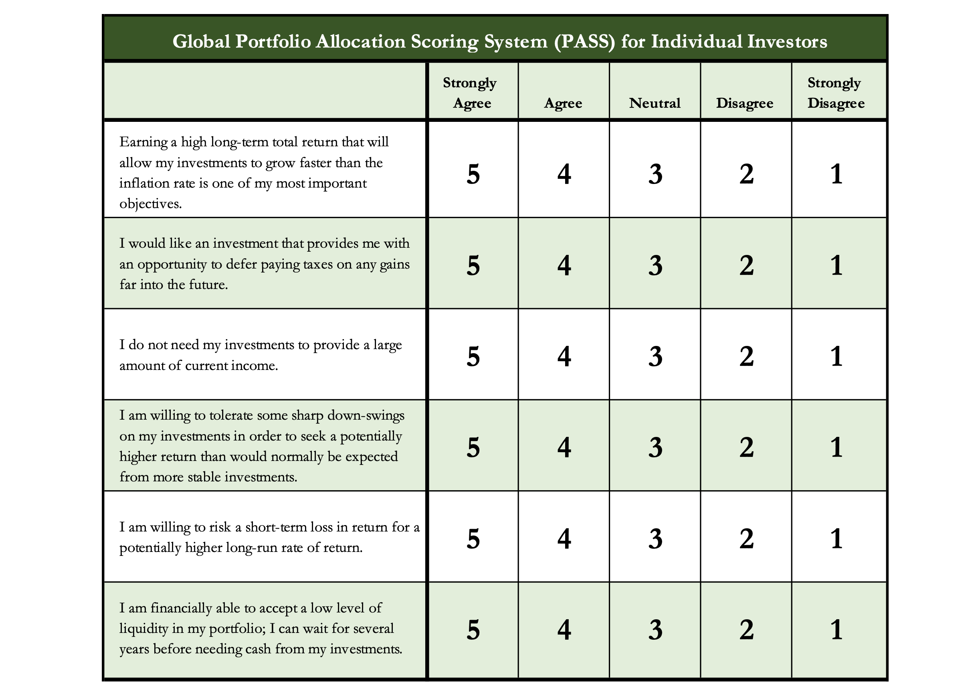
Determining Your Risk Tolerance

Slide 24
Comparing Different Investments

Slide 25
Comparing Different Investments

Slide 26
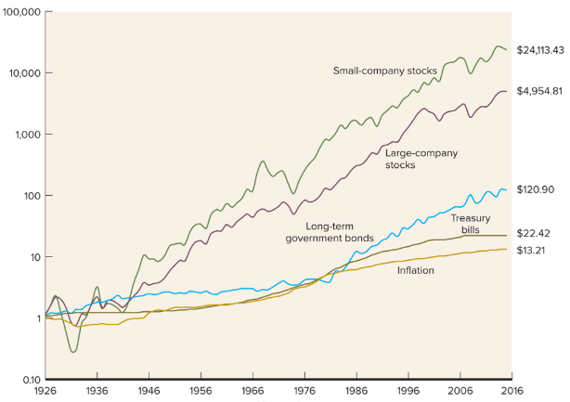
Comparing Different Investments

Slide 27
The Magic of Compound Returns

Slide 28
The Magic of Compound Returns

Slide 29
The Magic of Compound Returns
Quiz Question on Compound Returns:
Under which of the following scenarios will you have more money saved when you turn 65?
Investing $100 per month from age 25-35 (and then nothing from 35-65)
With an 8% return, you will have $185,000 accumulated at 65.
Investing $100 per month from age 35-65 (but nothing from 25-35)
With an 8% return, you will have $150,000 accumulated at 65.
(Note: If the returns on your investments are less than 6%, (B) will lead to greater wealth)

Slide 30
The Magic of Compound Returns
Quiz Question on Compound Returns:
Under which of the following scenarios will you have more money saved when you turn 65?
Investing $100 per month from age 25-35 (and then nothing from 35-65)
With an 8% return, you will have $185,000 accumulated at 65.
Investing $100 per month from age 35-65 (but nothing from 25-35)
With an 8% return, you will have $150,000 accumulated at 65.
(Note: If the returns on your investments are less than 6%, (B) will lead to greater wealth)

Slide 31
Questions From You #1
Is it worth working with an investment company if you are new to the stock market and investing? Is this affordable?
The best things that investment companies provide are:
  An investment strategy.
  Peace of mind.
Investment advisors can provide the best guidance when:
  You are just getting started.
  You have specific investment issues - education, retirement, business.
  You are retiring.

Slide 32
Questions From You #2
When you have a stock that appreciates in value, do you have to sell
the entire stock to gain the profits?
Answer: Maybe. Or, kind of.
Assume you bought 1 share for $100.
Assume it increased to $120.
You do have to sell entire share to get the $120 cash.
  And you will owe taxes just on the gain of $20.

Slide 33
Questions From You #2
When you have a stock that appreciates in value, do you have to sell
the entire stock to gain the profits?
Answer: Maybe. Or, kind of.
Assume you bought 5 shares for $20 each for a total investment of $100.
Assume each share increased to $24, making the value of your investment $120.
You can sell 1 share for $24 and leave the other $96 invested.
  And you will owe taxes just on the gain of $4 on the single share.

Slide 34
Questions From You #2
When you have a stock that appreciates in value, do you have to sell
the entire stock to gain the profits?
Answer: Maybe. Or, kind of.
Assume you bought 5 shares for $20 each for a total investment of $100.
Assume each share increased to $22, making the value of your investment $110.
At the end of the year, the company paid a $2-per-share cash dividend to you. You get this 2 x 5 = $10 cash income without selling anything – and you still have $110 invested in the company.
  And you will owe income taxes just on the $10 in dividends.

Slide 35
Questions From You #3
During graduate school, what are the different ways to invest the stipend…considering the stipend probably will stay constant regardless of inflation or other economic issues?
This will be different for everyone…but let’s generalize:
Let’s assume you’re investing for to buy a house in 5 years.
Let’s assume your monthly stipend is in the 100s of dollars (not 10s of thousands).
Let’s assume that inflation stays high for at 1-2 more years.
Let’s assume you graduate in 12 months.

Slide 36
Questions From You #3
During graduate school, what are the different ways to invest the stipend…considering the stipend probably will stay constant regardless of inflation or other economic issues?
Let’s assume you’re investing for to buy a house in 5 years.
  You probably want-need some appreciation – especially if we assume that home prices will continue to grow.
  This means you want to invest for moderate returns.
  But you don’t want to risk big losses to meet your 5-year goal.
    Gamestop lost 80% of its value last spring…before doubling in the past year.
    Bitcoin lost 50% of its value several times in the past 5 years…even though it’s 20x where it was 5 years ago.

Slide 37
Questions From You #3
During graduate school, what are the different ways to invest the stipend…considering the stipend probably will stay constant regardless of inflation or other economic issues?
Let’s assume your monthly stipend is in the 100s of dollars (not 10s of thousands).
Mutual funds allow you invest relatively small amounts of money.
  From $10 to $100…without fees or management costs, usually.
Fractional shares or stock slices are one of the coolest innovations in years.
  Some – but not all – brokers will let you buy a fraction of some – but not all – stocks for a fraction of the price.
  One share of Amazon costs $3,400. Stock slices let you own Amazon for as little as $5.

Slide 38
Questions From You #3
During graduate school, what are the different ways to invest the stipend…considering the stipend probably will stay constant regardless of inflation or other economic issues?
Let’s assume that inflation stays high for at 1-2 more years.
Cash is likely to be a bad investment.
  It provides security and peace of mind, but your interest rate might be below the inflation rate for a while. This is (one reason) why retirees really hate inflation.
Bonds are likely to be a bad investment.
  Because they pay fixed returns…and do not adjust for inflation.

Slide 39
Questions From You #3
During graduate school, what are the different ways to invest the stipend…considering the stipend probably will stay constant regardless of inflation or other economic issues?
Let’s assume that inflation stays high for at 1-2 more years.
Different types of stocks might be disproportionately affected.
  Will you continue to buy shampoo and milk as prices increase?
  Will you buy a new car or computer as prices increase?
  “Value” stocks might be better than “Growth” stocks.
  This is one of the arguments for working with an investment advisor and against passive investment strategies using index and mutual funds.

Slide 40
Questions From You #3
During graduate school, what are the different ways to invest the stipend…considering the stipend probably will stay constant regardless of inflation or other economic issues?
Let’s assume that inflation stays high for at 1-2 more years.
Some advisors and investors like moving to commodities in times of inflation:
  Gold, oil, wheat…
  Some commodities will be disproportionately affected by the sanctions on Russia & the war
  Bitcoin and other crypto?
    It’s had a great month. It hasn’t had a super past 6 months during inflation.
    It could be a nice inflation hedge, but it might be too soon to really now how effective it is (and what is driving how much it has increased over the past month).

Slide 41
Questions From You #4
How do you invest?
What does it mean to invest?
When you invest, how do you know if you should pull money out or not?
Won’t you lose the gains you would have made had you kept it in longer?
How might the war affect stocks and how do we know if we should buy, hold, or sell?
What are general trends associated with stocks?
Stocks vs bonds?

Slide 42
A Small Reminder
Throughout these sessions, we have encouraged you to communicate with your partners, spouses and families about your financial situations and financial goals.
We know that financial issues are cited as the #1 or #2 reason for divorce in the U.S.
Financial advisors always cite debt management as the primary financial issue that families struggle with.
Communication, trust and openness obviously matter in relationships…and knowing each other’s financial situation allows you to create a plan for sharing your future together.
Talk to your partners, talk to your children.
And ask your parents about their financial situations. They may
not want to talk about it, but it may impact your future.

Slide 43
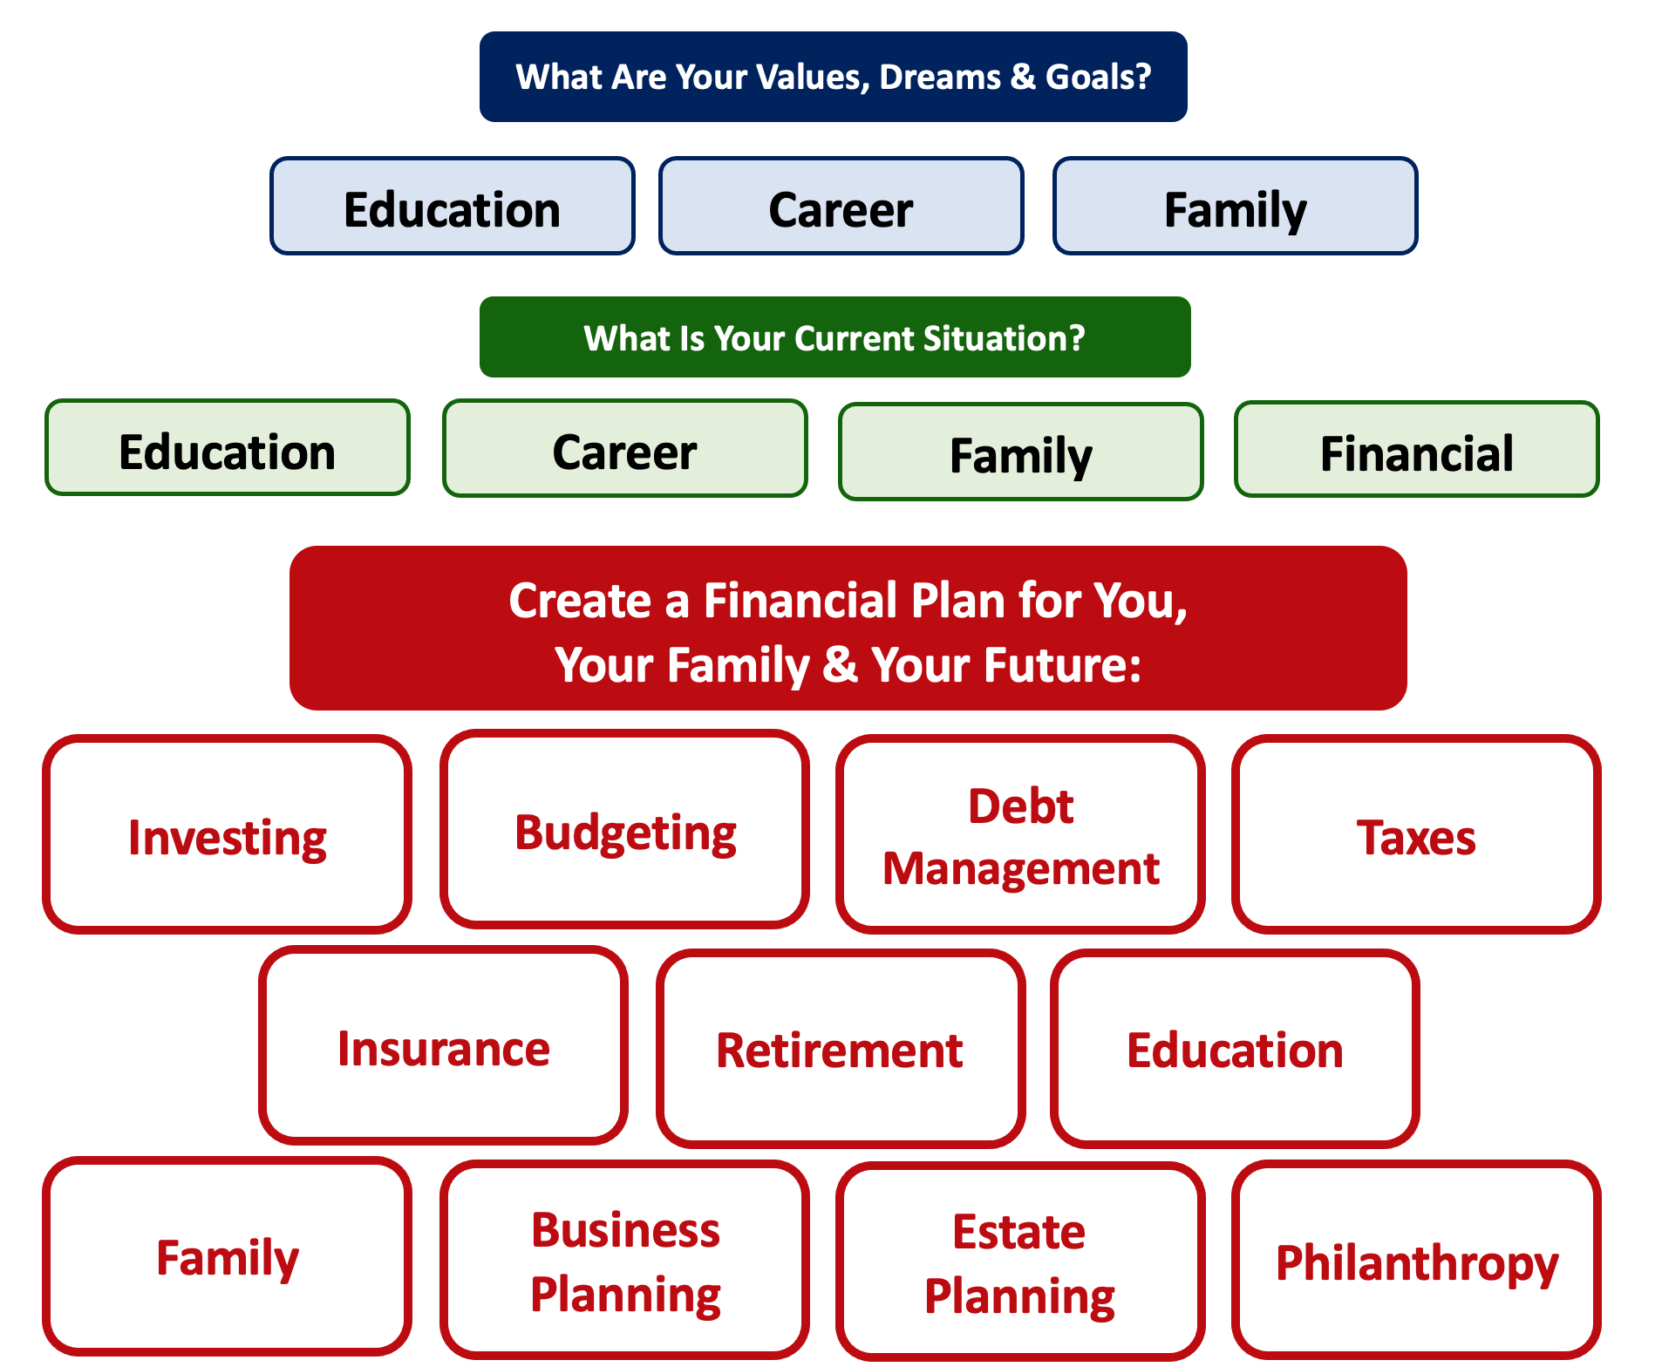

Slide 44
For most of us,
Investing is what will help us achieve our long-term goals.
But we have to have the money available to invest before we begin investing.
This will come from income & expense management, from debt management and from career planning.

Slide 45

Review From Prior Sessions
I utilize 4-5 different accounts on a regular basis, as defined below. This allows me to mentally align my finances with my goals, kind of like how I use 3 credit cards with 3 different purposes each.
Checking & Transaction Account
No risk,
0.0% return,
all cash
Short-to-Medium Term Goals
Some risk,
0-3% return goals,
cash + savings
Long-Term
Goals
Some Risk,
3-7% return goals,
savings + investments
Retirement
Accounts
Lots of risk,
8-12% return goals,
all investments

Slide 46
Review: A Few Rules About INVESTING
Investing lets COMPOUND INTEREST be your friend.
  With compound interest, your interest earns interest.
  Without actively making decisions, your money can grow exponentially.
  Yes, there is risk – the exponential growth rate could be negative.
  Such risk is greatest if you ‘invest’ over very short periods of time.
  Historically, over the past 100+ years, if you invest for 5+ years, you have benefited from positive exponential growth.
  The average return of a common stock over the past 100 years is 10%.
    The word ’average’ is very important here. But, the good news, we can all achieve ‘average’ returns relatively easily (though they may not be 10% in the future)

Slide 47
Review: A Few Rules About INVESTING
Investing lets COMPOUND INTEREST be your friend.
  With compound interest, your interest earns interest.
  Without actively making decisions, your money can grow exponentially.
  Yes, there is risk – the exponential growth rate could be negative.
  Such risk is greatest if you ‘invest’ over very short periods of time.
  Historically, over the past 100+ years, if you invest for 5+ years, you have benefited from positive exponential growth.
  The average return of a common stock over the past 100 years is 10%.
    The word ’average’ is very important here. But, the good news, we can all achieve ‘average’ returns relatively easily (though they may not be 10% in the future)
Not to be too esoteric or philosophical…
But compound interest doesn’t just apply to investing.
Compound interest applies to all aspects of grad school life:
Time Management
Mental Health
Health Management
Writing Skills
Relationships
And…Of course, Money Management

Slide 48
Review: A Few Rules About INVESTING
Investing lets COMPOUND INTEREST be your friend.
  With compound interest, your interest earns interest.
  Without actively making decisions, your money can grow exponentially.
  Yes, there is risk – the exponential growth rate could be negative.
  Such risk is greatest if you ‘invest’ over very short periods of time.
  Historically, over the past 100+ years, if you invest for 5+ years, you have benefited from positive exponential growth.
  The average return of a common stock over the past 100 years is 10%.
    The word ’average’ is very important here. But, the good news, we can all achieve ‘average’ returns relatively easily (though they may not be 10% in the future)
YOU, as grad students, are better wired and equipped to make long-term plans – education, career, financial & otherwise – than 99% of humanity.
Be confident. Be intentional.
Be diligent. Be awesome.

Slide 49
Developing An Investing Mindset
Investing – like budgeting – is as much
a mental game than a financial process.
Get in the habit of investing – at least a little bit – regularly over your professional life.
Delaying gratification is what you’re doing with your education – use investing to achieve your long-term personal goals.
Explore tax-preferred investing options – with an advisor or on your own. The IRS likes it when you invest in houses, in education and in retirement…and the IRS gives you tax benefits for doing so.
In investing, time is usually your best friend. Use it, don’t waste it.

Slide 50
Developing An Investing Mindset
If you have a spouse, partner, family or others who are affected by your investing decisions….
….Talk to them. Make investing a team effort.
Research on personal finance shows that couples feel more empowered and develop a closer, stronger relationship when they share financial goals, decisions and strategies with each other.

Slide 51
Isn’t this a lot like what you do with your education planning?

Slide 52
And as you begin to develop your full financial plan – seeing the trade-offs with Budgeting, Investing and Debt Management – you will begin to see how interconnected all of these aspects are.
Finance is just a matter of managing money across time.
And one thing we know about time is that our plans will change – so the better you have control of your initial financial plan, the more you will be able to adjust when life and time give you new goals.
Isn’t this a lot like what you do with your education planning?

Slide 53
Making Debt Management a Part of Your Plan
FINANCIAL STRATEGIES
EDUCATION STRATEGIES
BUDGETING
STRATEGIES
GRAD SCHOOL STRATEGIES
Identify Your
Income & Expenses
Identify Your Resources
Identify Your
Priorities & Goals
Identify Your
Priorities & Goals
Do Your Planning
Do Your Planning
Monitor & Modify Budgeting Activities
Monitor & Modify Your Progress & Plan

Slide 54
Making Debt Management a Part of Your Plan
FINANCIAL STRATEGIES
YOU,
as grad students, are better wired and equipped to make long-term plans – education, career, financial & otherwise – than 99% of humanity.
Be confident.
Be intentional.
Be diligent.
Be awesome.
EDUCATION STRATEGIES
BUDGETING
STRATEGIES
GRAD SCHOOL STRATEGIES
Identify Your
Income & Expenses
Identify Your Resources
Identify Your
Priorities & Goals
Identify Your
Priorities & Goals
Do Your Planning
Do Your Planning
Monitor & Modify Budgeting Activities
Monitor & Modify Your Progress & Plan

Slide 55
Investing – Some Perspective
I am biased because I am a finance professor. I study investing and I teach investing. My perspective on risk may be meaningless to you.
Do not take my advice on what level of risk you should take. Be thoughtful, be prudent.
Avoid doing things that you know are stupid and that you know will cause you stress.
But don’t be afraid of taking risks just because they scare you. You have already taken many, many risks in your life. Taking informed and measured risks will continue to open many doors and opportunities for you – in both your personal and financial lives.

Slide 56
Investing – Some Parting Words
Nothing in finance is free. Do not think some institution is giving you a super deal just because they like you. There will be costs.
Investment companies work really hard to get your money. They hire psychologists to figure out how to get you addicted to your products. Your money pays for their commercials, buildings, fancy cars and vacation homes.
I check my investment accounts daily. I do not make changes daily (or even monthly). I just don’t want any surprises.

Slide 57
Investing – Some Parting Words
If you ever invest based on personal relationships, be prepared for losses.
Nobody – NOBODY – can predict the future. And investing is all about predicting the future. Be careful about thinking you can predict the future.
Be your own boss. Take control of your investments. Nobody else is going to do it for you. Own your financial future.

Slide 58
brian.bolton@louisiana.edu

