Slide 1
MONEY MATTERS
SESSION #2 – BUDGETING
Maximizing your income and managing your expenses to support your personal & professional goals.
Manage Your Money Today
Maximize Your Money in the Future
September 28, 2021
October 6, 2021

Slide 2
Owning Your Financial Future
YOUR VALUES
YOUR GOALS
Education
Career
Family
FINANCIAL STRATEGIES
Investing
Income & Expense Management
Debt Management
Taxes, Insurance & Other

Slide 3
Owning Your Financial Future
INVESTING STRATEGIES TO SUPPORT YOUR GOALS
Today, September 8
BUDGETING: MANAGING INCOME & EXPENSES
Tuesday, September 28 12:00pm
Wednesday, October 6 6:00pm
DEBT & STUDENT LOAN MANAGEMENT
Wednesday, October 27 6:00pm
CAREER PLANNING & FINANCIAL PLANNING
Wednesday, November 17 6:00pm

Slide 4
Owning Your Financial Future
INVESTING STRATEGIES TO SUPPORT YOUR GOALS
Today, September 8
BUDGETING: MANAGING INCOME & EXPENSES
Tuesday, September 28 12:00pm
Wednesday, October 6 6:00pm
DEBT & STUDENT LOAN MANAGEMENT
Wednesday, October 27 6:00pm
CAREER PLANNING & FINANCIAL PLANNING
Wednesday, November 17 6:00pm

Slide 5
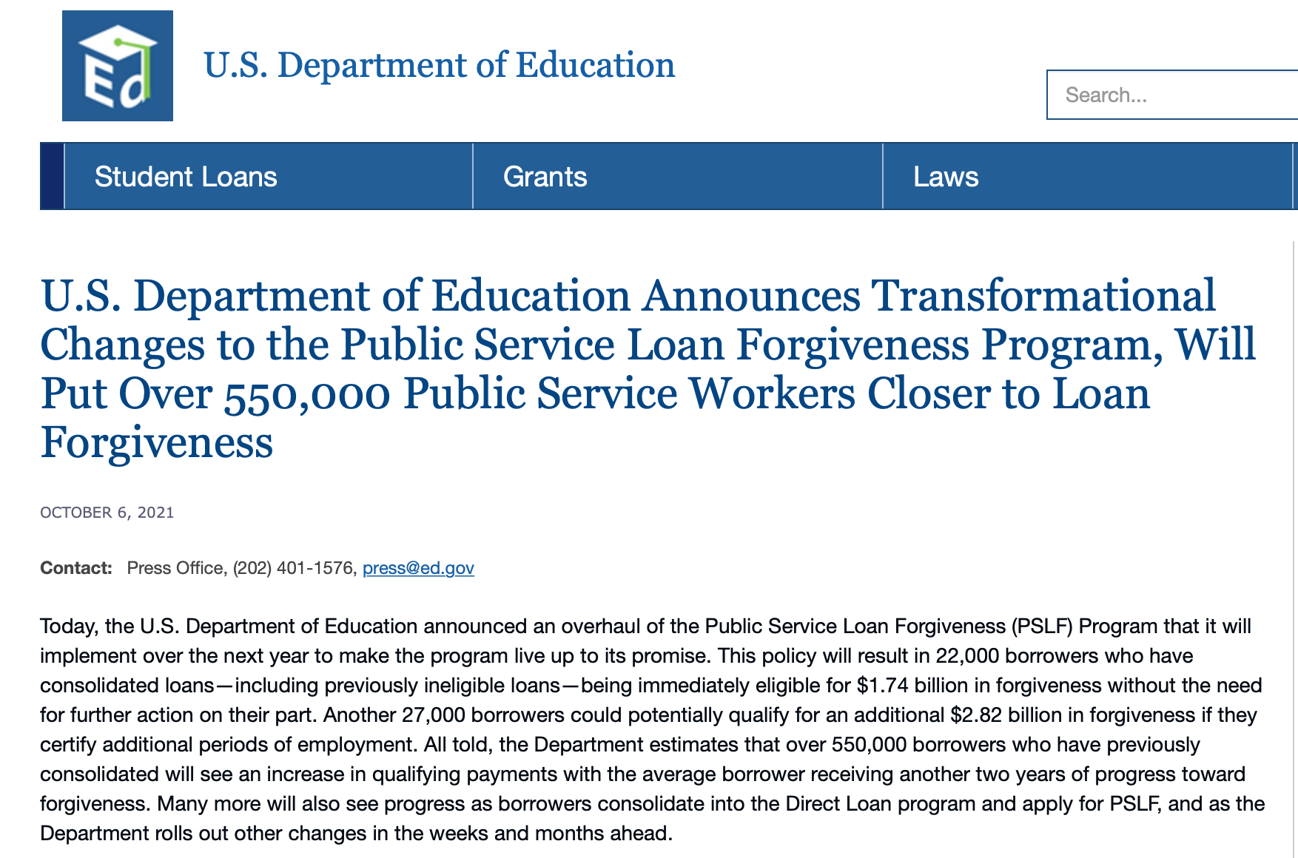
Owning Your Financial Future
DEBT & STUDENT LOAN MANAGEMENT
Wednesday, October 27 6:00pm

Slide 6
Owning Your Financial Future
INVESTING STRATEGIES TO SUPPORT YOUR GOALS
Today, September 8
BUDGETING: MANAGING INCOME & EXPENSES
Tuesday, September 28 12:00pm
Wednesday, October 6 6:00pm
DEBT & STUDENT LOAN MANAGEMENT
Wednesday, October 27 6:00pm
CAREER PLANNING & FINANCIAL PLANNING
Wednesday, November 17 6:00pm

Slide 7
Owning Your Financial Future
YOUR VALUES
YOUR GOALS
Education
Career
Family
FINANCIAL STRATEGIES
Investing
Income & Expense Management
Debt Management
Taxes, Insurance & Other

Slide 8
Today’s Agenda
Questions from you
Questions from Session #1 on Investing
Some strategies for managing your income and expenses
Including thinking about ways to increase your income while in grad school
Including developing habits that will last a lifetime
Including building on all of your other good habits
Questions from you

Slide 9
Questions From You
How can I save when my income is so low as a grad student?
My problem isn’t budgeting but it’s having too little income.
Your short-term priorities while in grad school need to be your education, your family and your mental health
Maybe saving cannot be a priority for you while you’re in grad school
The goal is to develop habits and a mindset that will prepare you to maximize the benefits of saving when your income allows you to do so. Be patient. The benefits of good habits will grow exponentially.

Slide 10
Questions From You
How can I save when my income is so low as a grad student?
My problem isn’t budgeting but it’s having too little income.
And think of ways to generate more money: gigs, internships, tutor, lab assistant, freelance positions, blogger, podcasts, consulting
Create new jobs for yourself: maybe sell your skills in social media marketing to a company you want to work for, regardless of your program
A lot of the advice we think of in budgeting is about “reducing expenses.” And that’s because we generally have more control over our expenses than we do over our income, at least in the short-term. Do what you can.
And, decreasing expenses can feel like an increase income. Same same.

Slide 11
Questions From You
How much of my income should I be saving each month?
Only you can answer this. Nobody can answer it for you.
It depends on:
What your goals are, both short- and medium-term.
What your immediate expenses are.
I frequently advise students to save $25 of every paycheck as soon as they receive each paycheck. Save or set aside as much as you can.
When I was getting my Master degree, I had no income. I was living off a little savings and a lot of debt. But I intentionally saved $10 to $25 on the first day of each month…simply to develop the habit.
In grad school, the habit is more important than the amount.
Now, I save on the 1st of each month and on the last day of each month.

Slide 12
Questions From You
Do you have any advice for how international students can increase their income?
This is tricky; In many cases, you may only be allowed to work on campus.
Tutoring, lab assistants, graduate assistants, contract projects on campus
This places greater emphasis on two things:
Finishing your degree so you can move on to higher-income pursuits sooner rather than later
Managing your expenses

Slide 13
Questions From You
How do I save for a big purchase – house, car, etc…?
Stary by asking yourself a few questions:
How much do I need to save?
When am I going to make this purchase?
Is this essential or discretionary? (A refrigerator or car vs. a vacation)
These questions will help identify timing and priority.
Knowing timing & priority will help determine how you save.
Do you use a bank savings account or do you have time to invest in the stock market?

Slide 14
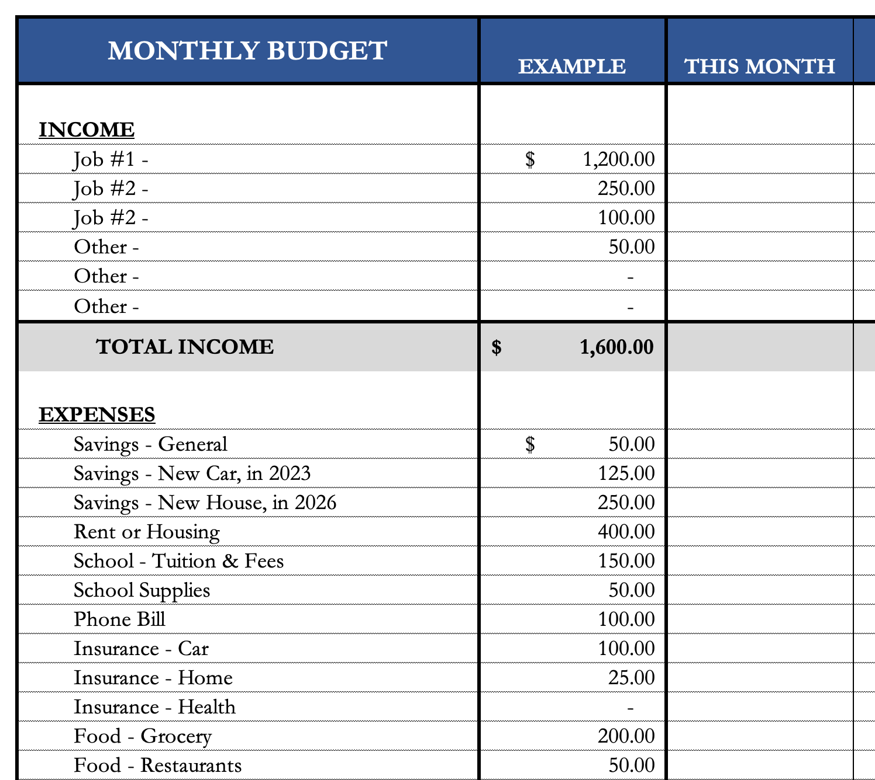
Questions From You
How do I save for a big purchase – house, car, etc…?
I would explicitly allocate some of my monthly savings to this purchase.
I have already penciled in my holiday gift purchases – even though I won’t make them for 2 months.
We will talk about my 5 buckets for saving- investing in a few slides.
If it’s a really big purchase (e.g. house), you could even set up a dedicated saving or investing account just for that purchase.

Slide 15
Questions From Session #1 on Investing
How much of my income should I be investing each month?
Again, only you can answer this. Nobody can answer this for you.
Your goals, values and resources are unique to you…and only you.
You may read reports about how much you should have saved by a certain age or whatever.
It’s okay to read those, but be sure to put them into your own perspective.
Those articles do not know what your goals are, do not know that you are in graduate school and do not know what your future plans are.
It is important to have a plan – but it is critical that that plan is unique to you and your situation.

Slide 16
Questions From Session #1 on Investing
Brian – You mentioned you have 4-5 bank and investing accounts. What are these different accounts and why do you use them?
A basic checking & transactions account. My paycheck is deposited here. And all bills are paid out of this account.
A savings account. This is dedicated to short-to-medium term goals, such as paying down debt or paying for a vacation.
An investment account. This is dedicated to long term goals, such as buying a house, children’s education or even retirement.
And 2 retirement accounts: 1 through work and 1 that I manage outside of my work retirement account.

Slide 17
Questions From Session #1 on Investing
Contribution from ULL
Paycheck
Work Retirement Plan
Bills
Transfer from Savings
Independent Retirement Plan
Short & Medium- Term Goals (0-5 Years)
Long-Term Goals (5+ Years)

Slide 18
Questions From Session #1 on Investing
Brian – You mentioned you have 4-5 bank and investing accounts. What are these different accounts and why do you use them?
Why does this work?
Research has found that humans engage in “mental budgeting.” Imagine that you have $10,000. You might manage (or spend) this $10,000 differently if you have it one account for “My Money” versus having $2,000 in a checking account + $8,000 in different savings & investment accounts.

Slide 19
Questions From Session #1 on Investing
Why does this work?
Because it allows me to align different goals with different accounts.
Checking & Transaction Account
No risk, 0.0% return, all cash
Short-to-Medium Term Goals
Some risk,
0-3% return goals, cash + savings
Long-Term Goals
Some Risk,
3-7% return goals,
savings + investments
Retirement
Accounts
Lots of risk,
8-12% return goals,
all investments

Slide 20
Why Are You Here?
Take a few seconds to ask yourself:
Why Are You in Graduate School?
What are your career goals?
To become a teacher or administrator?
To work for Google?
To become a professor?
To design some world-changing invention?

Slide 21
Why Are You Here?
Why do I think you are here?
I think you are here to think about your financial situation.
I think you are here to begin developing a financial plan.
I think you are here today to gain better control over your income and expenses to help you:
Eliminate some stress associated with a grad school budget.
Maximize your goals over the long-term.

Slide 22
Review: A Few Rules About INVESTING
Investing lets COMPOUND INTEREST be your friend.
With compound interest, your interest earns interest.
Without actively making decisions, your money can grow exponentially.
Yes, there is risk – the exponential growth rate could be negative.
Such risk is greatest if you ‘invest’ over very short periods of time.
Historically, over the past 100+ years, if you invest for 5+ years, you have benefited from positive exponential growth.
The average return of a common stock over the past 100 years is 10%.
The word ’average’ is very important here. But, the good news, we can all achieve ‘average’ returns relatively easily (though they may not be 10% in the future)

Slide 23
Review: A Few Rules About INVESTING
Investing lets COMPOUND INTEREST be your friend.
With compound interest, your interest earns interest.
Without actively making decisions, your money can grow exponentially.
Yes, there is risk – the exponential growth rate could be negative.
Such risk is greatest if you ‘invest’ over very short periods of time.
Historically, over the past 100+ years, if you invest for 5+ years, you have benefited from positive exponential growth.
The average return of a common stock over the past 100 years is 10%.
The word ’average’ is very important here. But, the good news, we can all achieve ‘average’ returns relatively easily (though they may not be 10% in the future)
Not to be too esoteric or philosophical…
But compound interest doesn’t just apply to investing.
Compound interest applies to all aspects of grad school life:
Time Management
Mental Health
Health Management
Writing Skills
Relationships
And…Of course, Money Management

Slide 24
Review: A Few Rules About INVESTING
Investing lets COMPOUND INTEREST be your friend.
With compound interest, your interest earns interest.
Without actively making decisions, your money can grow exponentially.
Yes, there is risk – the exponential growth rate could be negative.
Such risk is greatest if you ‘invest’ over very short periods of time.
Historically, over the past 100+ years, if you invest for 5+ years, you have benefited from positive exponential growth.
The average return of a common stock over the past 100 years is 10%.
The word ’average’ is very important here. But, the good news, we can all achieve ‘average’ returns relatively easily (though they may not be 10% in the future)
YOU, as grad students, are better wired and equipped to make long-term plans – education, career, financial & otherwise – than 99% of humanity.
Be confident. Be intentional.
Be diligent. Be awesome.

Slide 25
One Rule About BUDGETING
Budgeting is philosophically very easy but practically very difficult because there is just one basic rule that applies to Budgeting:
Spend less than you earn.
Of course, this is much easier said than done…Especially for grad students with limited income and fixed expenses.
If you spend more than you earn, you have to make up the difference somehow - student loans, credit cards, savings.
And this borrowing will set your goals back when it comes time to repay this borrowing. You are borrowing from your future.

Slide 26
How Do You Succeed at Budgeting
Be intentional. Know what you’re spending. Know what your income is.
Look in the mirror. Analyze yourself.
This can be painful. You may see some habits you do not like. But recognizing those habits is the first step to correcting them.
Think both short-term and long-term.
At its core, budgeting is about balancing monthly income and expenses.
But, be sure to connect your income and expenses to your long-term goals.
When I was getting my doctorate, my priority was my degree. I ate more Top Ramen than any human should ever eat (including every night for a month, as part of a bet). To me, this was a choice and a habit that was critical to fulfilling my goal – my degree.

Slide 27
How Do You Succeed at Budgeting
I do not want all of my life to be controlled by a budget.
I simply want my budget to be functional.
~ Quote from one of your grad student colleagues this summer

Slide 28
How Do You Succeed at Budgeting
I simply want my budget to be functional.
You want a budget to be a guide, not a rulebook.
You want a budget that is designed for you and nobody else.
You want to identify what is most important to you.
Yes, you may have to change behavior and make sacrifices – so make sure you are only sacrificing those expenses or parts of your financial life that are least important to you.

Slide 29
Five Budgeting Models

Slide 30
Five Budgeting Models

Slide 31
Five Budgeting Models

Slide 32
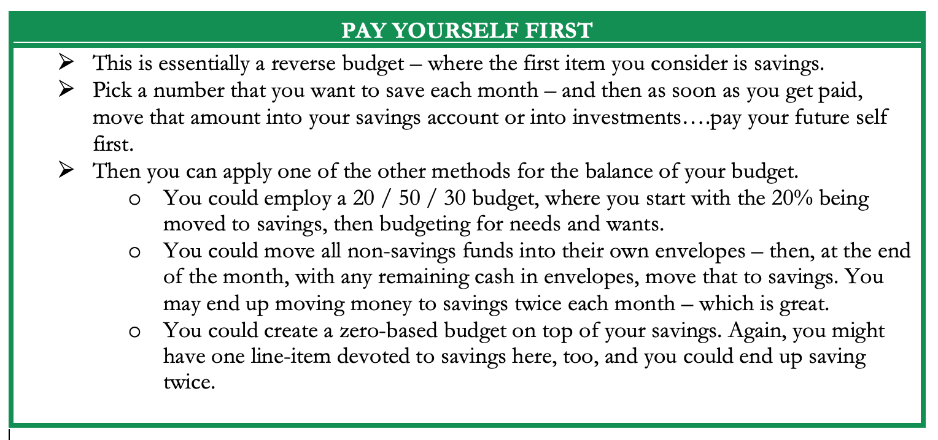
Five Budgeting Models

Slide 33
Five Budgeting Models

Slide 34
Five Budgeting Models
Which Budget Model is Best For You?
Only you can answer that.
Budgeting is more of a mental game than a financial process. You need to select the approach that:
Gives you the least stress and the most confidence;
Best aligns with your short- and long-term goals.
In practice, most people combine different models to best suit
what they are most comfortable with. (I personally pay myself first and then use a zero-based approach)
(And then, if I can, I pay myself last, too)

Slide 35
Developing A Budgeting Mindset
Budgeting is more of a mental game than a financial process.
Think of budgeting as part of a long-term financial plan.
Think of budgeting in the same way you think of studying, writing or working in the laboratory.
Recognize your own behavior, habits, priorities and goals. Only you know what is best for you. Choose the budgeting approach that works best for you…and for you only.

Slide 36
Developing A Budgeting Mindset
If you have a spouse, partner, family or others who are affected by your budgeting decisions….
….Talk to them. Make budgeting a team effort.
Research on personal finance shows that couples feel more empowered and develop a closer, stronger relationship when they share financial goals, decisions and strategies with each other.
Your pets may be affected by your budgeting decisions. But you don’t have to communicate with them. They don’t want to be bothered with budgeting decisions. They have other priorities.

Slide 37
Developing A Budgeting Mindset
Some exercises to help you develop a budgeting mindset.
Track all of your income and expenses – every penny – over an extended period of time (say, 1-2 months).
Write down the last 15 things you spent money on.
Write down the next 15 things you want to spend money on.
Identify your 10 biggest expenses over the past 12 months.
Predict every dollar of income you will earn over the next 12 months.
Predict what your income will be for each of the next 5 years.

Slide 38
Developing A Budgeting Mindset
Some exercises to help you develop a budgeting mindset.
Track all of your income and expenses – every penny – over an extended period of time (say, 1-2 months).
Write down the last 15 things you spent money on.
Write down the next 15 things you want to spend money on.
Identify your 10 biggest expenses over the past 12 months.
Predict every dollar of income you will earn over the next 12 months.
Predict what your income will be for each of the next 5 years.
What is the purpose of this self-analysis?
To ensure that your spending is aligned with your income.
To ensure that your spending and income are part of your plan.
To ensure your budget is driven by wants & needs, and not driven by impulses.
To be intentional.

Slide 39
Developing A Budgeting Mindset
Some actions that may help you better control your spending:
Wait 24 hours before making any purchase over a certain dollar amount
For me, it’s $100
Don’t make any purchases on certain days or after a certain time
For me it’s 9:00pm
Only use cash…because studies have found that spending cash causes us more pain than the abstraction of a credit card or debit card
It’s also why casinos use similarly abstract poker chips…because we don’t feel pain when we lose them.
Take 10 minutes every Sunday to write down what you’re allowed to spend in this week.

Slide 40
Developing A Budgeting Mindset
Some actions that may help you better control your spending:
Wait 24 hours before making any purchase over a certain dollar amount
For me, it’s $100
Don’t make any purchases on certain days or after a certain time
For me it’s 9:00pm
Only use cash…because studies have found that spending cash causes us more pain than the abstraction of a credit card or debit card
It’s also why casinos use similarly abstract poker chips…because we don’t feel pain when we lose them.
Take 10 minutes every Sunday to write down what you’re allowed to spend in this week.
And then reward yourself.
Turn this into a game.
If you predict you will spend $200 this week, and you only spend $150, reward yourself with half the difference.
Take $25 for happy hour or a night out.
Put the other $25 into savings or investing.

Slide 41
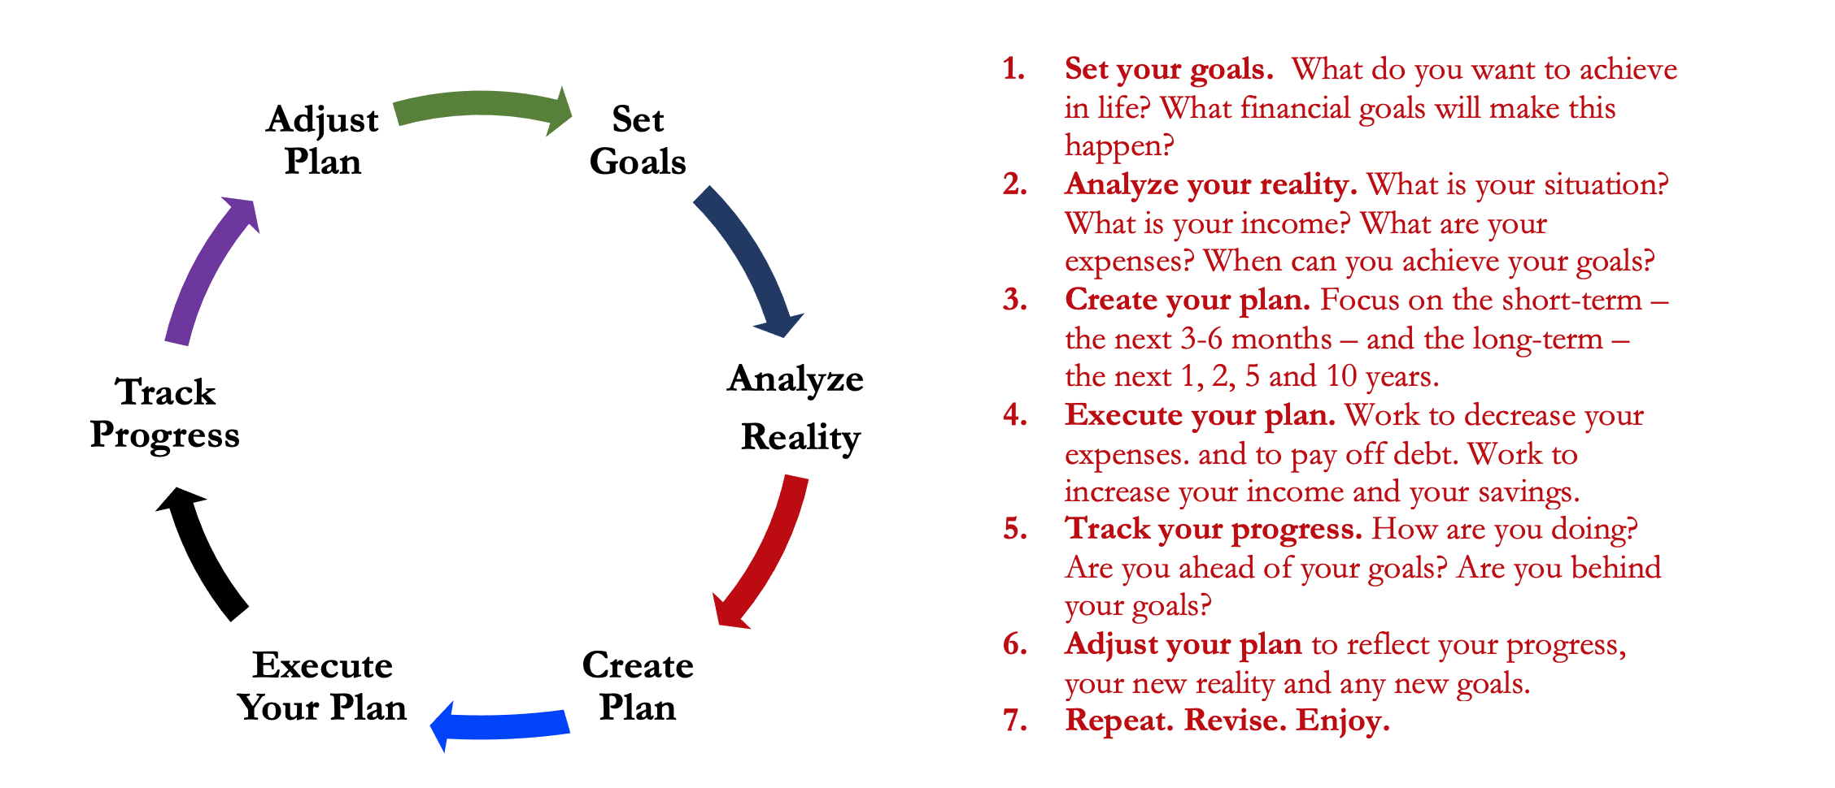
Isn’t this a lot like what you do with your education planning?

Slide 42
Making Budgeting a Part of Your Plan
FINANCIAL STRATEGIES
EDUCATION STRATEGIES
BUDGETING
STRATEGIES
GRAD SCHOOL STRATEGIES
Identify Your Income & Expenses
Identify Your Resources
Identify Your Priorities & Goals
Identify Your Priorities & Goals
Do Your Planning
Do Your Planning
Monitor & Modify Budgeting Activities
Monitor & Modify Your Progress & Plan

Slide 43
Making Budgeting a Part of Your Plan
FINANCIAL STRATEGIES
YOU,
as grad students, are better wired and equipped to make long-term plans – education, career, financial & otherwise – than 99% of humanity.
Be confident. Be intentional.
Be diligent.
Be awesome.
EDUCATION STRATEGIES
BUDGETING
STRATEGIES
GRAD SCHOOL STRATEGIES
Identify Your Income & Expenses
Identify Your Resources
Identify Your Priorities & Goals
Identify Your Priorities & Goals
Do Your Planning
Do Your Planning
Monitor & Modify Budgeting Activities
Monitor & Modify Your Progress & Plan

Slide 44
brian.bolton@louisiana.edu

