Slide 1


Welcome
Accelerate Northside

Slide 2
What You Need to Know
About the Numbers
Finance & Accounting
November 3, 2022
Dr. Brian Bolton
Professor of Finance

Slide 3
brian.bolton@louisiana.edu http://business.louisiana.edu/financeispersonal

Slide 4
Finance & Accounting
A little about me, the finance guy:
What are 2 things that I am grateful for:
  I am grateful to have a job where I get to work with and learn from inspiring people who are working to change their lives and to change their worlds.
  I am grateful that I will be in Texas with my family in 3 weeks.
Accelerate Northside 2022: What You Need to Know About the Numbers

Slide 5
Finance & Accounting
My plan for the next couple hours:
  We will start being a little bit philosophical in talking about finance and accounting….just putting things in perspective.
  And then we will spend most of our time be focused more directly
  on 3 (hopefully) relevant areas:
    Your Stakeholders
    Tracking Your Income & Expenses
    How is Your Business Performing?
Note: I will talk a little about taxes and tax planning. But a thorough discussion of taxes requires much more time than we have today.
Advice: It is never too soon (or too late) to connect with a tax accountant.
Accelerate Northside 2022: What You Need to Know About the Numbers

Slide 6
Finance & Accounting
There are no ‘right’ answers or perfect ways of understanding finance.
Our goal is to use our finance, accounting and strategy tools to make appropriate & reasonable decisions that help us pursue our mission.
We will go through this material at a pretty high level. Finance and Accounting require getting into the weeds at some point.
Feel free to ask about those weeds and details today or in the future.
Accelerate Northside 2022: What You Need to Know About the Numbers

Slide 7
ACTUAL HOMEWORK (for you to do, for Jonathan)
Identify your financial goals:
  What financial goals do you want to achieve in the next 3 months?
    These could involve building your team, getting business bank accounts, or achieving revenue milestones. Anything related to your business.
    These could also involve personal finance issues – because those will impact your business, too.
  What financial goals do you want to achieve in the next 12 months?
  What financial goals do you want to achieve in the next 3 years?
Accelerate Northside 2022: What You Need to Know About the Numbers

Slide 8
Finance & Accounting
PERSONAL FINANCE
BUSINESS FINANCE
BOOKKEEPING & ACCOUNTING
BUSINESS FINANCE
FINANCIAL PLANNING & MANAGEMENT
CORPORATE FINANCE
INVESTING & CAPITAL RAISING
Accelerate Northside 2022: What You Need to Know About the Numbers

Slide 9
What We Will Cover Today
PERSONAL FINANCE
BUSINESS FINANCE
BOOKKEEPING & ACCOUNTING
BUSINESS FINANCE
FINANCIAL PLANNING & MANAGEMENT
CORPORATE FINANCE
INVESTING & CAPITAL RAISING
Accelerate Northside 2022: What You Need to Know About the Numbers

Slide 10
What We Will Cover Today
PERSONAL FINANCE
Your life as an entrepreneur will regularly overlap with your life as an individual.
Knowing where to take advantage of the overlaps (such as in tax planning) and where to create an intentional divide (such as with relationships) can be critical to both your success in business and your happiness as a human. Be intentional with your choices.
Accelerate Northside 2022: What You Need to Know About the Numbers

Slide 11
What We Will Cover Today
PERSONAL FINANCE
Your life as an entrepreneur will regularly overlap with your life as an individual.
Knowing where to take advantage of the overlaps (such as in tax planning) and where to create a necessary divide (such as with relationships) can be critical to both your success in business and your happiness as a human.
Be intentional with your choices.
Accelerate Northside 2022: What You Need to Know About the Numbers

Slide 12
Personal Finance for Entrepreneurs
FINANCIAL MANAGEMENT
INVESTMENTS
INSURANCE
TAXES
FAMILY
ESTATE PLANNING
IN YOUR PERSONAL LIFE, YOU CONTROL
HOW THESE DIMENSIONS ARE CONNECTED
Accelerate Northside 2022: What You Need to Know About the Numbers

Slide 13
Personal Finance for Entrepreneurs
FINANCIAL MANAGEMENT
AS AN ENTREPRENEUR,
ALL OF THESE PERSONAL FINANCE DIMENSIONS ARE
GOING TO BE CONNECTED
TO YOUR BUSINESS.
INVESTMENTS
INSURANCE
TAXES
FAMILY
ESTATE PLANNING
Accelerate Northside 2022: What You Need to Know About the Numbers

Slide 14
Personal Finance for Entrepreneurs
FINANCIAL MANAGEMENT
How much of your savings is necessary to start the business?
Maybe you are using your home as your office.
Maybe you are using your personal computer to run the business.
Maybe your personal car is integral to the business.
INVESTMENTS
INSURANCE
TAXES
FAMILY
ESTATE PLANNING
Accelerate Northside 2022: What You Need to Know About the Numbers

Slide 15
Personal Finance for Entrepreneurs
FINANCIAL MANAGEMENT
How are you going to hire employees and grow the business?
Are you able to make any investments outside of the business?
Can you succeed if you don’t commit everything to the business?
Can you have a retirement account?
What physical investments – office, factory, equipment – will you need to make?
INVESTMENTS
INSURANCE
TAXES
FAMILY
ESTATE PLANNING
Accelerate Northside 2022: What You Need to Know About the Numbers

Slide 16
Personal Finance for Entrepreneurs
FINANCIAL MANAGEMENT
What insurance do you need for the business?
What insurance do you need for YOU, to ensure that the business can succeed?
What liability do YOU have personally for what the business does?
What legal structure will you choose for the business?
INVESTMENTS
INSURANCE
TAXES
FAMILY
ESTATE PLANNING
Accelerate Northside 2022: What You Need to Know About the Numbers

Slide 17
Personal Finance for Entrepreneurs
FINANCIAL MANAGEMENT
What legal structure will you choose for the business?
Will you file taxes as an individual or as a corporation?
What are the tax benefits available to entrepreneurs?
How will the business tax issues impact your family and your long-term personal goals?
INVESTMENTS
INSURANCE
TAXES
FAMILY
ESTATE PLANNING
Accelerate Northside 2022: What You Need to Know About the Numbers

Slide 18
Personal Finance for Entrepreneurs
FINANCIAL MANAGEMENT
How will the business tax issues impact your family and your long-term personal goals?
What are the pros and cons of making your venture a family affair?
How do you manage family relationships AND commit yourself to the business?
What happens to the business when you retire?
INVESTMENTS
INSURANCE
TAXES
FAMILY
ESTATE PLANNING
Accelerate Northside 2022: What You Need to Know About the Numbers

Slide 19
What You Can Do Tomorrow
Build your team. Don’t try to do everything on your own.
  You probably want to have an attorney and a tax accountant on your team. You may want to connect with other advisors, but having an attorney and accountant on your team is essential.
Separate your personal and business lives as much as possible.
  Get separate bank accounts for the business.
  Establish a credit history for the business.
Find an accounting system you like. Quicken, Quickbooks, TaxBot, Zero, Sage, FreshBooks are all decent options. Learn it, live it, love it.
Build your business plan. Tell the narrative of your business.
  Banks will want to see this. Investors will want to see this.
  View this as your roadmap or to-do list. Use it to guide both strategy and decision-making.
Accelerate Northside 2022: What You Need to Know About the Numbers

Slide 20
A Few Finance Principles
Nothing is free in finance & entrepreneurship. Every benefit has a cost. Understand what the benefits are.
Financial institutions and advisors are not your friends. They exist to take your money. Protect your money.
Debt can change your life – for better and for worse.
Be careful with how you use debt.
Interest is your friend – when you’re receiving it.
Interest is your enemy – when you’re paying it.
Finance is about trading money across time: short-term vs. long-term. Know the trade-offs you are making.
Cash is Queen (or King). Focus on cash inflows & cash outflows.
Accelerate Northside 2022: What You Need to Know About the Numbers

Slide 21
Don’t wait around for other people to be happy for you.
Any happiness you get,
You’ve got to make yourself.
Alice Walker
American Novelist, Poet, Teacher, Leader

Slide 22
Finance & Strategy
MISSION
What is your mission?
What is your purpose?
What problem are you trying to solve?
What opportunity are you working to fill?
What are you trying to accomplish?
Accelerate Northside 2022: What You Need to Know About the Numbers

Slide 23
Finance & Strategy
MISSION
STRATEGY
OPERATIONS
FINANCE
Accelerate Northside 2022: What You Need to Know About the Numbers

Slide 24
Finance & Strategy
MISSION
STRATEGY
OPERATIONS
FINANCE
Accelerate Northside 2022: What You Need to Know About the Numbers

Slide 25
Finance & Accounting Statements
In order to plan for the future – to prepare a strategic plan or to prepare a financial plan – we need to know where we are today.
  We need to know what resources we have available today.
  We need to know how we are (or have been) using resources.
  We need to know if our resource use is consistent with our mission and strategy.
  We can accomplish all this by using accounting information and financial statements.
Accelerate Northside 2022: What You Need to Know About the Numbers

Slide 26
Finance & Accounting Statements
Accounting, in general, is backward-looking.
It is an accounting of past financial transactions.
We’ll focus on 2 primary financial statements:
  The BALANCE SHEET – a picture of financial condition at a point in time.
  The INCOME STATEMENT – a summary of financial transactions during some period of time.
GAAP – Generally Accepted Accounting Principles guide how we recognize and treat transactions.
Accelerate Northside 2022: What You Need to Know About the Numbers

Slide 27
Finance & Accounting Statements
Accounting, in general, is backward-looking.
It is an accounting of past financial transactions.
But, we will use this accounting of past financial transactions to help us understand, predict and plan for the future
Accelerate Northside 2022: What You Need to Know About the Numbers

Slide 28
History does not repeat itself.
But it does rhyme.
Mark Twain
American author and humorist

Slide 29
Finance & Accounting Statements
Three principles of accounting:
Material – We recognize all transactions that occur, plus others that might have a “material” affect on the organization.
Conservative – When in doubt, and there is a lot of doubt in accounting, we present a worst-case scenario in order to manage risk and expectations
Matching – We always match revenues with expenses or assets with liabilities.
  “Double entry accounting” means we need 2 entries for each transaction.
  If we pay $1000 for a computer, Cash decreases by $1000 and Property & Equipment increases by $1000.
Accelerate Northside 2022: What You Need to Know About the Numbers

Slide 30

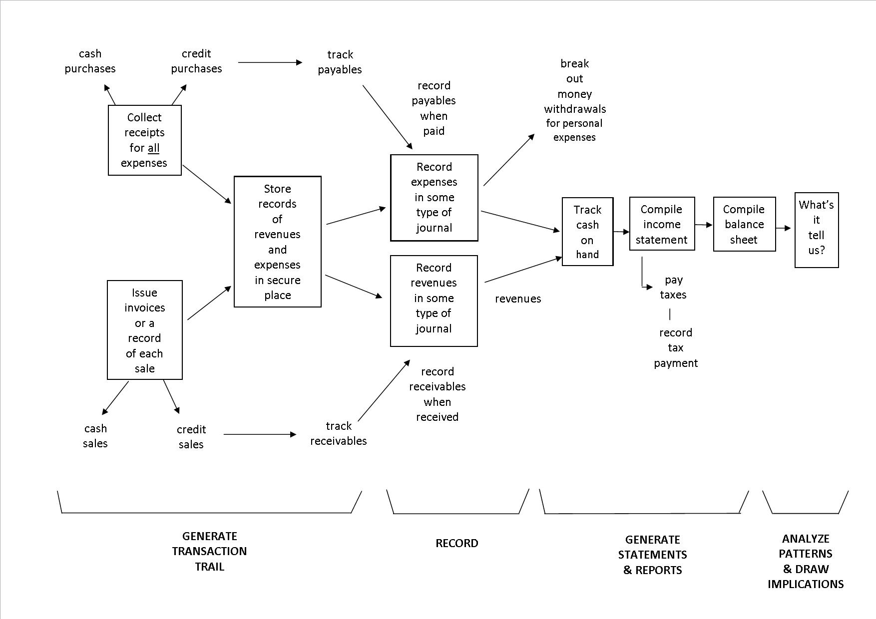
Accounting & Finance
Accelerate St. Landry 2021: What You Need to Know About the Numbers

Slide 31
Finance & Accounting Statements
The BALANCE SHEET – a picture of financial condition at a point in time.
Classifies items as “Assets” and “Liabilities”
Assets – Items or cash flows we OWN.
Liabilities – Items or cash flows we OWE.
The accounting identity:
Assets = Liabilities + Net Worth
Net Worth or Equity is the cash or value the business would have if it sold or liquidated today.
Accelerate Northside 2022: What You Need to Know About the Numbers

Slide 32
Finance & Accounting Statements
What are ASSETS?
  Cash & Cash Equivalents (like investments)
  Receivables – Cash or items that we are expecting to receive from other parties
    Sales we’ve made on credit, loans we’ve made but haven’t been repaid, contract revenues we’ve been promised but haven’t received cash
  Inventory – Materials, supplies or goods used to create revenue that we have on hand
  Prepaid Expenses – Expenses (like rent) that we’ve paid for in advance and will benefit from in the future
  Property & Equipment – Buildings, computers, vehicles and other tangible items that we own
Accelerate Northside 2022: What You Need to Know About the Numbers

Slide 33
Finance & Accounting Statements
What are LIABILITIES?
  Accounts payable – Typically supplies or materials that we’ve received but haven’t paid for yet.
  Accrued liabilities – Expenses we’ve incurred but haven’t paid for yet
    I only receive a paycheck on the last day of the month, but I work all month long. By the 20th of the month, my employer has incurred 2/3 of my paycheck without paying me. This 2/3 is an accrued liability.
  Deferred revenue – When we receive cash for a service prior to providing that service, this is recorded as “deferred revenue.” When we provide the service, we decrease the this account and increase the Revenue account.
  Long-Term Debt – Borrowed money to repay
Accelerate Northside 2022: What You Need to Know About the Numbers

Slide 34
Finance & Accounting Statements
What is NET WORTH?
Net Worth represents the accumulated earnings and investment that is in the business.
  Frequently called equity.
  Frequently called book value.
  Sometimes called market value.
This is what we want to maximize.
Accelerate Northside 2022: What You Need to Know About the Numbers

Slide 35
Finance & Accounting Statements
The INCOME STATEMENT – a summary of financial transactions during some period of time.
Classifies items as “Revenues” and “Expenses”
  “Operating Support & Revenue” and “Operating Expenses”
Revenues – Inflows or other benefits that the organization receives in exchange for providing goods or services in pursuit of its mission.
  Sales & Service Revenue – Cash inflows you receive in exchange for providing goods or services.
    This is usually the simplest, most obvious financial statement account (except maybe Cash)
Accelerate Northside 2022: What You Need to Know About the Numbers

Slide 36
Finance & Accounting Statements
Classifies items as “Revenues” and “Expenses”
  “Operating Support & Revenue” and “Operating Expenses”
Expenses – Outflows or other costs incurred in producing products or providing services in pursuit of its major operations and central mission.
  Cost of Goods Sold & Variable Expenses (Program Services) – Expenses incurred directly in providing goods and services for customers or stakeholders. Includes raw materials + labor to produce and provide the goods and services.
  Operating Expenses & Fixed Expenses – Expenses incurred by functions performed for the entity as a whole, not tied to specific products (“overhead” or “general and administrative”): rent, salaries, utilities, insurance, advertising, maintenance…
Accelerate Northside 2022: What You Need to Know About the Numbers

Slide 37
Finance & Accounting Statements
Revenues
– Cost of Goods Sold
= Gross Margin
– Operating Expenses (Overhead)
= Operating Income (Operating Margin) – Other Expenses (Interest, Non-Recurring)
= Taxable Income
– Income Taxes
= Net Income or Net Profit
(which is why this is sometimes called a P&L statement, or Profit & Loss statement)
Accelerate Northside 2022: What You Need to Know About the Numbers

Slide 38
Budgets & Financial Planning
You know what budgets are:
  Expected inflows and expenses to be incurred by the business in some future period (such as a year)
  We set budgeted financial statements – typically, Income Statements – before a period in order to manage our spending or expenses over that period.
  We do a lot of educated guessing when we create budgets – usually based on past performance and results.
  Useful in terms of managing funds, measuring performance and efficiency, setting goals and incentives
Accelerate Northside 2022: What You Need to Know About the Numbers

Slide 39
Budgets & Financial Planning
But why are they so important to entrepreneurs?
  Entrepreneurs do not have the same access to funds or capital that more established companies do.
  Entrepreneurs cannot launch a new product or pivot easily to quickly generate Revenue
  For Entrepreneurs…Cash is Queen!
    Entrepreneurial Finance is a lot like Personal Finance
    You have to generate cash to pay your bills.
    Your bills will not be constant or consistent.
    Having a financial plan can help you better understand when you will need cash and when you will generate cash
  Budgets are therefore (probably) more important to entrepreneurs than they are to more established, larger companies.
Accelerate Northside 2022: What You Need to Know About the Numbers

Slide 40
Budgets & Financial Planning
Here’s another exercise for you (but it’s not Homework that Jonathan is going to make you turn in and grade you on):
Plan out the next 12 months of cash inflows and cash outflows for your business.
  What do you notice? What are the trends?
  What numbers are you certain about?
  What numbers are just guesses?
  How can you create a plan to survive and thrive over the next 12 months?
If you do not have a business (yet), do this exercise with your own personal finances, for you and your family.
Accelerate Northside 2022: What You Need to Know About the Numbers

Slide 41
Let’s Do Some Math!!!
How do we use financial statements to manage our business?
How do we use financial statements to predict the future?
How do we use financial statements to tell our story?
Let’s analyze a real-life start-up business.
The following financial statements are from its first 3 years in business.
What stands out to you? Would you invest in this business?
Accelerate Northside 2022: What You Need to Know About the Numbers

Slide 43
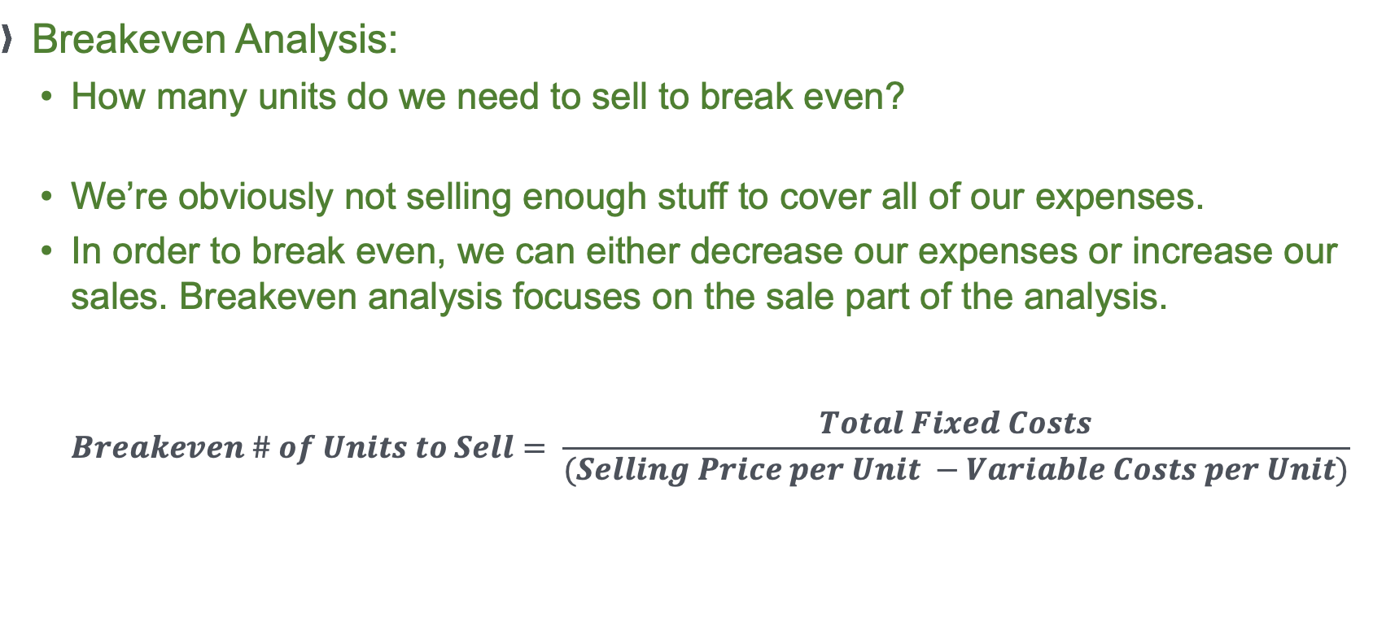
Let’s Do Some Math!!!
Breakeven Analysis:
  How many units do we need to sell to break even?
  We’re obviously not selling enough stuff to cover all of our expenses.
  In order to break even, we can either decrease our expenses or increase our sales. Breakeven analysis focuses on the sale part of the analysis.
  $Breakeven \# of Units to Sell= \frac{Total Fixed Costs}{(Selling Price per Unit −Variable Costs per Unit)}$
Accelerate Northside 2022: What You Need to Know About the Numbers

Slide 44
Accelerate Northside 2022: What You Need to Know About the Numbers

Slide 45
Accelerate Northside 2022: What You Need to Know About the Numbers

Slide 46
Accelerate Northside 2022: What You Need to Know About the Numbers

Slide 47
Accelerate Northside 2022: What You Need to Know About the Numbers

Slide 48
Accelerate Northside 2022: What You Need to Know About the Numbers

Slide 49
Accelerate Northside 2022: What You Need to Know About the Numbers

Slide 50
Let’s Do Some Math!!!
How is this company doing?
What stands out on the Income Statement?
What stands out on the Balance Sheet?
Would you invest in this company?
Why or why not?
Accelerate Northside 2022: What You Need to Know About the Numbers

Slide 51
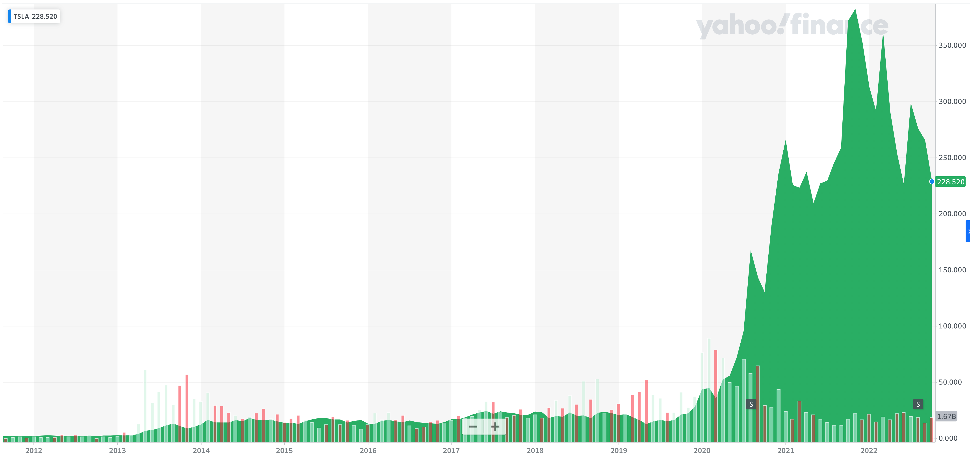
Let’s Do Some Math!!!

Slide 52
Let’s Do Some Math!!!
How is this company doing?
  The company is Tesla for 2009-2011.
  The stock was trading at $1.90 in 2011.
  The stock price reached $410 in November 2021.
  The stock price is currently around $230.

Slide 53
Financial Statements & Valuation
What is your mission? What is your purpose?
The benefits of pursuing this mission are probably obvious to us all.
The financial returns associated with this mission may not be so obvious.
The key is people. Stakeholders.
Accelerate Northside 2022: What You Need to Know About the Numbers

Slide 54
As you think about your businesses, your mission, your dreams, your visions for starting a new business, and what you want to do with what you get out of this program, try to answer one key question:
WHO CARES?
For your businesses, make a list of 3-5 groups of people or entities who care about that project.
Make a list of 3-5 people or entities who will contribute their human or financial resources to make that project successful.

Slide 55
As you think about your businesses, your mission, your dreams, your visions for starting a new business, and what you want to do with what you get out of this program, try to answer one key question:
WHO CARES?
For your businesses, make a list of 3-5 groups of people or entities who care about that project.
Make a list of 3-5 people or entities who will contribute their human or financial resources to make that project successful.

Slide 56
As you think about your businesses, your mission, your dreams, your visions for starting a new business, and what you want to do with what you get out of this program, try to answer one key question:
WHO CARES?
For your businesses, make a list of 3-5 groups of people or entities who care about that project.
Make a list of 3-5 people or entities who will contribute their human or financial resources to make that project successful.

Slide 57
Stakeholders & Entrepreneurs
Family
Investors
Employees
Business Entity
The Community
Customers
Suppliers
The Government
Others: future generations, trade associations, unions, activists, competitors, the media, business partners, the public, society

Slide 58
Finance & Accounting
Please define the following word:
VALUES
Now define this word:
VALUE
Accelerate Northside 2022: What You Need to Know About the Numbers

Slide 59
Stakeholders & Entrepreneurs
The word “VALUE,” meaning financial worth of something, is the same word as “VALUES”, meaning intrinsic desirability
Something only has financial value because we – people or stakeholders – decide that it has intrinsic desirability to us
Financial value is just a measuring tool. The real value is determined by our own desires.
Accelerate Northside 2022: What You Need to Know About the Numbers

Slide 60
Stakeholders & Entrepreneurs
Financial value is the result of people finding something intrinsically desirable.
The more intrinsically desirable something is to me, the more money I will be willing to pay for it.
  Also applies to non-financial resources – I may be willing to work harder for a cause I believe in than for a cause that doesn’t align with my own values.
Stakeholders will engage with your business because you are offering utility for them. What you are doing aligns with their values.
What you are doing makes their life better.
Accelerate Northside 2022: What You Need to Know About the Numbers

Slide 61
Stakeholders & Entrepreneurs
What you are doing makes their life better.
Most people are not going to give you money just because they like you.
But they will give you money if you and your business make their lives better.
It all comes back to your mission.
Accelerate Northside 2022: What You Need to Know About the Numbers

Slide 62
Stakeholders & Entrepreneurs
It all comes back to your mission.
  Stakeholders engage with – and contribute resources to – a business because they value what the business’s mission is.
  For a non-profit, people value the mission to alleviate suffering, fight for justice or to help rescue pets.
  For Apple and Walmart, people value different aspects related to their missions: products, prices, convenience, technology, jobs…
  Mission → Strategy → Operations → Finance
Accelerate Northside 2022: What You Need to Know About the Numbers

Slide 63
Stakeholders & Entrepreneurs
Family
Investors
Employees
Business Entity
The Community
Customers
Suppliers
The Government
Others: future generations, trade associations, unions, activists, competitors, the media, business partners, the public, society

Slide 64
Finance, Accounting & Stakeholders
Revenues
– Cost of Goods Sold
= Gross Margin
– Operating Expenses
= Operating Income
– Other Expenses
= Taxable Income
– Income Taxes
= Net Income
Accelerate Northside 2022: What You Need to Know About the Numbers

Slide 65
Finance, Accounting & Stakeholders
Revenues:
Customers give us money to make their lives better. Every dollar of Revenue any business has ever received has come from Customers.
Revenues
– Cost of Goods Sold
= Gross Margin
– Operating Expenses
= Operating Income
– Other Expenses
= Taxable Income
– Income Taxes
= Net Income
Accelerate Northside 2022: What You Need to Know About the Numbers

Slide 66
Finance, Accounting & Stakeholders
Revenues
– Cost of Goods Sold
= Gross Margin
– Operating Expenses
= Operating Income
– Other Expenses
= Taxable Income
– Income Taxes
= Net Income
Cost of Goods Sold:
We give cash to employees and suppliers to create the goods and services we provide to customers
Accelerate Northside 2022: What You Need to Know About the Numbers

Slide 67
Finance, Accounting & Stakeholders
Revenues
– Cost of Goods Sold
= Gross Margin
– Operating Expenses
= Operating Income
– Other Expenses
= Taxable Income
– Income Taxes
= Net Income
Operating Expenses:
We give cash to employees, the landlord, the advertising agency, the utilities company and others in exchange for giving us the infrastructure to run our business
Accelerate Northside 2022: What You Need to Know About the Numbers

Slide 68
Finance, Accounting & Stakeholders
Revenues
– Cost of Goods Sold
= Gross Margin
– Operating Expenses
= Operating Income
– Other Expenses
= Taxable Income
– Income Taxes
= Net Income
Other Expenses:
We give cash to the bank and other non-recurring, non-operating sources in exchange for certain benefits.
Accelerate Northside 2022: What You Need to Know About the Numbers

Slide 69
Finance, Accounting & Stakeholders
Revenues
– Cost of Goods Sold
= Gross Margin
– Operating Expenses
= Operating Income
– Other Expenses
= Taxable Income
– Income Taxes
= Net Income
Income Taxes:
We give cash to governments because they give us the social infrastructure for our business to succeed (in theory, at least, if not always in practice)
Accelerate Northside 2022: What You Need to Know About the Numbers

Slide 70
Finance, Accounting & Stakeholders
Net Income:
After we make our customers happy and we pay all other stakeholders who made our business possible, whatever cash is leftover is ours to keep, to give to our family, to re-invest in the business, to buy a boat, to return to outside investors.
Revenues
– Cost of Goods Sold
= Gross Margin
– Operating Expenses
= Operating Income
– Other Expenses
= Taxable Income
– Income Taxes
= Net Income
Accelerate Northside 2022: What You Need to Know About the Numbers

Slide 71
Finance & Strategy
MISSION
STRATEGY
OPERATIONS
FINANCE
Accelerate Northside 2022: What You Need to Know About the Numbers

Slide 72
The 3 Most Important Questions in Finance
What are the cash flows?
When do the cash flows occur?
What are those cash flows worth today?
Accelerate Northside 2022: What You Need to Know About the Numbers

Slide 73
The 3 Most Important Questions in Finance
What are the cash flows?
Cash Inflows & Cash Outflows
Revenues & Expenses
There may also be non-cash issues – that will eventually become cash issues – to keep in mind:
Benefits & Costs
(Reputation, branding, goodwill, relationships…all that may eventually lead to actual cash flows)
Accelerate Northside 2022: What You Need to Know About the Numbers

Slide 74
The 3 Most Important Questions in Finance
What are the cash flows?
  This is the most difficult issue in finance.
  This is especially difficult for entrepreneurs:
    You know exactly what your short-term cash outflows are going to be (rent, salaries, raw materials…)
    It can be very difficult to know – with any confidence – what your long-term cash inflows are going to be.
      This is why having a plan, having a strategy, having a roadmap is so vital
      You have to survive in the short—term…but if you do not have a strategy, you won’t go anywhere in the long-term
Accelerate Northside 2022: What You Need to Know About the Numbers

Slide 75
The 3 Most Important Questions in Finance
What are the cash flows?
  We want to identify and consider all direct and indirect cash flows.
  “Finance” is the art of predicting these cash flows.
  People think that finance is all math and problem solving. But finance is as much telling the story of an investment – the art – as it is doing the math related to any investment – the science.
Accelerate Northside 2022: What You Need to Know About the Numbers

Slide 76
The 3 Most Important Questions in Finance
When do the cash flows occur?
  The timing of cash flows is critical.
  Would you rather have $100 today or $100 in 3 years?
    Money is not free. It can always be used for something else (“opportunity cost”).
    In general, we only want to use money – or invest or spend money – if we expect some kind of return.
    The timing of cash outflows is usually far more certain and predictable than the timing of cash inflows.
Accelerate Northside 2022: What You Need to Know About the Numbers

Slide 77
Prediction is very difficult.
Especially when it’s about the future.
Niels Bohr
Danish Physicist
1922 Nobel Prize laureate

Slide 78
The 3 Most Important Questions in Finance
When do the cash flows occur?
  What cash flows are certain?
    Today’s cash outflows, short-term cash inflows, contractual obligations or benefits.
  What cash flows are possible?
    Revenues, partnerships, employee & program expenses
    As you think about your strategies, create different scenarios or possible outcomes.
    We never know exactly what will happen in the future. We can usually imagine several different scenarios better than we can predict one specific scenario.
Accelerate Northside 2022: What You Need to Know About the Numbers

Slide 79
The 3 Most Important Questions in Finance
What are those cash flows worth today?
  Once we know what the cash flows are and once we know when the cash flows occur (or think we know)…determining what those cash flows are worth today is a simple math problem.
    We care about estimating what the future cash flows are worth today because it helps us determine what short-term and long-term decisions to make today.
Accelerate Northside 2022: What You Need to Know About the Numbers

Slide 80
Connecting These 3 Questions to Your Business Plan
What are your sources of Revenue?
  Write down all the ways in which your business will generate cash inflows.
What are your Expenses?
  Write down all the ways in which your business will incur cash outflows.
What external financing do you need?
  Do you have personal resources to start the business?
  Will you have partners or investors?
  Will you need bank or SBA financing?
Initially, you may not need to include numbers – just know what the categories or descriptions are – but you will want to know numbers eventually.
Accelerate Northside 2022: What You Need to Know About the Numbers

Slide 81
MORE HOMEWORK (not for Jonathan, just for you)
At least once a week….
  Write down – on paper, on your phone, in Excel, in Quicken – all of your cash INFLOWS from the previous week and all of your expected cash INFLOWS for the upcoming week.
  Write down – on paper, on your phone, in Excel, in Quicken – all of your cash OUTFLOWS from the previous week and all of your expected cash OUTFLOWS for the upcoming week.
Accelerate Northside 2022: What You Need to Know About the Numbers

Slide 82
MORE HOMEWORK (not for Jonathan, just for you)
At least once a week….
  Write down – on paper, on your phone, in Excel, in Quickbooks – all of your cash INFLOWS from the previous week and all of your expected cash INFLOWS for the upcoming week.
  Write down – on paper, on your phone, in Excel, in Quickbooks – all of your cash OUTFLOWS from the previous week and all of your expected cash OUTFLOWS for the upcoming week.
Personal finance suggestion:
Do this same exercise for your family and personal finances, too. Looking in the mirror like this can really help you appreciate what your cash flows are & what decisions you are making.
Accelerate Northside 2022: What You Need to Know About the Numbers

Slide 83
The future enters into us,
In order to transform itself in us,
Long before it happens.
Rainer Maria Rilke
Austrian Poet & Novelist

Slide 84
Remember VALUES → VALUE
Please define the following word:
VALUES
Now define this word:
VALUE
THESE ARE THE SAME WORDS
Accelerate Northside 2022: What You Need to Know About the Numbers

Slide 85
Remember VALUES → VALUE
Value is not the same as money
Money is one way of measuring value, but value is about more than money
Focus on values – and money will usually follow
  We will talk about measuring value in monetary terms, but that is just one way of measuring value
Think of value very broadly throughout this program and in your business
Accelerate Northside 2022: What You Need to Know About the Numbers

Slide 86
MORE HOMEWORK!!! (again, just for you, not Jonathan)
Once a month or once a year, take an hour to write down your values.
Write down the 10-15 priorities in your life that guide who you are and what you want.
  For personal finance, being intentional about what your values are will help you make sure your financial decisions are consistent with your personal values.
  For your business, being intentional about what your business values are will help you make sure your business decisions are aligned with your mission & goals.
Accelerate Northside 2022: What You Need to Know About the Numbers

Slide 87
Business Finance & Valuation
Question: How do we decide which investments to make?
Answer: We make those investments with the highest
return on investment.
Question: How do we measure return on investment?
Answer: In short… We use some measure of:
Cash Inflows Benefits
Cash Outflows Costs
Accelerate Northside 2022: What You Need to Know About the Numbers

Slide 88
Business Finance & Valuation
For individuals, financial return may not be the goal.
  Should you borrow $100 to pay for your education?
  How do we account for the experience, the knowledge, the opportunities and everything else that education provides?
Why are you here right now? Why are you paying – with time, energy & money – for this experience?
  This is an investment in your business.
  This is an investment in your future.
  This is an investment in your family.
  This is an investment in your purpose.
Accelerate Northside 2022: What You Need to Know About the Numbers

Slide 89
Business Finance & Valuation
This is the essence of finance – exchanging cash flows, or goods, services and resources, over time.
We make decisions about what we are willing to give up today (or receive today) in exchange for receiving something in the future.
We want to make decisions (financial decisions) that make us better off…however we decide to measure “better off”
  Financially better off, happier, smarter, healthier…
Accelerate Northside 2022: What You Need to Know About the Numbers

Slide 90
Business Finance & Valuation
In finance – or in business – we never want to make an investment – or spend any money – where the expected benefits are less that the expected costs.
  Thinks of “benefits” and “costs” as economic benefits and costs, which is NOT necessarily the same as financial inflows and outflows.
Accelerate Northside 2022: What You Need to Know About the Numbers

Slide 91
Business Finance & Valuation
What is your mission? What is your purpose?
The benefits of pursuing this mission are probably obvious to us all.
The financial returns associated with this mission may not be so obvious.
The key is people. Stakeholders.
How does your mission make lives better?
Accelerate Northside 2022: What You Need to Know About the Numbers

Slide 92
ACTUAL HOMEWORK
(FOR YOU TO DO, FOR JONATHAN, FOR NEXT WEEK)
Identify your financial goals:
  What financial goals do you want to achieve in the next 3 months?
    These could involve building your team, getting business bank accounts, or achieving revenue milestones. Anything related to your business.
    These could also involve personal finance issues – because those will impact your business, too.
  What financial goals do you want to achieve in the next 12 months?
  What financial goals do you want to achieve in the next 3 years?
Accelerate Northside 2022: What You Need to Know About the Numbers

Slide 93
If you can’t fly, then run.
If you can’t run, then walk.
If you can’t walk, then crawl.
But whatever you do,
You have to keep moving forward.
Reverend Dr. Martin Luther King, Jr.
1964 Nobel Prize laureate

Slide 94
brian.bolton@louisiana.edu http://business.louisiana.edu/financeispersonal

