Slide 1


MONEY MATTERS 2023:
UL SYSTEM FINANCIAL WELLNESS SERIES
Session #10:
Financial Planning for Veterans
July 18, 2023

Slide 2
Brian Bolton
Professor of Finance brian.bolton@louisiana.edu http://business.louisiana.edu/financeispersonal

Slide 3
Owning Your Financial Future
Adults Returning to Finish a Degree: Financial & Other Concerns
June 6, 2023
Financial Planning for Graduate Students
June 7, 2023
Financial & Tax Planning for International Students
June 8, 2023
The Financial Aspects of Your Side-
Hustle #1 – Planning, Strategies, Legal, Resources
June 20, 2023
Family Financial Planning: Making Finances Work for the Whole Family
June 23, 2023
Family Financial Planning: Sending Your Loved-Ones Off to College
June 27, 2023
Family Financial Planning: Caring for Adult Dependents
June 28, 2023
Changing Careers: The Financial & Personal Issues
July 13, 2023
Building Savings Accounts & Emergency Funds
July 14, 2023
Financial Planning for Veterans
July 18, 2023 ***
Financial Planning When Retirement is Getting Close
(5-7 years out)
July 19, 2023 ***
The Financial Aspects of Your Side-
Hustle #2 – Taxes, Profitability, Expansion, Success
July 25, 2023
Financial Planning for the Fun Stuff: Vacations, Home Improvements, New Vehicles
June 26, 2023
Investing 101
August 1, 2023
Navigating the Impacts of Inflation & Turbulent Economic Times
August 2, 2023
Most sessions are from 12:00-1:00pm
*** Sessions on July 18, 19 are from 3:00-4:00pm.

Slide 4
WHY IS FINANCIAL PLANNING
SO IMPORTANT FOR VETERANS?
LET’S BEGIN WITH 3 BIG REASONS:
You have more unique benefits and cash flow streams than most civilians.
You may not have had to worry as much about money while in active service…so things may be new to you.
Transitioning from active duty to civilian is not always an easy transition. And we never want money issues to add to those challenges (or to become your biggest challenges).

Slide 5
Happiness
Long-Term Goals
Short-Term Goals
Financial Needs
Family Needs

Slide 6
3 Opening Morals
Personal Finance is…personal.
It’s about you and not about anyone else.
You have to make it about you and your goals.

Slide 7
3 Opening Morals
Because personal finance is personal, it is virtually impossible for me to give you any specific advice.
However, there is one word of advice that applies to 99% of people working on their finances:
SAVE

Slide 8
SAVINGS
INVESTING
OWNERSHIP
WEALTH

Slide 9
3 Opening Morals
Financial Planning for Veterans….is 90% the same as Financial Planning for Civilians.
That 10% difference relates to unique opportunities and unique words of caution.
We will touch on both the 90% and the 10% today.

Slide 10
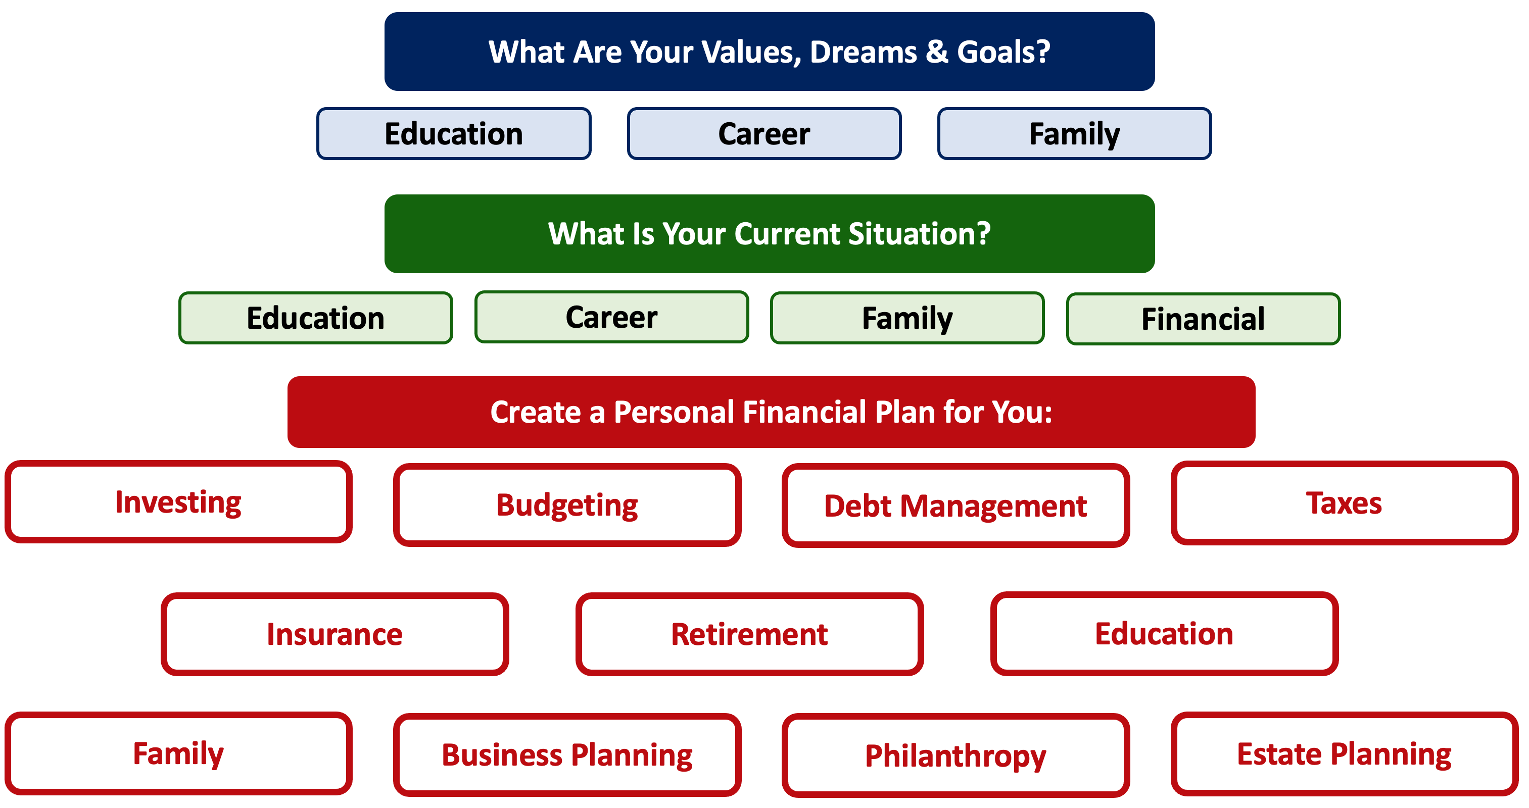

Slide 11
TODAY THE NEXT 6 MONTHS THE NEXT 12 MONTHS 2 YEARS AFTER GRADUATION 3 YEARS AFTER GRADUATION
ONCE EVERY 3 MONTHS:
TRACK EVERY PENNY THAT YOU SPEND & TRACK EVERY PENNY THAT YOU EARN
IN THE NEXT 3 MONTHS:
IDENTIFY WAYS TO DECREASE YOUR DISCRETIONARY SPENDING BY 25%
IN THE NEXT 6 MONTHS:
MAKE A PLAN TO MANAGE – AND PAY OFF – YOUR DEBT
IN THE NEXT 6-12 MONTHS:
OPEN MULTIPLE SAVINGS ACCOUNTS, 1 FOR EACH GOAL
IN THE NEXT 12 MONTHS, OPEN AN IRA OR ROTH IRA
WITHIN THE NEXT 2 YEARS :
HAVE AN “EMERGENCY FUND” ACCOUNT, WITH 3-6 MONTHS OF NON-DISCRETIONARY EXPENSES
WITHIN 3 YEARS OF GRADUATION:
ELIMINATE ALL OF YOUR BAD DEBT.

Slide 12
TODAY THE NEXT 6 MONTHS THE NEXT 12 MONTHS 2 YEARS AFTER GRADUATION 3 YEARS AFTER GRADUATION
IN THE NEXT 6 MONTHS:
IDENTIFY ALL OF YOUR MILITARY BENEFITS – Such as money for education, insurance benefits and discounts, preferred rates on mortgages, car loans and credit cards.
THE U.S. DEPARTMENT OF VETERANS AFFAIRS IS PROBABLY THE FIRST PLACE TO CONTACT…AND THEY CAN PUT IN YOU TOUCH WITH OTHER ORGANIZATIONS, AS NECESSARY.
ALWAYS GO THROUGH OFFICIAL ORGANIZATIONS.
YOU HAVE UNIQUE BENEFITS…WHICH MEANS YOU CAN BECOME A UNIQUE TARGET FOR SCAMS OR OTHER SCHEMES.

Slide 13
TODAY THE NEXT 6 MONTHS THE NEXT 12 MONTHS 2 YEARS AFTER GRADUATION 3 YEARS AFTER GRADUATION
Whenever anyone calls you, texts you or sends you an email telling you about all of the amazing benefits you are eligible for…be suspicious.
Official organizations may send you a letter or even an email. But do not click on those emails. And do not give out any personal information to solicitors over the phone.
Always do your own research and go directly to the official websites before providing any personal information.

Slide 14
THE 3 FINANCIAL PLANNING PRIORITIES

Slide 15
10 FINANCIAL PLANNING TIPS
#1
Prepare a reasonable and thorough budget.
This begins with identifying all of your expenses – both non-discretionary and discretionary.
Analyze your budget and think about values, behaviors, goals.
Think about how you can reduce the expenses in your budget.

Slide 16
10 FINANCIAL PLANNING TIPS
#2
Prepare an inventory of all financial
and other benefits available to you.
Education – GI Bill
Health Care – VA Medical Benefits, SSDI, Tricare
Loan Benefits – VA Home Loan Programs
Life Insurance – Servicemembers’ Group Life Insurance
Retirement – Several different pension and defined contribution plans

Slide 17
10 FINANCIAL PLANNING TIPS
#3
Make sure you have all of the health insurance
you need and you are eligible for.
The VA may provide the best coverage for you and your family…but it may not. You may need private coverage, that may come with government discounts. Do your research. Do NOT assume that you only have 1 choice or that that 1 choice is best for you.

Slide 18
10 FINANCIAL PLANNING TIPS
#4
If you have a hobby, side-hustle or active business, make sure you create a legal business entity.
Creating an LLC – limited liability company – or a corporation will take you about 2 hours and between $200 and $500 (depending on your industry)…but that effort will save you from enormous potential liability in the future.

Slide 19
10 FINANCIAL PLANNING TIPS
#5
Prepare a last will and testament.
Prepare a living will (for medical decisions during life).
Either of the above will start at about $300 with an online service, and could go as high as $2000 with a local attorney. But the peace of mind can be priceless.
Make sure you have beneficiaries identified for all your benefits, policies and accounts.

Slide 20
10 FINANCIAL PLANNING TIPS
#6
Check your credit report.
Check your credit score.
Your credit history has probably not been as smooth and consistent as most civilians. This may confuse the credit agencies…and this may result in lower credit scores than you deserve.
Or, maybe you have earned a low credit score. That’s fine. Now just begin the process of improving your credit score so that your budget will not be held hostage by high interest rates in the future.
The key to improving your credit score is to make all
payments on time. After that, the score will improve naturally.

Slide 21
10 FINANCIAL PLANNING TIPS
#7
Be patient.
And do your research.
All of the benefits you have earned do come with a small cost: paperwork and bureaucracy.
It can be extremely frustrating to navigate the system and to learn what you are entitled to and what you need to do to get your benefits. Let’s assume that this bureaucracy is in place to protect you from frauds. Be patient, take your time and be diligent.

Slide 22
10 FINANCIAL PLANNING TIPS
#8
Consider saving for retirement on your own.
While you do have unique benefits that most civilians do not have, some of these benefits can have relatively low payout promises…payments that may not be enough to support you and your family in the future.
If you have the means, you should be able to contribute to a tax-preferred thrift savings plan (like a 401(k)) or other defined contribution plan with the VA. You can also certainly have an Individual Retirement Account or Roth IRA on your own.

Slide 23
10 FINANCIAL PLANNING TIPS
#9
Understand your tax responsibilities and obligations.
Because your income sources and streams may be more diverse than most civilians, your tax responsibilities will be more complex.

Slide 24
10 FINANCIAL PLANNING TIPS
#9
Understand your tax responsibilities and obligations.
Some of your income might be tax-free at both the state and federal levels. You might even get property and vehicle tax benefits. Retirement pay is probably taxable (at the federal level, possibly at the state level). Disability benefits are probably tax free. Life insurance proceeds are probably tax-free.
Note that this gets complex very quickly, given the different benefits.
Also note that how long you served may make this even more complex very quickly. Also note that the tax rules are different for active-duty military…so do not assume that the tax processes are the same for active-duty and for veterans.
Spending $300 to spend a few hours with a tax accountant or
consultant to fully understand your situation may be $300 well-spent.

Slide 25
10 FINANCIAL PLANNING TIPS
#10
Never stop investing in yourself.
You have access to education benefits – use them!
You have access to discounted home and business loans – use them.
While you were active duty, the military invested in you - to serve the military’s needs and purposes. You made our country better. And the military probably made you better in many ways. Now that you are a veteran, the military system is not going to be looking out for you nearly as much. The investment opportunities may exist, but you have to go get them.
Now go make your post-active duty life better in the same way
that you made our country better during your active service.

Slide 26
10 FINANCIAL PLANNING TIPS
#11 – BONUS!
Never lose connections with your military community.
Few people have deeper connections and more shared experiences than veterans. Your military sisters and brothers have been through what you have been through.
Use them for your life support system.
Use them for your financial planning support system.
Use them for friendship.

Slide 27
3 FINAL PIECES OF ADVICE
DO YOUR RESEARCH
(because nobody else is going to do it for you).
PROTECT YOURSELF, YOUR FAMILY & YOUR BENEFITS
(because many scam artists would love to take what you have)
NEVER STOP GROWING, ADVANCING & INVESTING IN YOURSELF
(because you know how to do this better than anyone)

Slide 28
A Few Opening Morals
SAVINGS
INVESTING
OWNERSHIP
WEALTH

Slide 29


Slide 30
Financial Wellness
A goal without a plan is just a dream.
Wealth is largely the result of habit.
The most difficult thing is the decision to act; the rest is mere tenacity.
It takes as much energy to plan as it does to wish.
You cannot escape the responsibility of tomorrow by avoiding it today.

Slide 31
ABOVE ALL…
THANK YOU FOR YOUR SERVICE
THANK YOU FOR YOUR SACRIFICE
THANK YOU FOR BEING YOU

Slide 32
Owning Your Financial Future
Adults Returning to Finish a Degree: Financial & Other Concerns
June 6, 2023
Financial Planning for Graduate Students
June 7, 2023
Financial & Tax Planning for International Students
June 8, 2023
The Financial Aspects of Your Side-
Hustle #1 – Planning, Strategies, Legal, Resources
June 20, 2023
Family Financial Planning: Making Finances Work for the Whole Family
June 23, 2023
Family Financial Planning: Sending Your Loved-Ones Off to College
June 27, 2023
Family Financial Planning: Caring for Adult Dependents
June 28, 2023
Changing Careers: The Financial & Personal Issues
July 13, 2023
Building Savings Accounts & Emergency Funds
July 14, 2023
Financial Planning for Veterans
July 18, 2023
Financial Planning When Retirement is Getting Close
(5-7 years out)
July 19, 2023
3:00pm ***
The Financial Aspects of Your Side-
Hustle #2 – Taxes, Profitability, Expansion, Success
July 25, 2023
Financial Planning for the Fun Stuff: Vacations, Home Improvements, New Vehicles
June 26, 2023
Investing 101
August 1, 2023
Navigating the Impacts of Inflation & Turbulent Economic Times
August 2, 2023
Most sessions are from 12:00-1:00pm
*** Sessions on July 18 & 19 are from 3:00-4:00pm.

Slide 33
Brian Bolton
Professor of Finance brian.bolton@louisiana.edu http://business.louisiana.edu/financeispersonal

